Slide 1


COMHAIRLE CONTAE ÁTHA CLIATH THEAS SOUTH DUBLIN COUNTY COUNCIL
MEETING OF Tallaght Area Committee
Monday 26 January 2026
Arts Office Report

Slide 2
SDCC
Arts Office January ACM Report
Created by
Arts Office
Presented by
Richie O’Sullivan

Slide 3
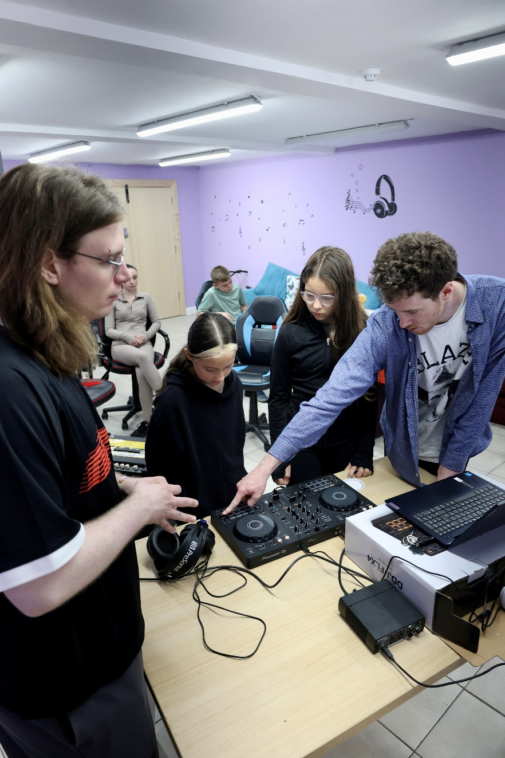
NOISE Music
In the period from September to December programmes took place in Brookfield Community Centre, Killinarden Community Centre, and CONTACT Studio in Rua Red Arts Centre.
A one-off Open DJ workshop took place in the Maldron Hotel as part of the South Dublin Comhairle an nÓg Annual Conference.
Total number of workshops: 29
Total number reached: 123 young people aged between 8 and 18 (this includes 20 at the Comhairle na nÓg event)
The Brookfield programme reached 22 young people as part of The Power Kids youth club. They engaged well with the programme, and an established group of 12 young people has been established.
The Killinarden programme reached 77 (60 in Killinarden Community School and 17 in Killinarden Community Centre). The outreach has not resulted in an established group, and we are continuing to work with KCC Youth Project to develop youth arts programming in the area, with plans to run some primary school programmes in the New Year.
The NOISE Music Collective in CONTACT Studio worked with 13 young people. These are more experienced young DJs, producers, and musicians, aged between 14 and 18 who intend to pursue music as a career. We will continue to work with the group in the New Year, with several projects due for completion by Easter.

Slide 4
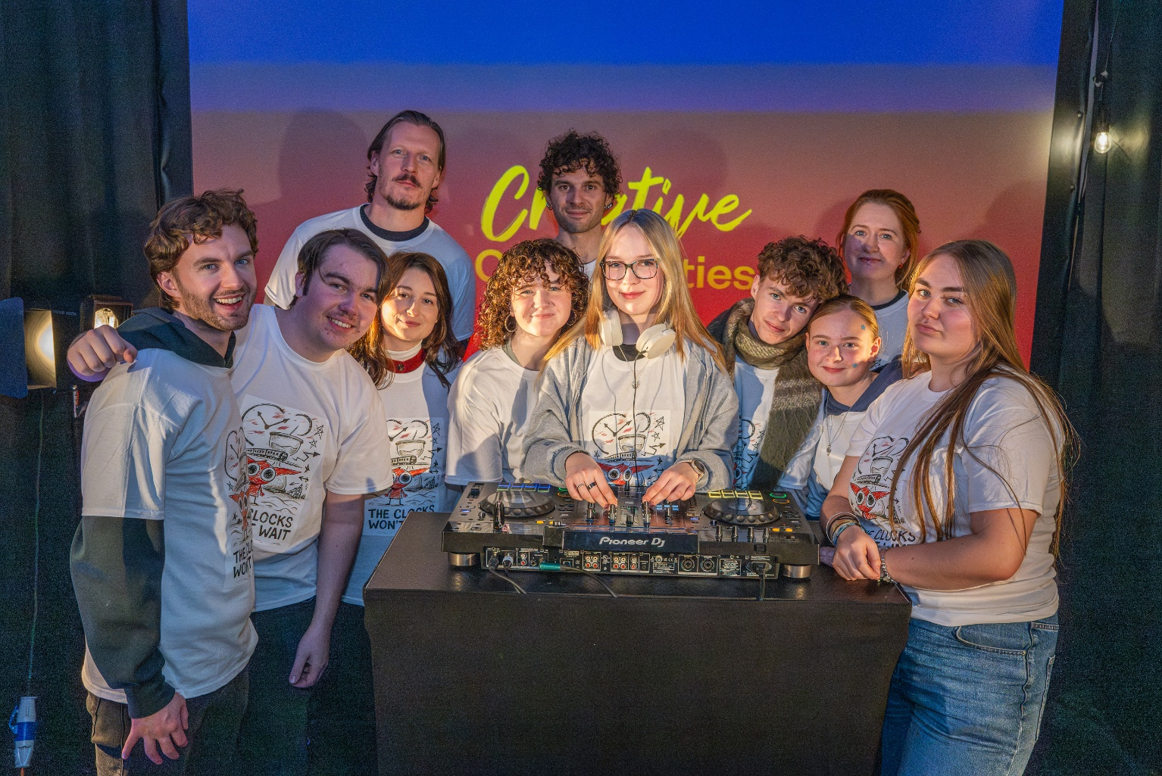
Behind the Scenes and The Night Belongs To Us
Behind the Scenes is a newly established group of young people interested in pursuing careers in creative production and design, event management, lighting, sound, and event promotion. It is funded by the Arts Council’s Young Ensemble Scheme.
It is managed by NOISE Music, Alternative Entertainments, and CONTACT Studio, and supported by Sofft Productions. They designed their first event in Adamstown in November, to launch the NOISE Music project The Clocks Won’t Wait.
Their next event will take place in The Civic on Fri 23rd Jan as part of the Tradfest fringe programme.
The group will be producing and promoting The Night Belongs To Us events around the county throughout 2026.
Members have received paid work experience with Sofft Productions at a number of events including Spectrum in Rua Red on Culture Night.
The Night Belongs To Us ran 7 events in The Civic Theatre’s Studio Space this year, featuring 55 performers aged between 14 and 18, and reaching a total audience of 234.

Slide 5
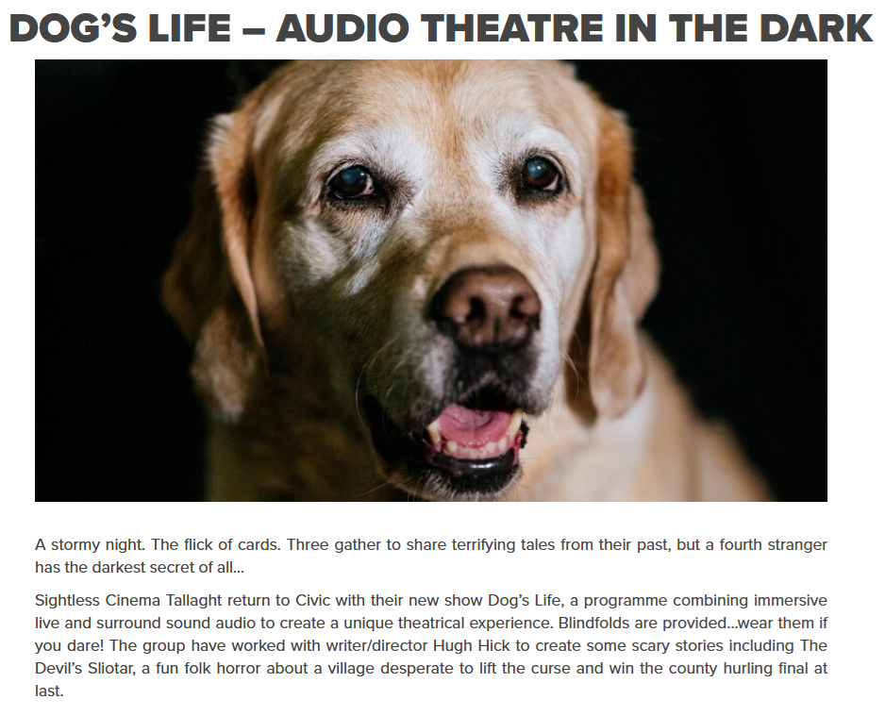
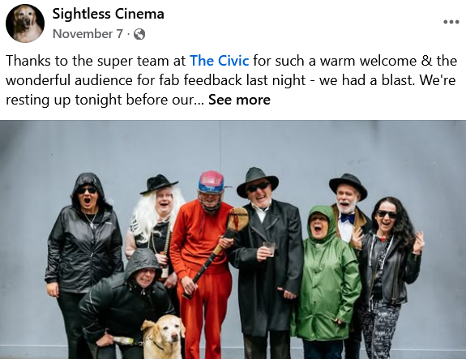
Sightless Cinema
Sightless Cinema - Audio Theatre for People With Sight Loss by Ciarán Taylor
CONTACT Studio has recorded, mixed and edited the yearly audio plays by the South Dublin Sightless Cinema Group.
These were played in front of a live audience in the Main Space at the Civic Theatre this 6 NOV for their show “DOG’S LIFE”

Slide 6
Thank you

