Slide 1
Outdoor Market Report
Lucan / Palmerstown / North Clondalkin Area Committee Meeting – 16th December 2025
Presented by
Mairéad Murphy

Slide 2
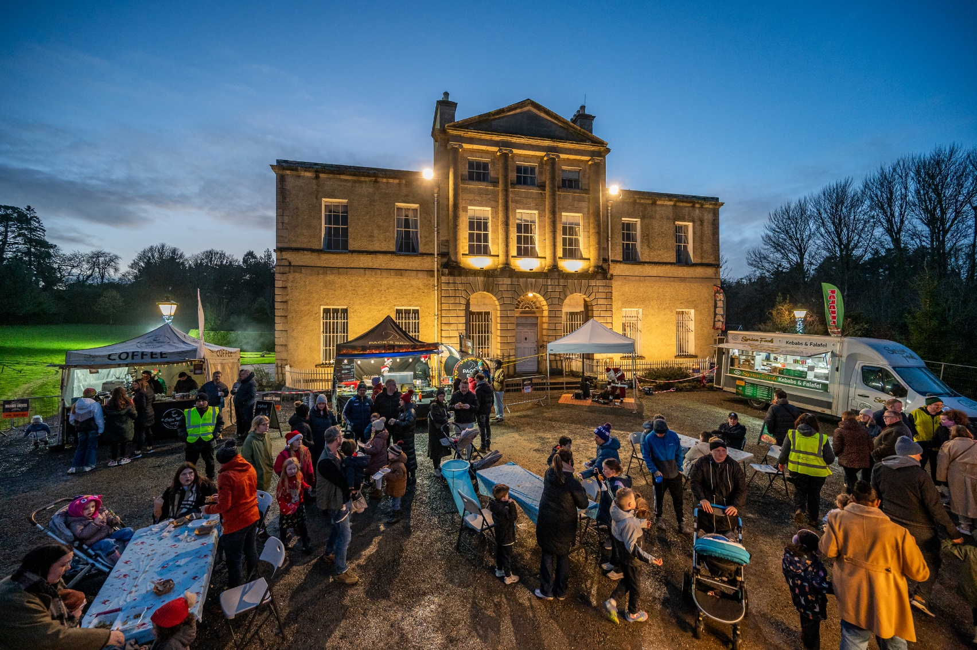
Christmas Market at Lucan House
Lucan has seen very strong engagement with outdoor markets and live events throughout 2025, delivering clear benefits for the local area.
These activities have helped position Lucan as a welcoming destination for community-based tourism and family-friendly experiences.
Lucan House Christmas Market took place on Sunday 7th December and attracted over 3,000 visitors across the day, creating a vibrant festive atmosphere.
This event brought significant extra footfall into the village, which boosted local shops, cafés, and restaurants as people stayed longer and returned again.

Slide 3
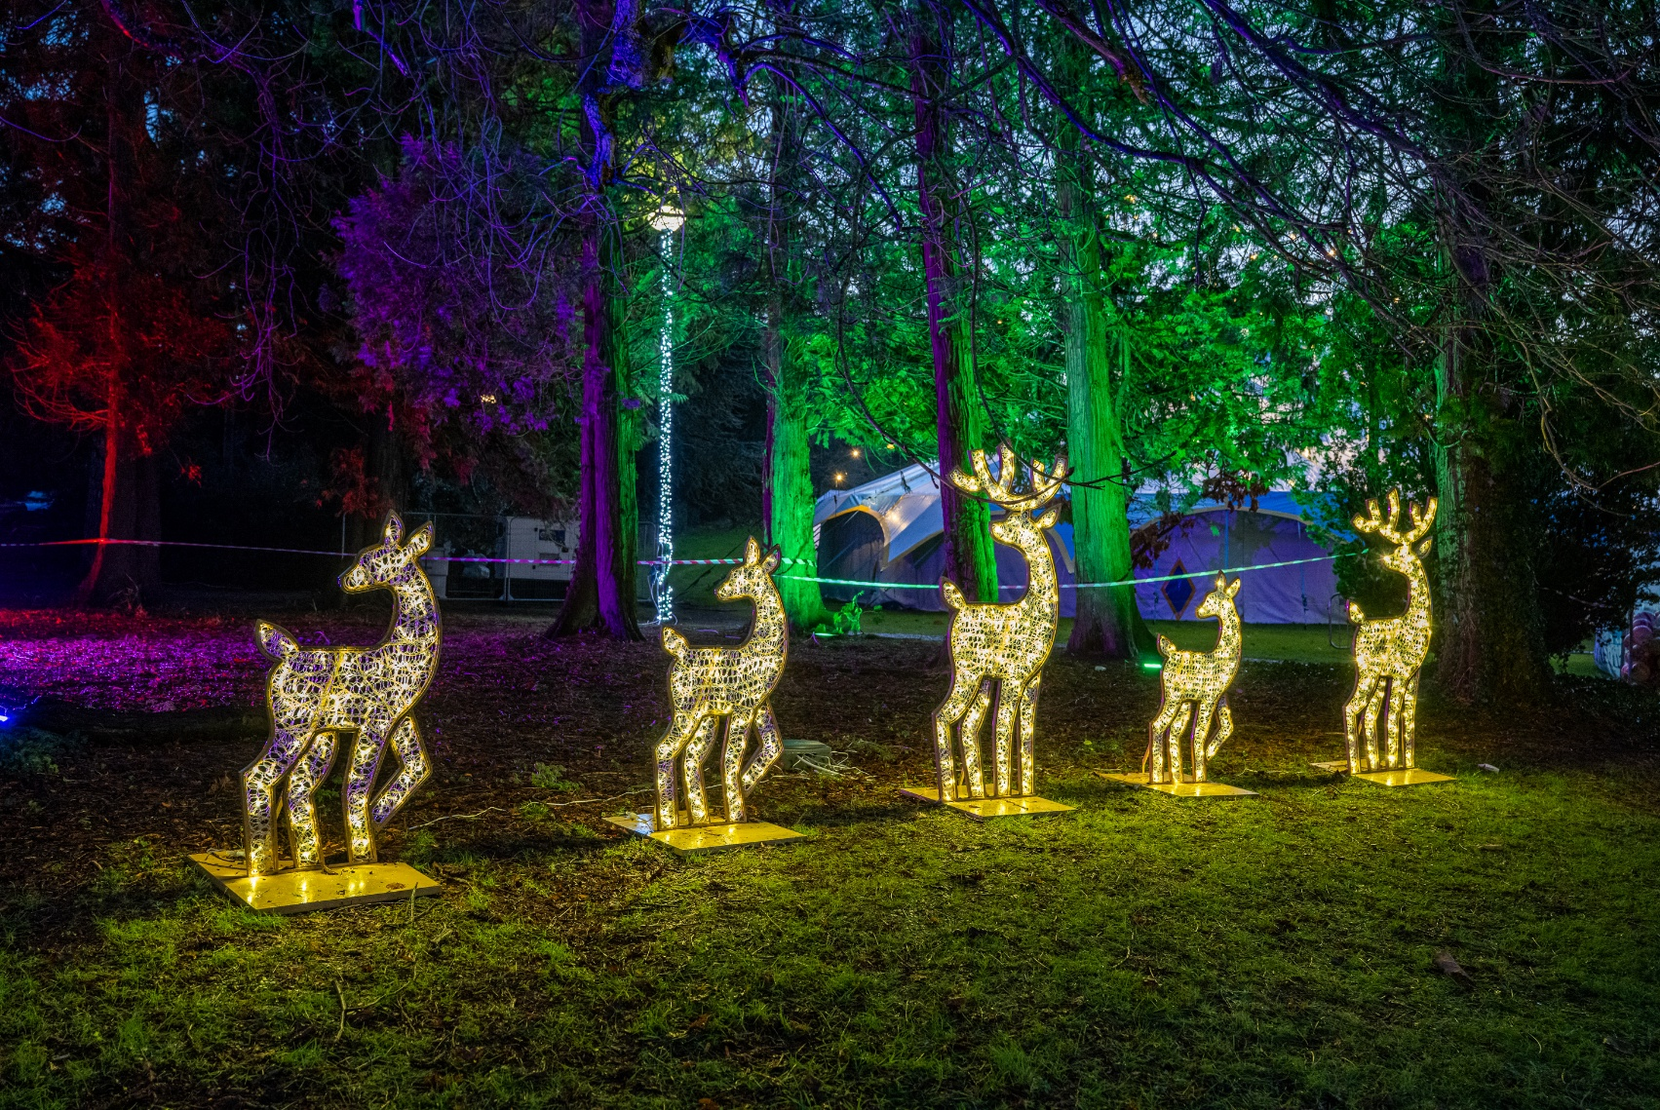
Christmas Market at Lucan House
The market provided local and regional traders with a valuable opportunity to showcase and sell their products, including craft stalls, food trucks, local
produce, and seasonal offerings.
The event was organised in collaboration with Dublin Market Events, Fusion Events and SDCC Libraries
There was a strong community presence throughout the day despite the bad weather and great feedback was received from vendors and visitors alike.

Slide 4
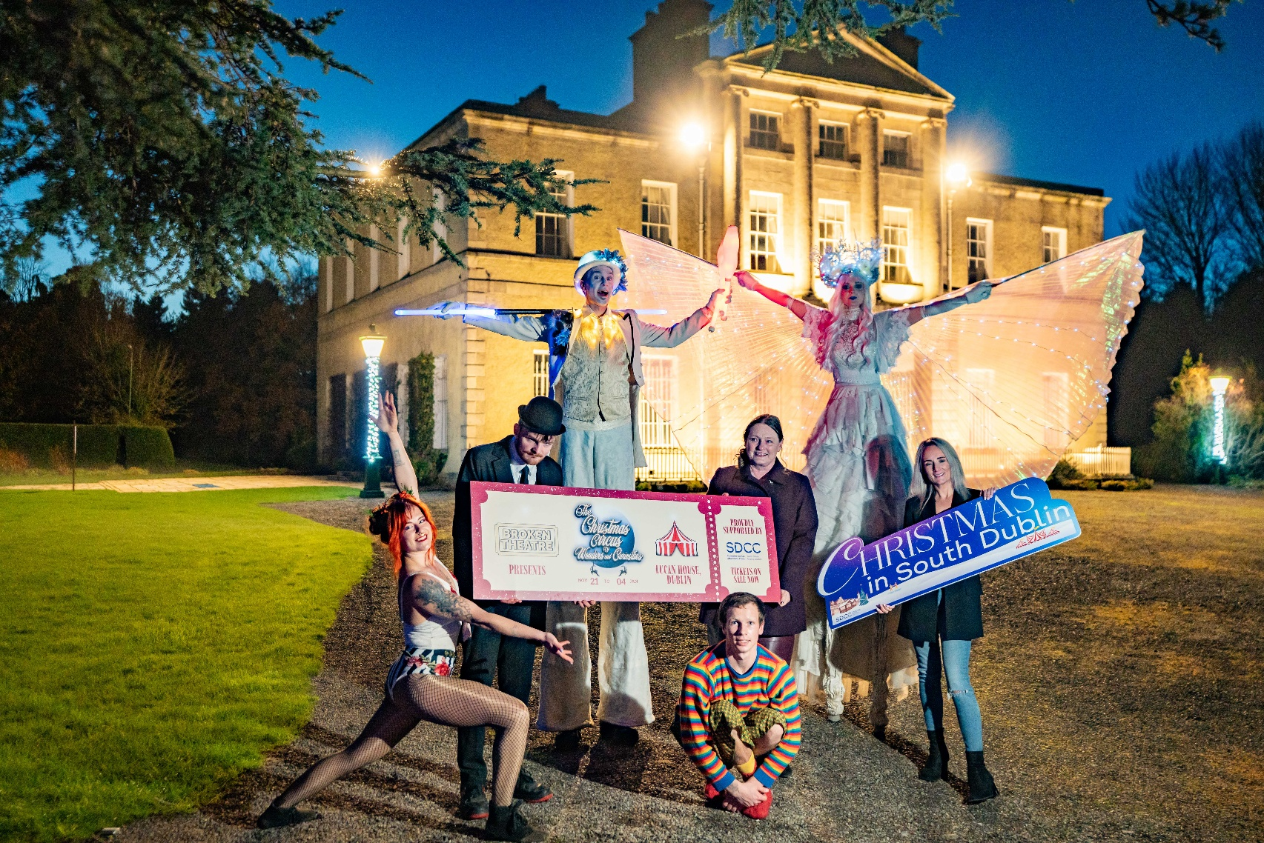
Christmas Circus at Lucan House
The Christmas Circus of Wonders and Curiosities runs six shows each weekend, with space for over 200 people at each show, meaning up to 1,200 attendees per weekend.
Ticket uptake was slow at the beginning, but attendance has grown steadily since opening night reflecting strong interest over time.
Because the circus runs regularly over several weeks, it keeps people coming into the area week after week rather than just for one day.
This ongoing activity has helped support nearby businesses and adds to the range of things for families to do locally.

Slide 5
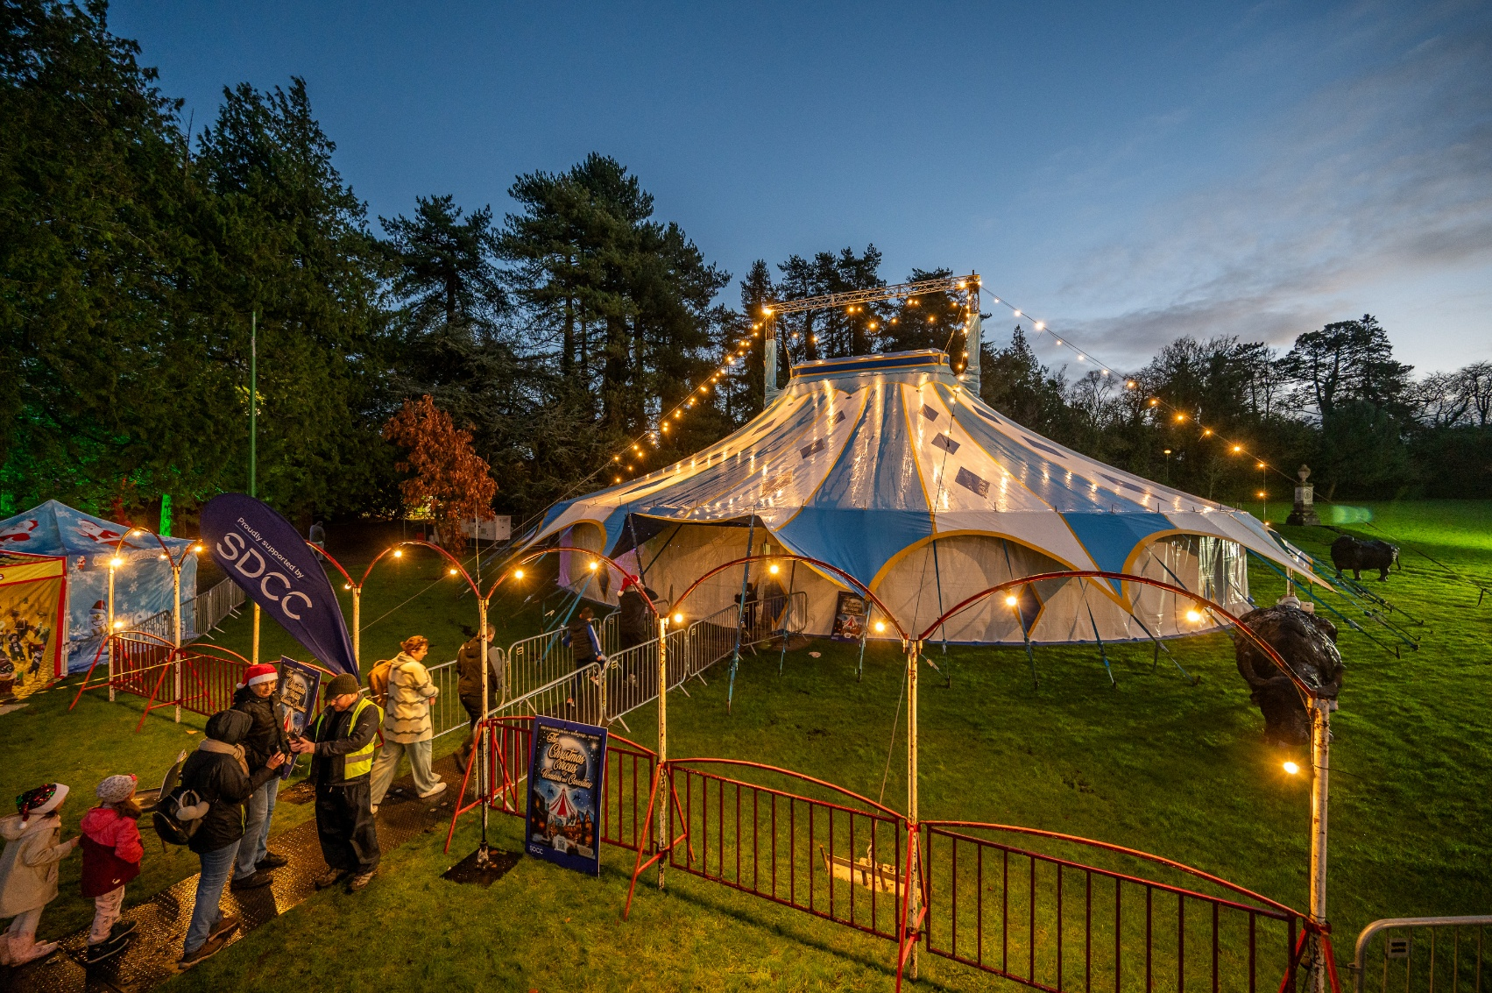
Christmas Circus at Lucan House
The event was organised in collaboration with Broken Theatre and Fusion Events
The Circus of Wonders and Curiosities has animated the historic grounds of Lucan House, showcasing the potential for creative and family-friendly events in this unique setting. It has given visitors a taste of what can be achieved in the space and generated strong interest in returning to the grounds for future events.
While we don’t yet have full figures for the wider economic dividend, such as bed nights and additional local spending, direct revenue from the Circus of Wonders is estimated to achieve more than €200,000 through ticket sales and on-site food and drink sales.

Slide 6
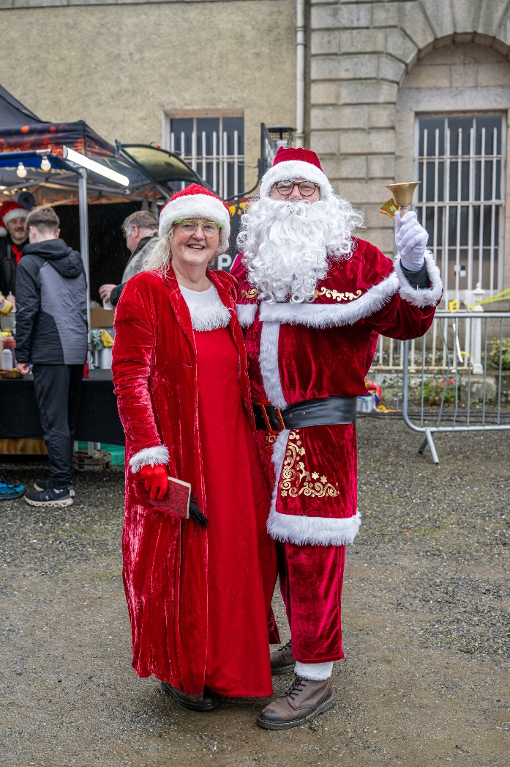
Importance of Outdoor Events
Events such as the Christmas Market and the Christmas Circus of Wonders and Curiosities bring people into the area, support local businesses, and make good use of public and heritage spaces.
They improve the experience for visitors and residents alike and strengthen Lucan’s reputation as a vibrant destination.
The success of these events makes a strong case for continuing to support and develop similar activities as part of Lucan’s wider tourism and economic development strategy.

Slide 7
Thank you

