Slide 1


COMHAIRLE CONTAE ÁTHA CLIATH THEAS SOUTH DUBLIN COUNTY COUNCIL
MEETING OF Lucan/Palmerstown/North Clondalkin Area Committee Meeting
Tuesday 16th December 2025
HEADED ITEM
Arts Office Report

Slide 2
SDCC
Arts Office December ACM Report
Created by
Arts Office
Presented by
Richie O’Sullivan

Slide 3
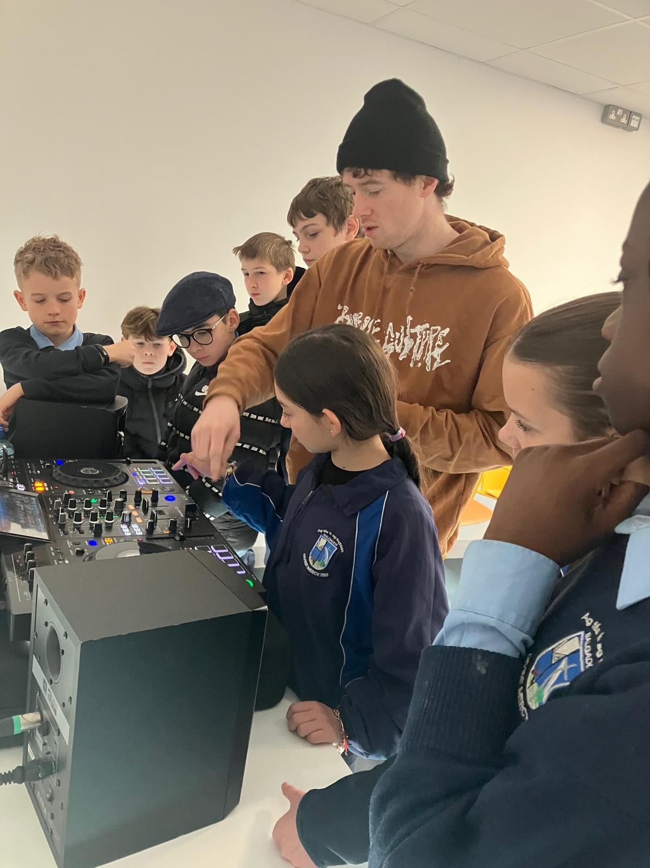
NOISE Music
Programmes in Balgaddy Child and Family Resource Centre and Quarryvale CYC finished in the last week of November.
Programmes in Griffeen Youth Centre and Balgaddy Community Centre finished w/e Friday 12th December.
Music, videos, and photos from workshops in the area are on Instagram - @noisemusicsouthdublin. More content is currently being edited to be shared in the New Year.
NOISE Music programmes in these areas will recommence in February/March 2026, with the addition of a programme in Adamstown Community College, supported by Adamstown YCC.

Slide 4
Thank you

