Slide 1
Whitehchurch Sports Hub
Presentation to Rathfarnham Templeogue Firhouse Bohernabreena ACM
9th Dec 2025
Presented by
Edel Clancy

Slide 2
Project Brief

Slide 3
To provide a single-story community sports facility designed to house Whitechurch Boxing Club and Ballyboden Wanderers GAA .
The original specification requirements are listed below. The items in orange have been omitted in the redesign in order to reduce costs.
Whitechurch Boxing Club:
A dedicated space which does not need to be cleared at the end of the day, not a multi-function space.
Full size raised ring – Not demountable. 18’ inside the ropes, Championship Ring.
Space for training equipment to be left in-situ throughout the day and at all times.
Independent access at all times for higher performing athletes.
Toilets and Changing facilities. Showers.
Kitchen space for refreshments.
Office space with secure document storage.
Cushioned flooring – Jigsaw flooring
Storage areas – segregated and racked.

Slide 4
Ballyboden Wanderers GAA:
Storage spaces segregated for age groups.
Storage for mobile goalposts and associated cones, markings etc.
Changing spaces, referees area and storage. Typically 18 - 25 persons
Showers if possible but may not be required. Male and female. Individual, Non communal.
Shared community space.

Slide 5
Project Update

Slide 6
Approval has been received from St. Laurence O’Toole Diocesan Trust C.L.G to proceed to Part 8.
Topographical and geotechnical surveys have been completed.
EIA & AA screening: Specialist consultant appointed; reports completed
Ecological assessments and field surveys (desktop study, habitat and invasive species surveys, key ecological receptor survey, and preliminary bat roost assessment) have been completed. Reports, including the Preliminary Ecological Appraisal, are finalised
Due to the delay in going to Part 8 the ecological assessment, EIS and AA undertaken for the original design are now out of date and will require reassessment. Ecological fieldwork needs to be undertaken at specific times of year, with the next suitable survey window likely to be March 2026.
A consultant engineer has been appointed for the water and SuDS design. The SuDS layout and report have been received and are currently under review by SDCC Drainage.

Slide 7
Project Cost and Budget Provision

Slide 8
Budget Provision
Current budget in Capital 2025-2027 :
€1,550,000
Proposed budget in Capital 2026-2028:
€2,350,000
Profiled across 2 years as follows:
2026: €1,700,000 - €650,000 levies, €550,000 reserves, €500,000 Revenue
2027: €650,000 levies
Revised cost €2,296,665 incl VAT - revised from previous costs of €2,804,079 and subsequently €2,483,825
The revised proposal reduces the gross floor area by approximately 104 sqm (from 523.1 sqm to 419.1 sqm). This was achieved through the omission of shared central facilities, the revised more compact GAA layout, and a modest reduction in the boxing training area.

Slide 9
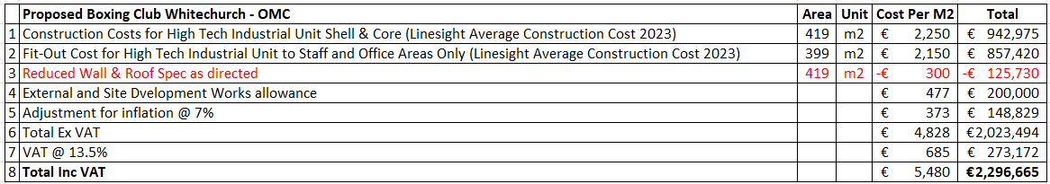
Estimated Project Costs
Please note the following Comments & Exclusions
Design Team fees, Technical Fees and salaries are excluded.
FF & E and specialist fit out is excluded.
Utilities fees / connections are excluded.
No allowance made for future inflation beyond 12 months from this date.
All costs are for budget purposes only and subject to detailed design and a competitive tender process.

Slide 10
Design Plan

Slide 11
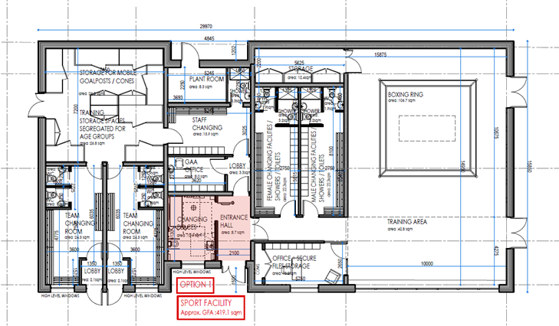

Slide 12
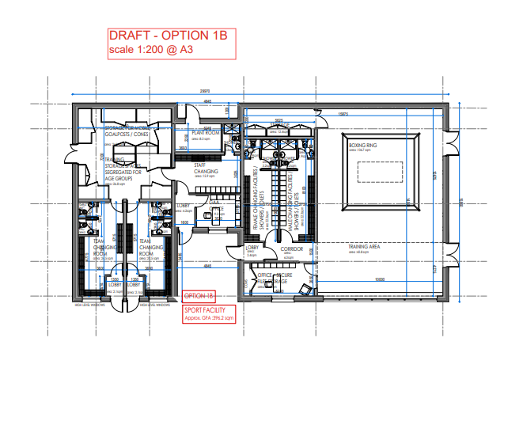
A further reduction could be explored by omitting the Changing Places sanitary facility and small main entrance hall ( in red on previous slide )

Slide 13
Next Steps

Slide 14
Sign off on revised design and business case
Prepare Part 8 documents and redo any required screenings
Go to Part 8 – Q2 2026

Slide 15
Thank you

