Slide 1
Tenant Participation
Strategy 2025-29
Meeting of South Dublin County Council
8th December 2025

Slide 2
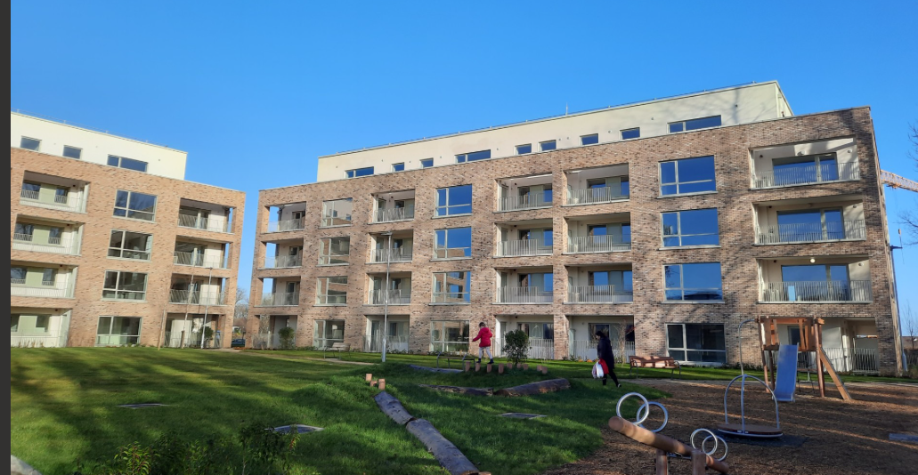
Alignment with Corporate Plan 2025-29
It is critical for successful management of over 10,800 social housing tenancies that our Tenant Participation strategy is aligned to key corporate goals:
Quality Housing: provide quality social & affordable homes for everyone who needs them
Connect Communities & Citizens: support our communities to be integrated, inclusive & safe
Citizen –first: be a citizen centred organisation

Slide 3
What is a Tenant Participation Strategy?
Two-way process involving our tenants working in partnership with the council to share ideas, information and have input into decisions to improve housing services.
Creating partnerships, sharing ideas, raising any concerns and work together to improve and inform services
Empowering our tenants, encouraging active engagement, and to listen to their voices when it comes to how we can support and improve their quality of life where they live

Slide 4
What’s Involved?
• Identify the target area, the local issues and establish key objectives, goals and targets
• Develop and circulate a tenant participation survey
• Identify key local players - formation of the local working group
• Develop a Local Action Plan with achievable actionable goals and timeframes
• Measure outcomes (KPIs)

Slide 5
Tenant Commitment
Tenants will be invited to become involved at a level that suits them.
Level 1 – Responding to surveys Attend public meetings Provide feedback
Level 2 - A member of the Local Tenant Participation Working Group Organise and attend community events.
Level 3 - An active member of the Local Tenant Participation Working Group. Develop and analyse surveys and the local action plan. Represent community at council wide workshops and events.

Slide 6
Key Strategic Targets for 2025 – 2029
To put tenant’s views at the centre of our housing and estate management delivery
Use our resources to support tenant participation.
Inviting our tenants and service users to actively review our policies
Offer a range of opportunities for tenants to be involved
Make our communities a better place to live
Help build networks between tenants and local communities
Tenancy training and information briefing at tenancy sign up with up to 3 follow up tenancy checks
Develop local Tenant Participation working groups action plans that will set out key milestones to be delivered.

Slide 7
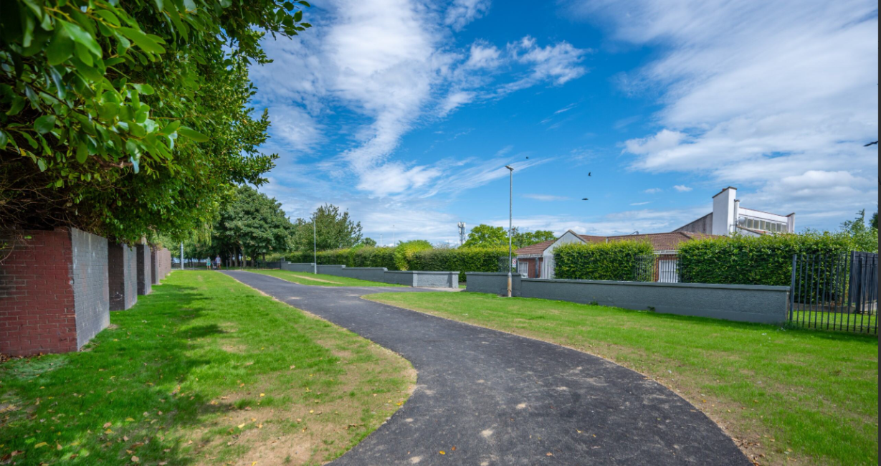
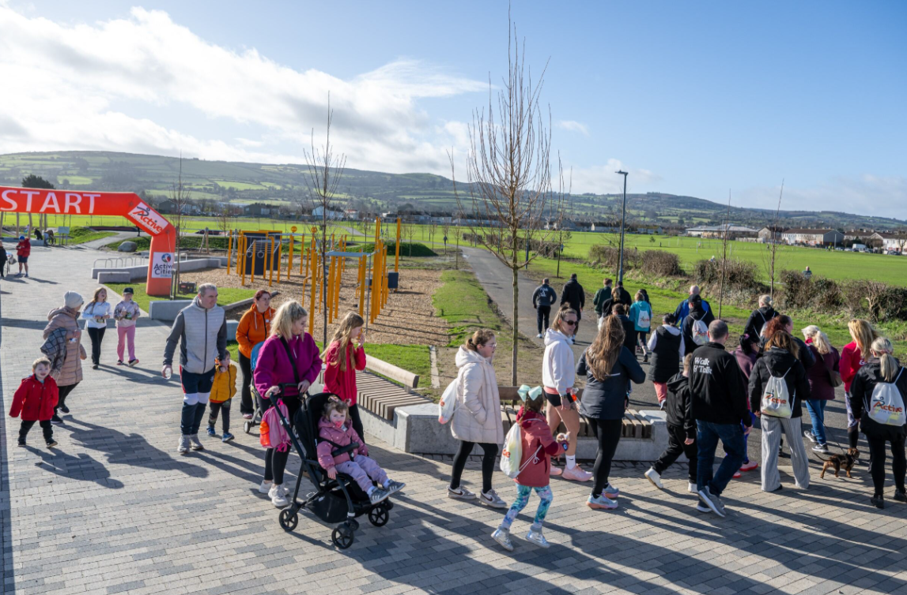
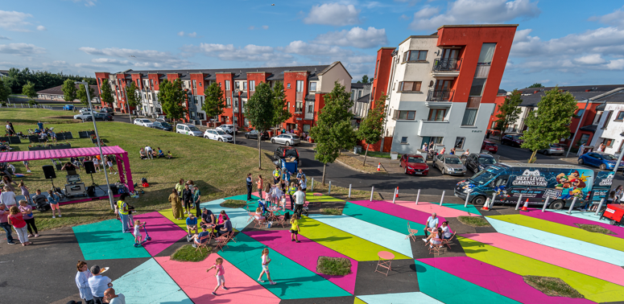
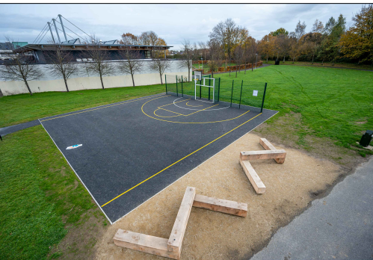
Proactive Estate Management Works & Initiatives
The Alcoves
Whitechurch
Walk & Talk
New MUGA
Mac Uilliam Estate
Balgaddy Better Blocks

Slide 8
Implementation, Monitoring & Improvement
Director of Housing, in conjunction with Housing Strategic Policy Committee, will be responsible for this strategy
Annual estate management action plan to support strategy implementation
Regular reporting to local area committees on key performance indicators
Feedback from tenants will be used to inform and improve our performance
Key Performance Indicators
The level of tenant participation
Number of pre- tenancy training events
The number of new groups established within the community
Profile of participants and underrepresented groups
The number of estate management events/initiatives

Slide 9
Thank you

