Slide 1
Title: Car Parking Policy Update
To review car parking arrangements in multi-unit developments including planning grants, OMC & Council Management & EV charging provision
Department: Planning and Transport
Director: Eoin Burke

Slide 2
Planning - Parking Objectives and Implementation:
County Development Plan 2022-2028 Chapter 7 - Sustainable Movement
High Level Objective
Support the County’s climate action commitments by reducing greenhouse gas emissions from transport
SM6 – Demand Management / Mobility Management Plans
Require Mobility Management Plans for major trip-generating developments.
Encourage car-pooling, shared mobility, and reduced car dependency.
SM7 – Car parking and Electric Vehicle (EV) charging: adopt a balanced approach to car-parking provision, ensure EV charging infrastructure is provided in suitable locations.
Title: Car Parking Policy Update

Slide 3
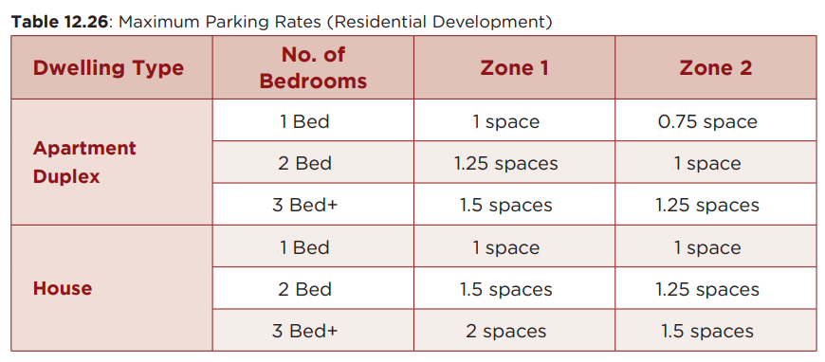
Residential Parking Rates
Title: Car Parking Policy Update

Slide 4
Residential Parking Rates
The number of spaces provided for any particular development should not exceed the maximum provision.
The proximity of the site to public transport and the quality of the transport service it provides.
The proximity of the development to services that fulfil occasional and day to day needs.
The existence of a robust and achievable Workforce Management or Mobility Management Plan for the development.
The levels of car dependency generated by particular uses within the development.
The ability of residents to live in close proximity to the workplace.
Peak hours of demand and the ability to share spaces between different uses.
Uses for which parking rates can be accumulated.
The ability of the surrounding road network to cater for an increase in traffic.
Title: Car Parking Policy Update

Slide 5
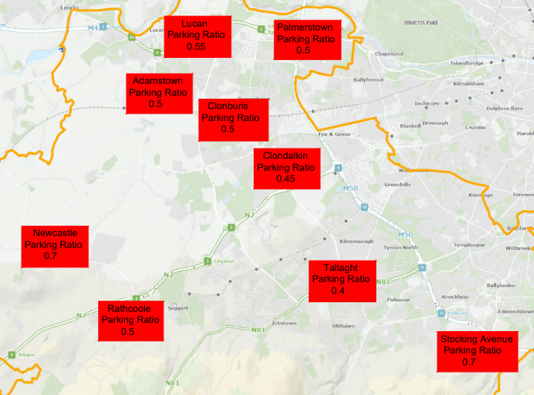
Parking Ratios are in Spaces per Unit

Slide 6
OMC Management of Car Parking Spaces
If there are no rules regarding parking allocation - more spaces available to share but some residents using intimidation to take over spaces.
The more spaces allocated/licenced, the more spaces are not available to share. Inefficiency of car parking use.
Discussions with all stakeholders around agreeing the percentage of allocated spaces and percentage of shared spaces.
All tenures: Pressure from residents to increase car parking levels.
Climate Action commitments: Road capacity issues:
Title: Car Parking Policy Update

Slide 7
Electric Vehicle Charging
SDCC County Development Plan:
Under Policy E4: Electric Vehicles — “Promote the delivery of EV charging facilities in accordance with relevant regulations and national and regional policy and guidance.”
Electric Charger Hubs
On 15 July 2025, the Irish government published its “Private Wires Policy” Statement
(3) facilitate on-street electric vehicle parking, Further details are awaited on the implementing measures, and the Policy Statement indicates the potential for future public consultation (although no timing is specified).
Title: Car Parking Policy Update

Slide 8
Thank you !
Public Electric Vehicle Charging provision
A list of current public chargers in South Dublin LA is linked here
https://data-sdublincoco.opendata.arcgis.com/datasets/public-ev-charging-points-sdcc?utm_source=chatgpt.com
SDCC Planning Policies promoting destination charging spaces at Service Stations, Work locations, Shopping centres Leisure facilities and public buildings.

