Slide 1


COMHAIRLE CONTAE ÁTHA CLIATH THEAS SOUTH DUBLIN COUNTY COUNCIL
MEETING OF Lucan/Palmerstown/North Clondalkin Area Committee Meeting
Tuesday 25th November 2025
HEADED ITEM NO.
Arts Office Report on

Slide 2
SDCC
Arts Office November ACM Report
Created by
Arts Office
Presented by
Gerry Horan

Slide 3
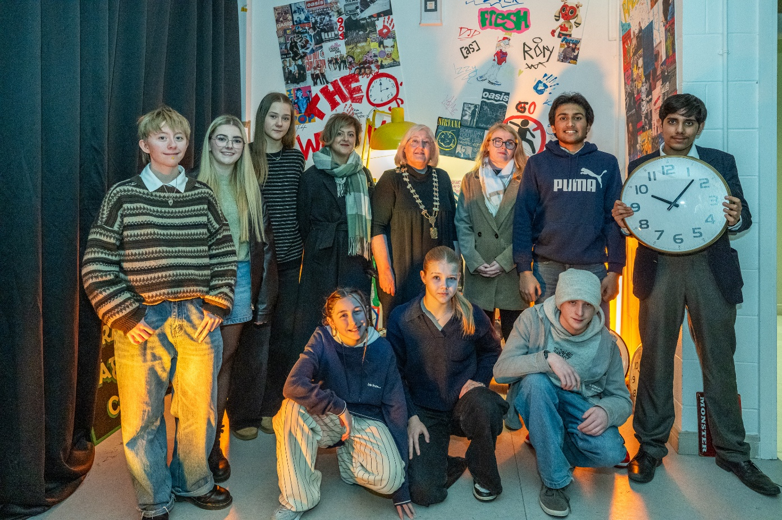
NOISE Music
NOISE Music’s “The Clocks Won’t Wait” project was launched at an event in Adamstown Community Centre on Fri 21st Nov.
5 music, dance, and spoken word performance films were created during the project by a group of 13 young people.
The videos are being shared on social media platforms in the coming weeks.
NOISE Music’s currently active programmes in Quarryvale, Balgaddy Child and Family Resource Centre, Balgaddy Community Centre and Griffeen Youth Centre will finish in December.
Total number of participants: 54, aged from 8 to 18.
Music created in these programmes has been shared on NOISE Music’ Instagram, with more works to be shared before year end.

Slide 4
Thank you

