Slide 1
Adamstown Mid-Term Review Phases 1-5
Created by
Danielle Cantwell
Presented by
Danielle Cantwell

Slide 2
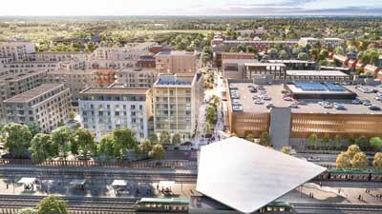
Adamstown 2025-Aerial View
Adamstown SDZ Background
Mid-Term Review (Phases 1-5)
Phase 6 Update
What’s Next for Adamstown…..
Contents
Adamstown SDZ

Slide 3
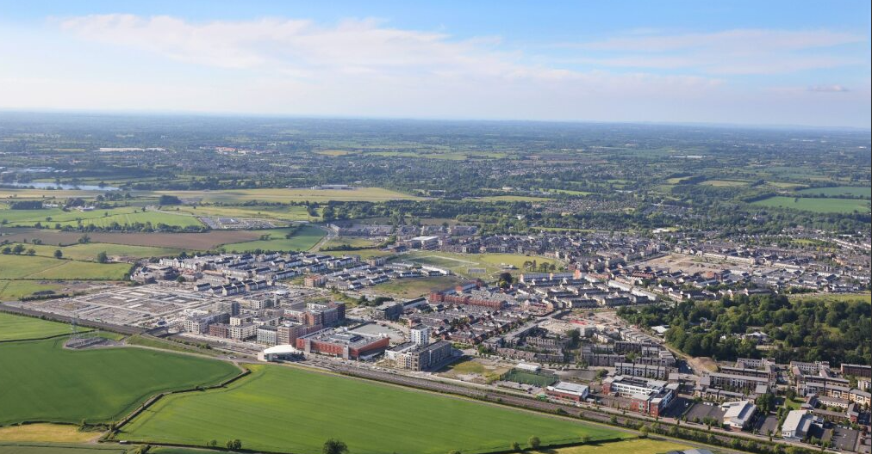
Adamstown SDZ 2025

Slide 4
Adamstown SDZ
Background
1st of July 2001, the government ordered the designation of 223.5 ha of privately owned land at Adamstown, as an SDZ for the purpose of delivering residential development and associated infrastructure and facilities
There are 13 sequential phases of development in the Scheme, with the critical first phase being split into phases 1A and 1B. Phase 1 comprises 1,000 units, evenly split between the two sub-phases. The remaining phases with the exception of the last phase, which allows for maximum roll out of the scheme, each have 800 units.
The phases are sequential rather than time specific to ensure flexibility and allow for changing market conditions over time.
The phasing framework is linked to residential unit occupation. Ensuring that essential services are delivered in tandem with population growth.
Prior to any phase of development, a schedule detailing compliance with the requirements of the previous phase or phases of development, must be submitted to the Planning Authority.

Slide 5
Adamstown Mid-Term Review
Requirement
To carry out a mid-term review as per Section 4.3.2 of the Planning Scheme.
Ensure that the required infrastructure and facilities detailed in phases 1-5 have been provided and are operational, and to confirm that the Scheme is progressing in a satisfactory manner.
While this official review is required by the Planning Scheme, SDCC, as the Development Agency, has provided for an iterative approach to the Planning Scheme through approvals from An Bord Pleanála (now known as An Coimisiún Pleanála) for Non-Material Amendments to the Scheme in 2014, 2017, 2020 and 2023.
Scope
Assess the implementation and delivery of the Scheme with particular focus on the required infrastructure and facilities detailed in phases 1-5.
The first 5 phases represent the formative stages of Adamstown’s development, when core housing and community facilities were first delivered and provides the key infrastructure that underpins the ongoing town centre and high-density development within the SDZ.

Slide 6
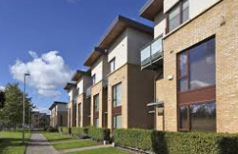
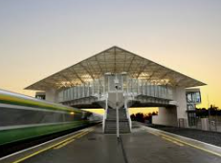
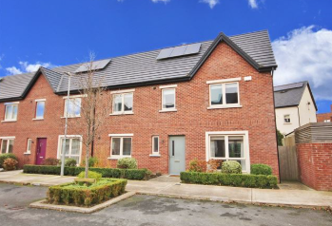
Adamstown Mid-Term Review
Key Facilities Delivered Phases 1-5
Housing
c4,200 homes occupied by the end of Phase 5, with a range of apartments, duplexes, and houses
Transport & Connectivity
Adamstown Railway Station operational, with temporary park & ride provided.
Celbridge Link Road (a Phase 7 requirement) and Adamstown Link Road completed.
Dedicated bus connections linking Adamstown to the Dublin city centre and the surrounding areas.
Upgraded road network.

Slide 7
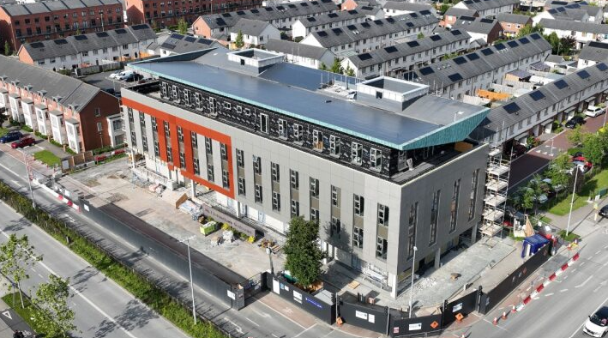
Adamstown Mid-Term Review
Key Facilities Delivered Phases 1-5
Education
Two 16-class primary schools completed as part of Phase 2 of the Scheme and one post-primary school completed (1,000 pupil capacity)
Additional primary school sites being progressed by the Department of Education & Youth (School site #3 at Tandy’s Lane)
Childcare
2no childcare facilities delivered, with further permitted facilities underway in later phases.
Health & Community
A change of use planning permission was granted for the
Conversion of the former marketing suite to a Primary Care
Centre at No. 1 Adamstown Boulevard, in the heart of the town
centre. Work began in 2024 and has recently been completed
and handed over to the HSE.
Community Centre with sports hall and multi-purpose rooms
delivered, in close proximity to the schools.

Slide 8
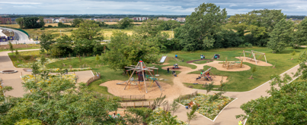
Adamstown Mid-Term Review
Key Facilities Delivered Phases 1-5
Parks & Recreational Facilities
Airlie Park (11ha) and Tandy’s Lane Park (7ha) completed, including playgrounds, sports pitches, MUGAs, and biodiversity enhancements.
Through URDF funding, an additional public facility, Adamstown Plaza was constructed and open to the public.

Slide 9
Adamstown Mid-Term Review
Key Achievements
Delivery of critical infrastructure with certain infrastructure provided ahead of schedule such as the Celbridge Link Road.
All phases to date successfully balanced housing growth with facilities and amenities
Despite significant challenges such as the economic recession and the Covid-19 pandemic, the delivery of Adamstown has continued at pace.
The mid-term review confirms that the SDZ remains firmly on track to achieve its long-term vision to deliver a well-connected, inclusive, and sustainable community alongside the timely provision of essential infrastructure and amenities.

Slide 10
Adamstown Mid-Term Review
Phase 6 Update
c4950 homes occupied.
Outline permission granted for the construction of a Primary School (32 no. Classroom) at school site #4 (Aderrig).
Phasing transfer for library from Phase 6 to Phase 7 has been approved (late May 2025)
Retail (District Centre)-80% of units have been leased.
Railway Order approved by An Bord Pleanála (now known as An Coimisiún Pleanála).​ DART+ South-West – 12 trains to 23 trains per hour per direction planned.

Slide 11
What’s Next for Adamstown
Phase 7 and beyond…
New home delivered in line with the Planning Scheme.
Expansion of community facilities.
Completion of further childcare facilities.
Central Boulevard Park (URDF funded project) with construction hoped to commence Q4 2025/Q1 2026.
Adamstown Civic Building which will include a library and supplementary library facilities and an Enterprise Centre to be located in the town centre.
Improved bus and rail connectivity.
Tobermaclugg Park (including pitches/courts, play facilities, landscaping and footpaths)

Slide 12
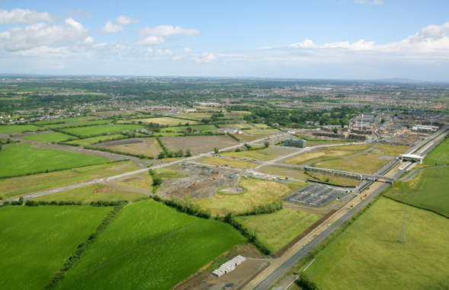
Adamstown 2006 & 2025

Slide 13
Thank you
E: info@sdublincoco.ie
T: 01 4149000

