Slide 1
Village & District Centre Enhancements
- SPC Update
Created by
G. Walsh
Presented by
G. Walsh
Notes:
Me
Priory Market
Keep up to date, give us email
Books, drawings, articles that we liked

Slide 2
Projects Completed
Villages
Saggart (2020)
Templeogue (2022)
District Centres
Castletymon (2023)
Dodsboro (2024)
Rosemount (2025)
Bawnogue (Dec 2025)
Notes:
Cllr Requests, Difficult Maintenance (street furniture), bus connects, active community

Slide 3
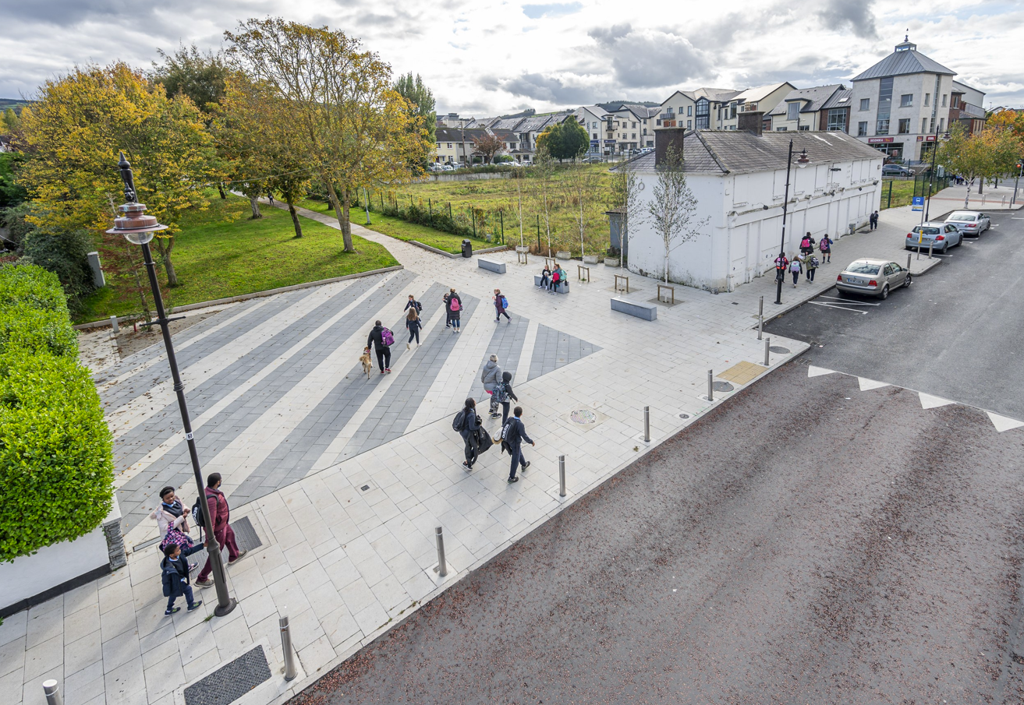
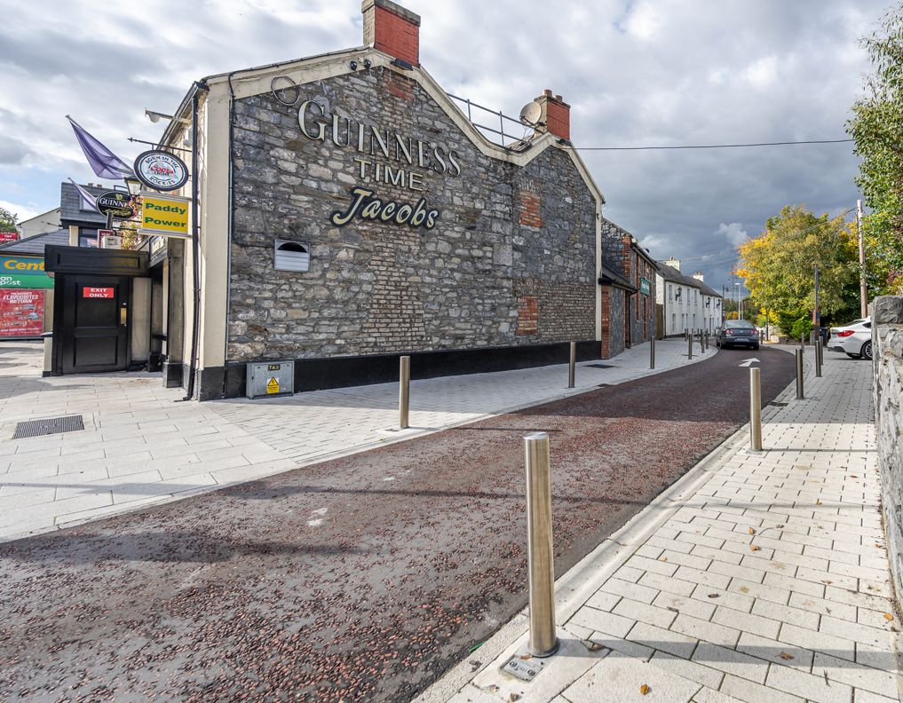
Saggart
Notes:
Heritage to Modern

Slide 4
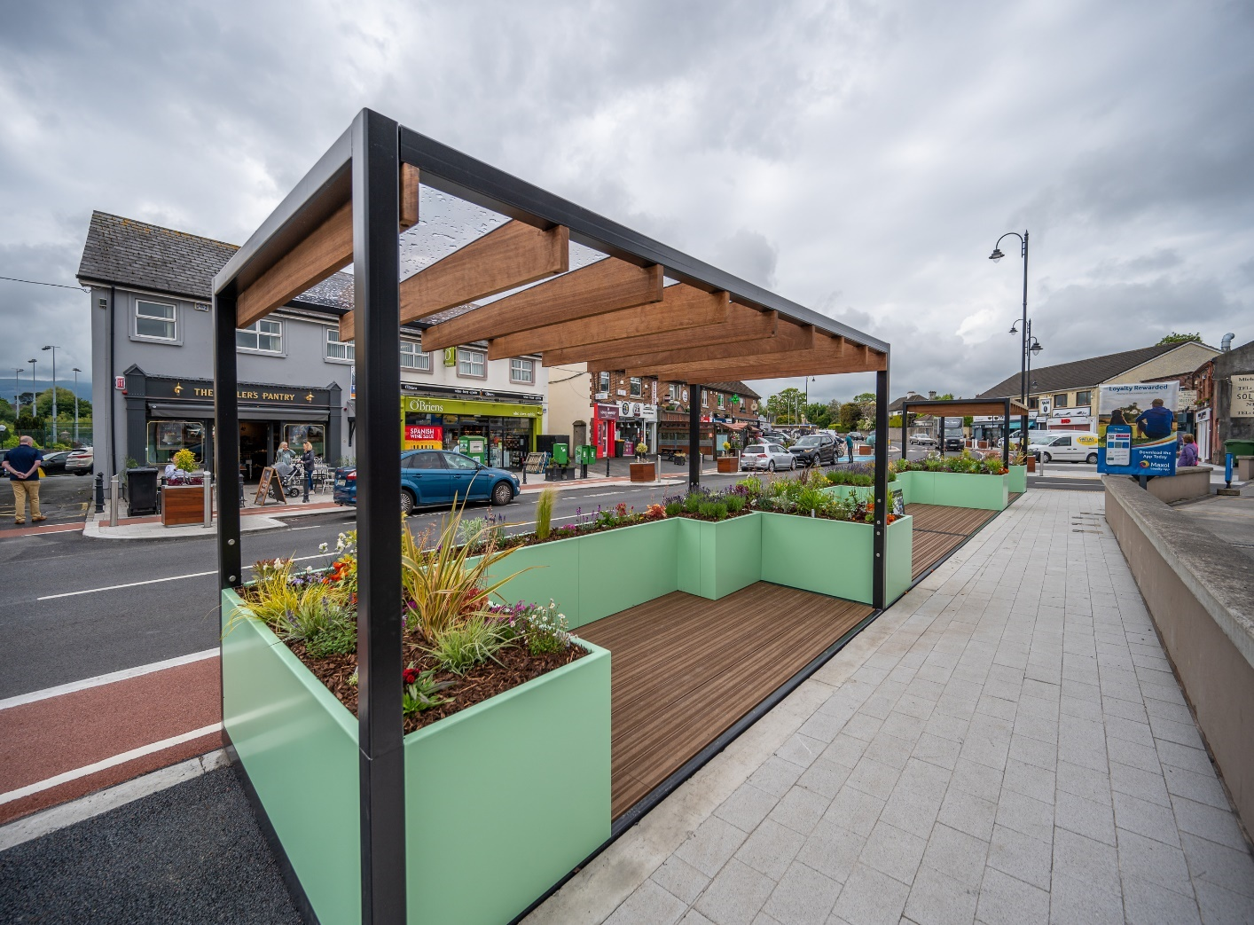
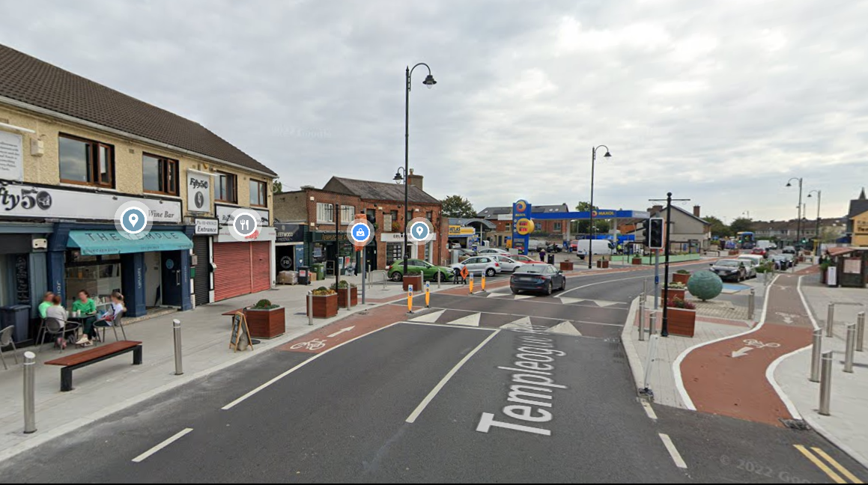
Templeogue
Notes:
Heritage to Modern

Slide 5
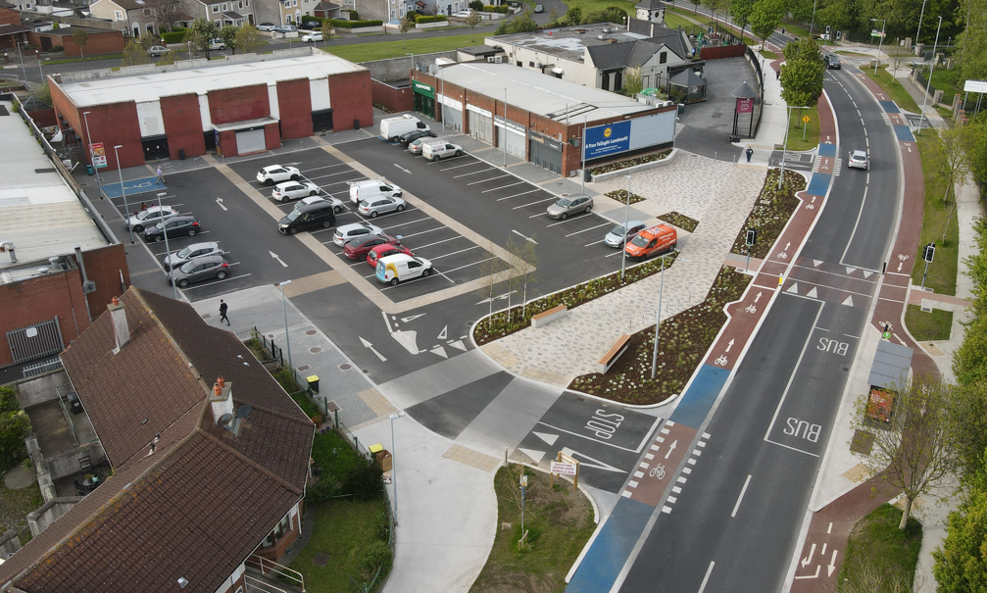
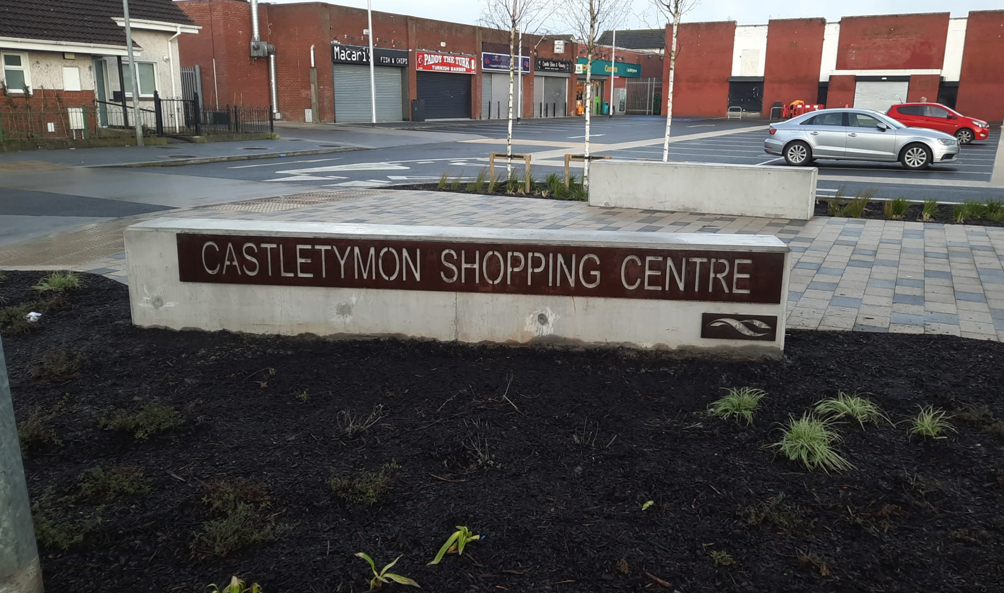
Castletymon
Notes:
Heritage to Modern

Slide 6
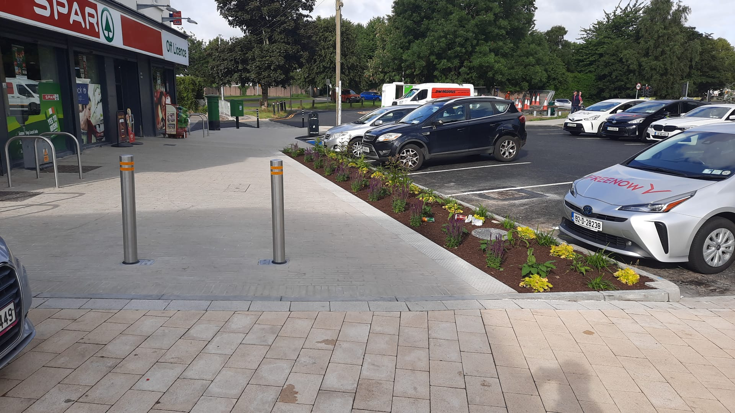
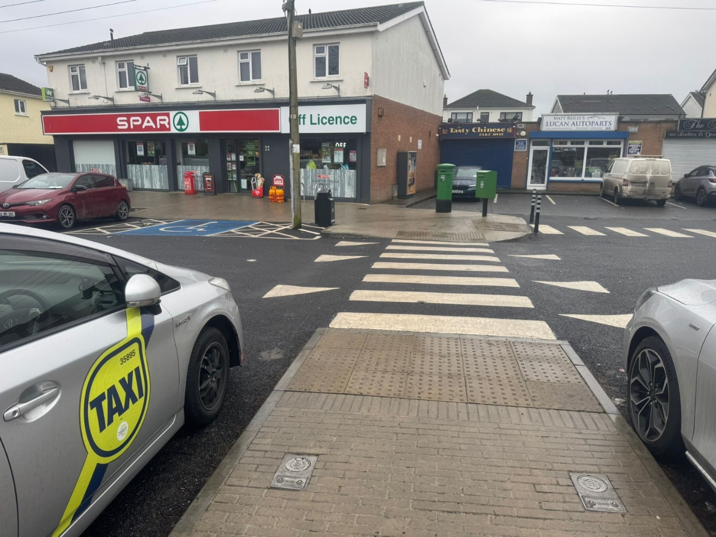
Dodsboro
Notes:
Heritage to Modern

Slide 7
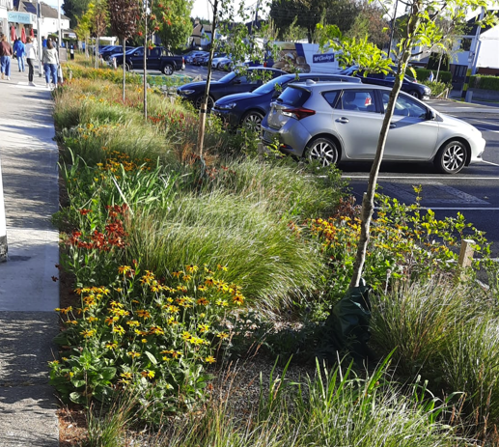
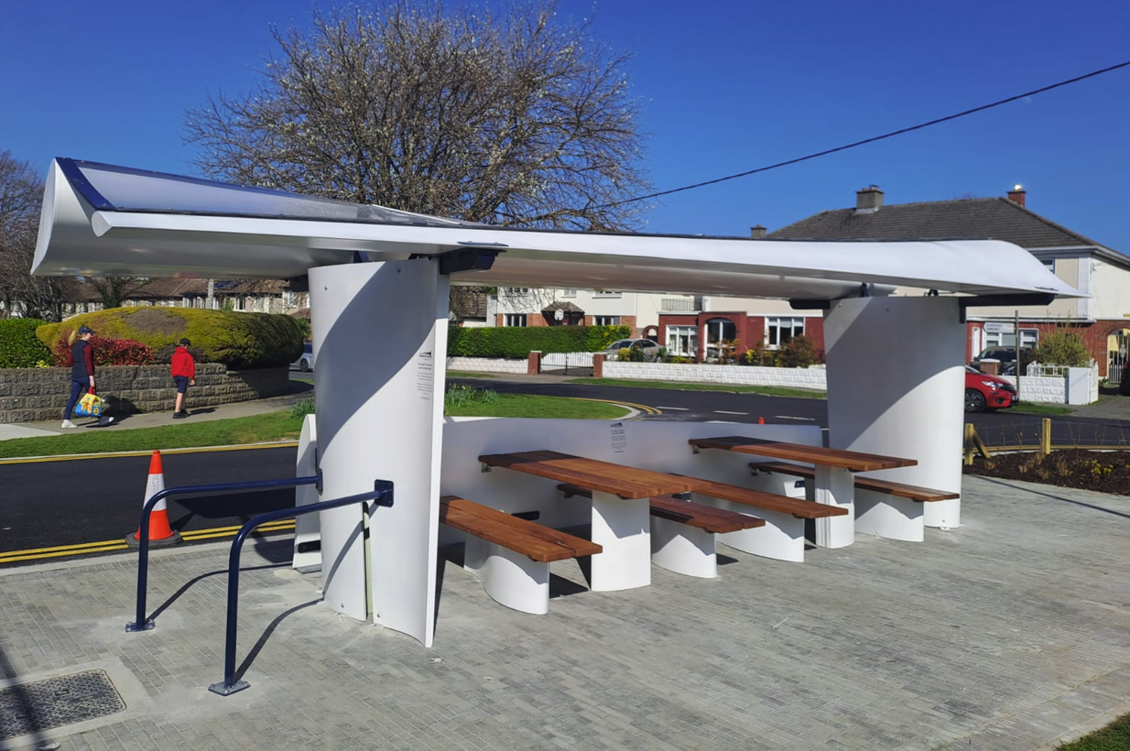
Rosemount
Notes:
Heritage to Modern

Slide 8
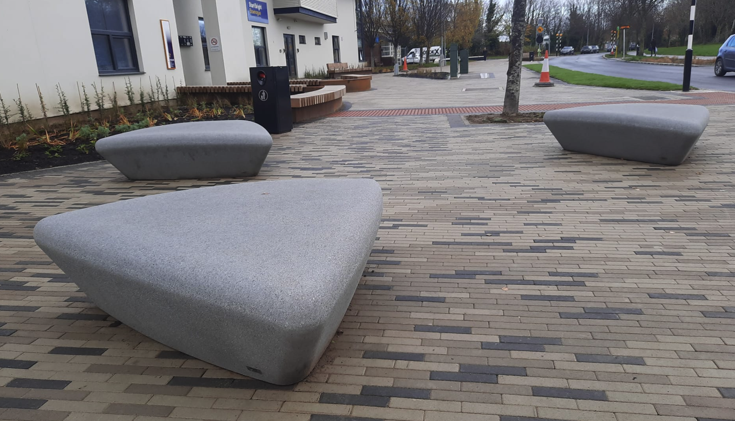
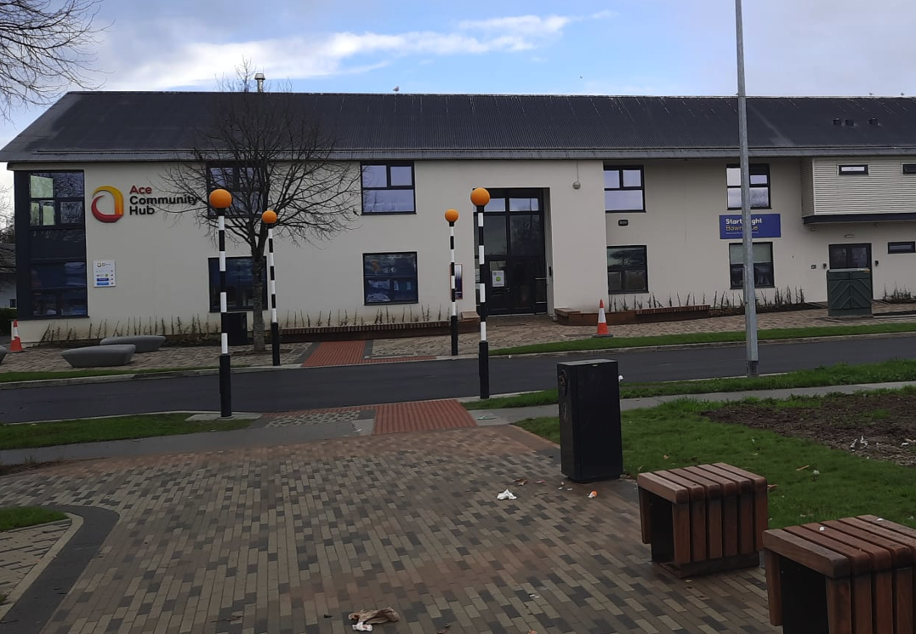
Bawnogue
Notes:
Heritage to Modern

Slide 9
Next Projects
Villages
Brittas (Construction Q3 2026)
Tallaght (Public Consultation Ongoing)
Clondalkin (Commence 2026)
District Centres
Neilstown (Commence 2026)
Whitechurch
Notes:
Cllr Requests, Difficult Maintenance (street furniture), bus connects, active community

Slide 10
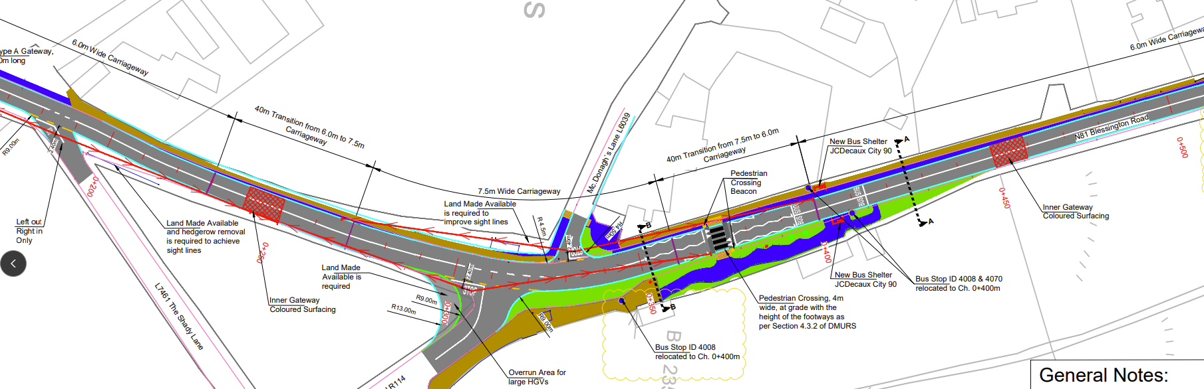
Brittas
Notes:
Heritage to Modern

Slide 11
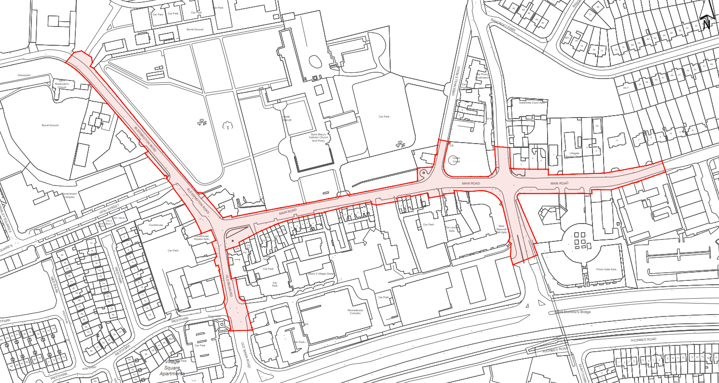
Tallaght
Notes:
Heritage to Modern

Slide 12
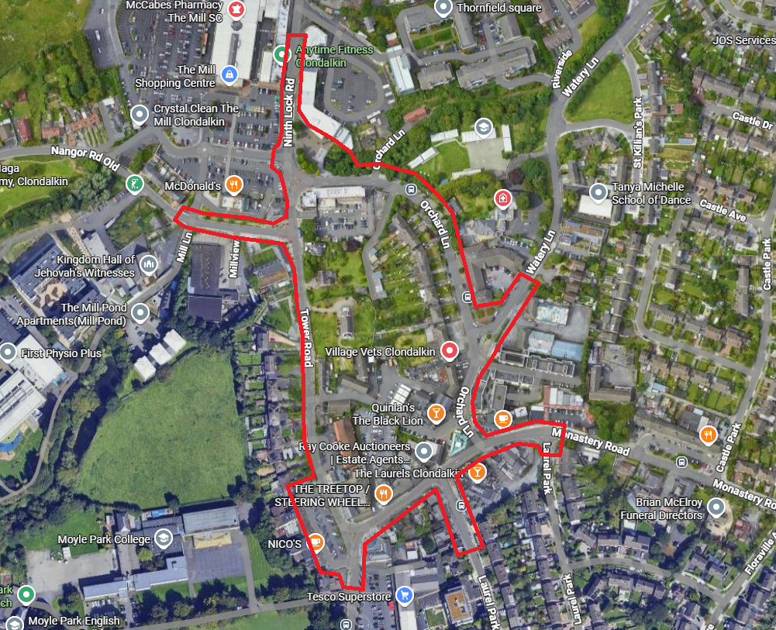
Clondalkin
Notes:
Heritage to Modern

Slide 13
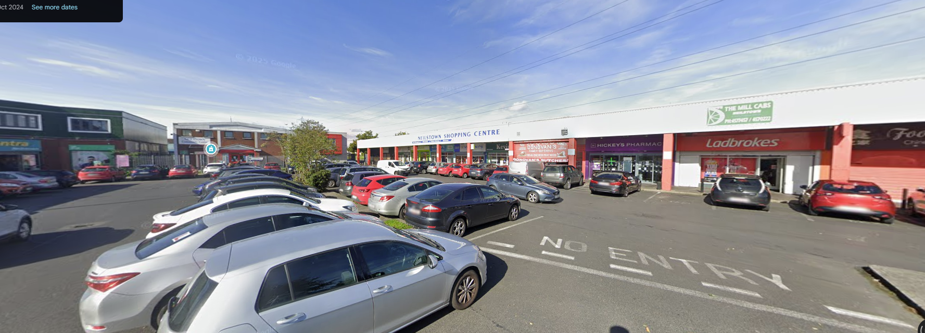
Neilstown
Notes:
Heritage to Modern

Slide 14
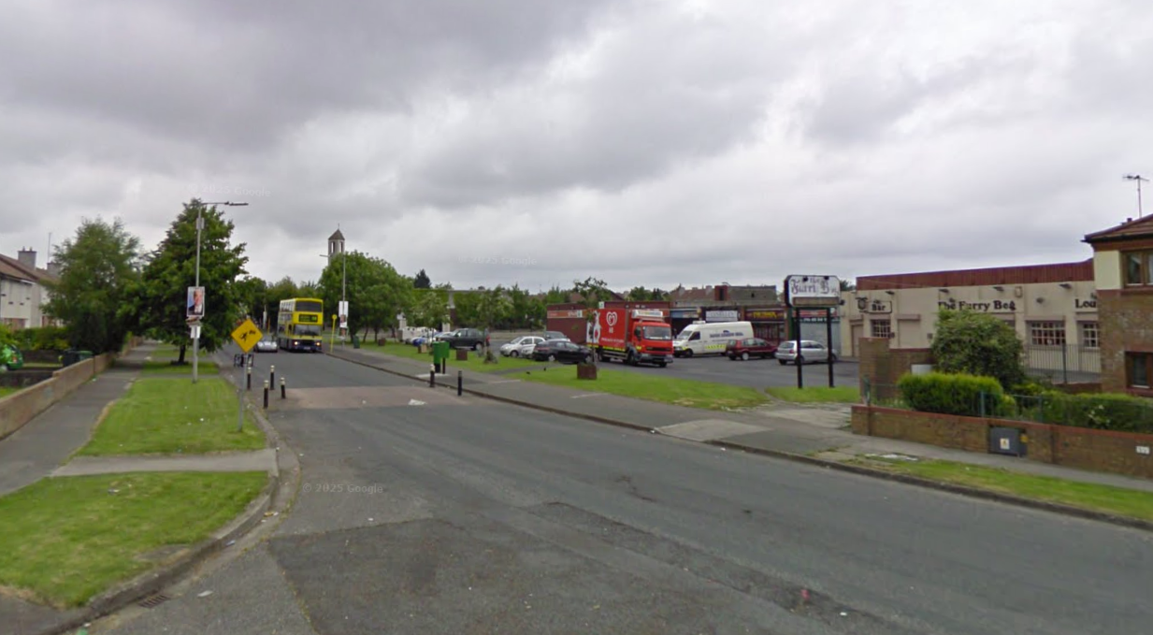
Whitechurch
Notes:
Heritage to Modern

Slide 15
Future
Projects
Villages
Rathfarnham
Newcastle
Rathcoole
District Centres
Deansrath
St. Dominics
Old Bawn
Notes:
Cllr Requests, Difficult Maintenance (street furniture), bus connects, active community

Slide 16
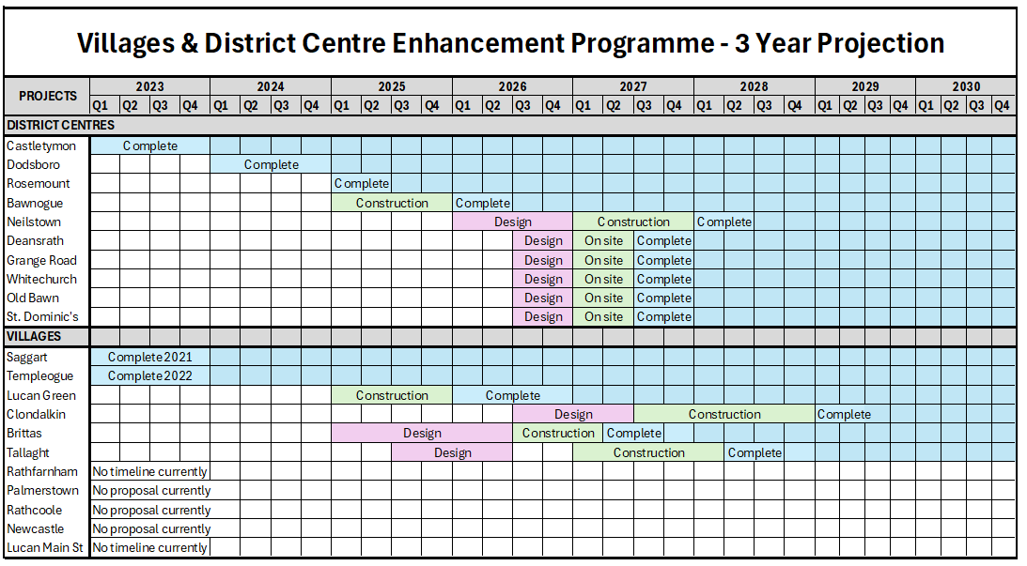
Timeline
Notes:
Cllr Requests, Difficult Maintenance (street furniture), bus connects, active community

Slide 17
Thank you
Questions?

