Slide 1
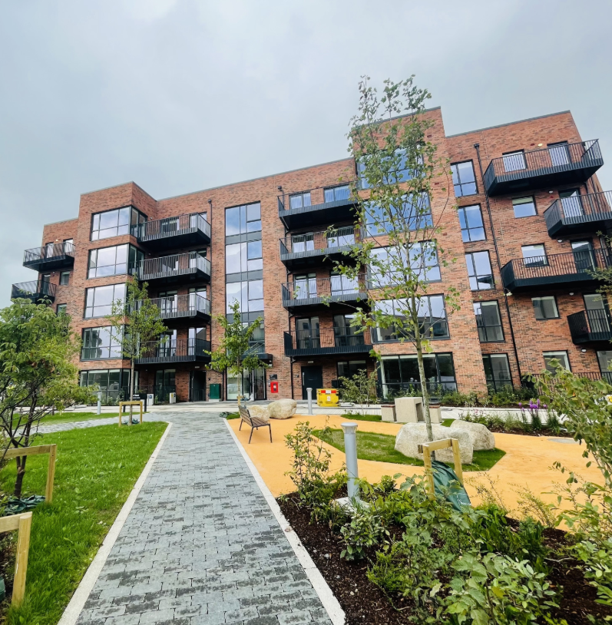
Housing Delivery
Report
Clondalkin, Newcastle, Rathcoole, Saggart and Brittas ACM

Slide 2
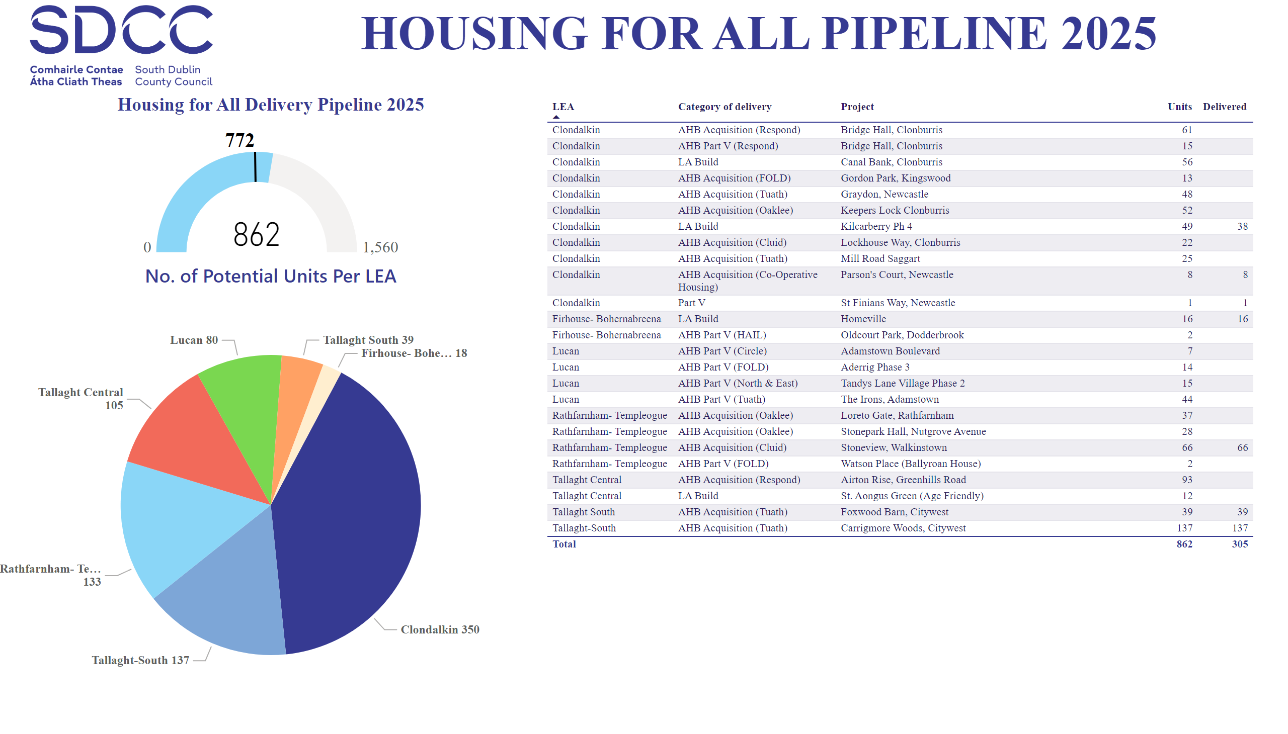
2025
Notes:
image
No alt text provided
Housing for All Delivery Pipeline 2025
No alt text provided
textbox
No alt text provided
Potential Units
No alt text provided
No. of Potential Units Per LEA
No alt text provided

Slide 3
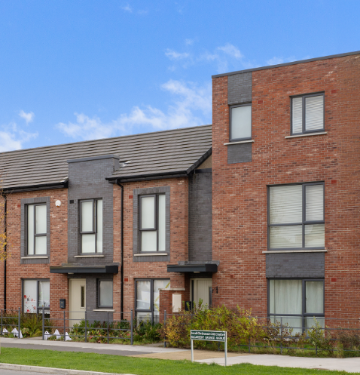
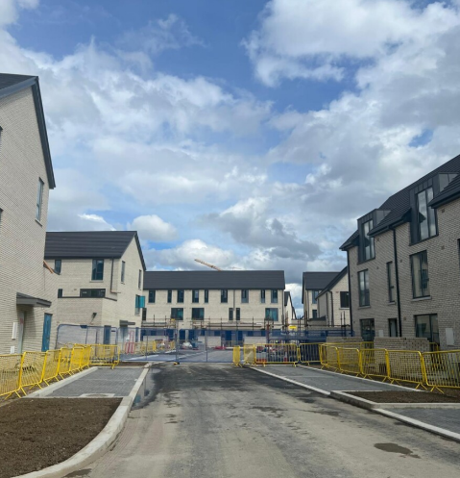
Large Development Sites
Kilcarbery Grange: 1,034 homes with 30% social (310 homes)
Phases 1, 2 and 3 of this project are now complete, with delivery of 301 social homes to date. Construction on phase 4 almost complete with delivery of the final 9 homes anticipated at the end of November.
Clonburris Phases 1-6: Phases 1 & 2 comprising 382 homes (149 social), Phases 3,4,5 with potential for 1,275 homes & Phase 6 with potential for 650 homes
Phase 2 – Canal Extension is currently in snagging phase and is track for completion by end November 2025.
Phase 1 – Kishoge. Cunninghams Contractors have been appointed to construct 284 social, affordable, cost rental & Traveller homes. Site clearance and decanting works are now concluded with formal construction commenced.
Phases 3, 4, 5 - plans for approximately 1,275 social and affordable homes have been submitted to An Coimisiún Pleanála under a Part 10 planning application. Submission period has ended with minimal submissions received. Decision expected by early 2026.
Phase 6 - Kishoge District Centre – approx. 650 homes, procurement process has commenced with contractor to be appointed by end 2026.
Rathcoole: Approx 125 homes
Architect led design team have been appointed to progress the masterplan through to Part 10 planning application to An Bord Pleanála. Update to be brought to full Council meeting in December 2025

Slide 4
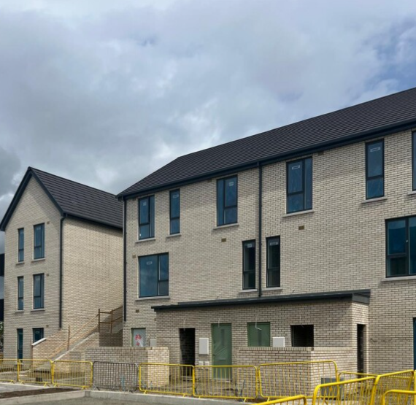
SDCC Build Programme
LEA | Project | Units | Status
Clondalkin | Lindisfarne | 19 | Substantially complete December 2024
 | Canal Bank, Clonburris | 56 | On-site – delivery from November 2025. Mixed Tenure Scheme –56 Social homes & 60 Affordable Purchase homes.
 | Kilcarbery Grange | 47 | On-site – 301 delivered to date. Balance to be delivered by end November 2025
 | Alpine Heights (Age-Friendly) | 13 | Contractor on site. Delivery Q3.2026
 | Deansrath – Melrose (Age-Friendly) | 27 | Contractor on site. Delivery Q3.2026
 | Kilcarbery School Site | 18 | Contractor on site. Delivery Q1.2026
Canal Bank, Clonburris

Slide 5
AHB & Part V Delivery
LEA | Project | Expected Units | Status
Clondalkin | Parsons Court, Newcastle. CHI | 8 | Complete
 | Gordon Park, Part V - FOLD | 13 | On-site – Completion Q4.2025
 | Keepers Lock, Clonburris Part V - Oaklee | 86 | On-site – phased handover from November 2025. 26 Affordable Purchase agreed under PV
 | Parkleigh Copse, Sevenmills Part V - Respond | 76 | Part V negotiations concluded. Completion Q4.2025
 | St Johns Road, Clondalkin Part V – CHI | 44 | Part V negotiations concluded. Completion Q4.2025
 | Main Street, Saggart Part V – Cluid | 28 | Part V negotiations concluded. Completion Q1.2026
 | Graydon, Newcastle Part V - Tuath | 48 | Part V negotiations concluded. Completion Q4.2025
 | Lockhouse Way, Sevenmills AHB Acquisition - Cluid | 42 | Phased completion from Q4.2025 to Q1.2026
 | Mill Road, Saggart Part V – Tuath | 143 | Part V negotiations concluded. Phased completion through 2025 & 2026
 | Garters Lane, Saggart Part V - Tuath | 223 | Part V negotiations complete. Phased handover from Q3.2027

Slide 6
Housing Acquisitions Programme 2025
Acquisitions complete to date
72
Acquisitions in Conveyance
11
Sale Agreed / Negotiation
23
Anticipated Completions for 2025
83

Slide 7
Thank you

