Slide 1
Lucan Palmerstown
North Clondalkin
ACM
November 2025
Created by
{Rosena Hand}
Presented by
{Rosena Hand}

Slide 2
Lucan Library October Statistics
230 new registrations
9,293 item issues
821 item renewals
12,331 visitors
439 My Open Library Visits

Slide 3




STEAM Events
Halloween Science with Anyone4Science
Potion Making (ages 6 – 8): Mix, fizz, and bubble! In this magical science workshop, young wizards and witches will explore the world of acids and bases by creating colourful, fizzy potions.
CSI (ages 9 – 12): Step into the shoes of a Forensic Scientist! In this hands-on science workshop, young Scientists will learn two real life forensic Science techniques, they will analyze evidence, and solve a make-believe crime scene.
Saturday 1st November
Makerspace Drop-in Session
Lucan library will be welcoming our maker-in-residence for a fun makerspace drop-in session.
Friday 7th November
‘Mystery Liquids’ Science Workshops for Schools with Anyone4Science
XYZ Mystery liquids In this workshop the children are given 3 mystery liquids. Using pipettes they make 3 potions. They then add indicator to all 3. What happens? Why? What were the liquids? In the explanation the children are introduced to acid base chemistry and indicators.
Friday 7th November

Slide 4
STEAM Events
Science Week: ‘Colourful Chemistry’ Science Workshops for Schools with Anyone4Science
Colourful Chemistry 1st-6th class In this workshop the children consider secondary colours and the possibility of separating them back to their original primary colours. The children use their new chromatography skill to investigate the dyes used by food manufacturers in products such as Skittles.
Friday 14th November
STEAM Saturday with Helen
For children aged 9 – 12 years.
Join us for a fun afternoon of science and learning, led by Lucan library staff member Helen.
Saturday 22nd November

Slide 5


Health and Wellbeing
Yoga Classes with Anne – Quiet Space Yoga & Retreats
Join Anne from Quiet Space Yoga & Retreats for a series of free yoga classes at Lucan Library.
These classes combine gentle strength-building exercises, stretches to improve flexibility, and guided relaxation to leave you feeling calm and refreshed.
Suitable for all levels.
5-week course starting Wednesday 5th November
Changing Gears with Age and Opportunity
Changing Gears is a free initiative for over 50s to reflect on life experience to date, lessons learned and planning your next steps.
How does it work? Changing Gears provides time to reflect on your personal life experience, the challenges you have faced, and the skills and resources you have developed. You will learn strategies for building resilience and managing change, helping to lay the foundations for a positive and fulfilling future.
6-week course starting Thursday 6th November

Slide 6

Poet’s Perch Book Launch
Lucan Library’s monthly poetry group, Poet’s Perch, will be launching their debut poetry anthology in the library this month.
Published by Luain Press, this book will feature poetry written by the group, compiled by group facilitator Natalie Ryan.
Saturday 29th November, 2pm

Slide 7
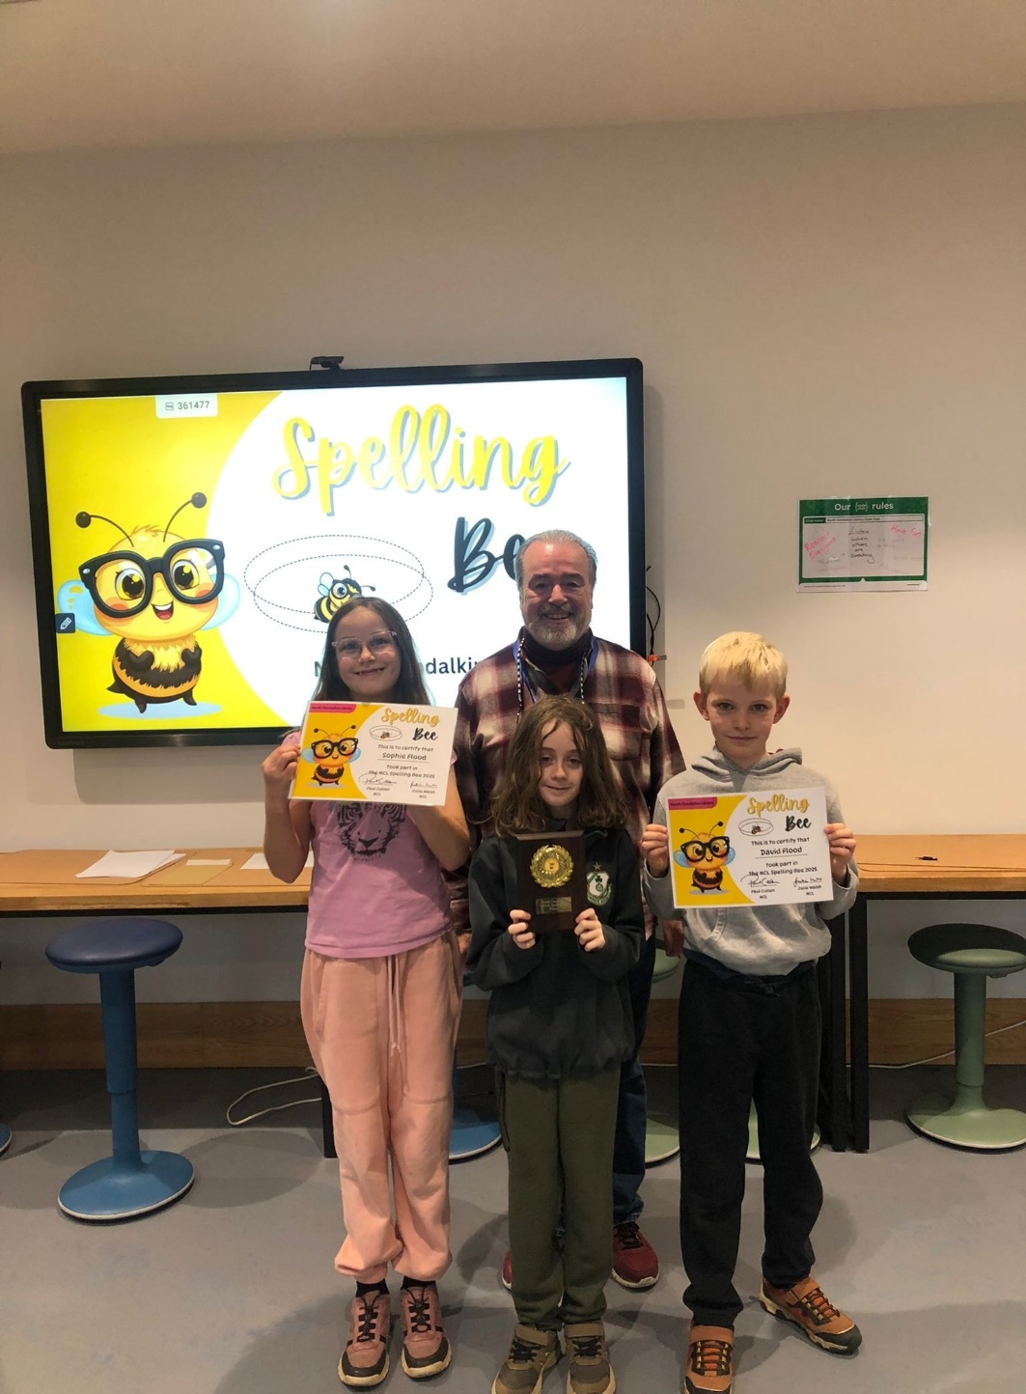
North Clondalkin Library October Statistics
Footfall: 9,036
Events: 222
Event attendees: 2,239

Slide 8
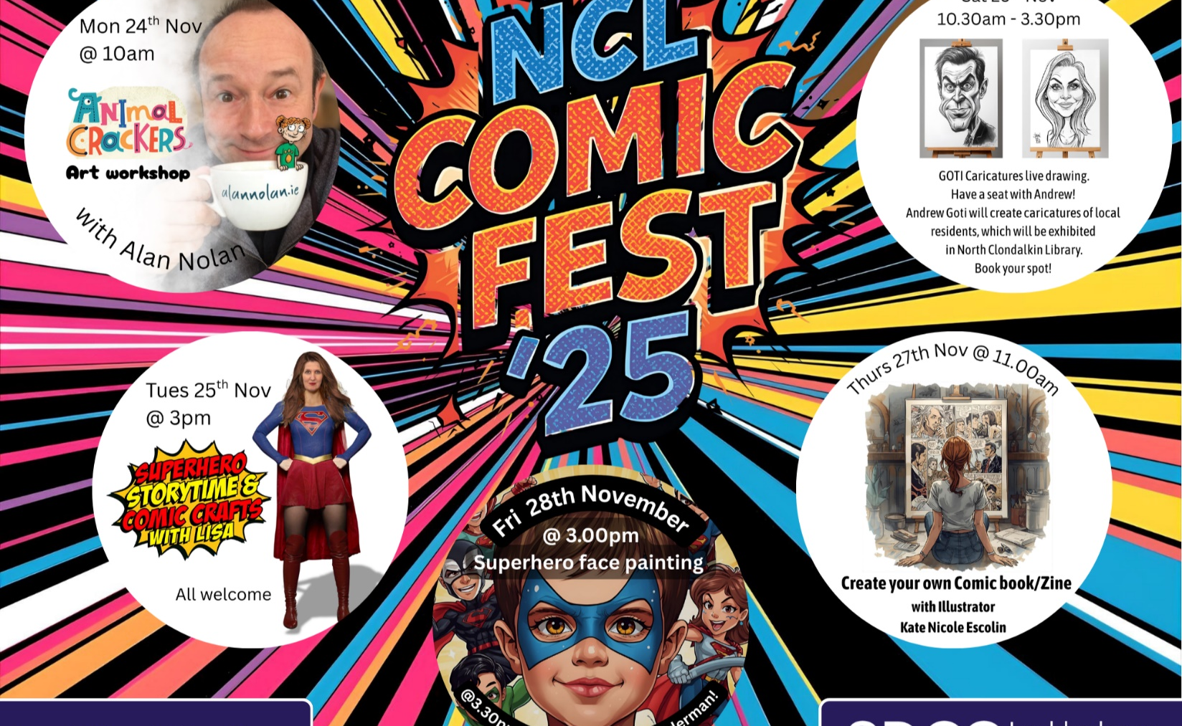
Clondalkin Comic Fest 2025
North Clondalkin Library celebrates Comic Fest 2025 with a week-long programme of events and activities during November 24th –November 29th .
Author visits included: Animal Crackers Art workshop with Alan Nolan. (Monday 24th November)
Create your own Comic Book/Zine with Kate Nicole Escolin. (Thursday 27th November)
Other events included: Superhero Storytime & Comic Crafts (Tuesday 25th November)
Superhero face painting with special visit from Spiderman ( Friday 28th November)
GOTI Caricature live drawing . Andrew Goti will create caricatures of local residents – which will be exhibited in NCL.

Slide 9

Christmas Craft Fair
This years Christmas Craft Fair will take place on Saturday 22nd November.
The day will be filled with fun activities including:
Over 25 stalls from local crafts people
Music from Night moves
Carols from Ronanstown Youth Club
Puppet Shows x 2
Christmas Laser cutting session in our maker space
A special visit from Santa Claus.
Selection boxes provided by Supervalu.

Slide 10
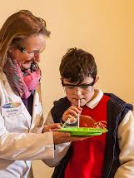
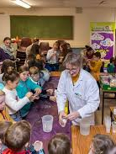
Maths and Science Week
We have a wide range of events organized to celebrate Maths and Science week:
11/11/25 : Digital Literacy Skills course (ETB) Adult event.
11/11/25 Sensory winter Bottle Craft. Inclusive event for children.
12/11/25: Nintendo Switch –Kids Gaming
13/11/25: CSI workshop with Anyone for Science (Secondary schools)
14/11/25: Colourful Chemistry workshop with Anyone for Science (Primary schools)
15/11/25: Crosscare Coding Club
16/11/25: 3D Printing Drop- in Hour.

Slide 11
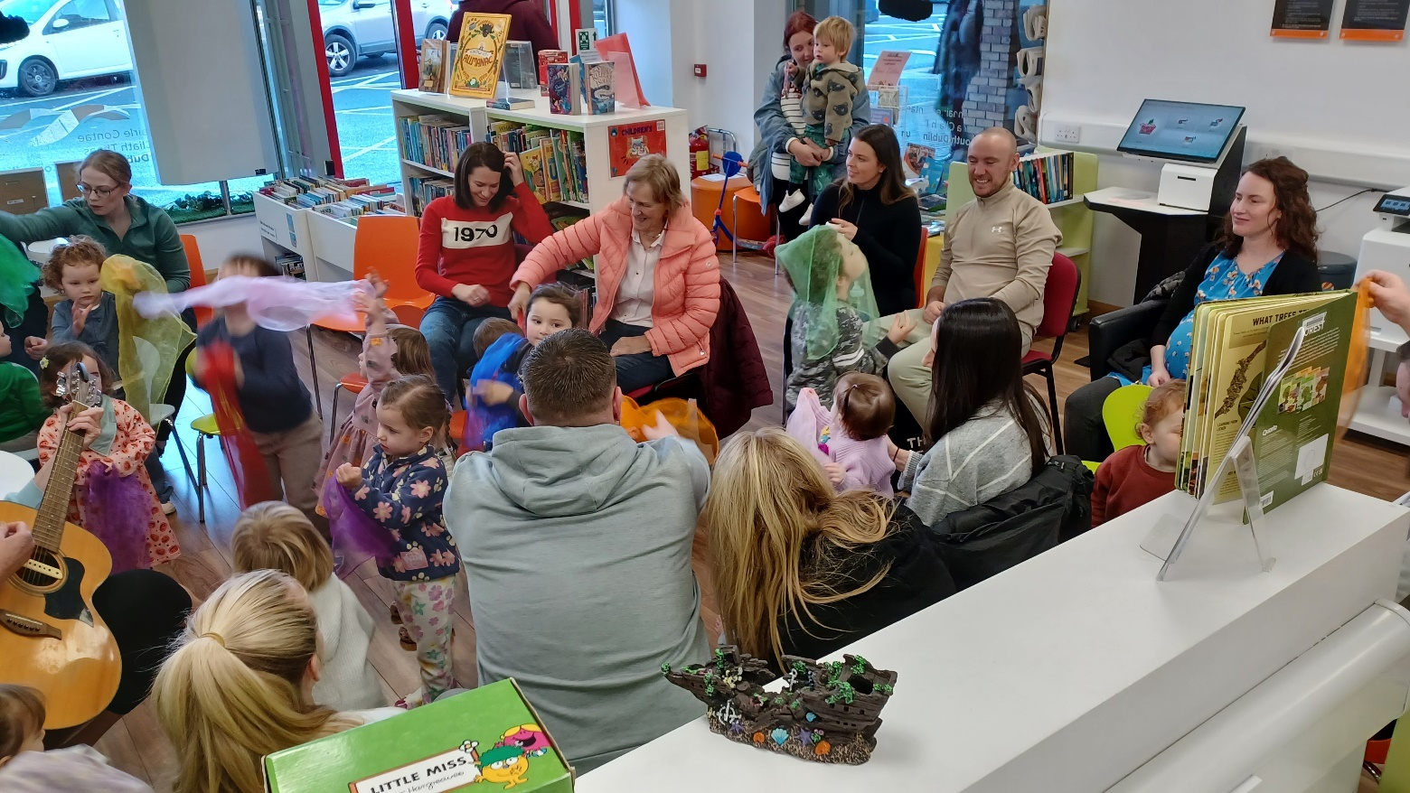
Palmerstown Library
November Highlights
Palmerstown Library held approximately 20 events in October 2025 - ranging from knitting clubs to book clubs to workshops and talks for adults and children.
Each Saturday morning are workshops for kids ranging from Music workshops to Arts & Crafts.
Class visits take place each Thursday with the local primary schools.
Local Historian, Gráinne Ní Mhuiri is giving a talk in the library on ‘The History of World War 1 Cottages in Palmerstown’.
November sees the launch of our new collection: ‘Classic Irish Literature’ showcasing Ireland’s rich history of literature.
New to Palmerstown Library is our new exhibition space affording locals a space to exhibit their work.
Weekly “Storytime @ The Library” with our resident storyteller for kids and Saturday morning events for kids are ongoing.

Slide 12


Mobile Libraries Statistics 2025
Mobile Libraries in October issued 6,939 items, registered 69 new borrowers and had 3193 visitors at their public stops and held 6 events attended by 177 people.
Mobile Libraries visited 20 schools with 6 -7 classes per visit in October. 3000 children borrowed mobile library books through our schools service. There were 84 library@home visits to our patrons who physically cannot avail of our libraries. We are hoping to develop this service in 2026 to nursing homes throughout South Dublin.

Slide 13
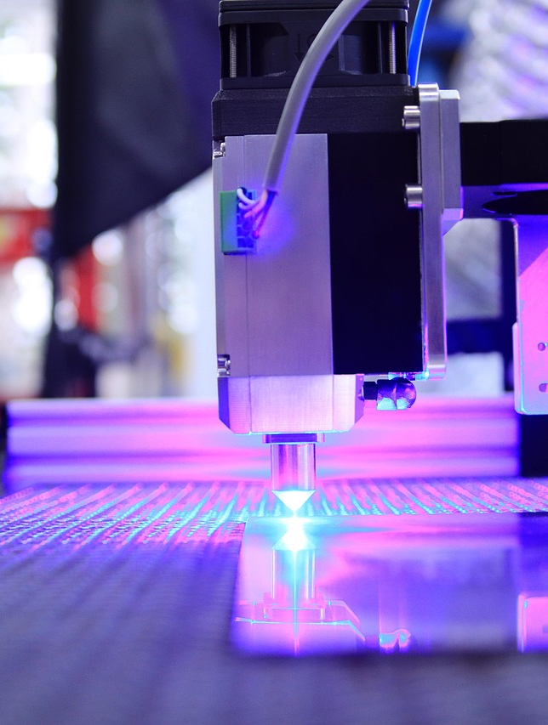
Mobile Libraries Events
In October Mobile Libraries visited TUD creche, Abacus Special needs school and a Halloween Camp at The Park Community centre.
One new and exciting event was a Laser Workshop that we brought to the students in Tallaght Youth Reach. They have requested a further workshop on 3D printing which is planned for January.
We parked up at the Jobstown Mental Health Fair Day on 10th October promoting our events at The Red Line Book festival to attendees at the Fair.

Slide 14
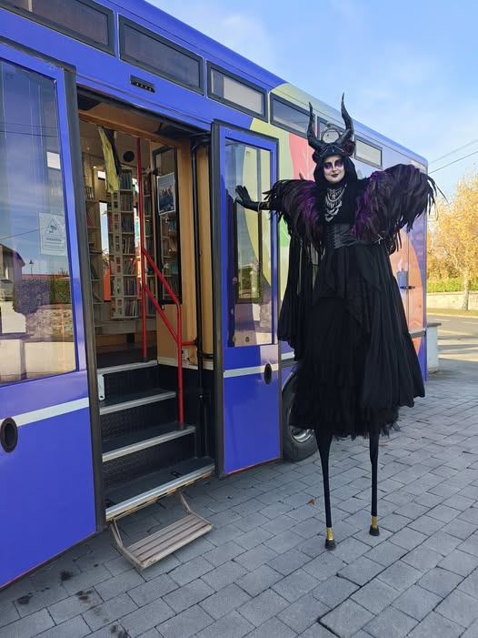
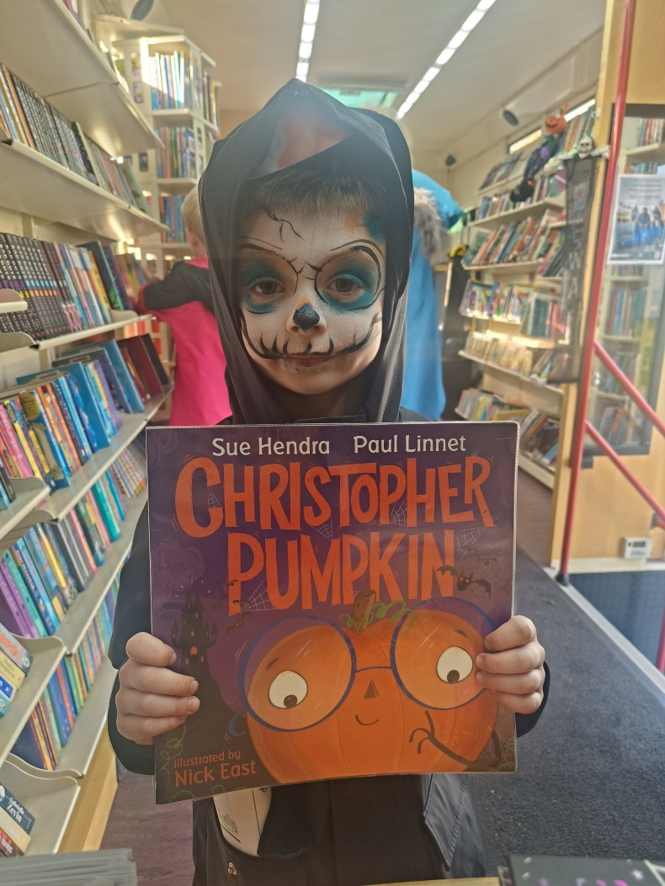
Mobiles in November
Mobile Libraries provided a quiet space at the Spookdalkin event at The Round Tower in Clondalkin on 2nd November. It was a truly spectacular local event . Many young families used our space to take time out from this busy event on a dry Sunday afternoon.
The second visit to Finnstown Homeless service in Lucan will take place on Sat 15th at 2pm.
All our usual visits to creches and homes will continue in November

Slide 15

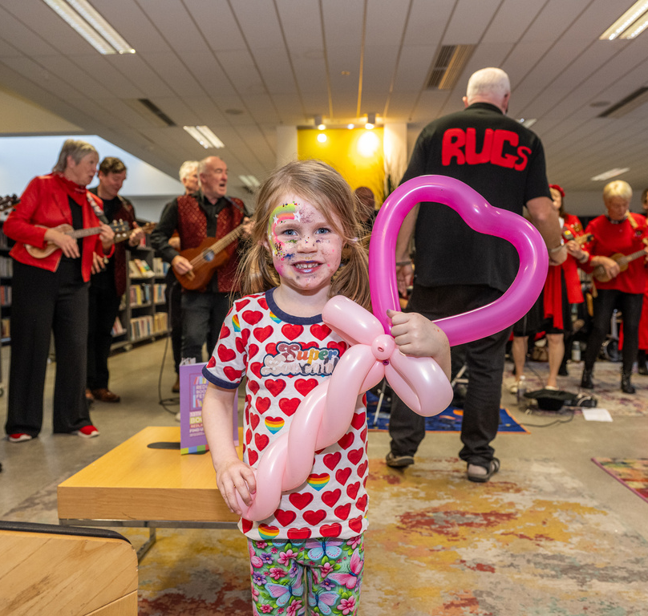
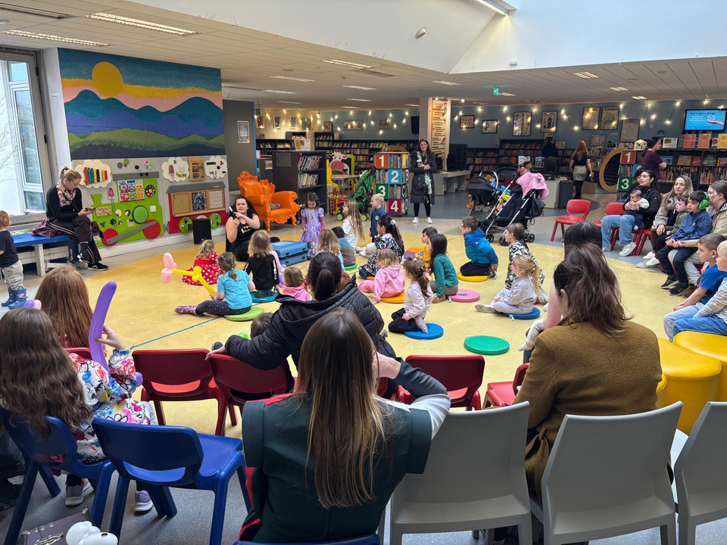


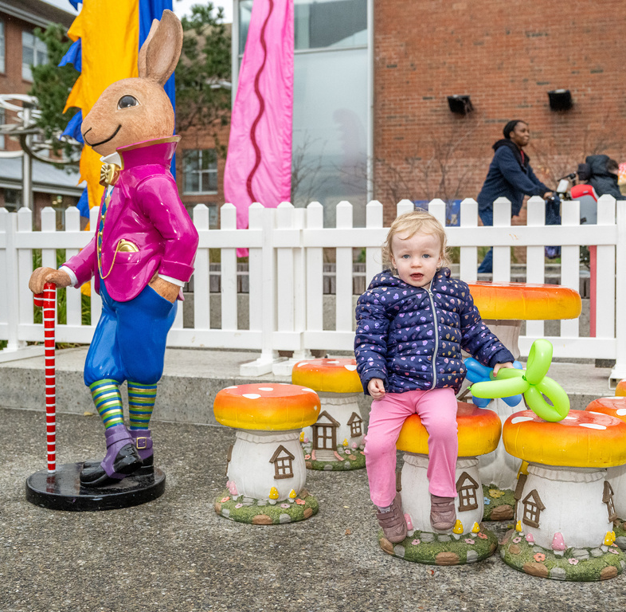
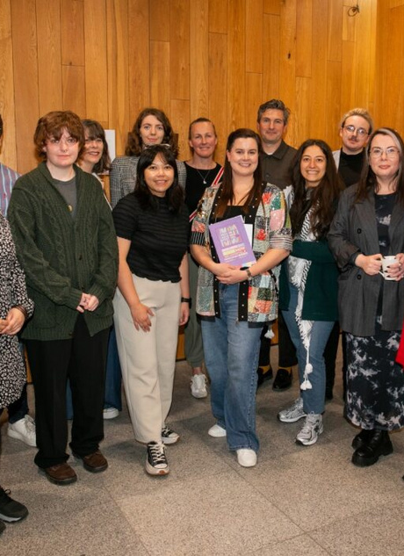
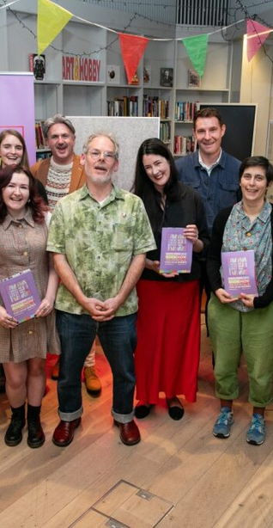
Red Line Book
Festival 2025 -
Highlights
The festival celebrated its 14th year in 2025 and took place from 13th - 19th October in libraries and venues all across South Dublin.
The Red Line Family Fun Day remains a significant event in the festival. The day saw over 2,000 people attend events in Tallaght Library, the Civic theatre and outdoor space in Parthalán Place.
The Illustrator in Residence program saw 15 participants exhibit their work in Ballyroan Library following a 5-week mentorship programe with artist Celina Buckley
The prestigious Red Line bi-lingual poetry competition saw over 500 entries from all over Ireland, with the winning poem “Schooner” coming from Galway poet James Anthony.

Slide 16
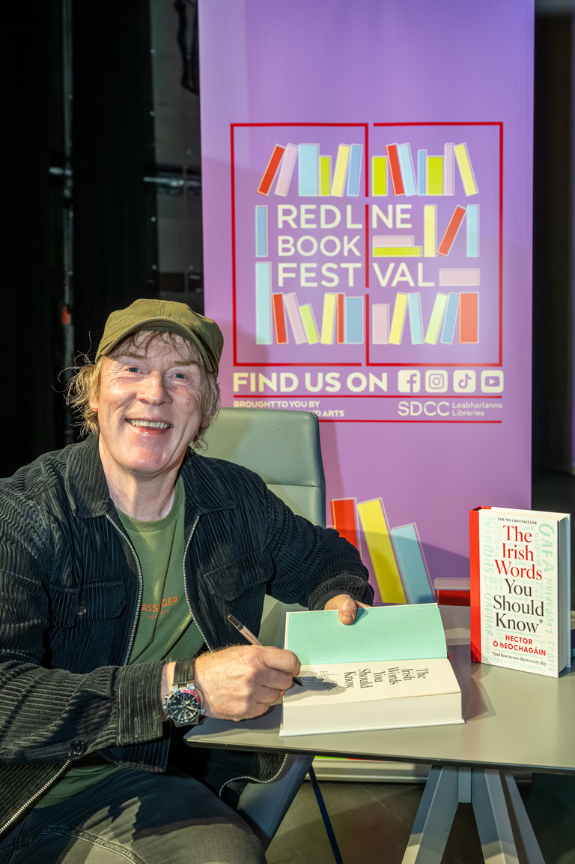
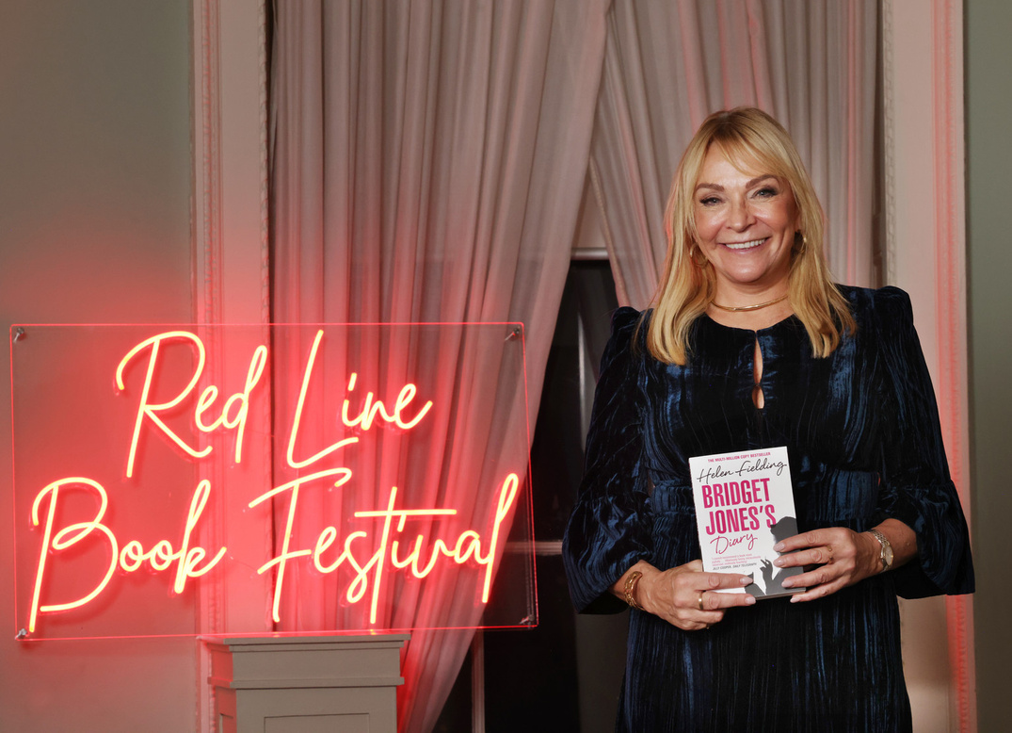
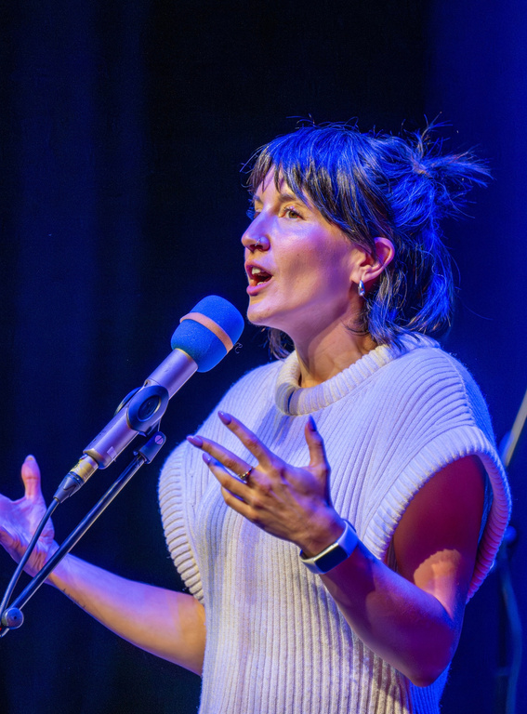
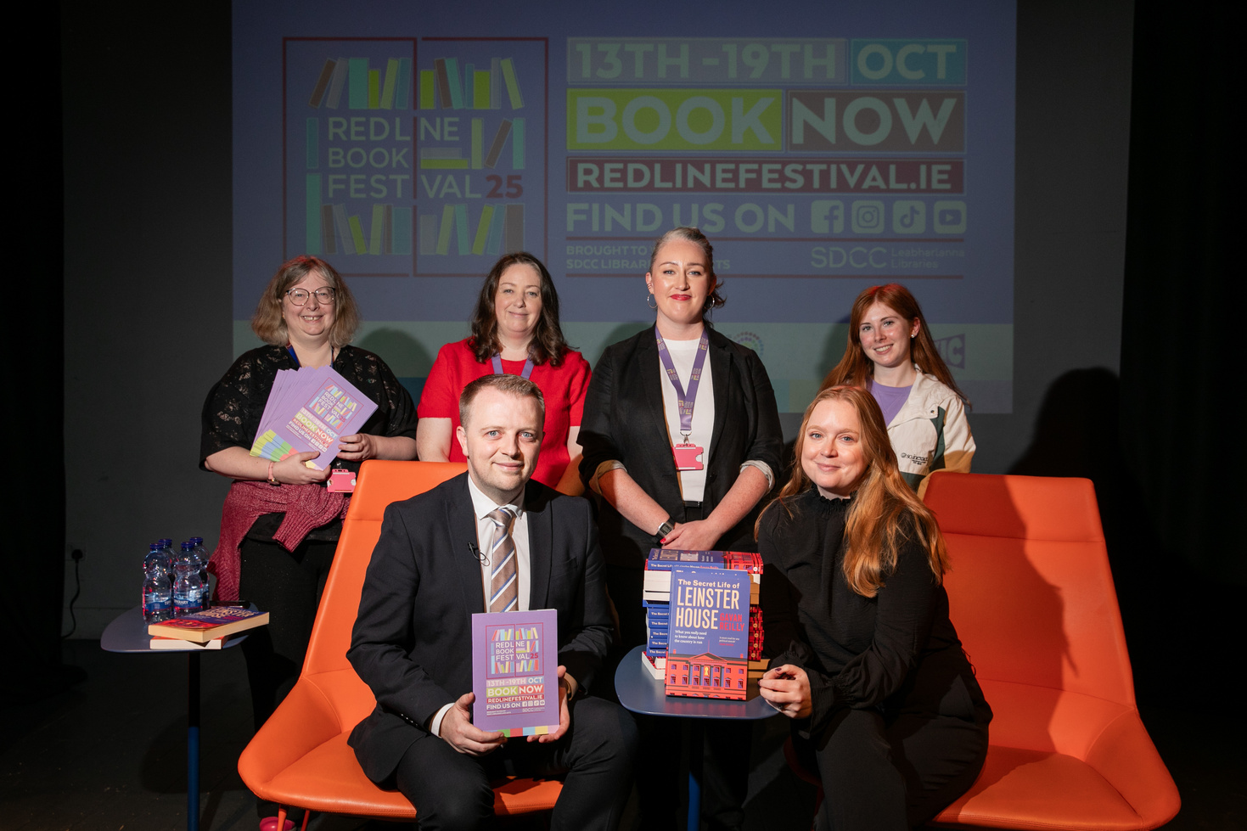
Festival Highlights
The festival lineup featured a host of national and international authors, while also platforming local and emerging writers.
Bridget Jones creator Helen Fielding spoke to a sold-out audience in Rathfarnham Castle, interviewed by Tallaght native Vicky Notaro.
Gavan Reilly and Jennifer Bray enthralled a full capacity crowd in Rua Red with tales of Leinster House
Irish language author and advocate Hector O’Eochagáin in conversation with presenter Muireann O’Connell brought lively banter and laughter to a raucous Civic theatre
The End of the Line: A Spoken Word Celebration featured 10 acclaimed poets from across Ireland in a rousing closing event to the festival

Slide 17
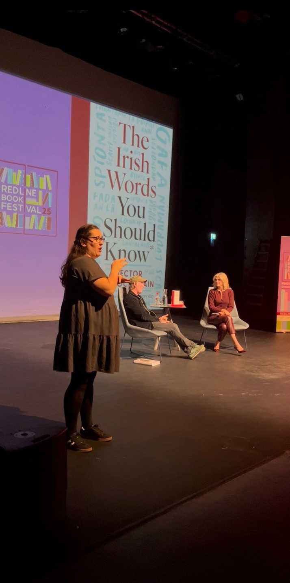
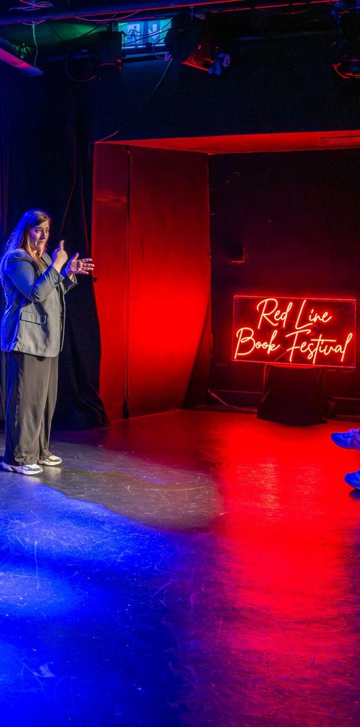
Accessibility
Irish sign language played an important part in increasing accessibility for this year’s festival.
ISL interpretation was provided for 4 main events in the Civic theatre and Rathfarnham Castle.
Feedback for provision of this service was excellent, both from attendees and event participants. We aim to increase the provision of ISL to more events in 2026.

Slide 18
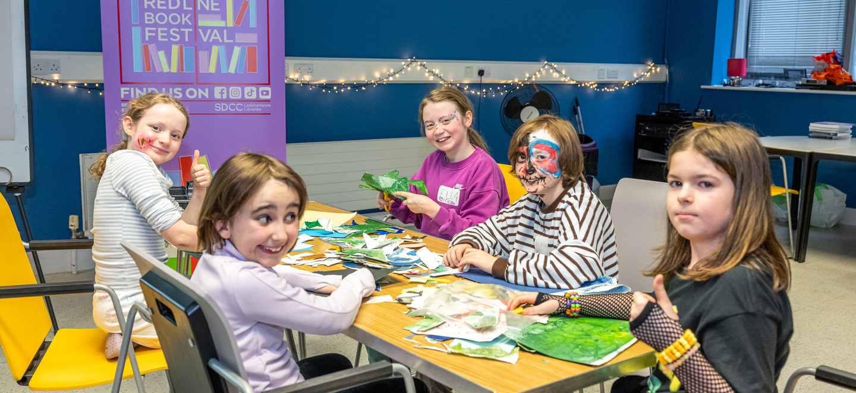
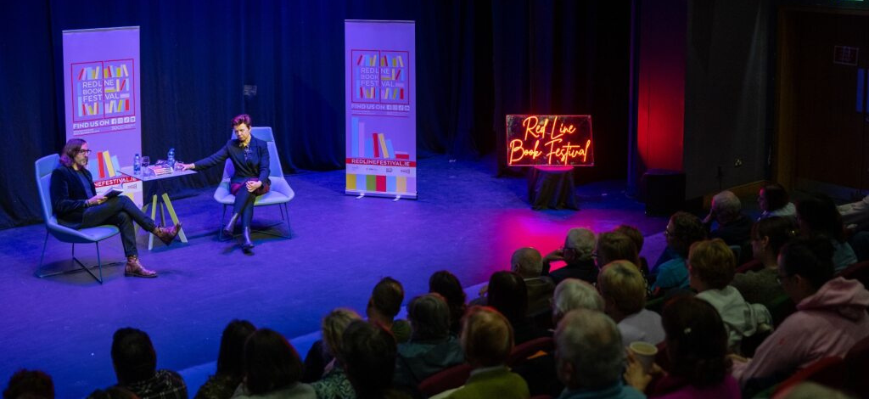
Engagement and Participation
There were 45 events delivered across 12 venues for the 2025 festival. 17 events booked out.
Total attendance was approx. 5,500 people, a 10% increase on 2024.
Social media engagement increased by 31% on select channels. Follower numbers increased by 23%.
Media engagement was significant in 2025, with festival coverage appearing in national outlets including Newstalk, the Sunday Independent, the Irish Times, the Journal and RTE.ie

Slide 19
Thank you

