Slide 1
Tallaght,
Castletymon and Mobile Libraries
ACM
November 2025
Created by
{Library Events and Communications}
Presented by
{Liz Corry}

Slide 2
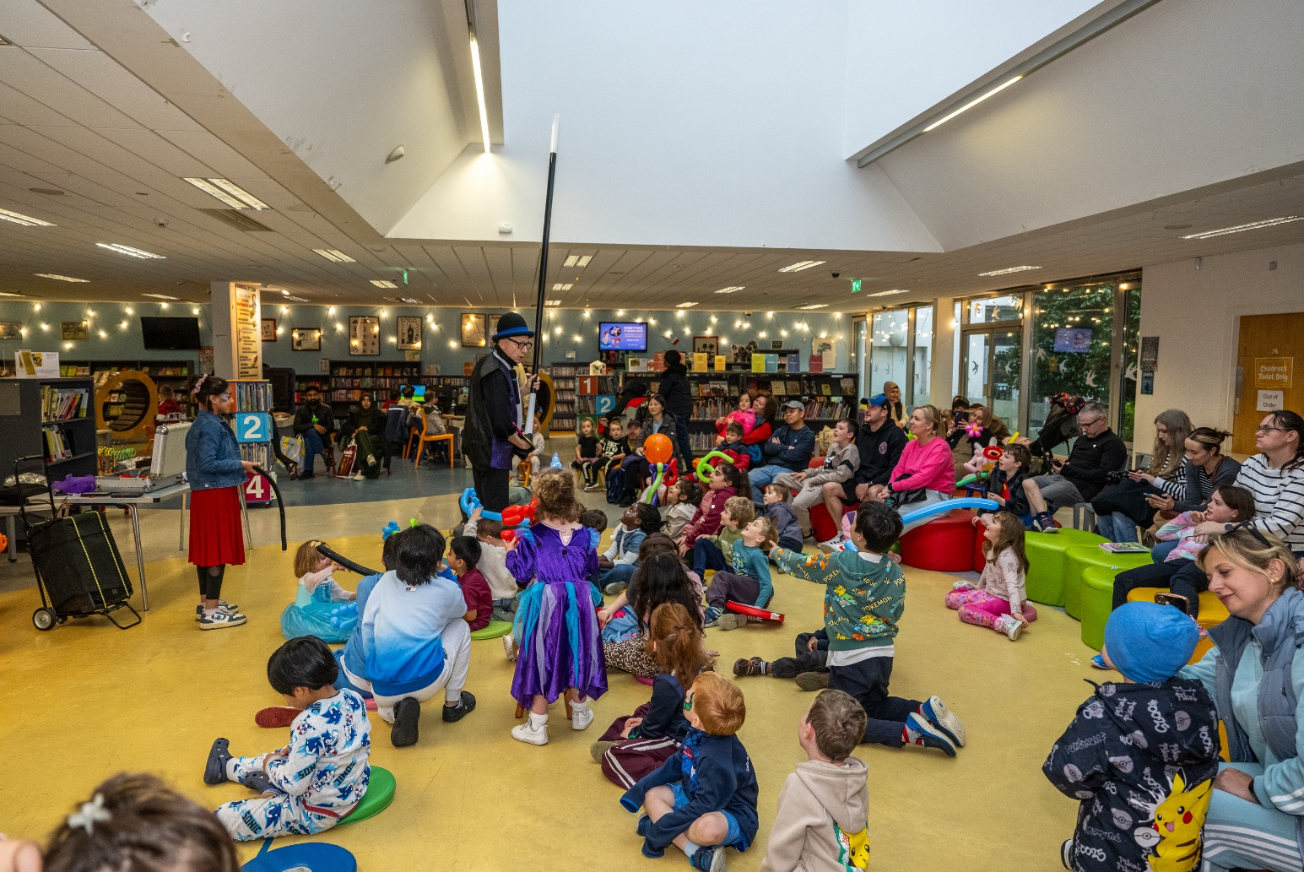
Tallaght Library October Statistics
Tallaght Library had 178 events, 2998 event attendees and overall footfall of 22,045 in October

Slide 3
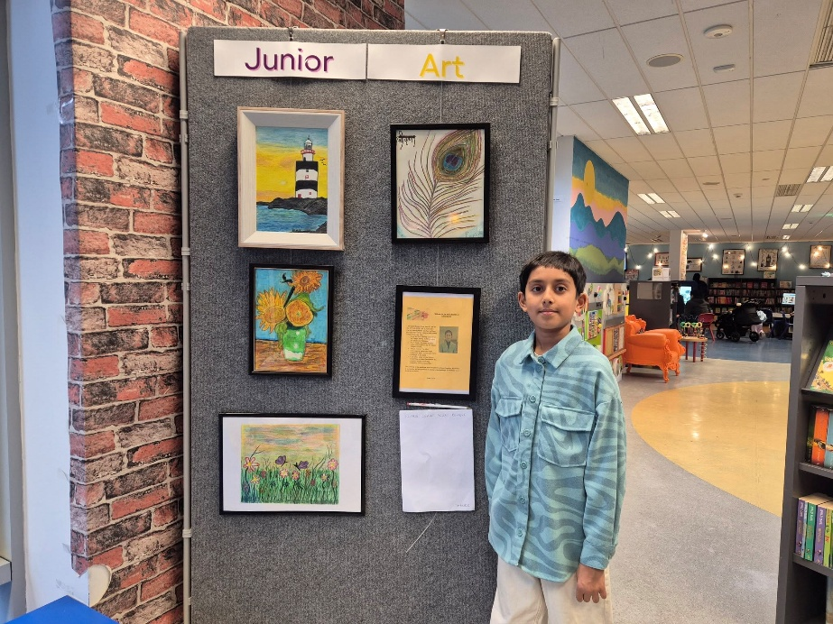
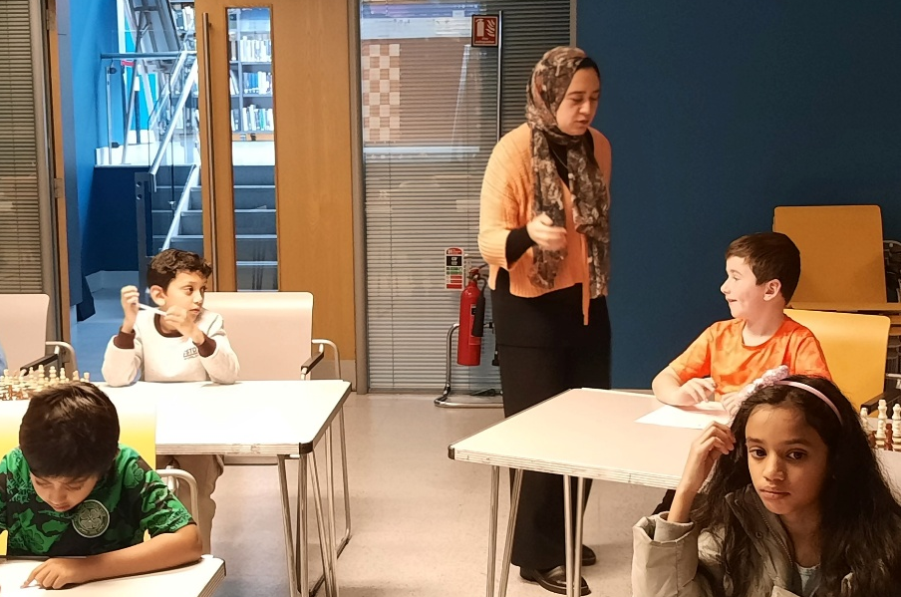
November Highlights for Kids and Teens
Junior Exhibition - New to Tallaght Library!
Kapish Bansal’s work was on display until 15 November
Children’s Chess Course
Four-week course with Grand Master Shrook Wafa
Science Workshops
Secrets of Superhero Science
Science of Bath Bombs
Santa CSI – Who Stole Rudolph

Slide 4
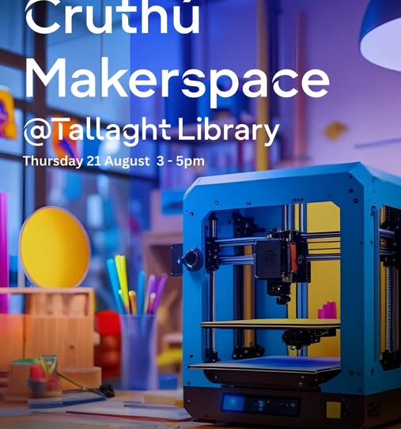
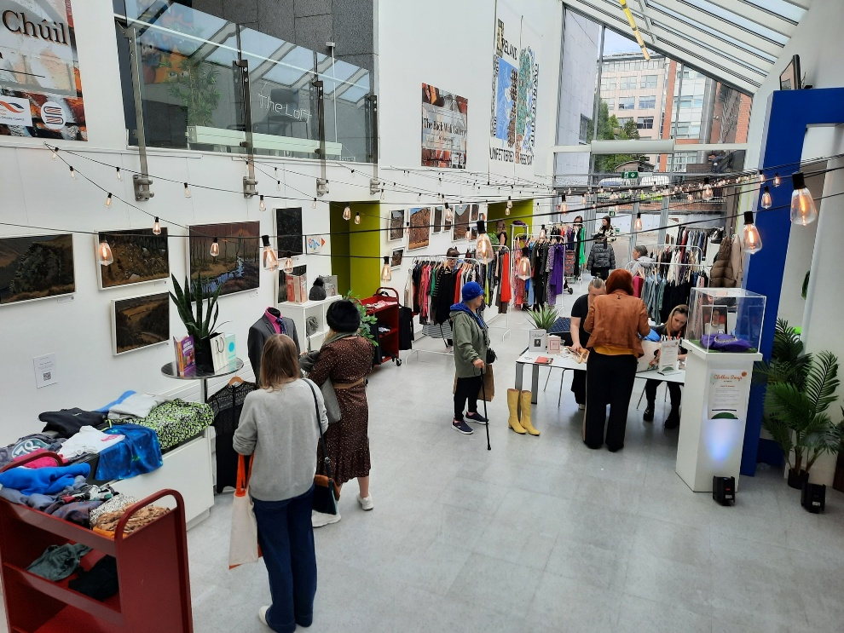
November Highlights for Adults
Cruthú Maker Space
Design Your Own Book Nook x 2 workshops
Author Talks
Great Irish Wives with Nicola Pierce
Whodunnit? With crime author Zoe Miller
Pride and Prejudice Book Club
Jane Austen 250 Years Celebrations
Christmas Season Begins…
Xmas Jumper/Tshirt swap - Saturday 15 November
- Age Friendly Vintage Christmas Cards Workshop

Slide 5
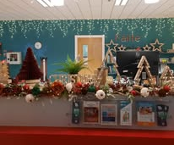
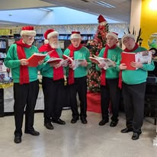
Coming up in December
Tallaght Library Becomes a Winter Wonderland with decorations galore
Christmas Fair on 6th December
Christmas Family Day on 13th December
Christmas Bingo, Wreath Making Workshop, Christmas Cinema, Magic, Music and much, much more!

Slide 6
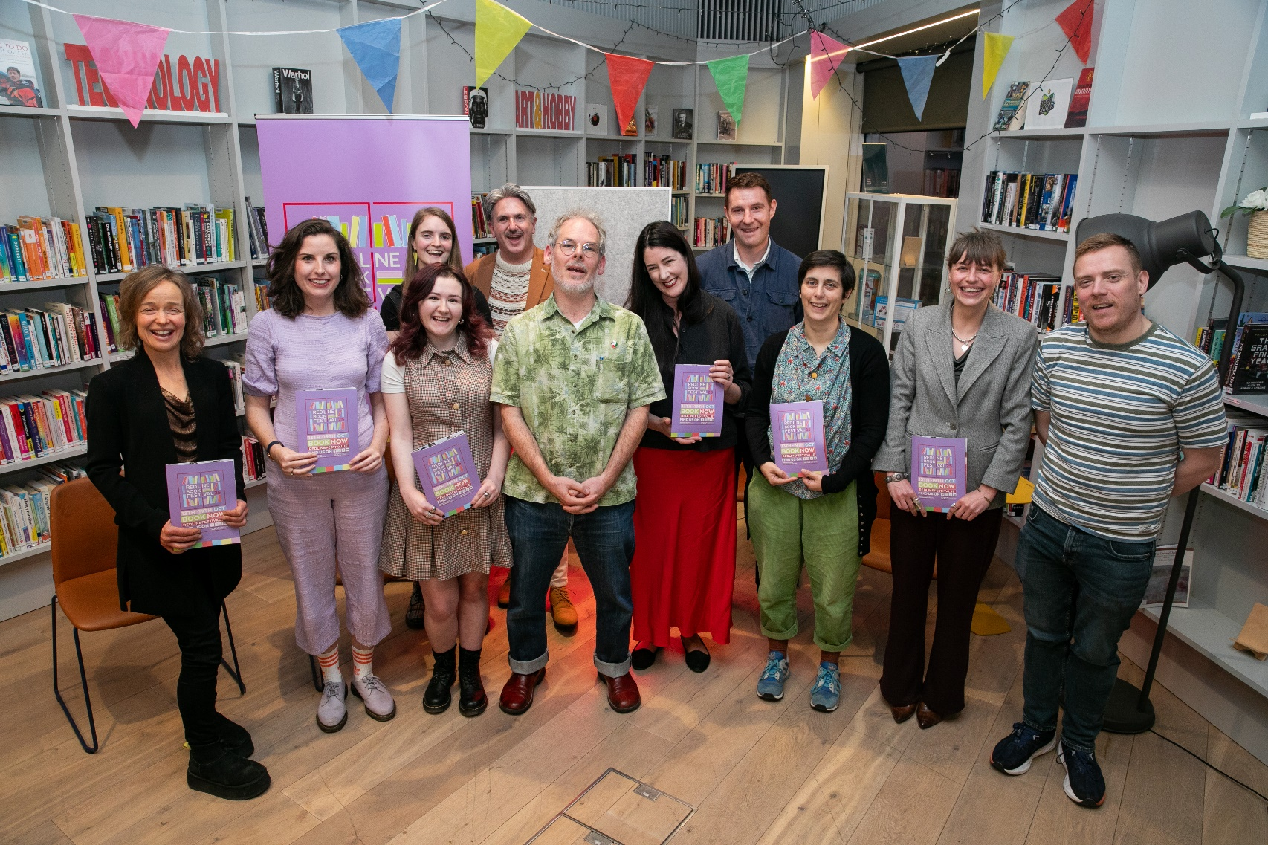
Castletymon Library October statistics
Castletymon Library had 41 events, issued 3131 items, registered 189 new borrowers and had 6345 visitors.

Slide 7
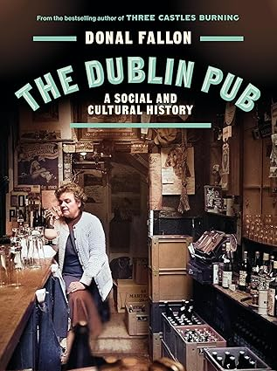
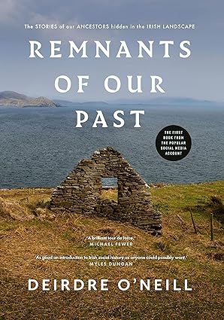
Castletymon Library November Highlights
For Adults:
Therapist Gillian Fagan will be here on 5th November for her talk Living Out Loud: Thriving as a Late-Discovered Neurodivergent Adult (or Ally), delivered as part of Neurodiverse South Dublin.
Donal Fallon, author of Three Castles Burning, will be talking about and reading from his new book The Dublin Pub: A Social and Cultural History on 12th November.
Horticulturist Aoife Munn will also return with a talk on how best to Create a Tranquil Garden (19th).
Our final talk for adults of the month is from author Deirdre O’Neill, who will be reading from and discussing her book Remnants of Our Past (26th).

Slide 8
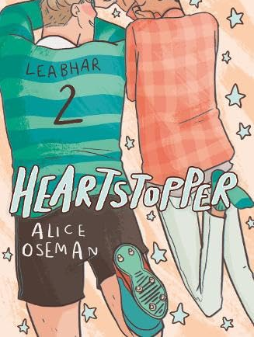
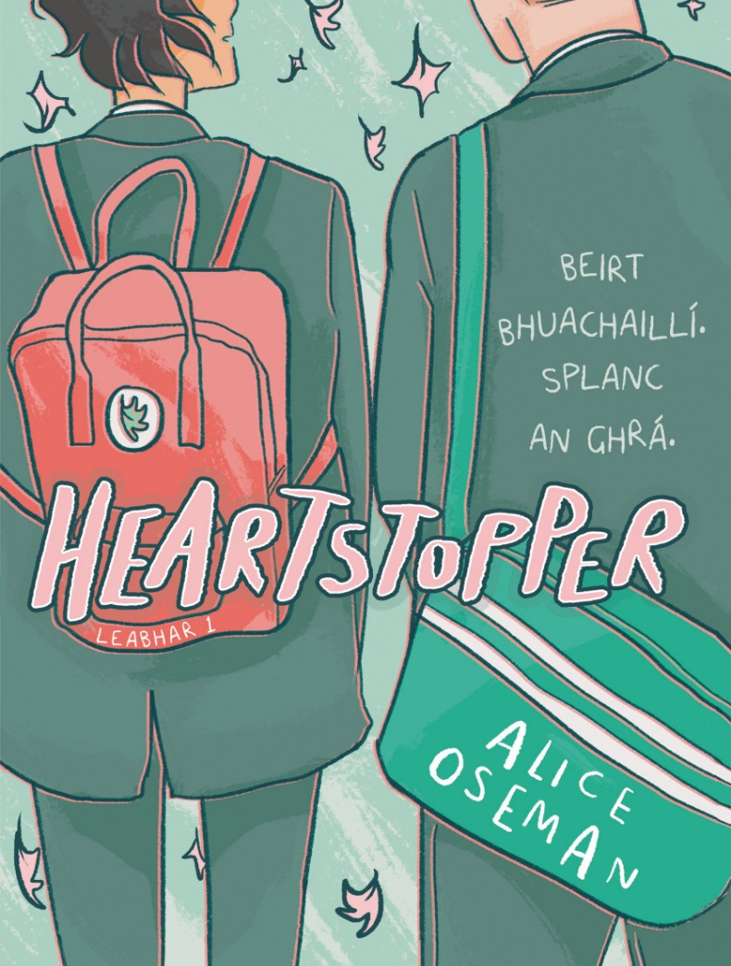
Castletymon Library November Highlights
For Schools
We have Eoghan Kelly, translator of Heartstopper into Irish coming to teach a Translation Workshop for TY on the 4th.
We also have YA author Claire Hennessy delivering a session on Writing Dystopias for TY on the 28th.
We also continue The Comics Project, our nine-week programme with writer Juliette Saumande, illustrator Elida Maiques and children with additional literacy needs wherein they learn how to write and draw comics, which will be assembled in a publication at the project’s conclusion.
Finally for Science Week, we have four events from Anyone4Science, two sessions of Pharmaceutical Technician Workshops (11th) and two sessions of Colour Families (12th).

Slide 9


Mobile Libraries Statistics Oct 2025
Mobile Libraries in October issued 6,939 items, registered 69 new borrowers and had 3193 visitors at their public stops and held 6 events attended by 177 people.
Mobile Libraries visited 20 schools with 6 -7 classes per visit in October. 3000 children borrowed mobile library books through our schools service.
There were 84 library@home visits to our patrons who physically cannot avail of our libraries. We are hoping to develop this service in 2026 to nursing homes throughout South Dublin.

Slide 10
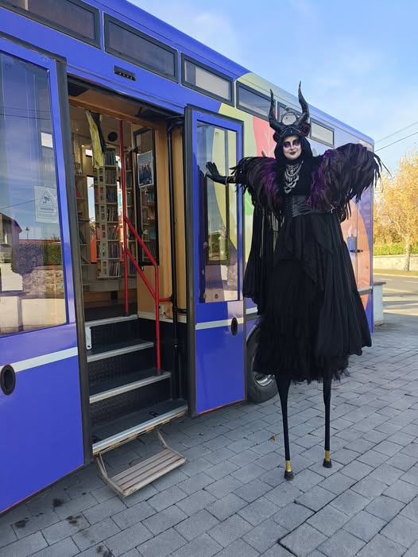
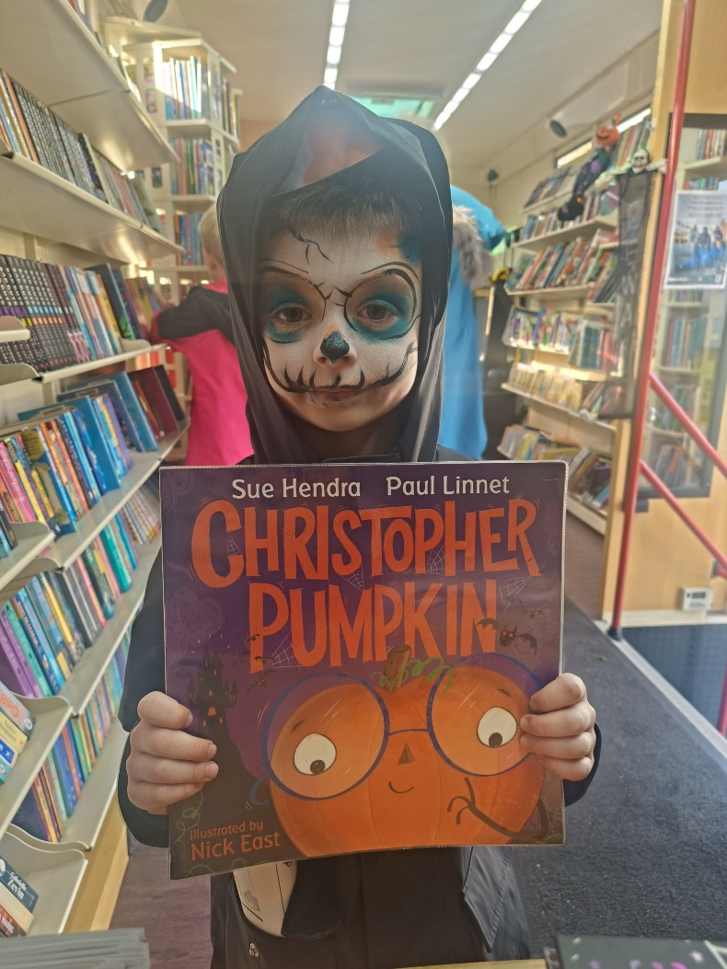
Mobiles in November
Mobile Libraries provided a quiet space at the Spookdalkin event at The Round Tower in Clondalkin on 2nd November. It was a truly spectacular local event . Many young families used our space to take time out from this busy event on a dry Sunday afternoon.
The second visit to Finnstown Homeless service in Lucan will take place on Sat 15th at 2pm.
All our usual visits to creches and homes will continue in November

Slide 11

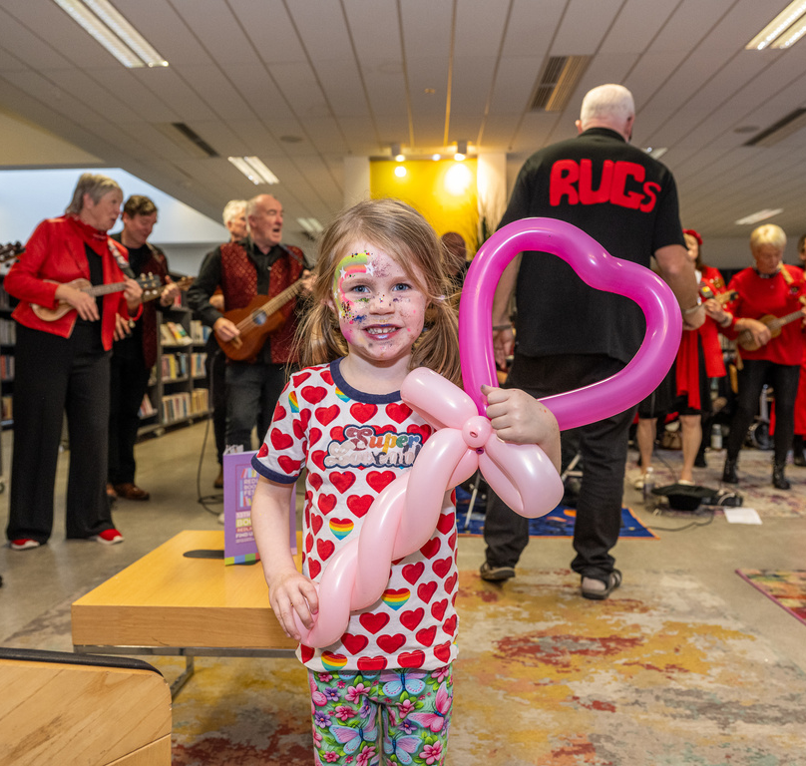
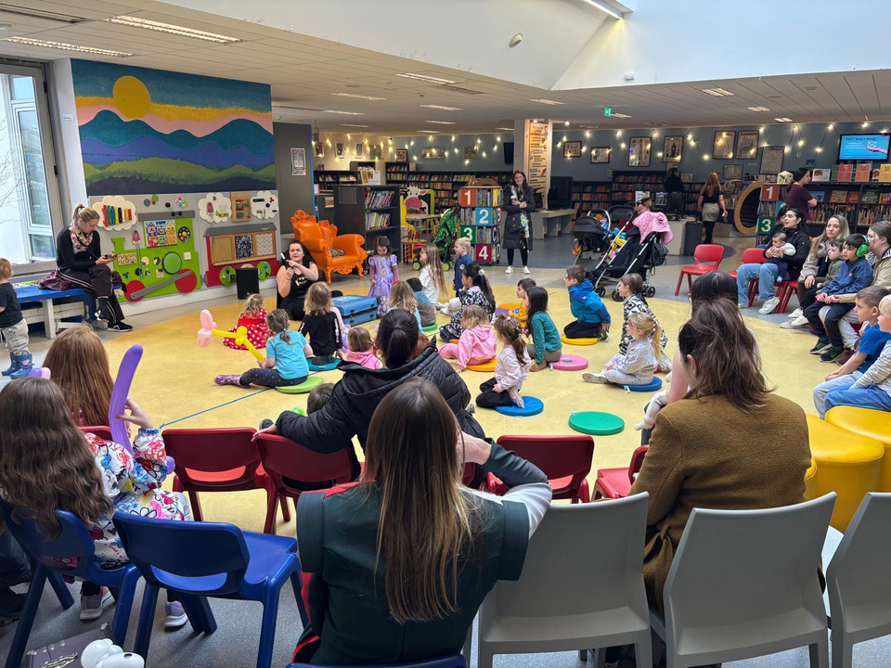


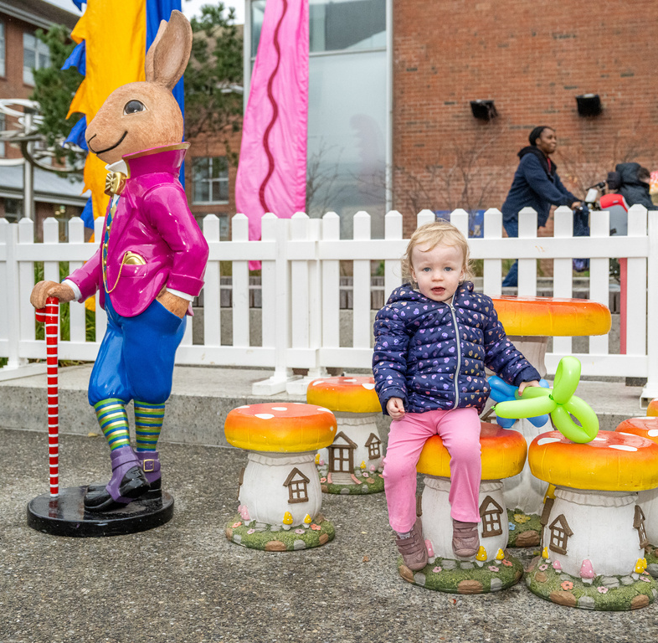
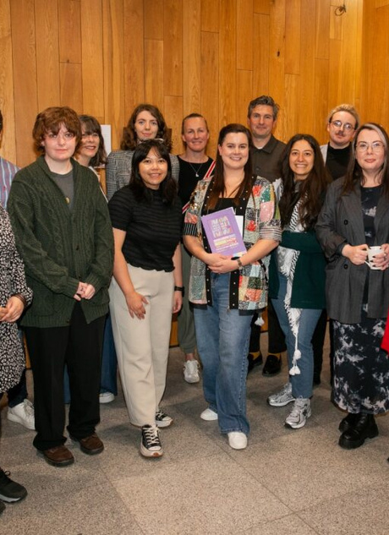

Red Line Book
Festival 2025 -
Highlights
The festival celebrated its 14th year in 2025 and took place from 13th - 19th October in libraries and venues all across South Dublin.
The Red Line Family Fun Day remains a significant event in the festival. The day saw over 2,000 people attend events in Tallaght Library, the Civic theatre and outdoor space in Parthalán Place.
The Illustrator in Residence program saw 15 participants exhibit their work in Ballyroan Library following a 5-week mentorship programe with artist Celina Buckley
The prestigious Red Line bi-lingual poetry competition saw over 500 entries from all over Ireland, with the winning poem “Schooner” coming from Galway poet James Anthony.

Slide 12
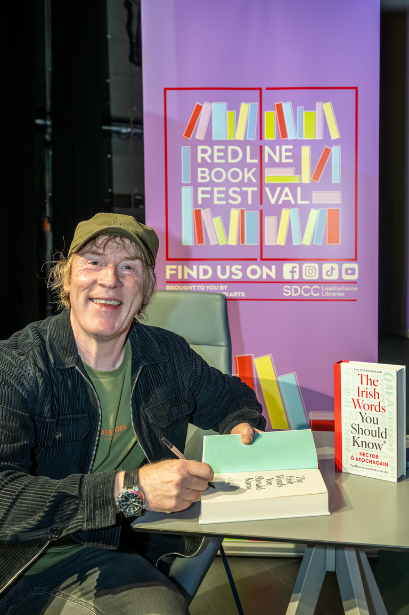
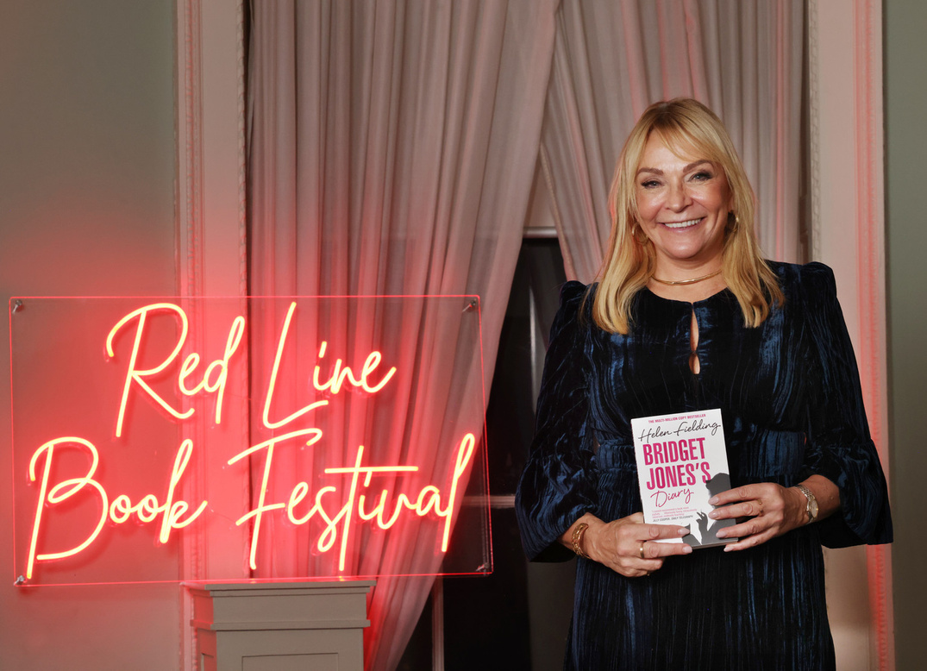
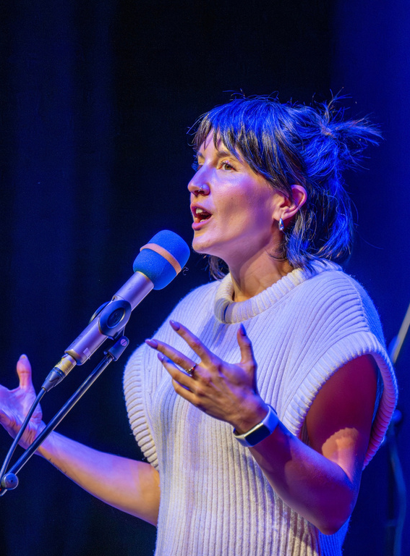
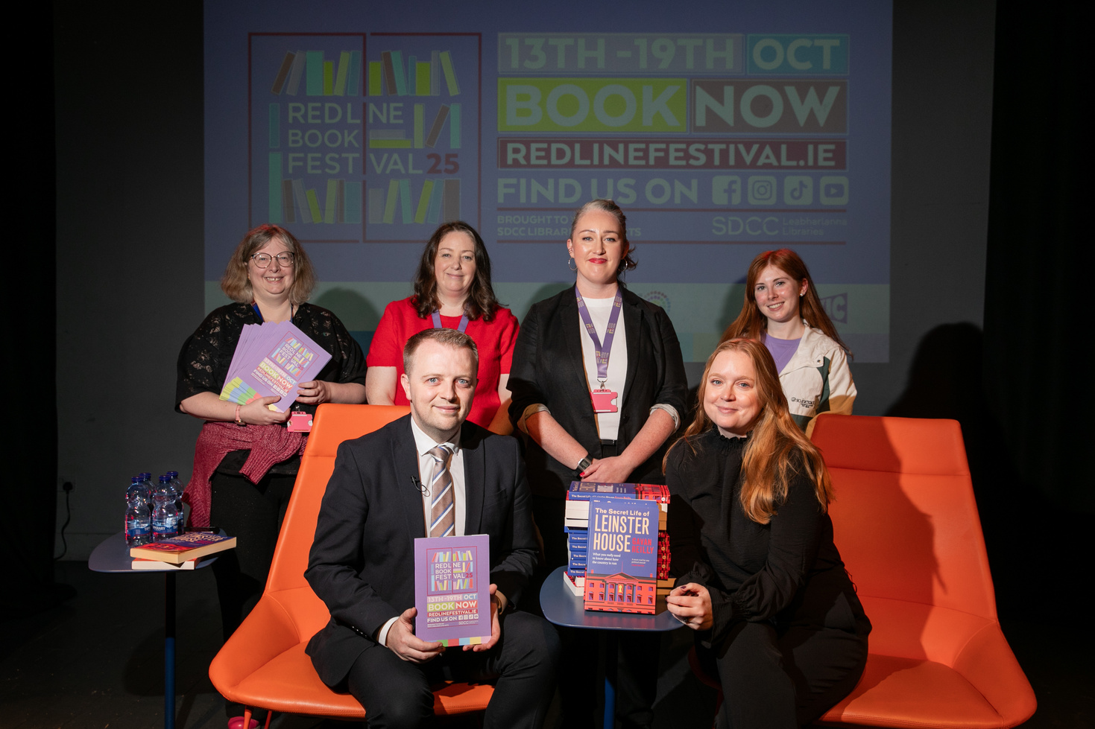
Festival Highlights
The festival lineup featured a host of national and international authors, while also platforming local and emerging writers.
Bridget Jones creator Helen Fielding spoke to a sold-out audience in Rathfarnham Castle, interviewed by Tallaght native Vicky Notaro.
Gavan Reilly and Jennifer Bray enthralled a full capacity crowd in Rua Red with tales of Leinster House
Irish language author and advocate Hector O’Eochagáin in conversation with presenter Muireann O’Connell brought lively banter and laughter to a raucous Civic theatre
The End of the Line: A Spoken Word Celebration featured 10 acclaimed poets from across Ireland in a rousing closing event to the festival

Slide 13
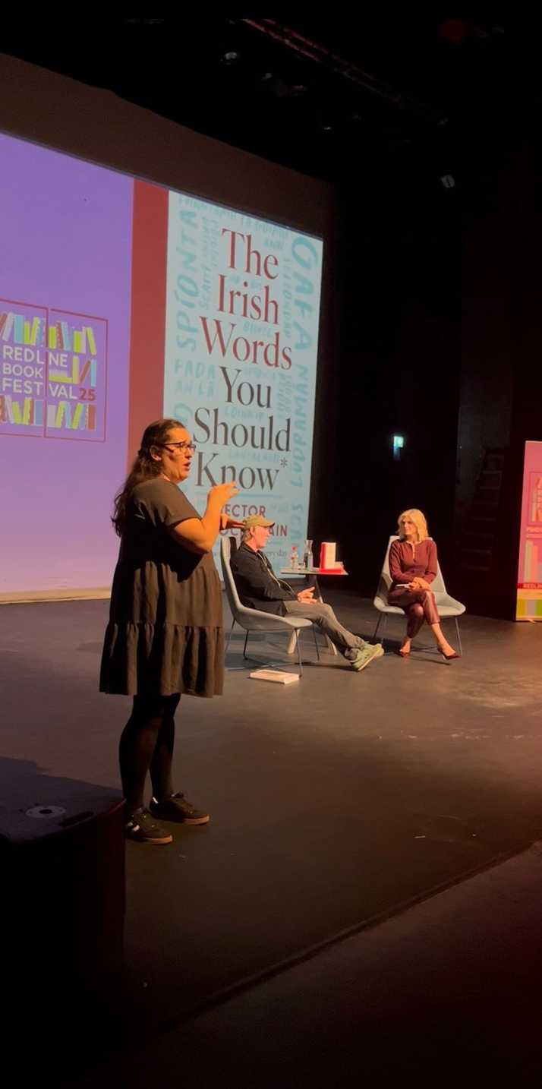
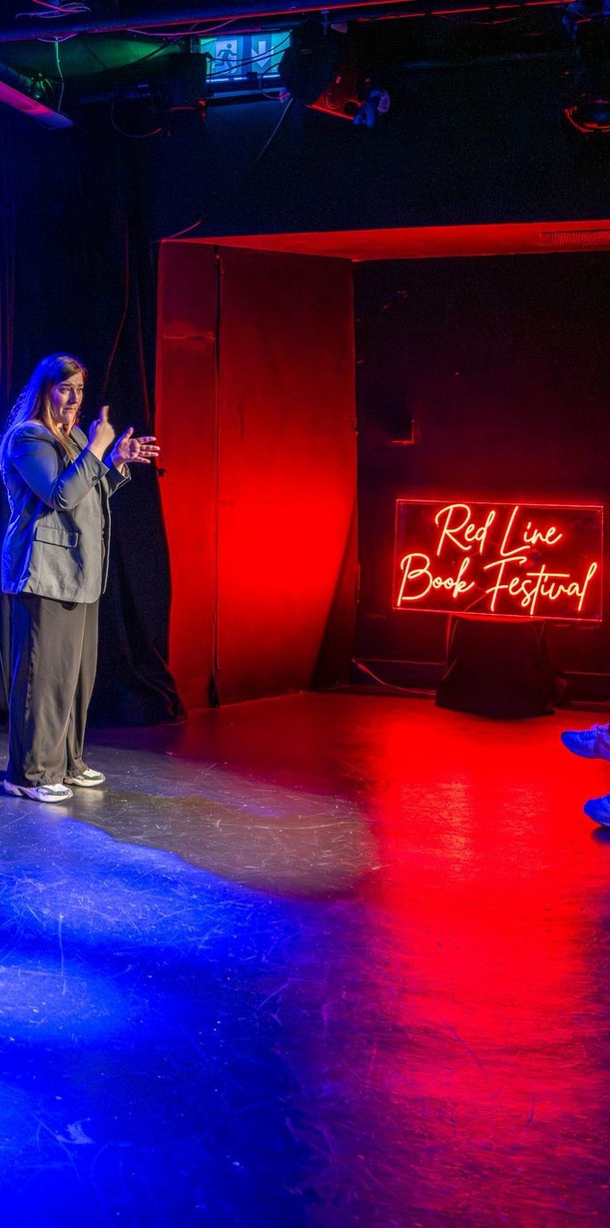
Accessibility
Irish sign language played an important part in increasing accessibility for this year’s festival.
ISL interpretation was provided for 4 main events in the Civic theatre and Rathfarnham Castle.
Feedback for provision of this service was excellent, both from attendees and event participants. We aim to increase the provision of ISL to more events in 2026.

Slide 14
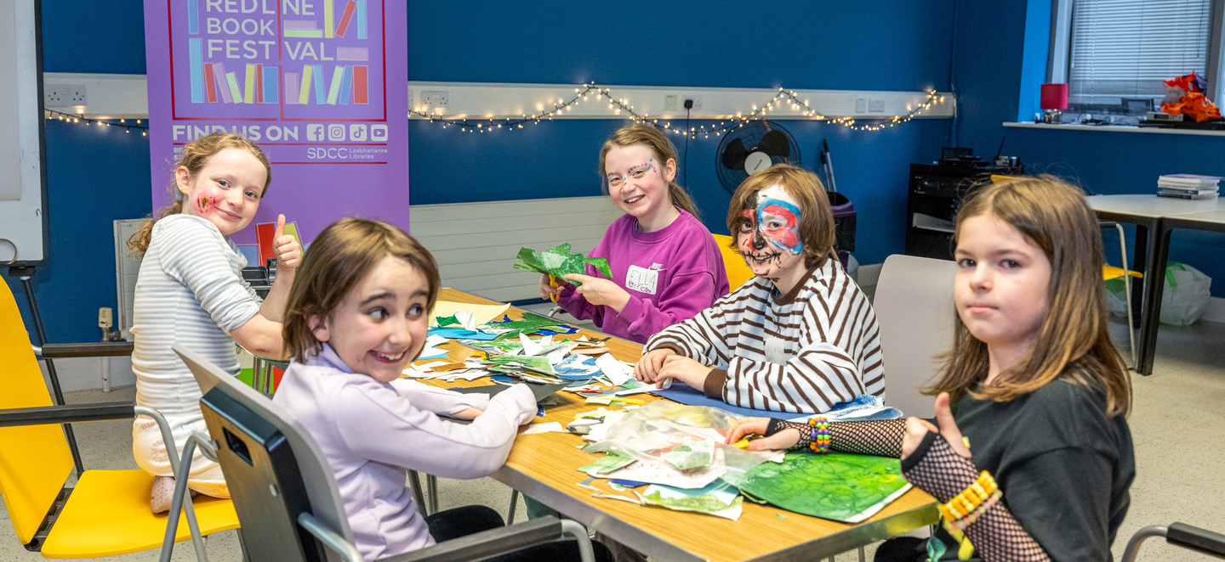
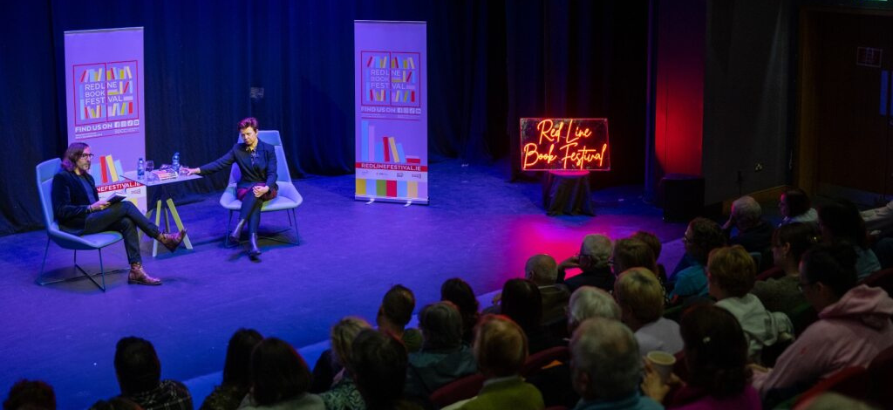
Engagement and Participation
There were 45 events delivered across 12 venues for the 2025 festival. 17 events booked out.
Total attendance was approx. 5,500 people, a 10% increase on 2024.
Social media engagement increased by 31% on select channels. Follower numbers increased by 23%.
Media engagement was significant in 2025, with festival coverage appearing in national outlets including Newstalk, the Sunday Independent, the Irish Times, the Journal and RTE.ie

Slide 15
Thank you

