Slide 1
South Dublin Local Economic and Community Plan 2024-2030
social, Community, Equality & Integration Spc

Slide 2
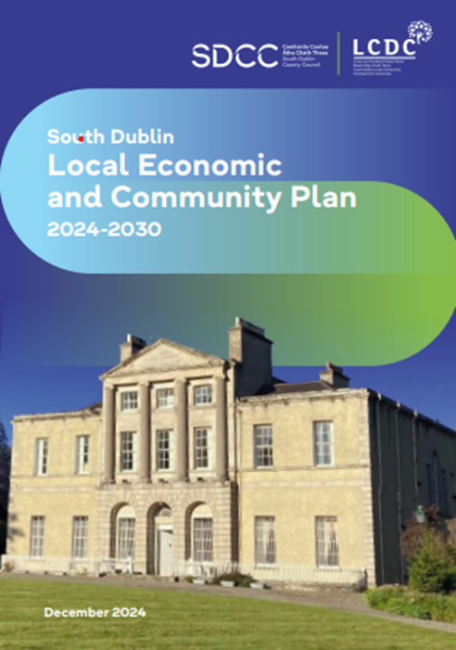
The South Dublin LECP 2024 – 2030 is a 6 year statutory plan prepared by the LCDC in conjunction with the Economic, Development, Enterprise & Tourism SPC and was adopted at the December 2024 Council meeting.
The LECP is structured around 6 High Level Goals supported by objectives and underpinned by 120 actions.
It integrates both economic and community objectives aligning with social inclusion, enterprise growth and sustainable communities.
The LECP has been aligned with local, regional, national and international frameworks e.g. South Dublin County Development Plan, UN Sustainable Development Goals.

Slide 3
High Level Goals
Goal 1: For the County of South Dublin to become a better place in which to live and work.
Goal 2: To improve the physical and mental health of those living and working in South Dublin.
Goal 3: Increase access to education, upskilling and lifelong learning to further meet the social and economic needs of residents and employers now, and into the future.
Goal 4: Fairness, collaboration and innovation to be at the core of South Dublin’s transition to becoming a low carbon County.
Goal 5: Empower communities through SMART initiatives and skills development to help make their areas better places in which to live, work and visit.
Goal 6: For society within South Dublin County to be more inclusive, equitable and welcoming of diversity

Slide 4
Actions & Implementation
There are 120 Actions listed under the 6 High Level Goals.
To effectively manage the LECP, a two year implementation plan of priortised actions is embedded to ensure progress is monitored.
Examples of the actions are:
Objective 1.1 (Housing) KPIs include number of homes at design/planning/construction, actions delivered from the Traveller Accommodation Plan
Objective 1.2 (Safer Place) A comunications campaign on domestic and gender based violence and increase Garda Clinics.
We are currently investigating IT systems to assist action holders in reporting progress on their assigned actions and to reduce the administrative burden for both stakeholders and staff.
Update reports will be presented to the LCDC twice a year and we are currently collating information from stakeholders.

Slide 5
Thank You

