Slide 1
Community Dept Capital Project Updates
social, Community, Equality & Integration Spc

Slide 2
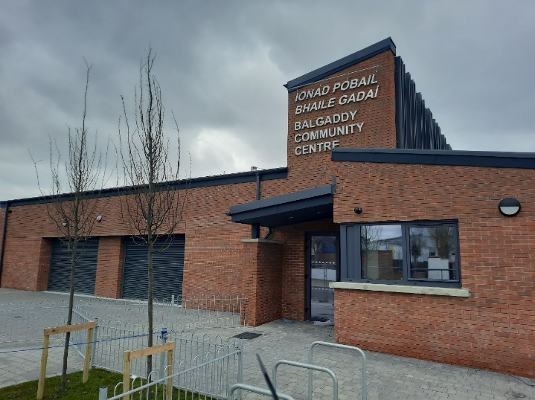
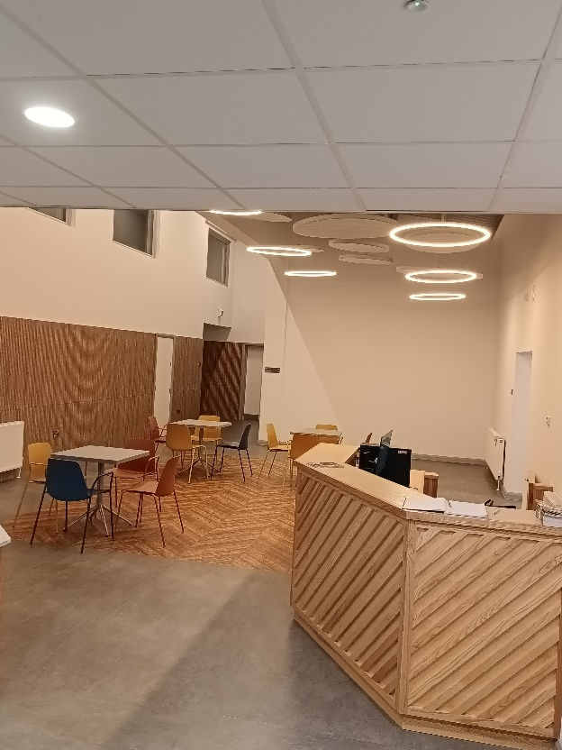
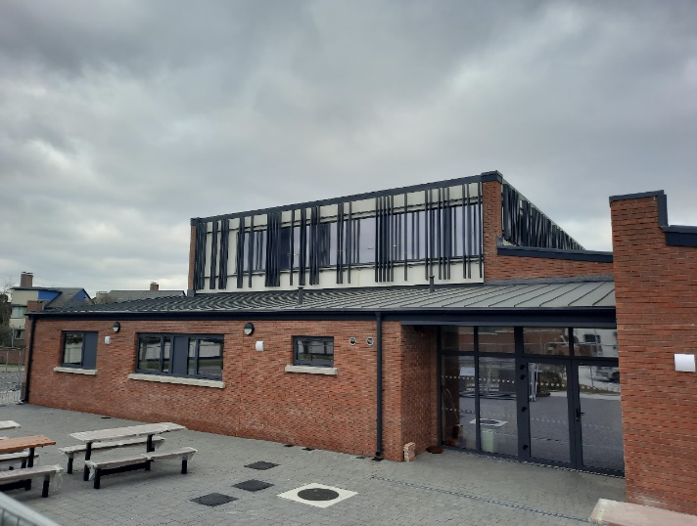
Balgaddy Community Centre
Building construction completed and handed over to the Council on the 7th of July
Regional Board established to manage the Balgaddy, Neilstown and Rowlagh Community Centres
Temporary Centre Manager employed to oversea initial establishment of the centre, with a range of activities and services to meet local needs now being introduced

Slide 3
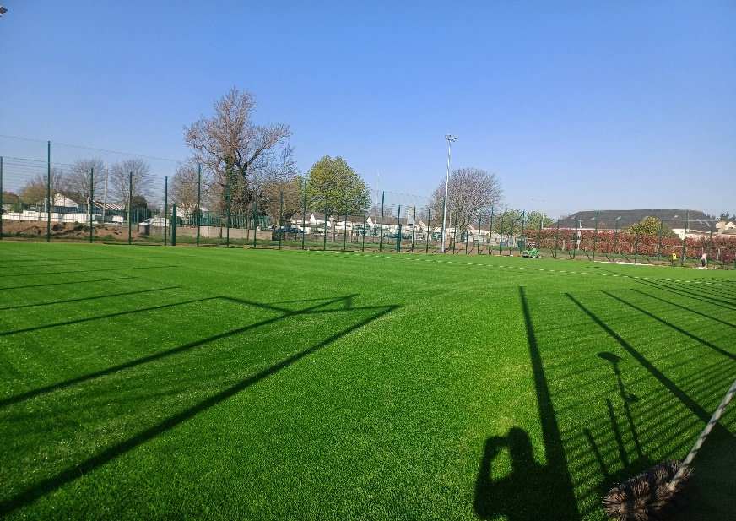
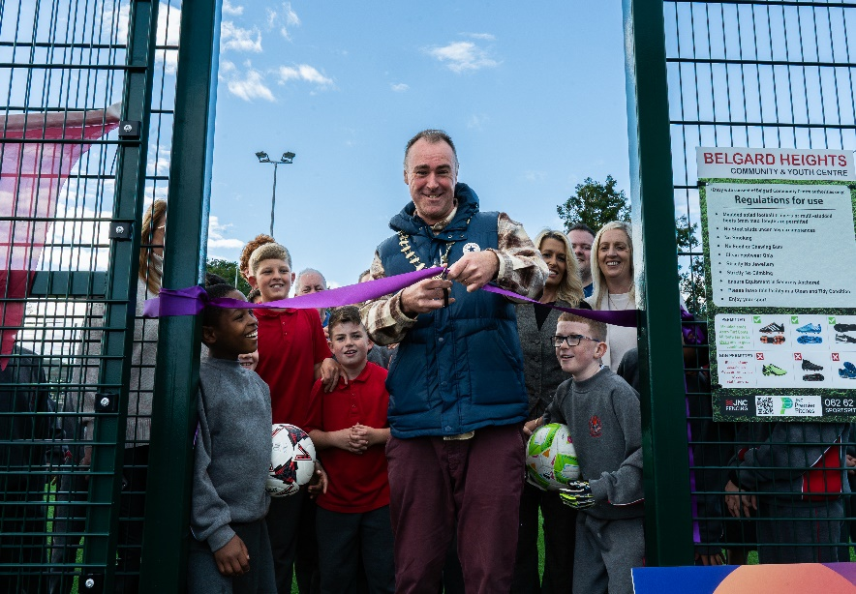
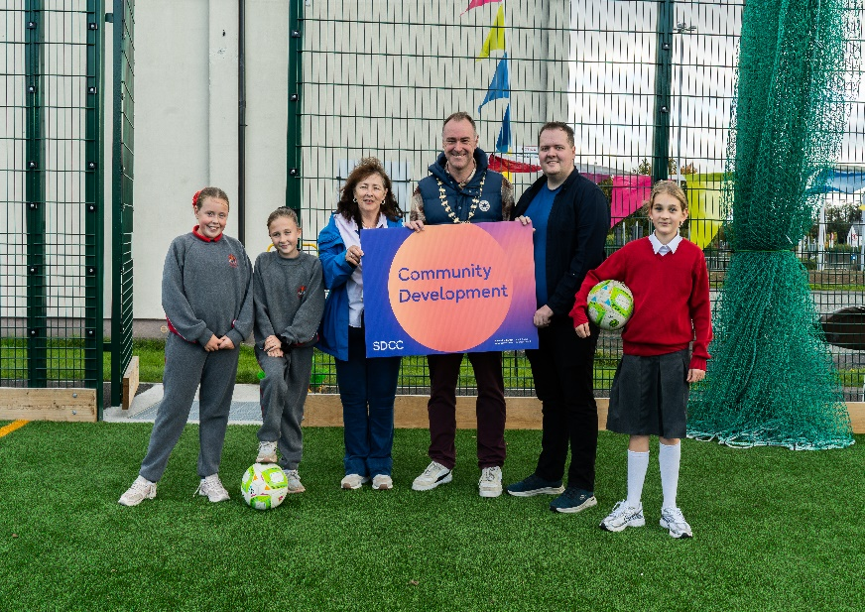
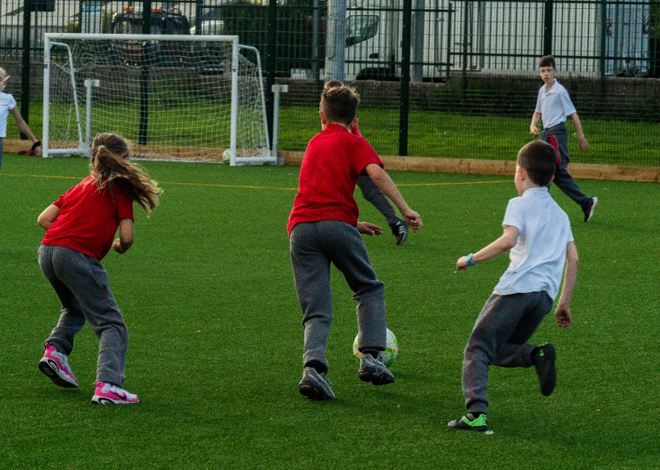
Belgard All-Weather Pitch
All Weather pitch completed and handed over to the Council on the 3rd of June
Management Licence Updated with the Belgard Community Centre Board to include the management of the All-Weather Pitch
Pitch officially opened by the Deputy Mayor Cllr Trevor Gilligan on the 30th of September

Slide 4
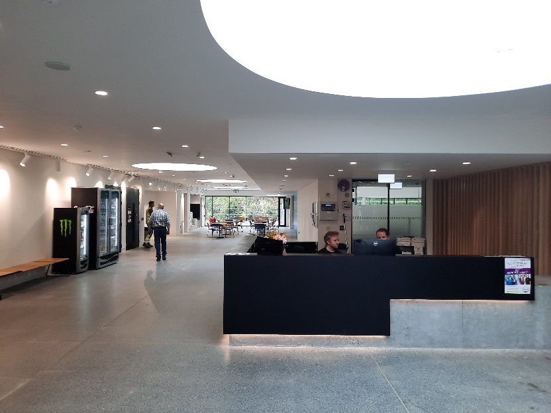
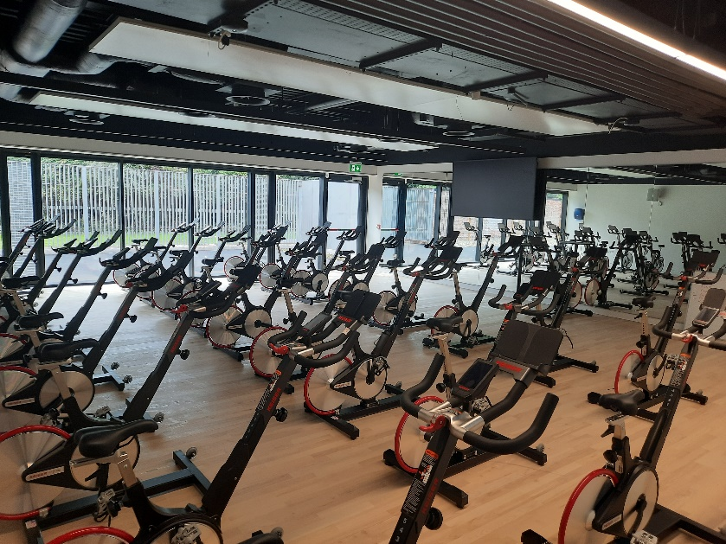
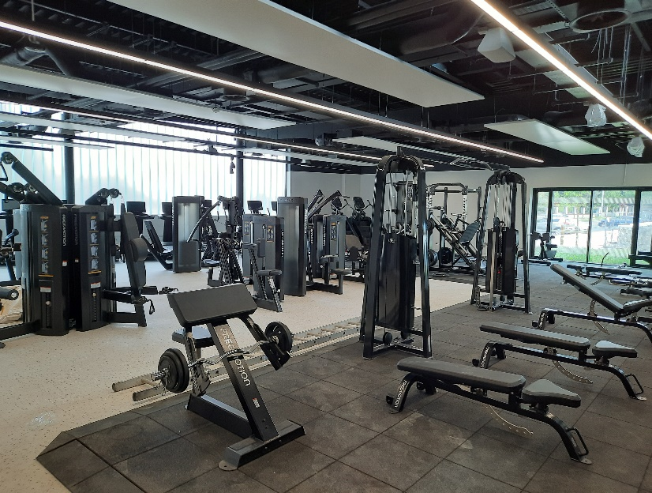
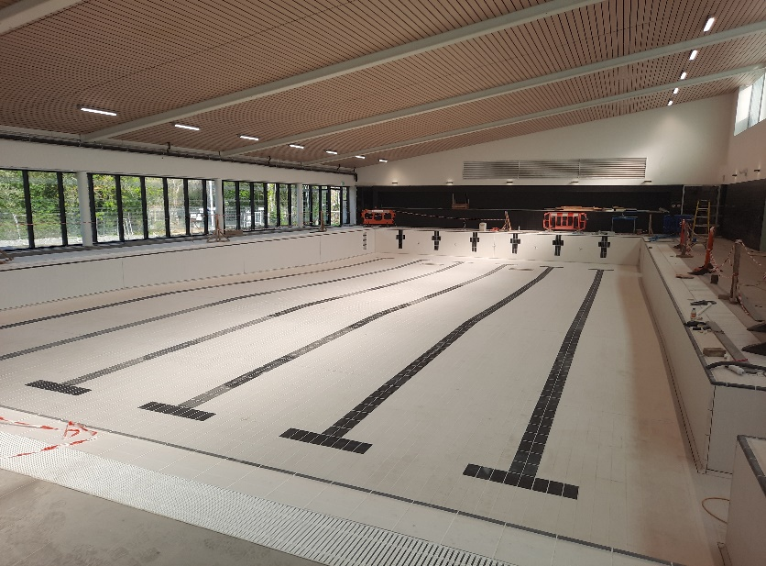
Lucan Swimming Pool
The Dry Side (Gym and Activity Rooms) opened to the public on July 28th and feedback from operator and facility users has been very positive.
The contract with PJ McLoughlin was terminated on August 22nd and an interim contractor appointed to progress works in the short term while a tender for a new contractor was issued.
The tender processed is now complete and a contract is being issued to the new contractor.
An update on the final completion programme will be determined once the new contractor is in place.

Slide 5
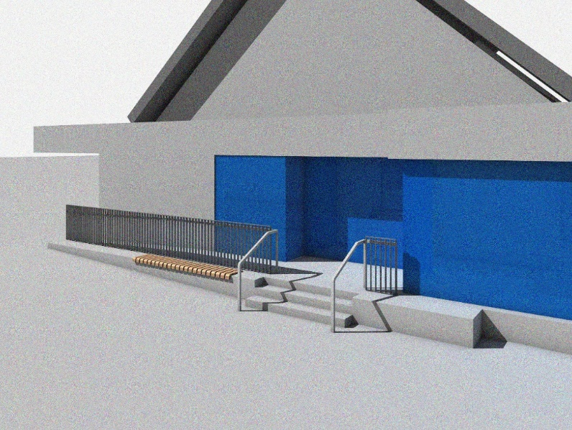
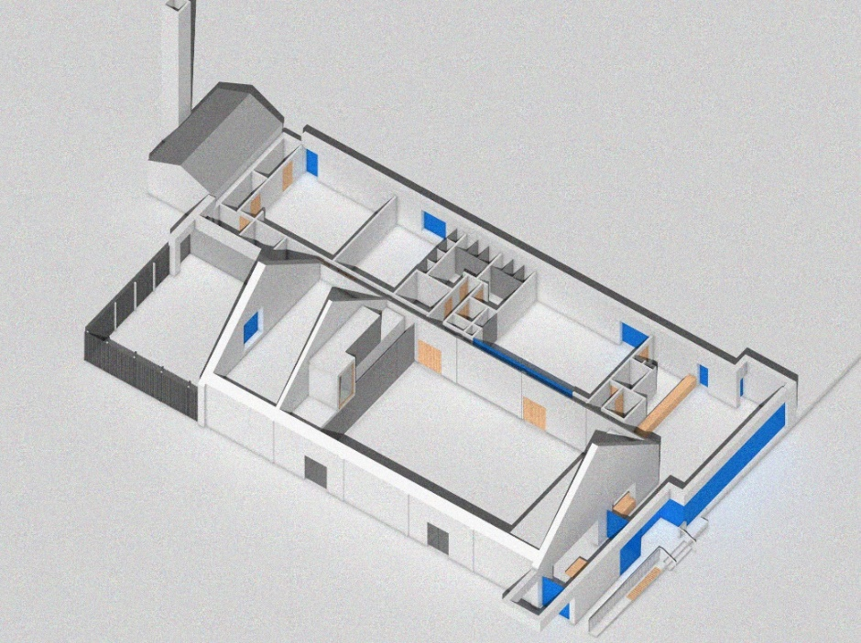
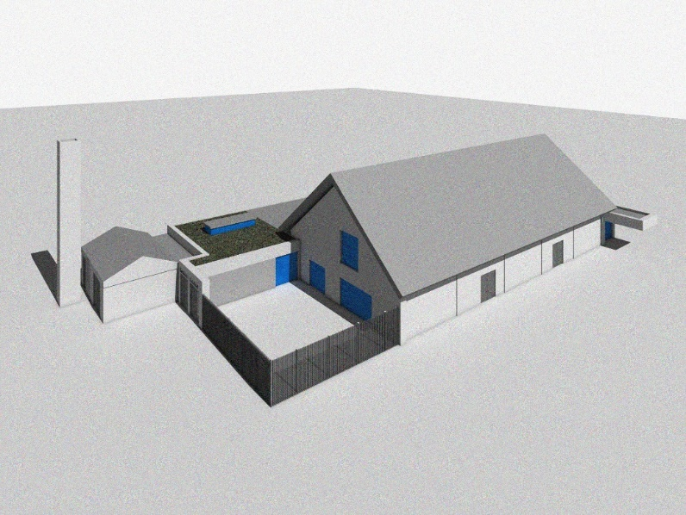
Ballyroan Community & Youth Centre
Part 8 Report was approved at the September Council Meeting
Location of bin storage being reviewed following onsite meetings with Men’s Shed
Architectural Services now developing package in order to progress to tender, with aim of having construction works started on site in Q2 2026
Construction Programme duration estimated to be 9 months

Slide 6
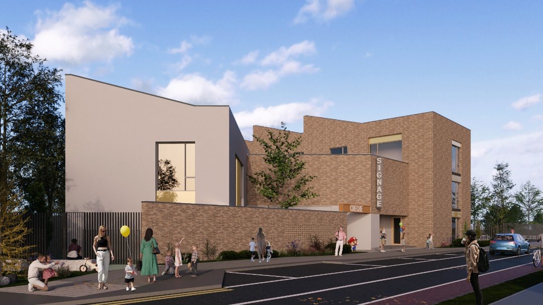
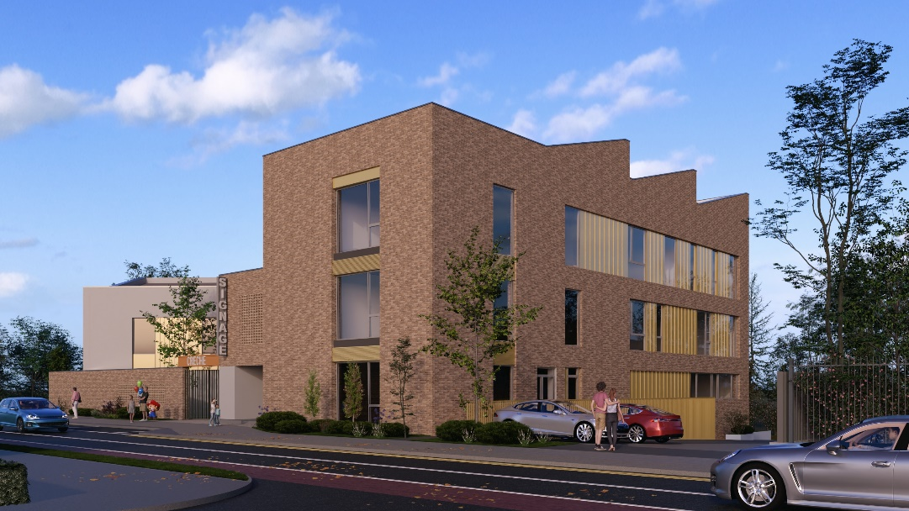
Citywest Community Centre
Planning Application has been submitted by the Developer seeking planning permission for revised Community Centre and Creche, designed in conjunction with Architectural Services and Community Depts.
Planning Application due for decision on 12th of November
Aim to commence construction works in Q1 of 2026, with an anticipated full completion of the building Q4 2027

Slide 7
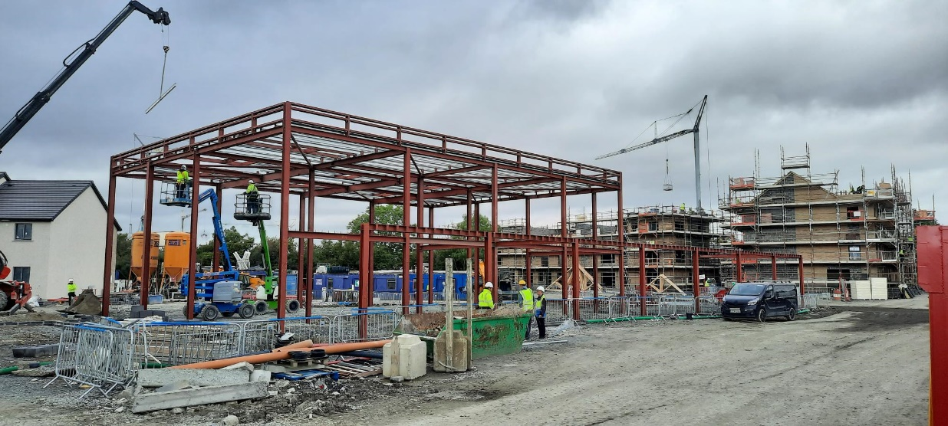
Kilcarbery Community Centre
Construction works on phase 1 shell and core of the building commenced on site in April.
Anticipated these works will be completed in Q1 2026.
ASD currently progressing tender package for phase 2 concerning the fit out works for the building.

Slide 8
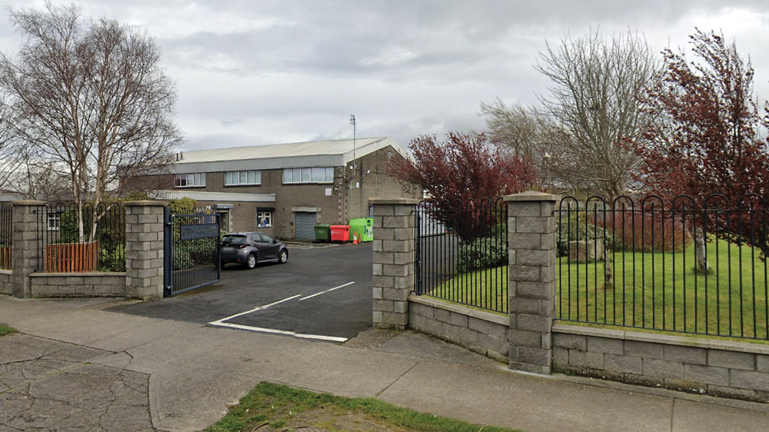
Jobstown, Newcastle, Citywest Youth Facility, Whitechurch Sports Facility
Jobstown Community Centre: Architectural Services working on a tender package for major upgrade works following recommendations from a Fire Safety Audit. Works scheduled to commence in Q1 2026.
Newcastle Community Centre: Discussions ongoing with Planning and Developers to develop a delivery proposal.
Citywest Youth Facility: LDA as property owner have been advised by Planning Dept that a planning application for change of usage is required for the facility. SDCC will fit out and arrange provision of youth facility, subject to above being granted.
Whitechurch Sports Facility: Designs have been revised inline with budget and are awaiting business case approval ahead of going for Part 8 public consultation.

Slide 9
Thank you

