Slide 1
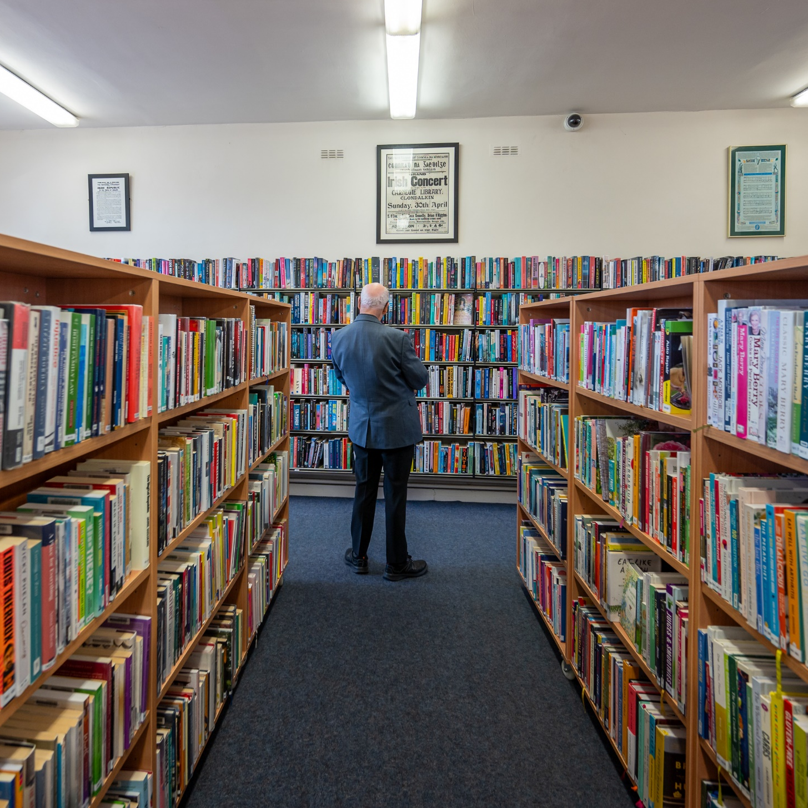
Clondalkin
& Mobile Libraries
ACM Report October 2025

Slide 2
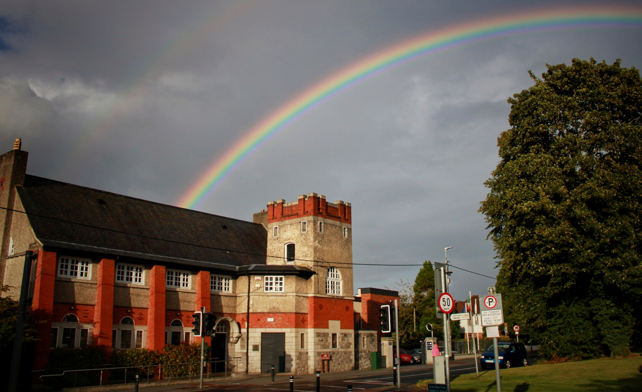
Statistics
October 2025
6455 Visitors
3116 Issues
151 New Members
Image: Richie O’Sullivan

Slide 3
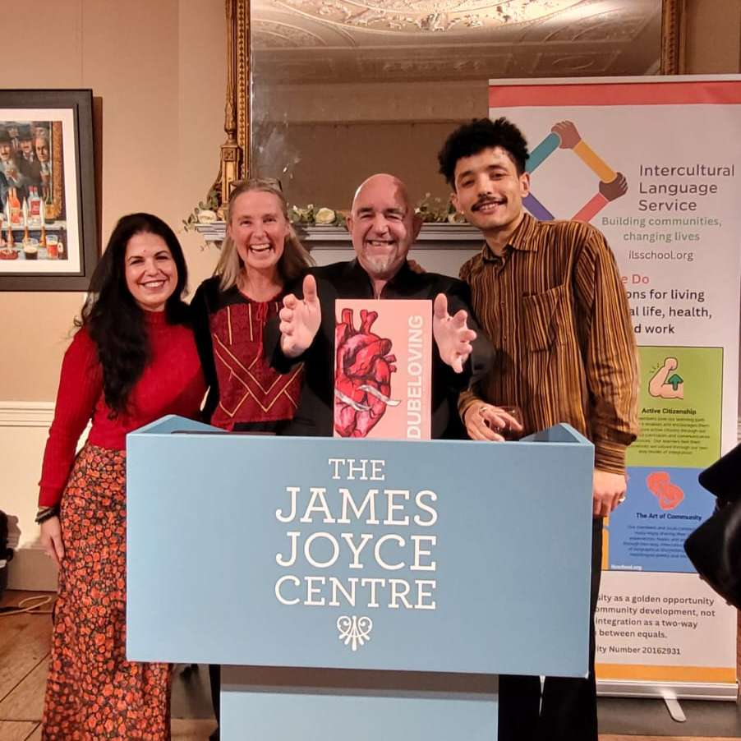
Intercultural Poetry
Clondalkin Library staff member Maria recently attended the lauch of Poetry Anthology Dubeloving at the James Joyce Centre.
Dubeloving is ‘an anthology of plurilingual poetry curated by poets Fiona Bolger and Rafael Mendez, as part of the Intercultural Language Service workshops founded by linguist Peter Sheekey, which promote community-building and creative collaboration.
We’re especially proud that three of the intercultural poetry workshops leading to this collection took place at Clondalkin Library in 2024–2025.

Slide 4
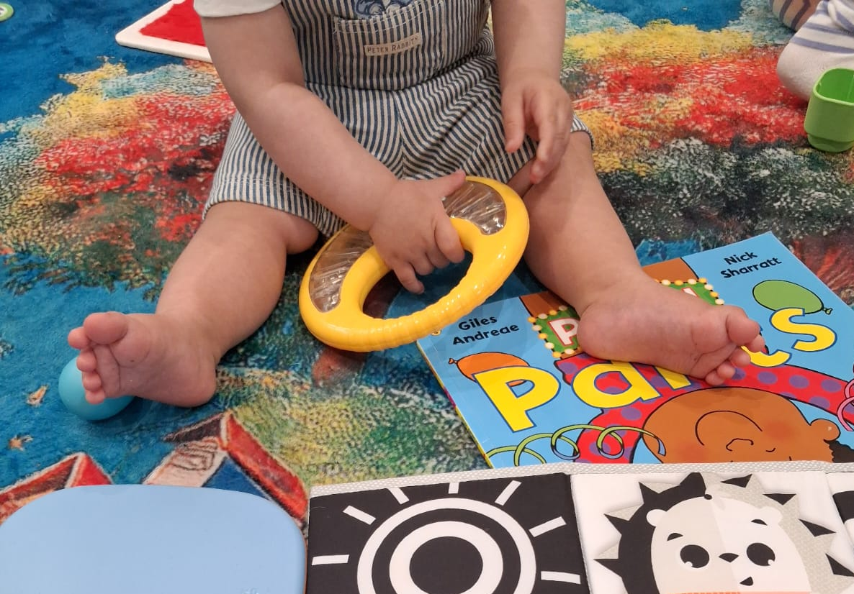
PEEP Playgroup
The Peep Learning Together Programme helps parents, carers and practitioners make the most of the learning opportunities in everyday life, supporting their babies' and young children's learning through play.
Over six weeks trained facilitators from Blue Skies worked with 11 families to play, learn and build connection.
When asked what they enjoyed about the sessions parents said:
Social interaction with other children and adults. Variety of toys, instruments, sensory activities, songs and stories.
Other parental interaction and support in a safe and supportive environment.
Seeing my child enjoying themself while having another opportunity to participate in social music, story & sensory activities with peers.
Its so inclusive and all very natural
Clondalkin Library will host another block of 6 sessions in November / December with new families and we’re hoping to continue to build on the success with more sessions in 2026

Slide 5
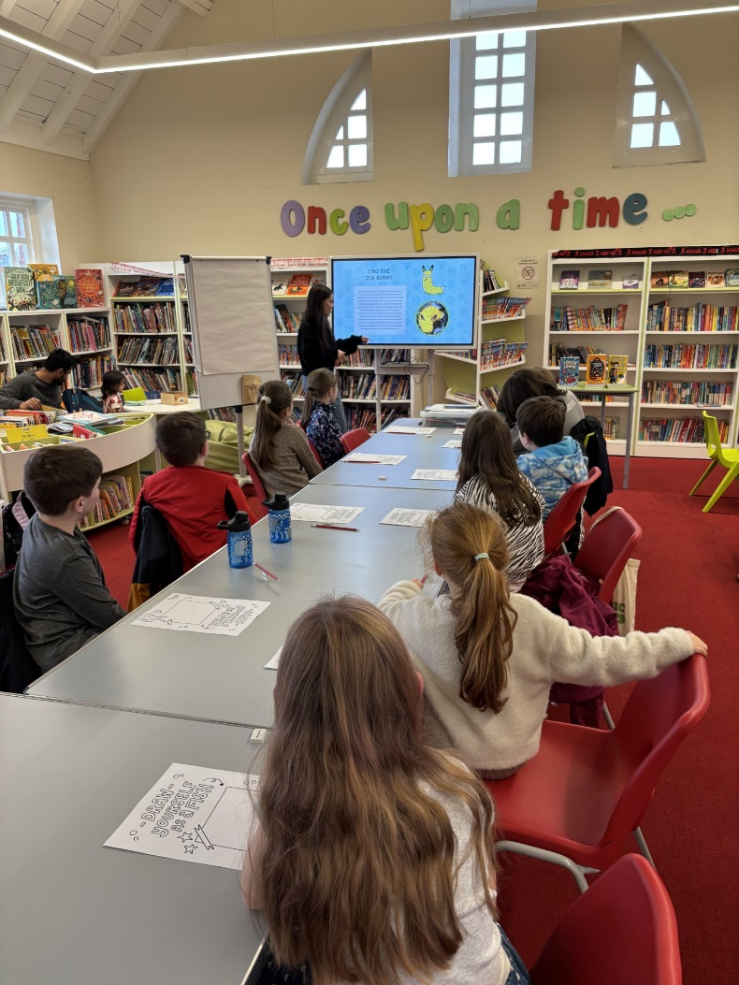
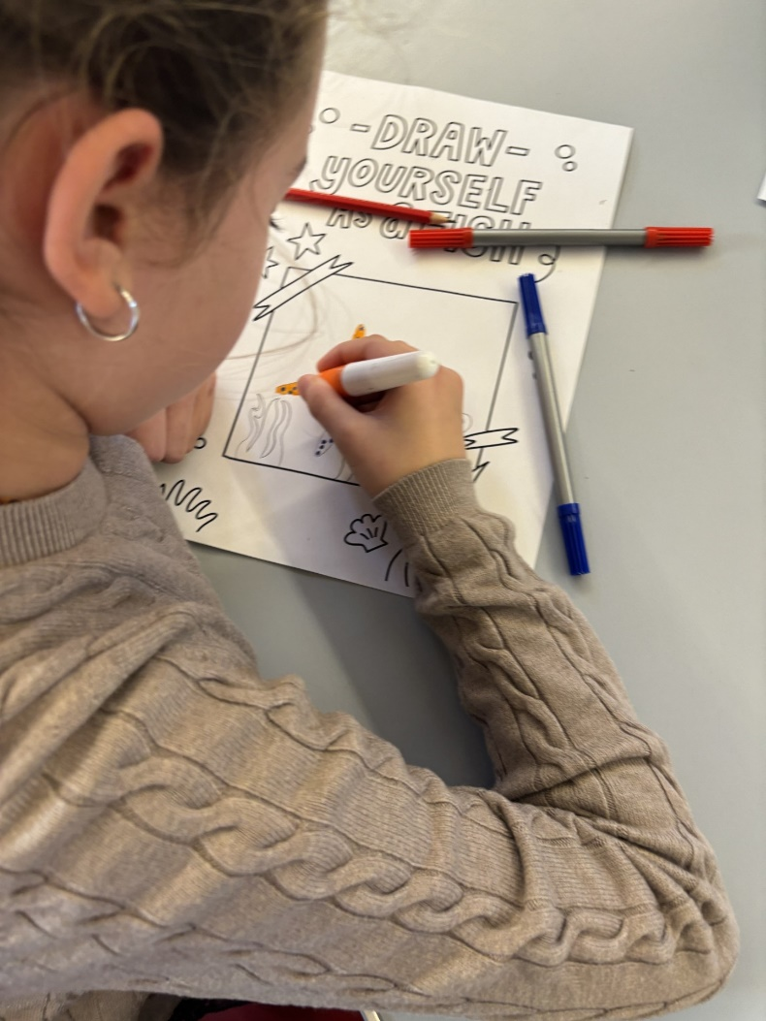
Mid Term family activities
During the October mid term Clondalkin Library had a busy week full of family events including:
Halloween Storytime
Arts and Crafts
Draw-a-Long with Aoife Dooley
Knight for Hire
Board Games Club
Halloween scavenger hunt
Lego and Duplo freeplay
3D printer drop-in sessions

Slide 6
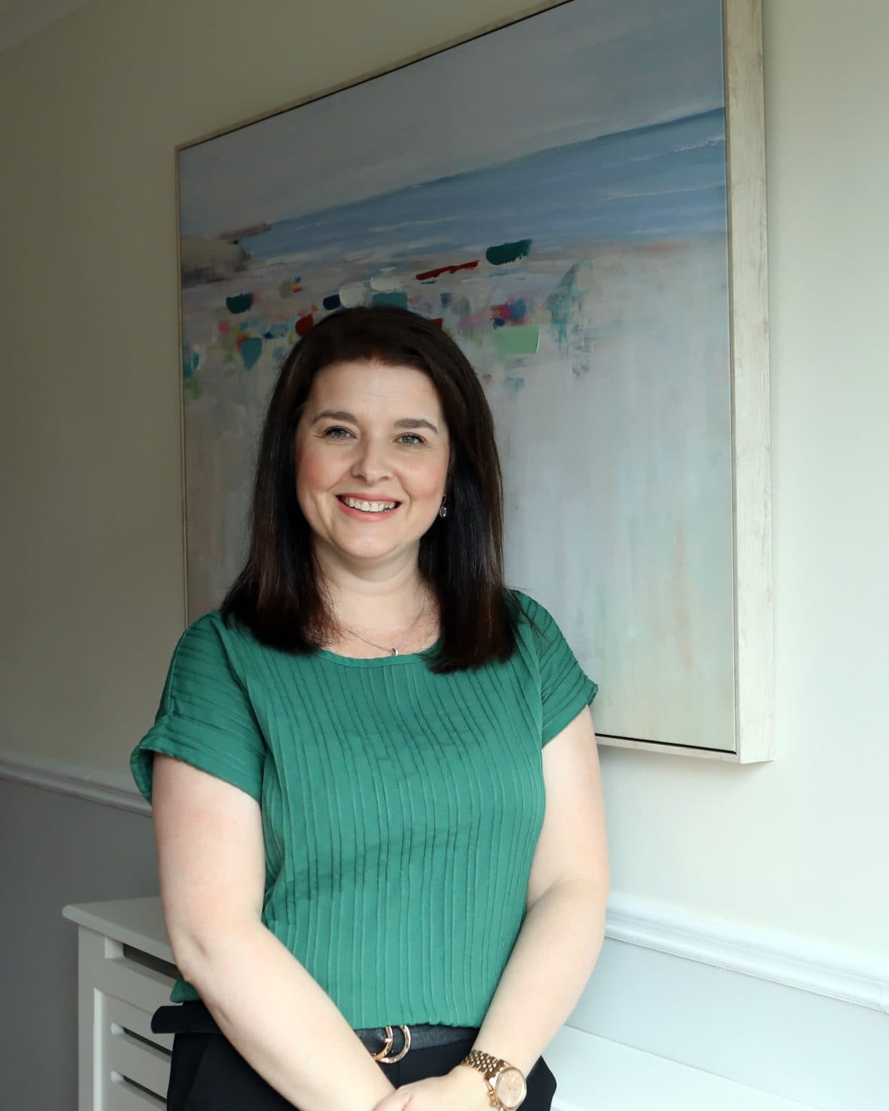
Neurodiverse South
As part of our Neurodiverse South programme Clondalkin Library hosted the following talk on 5th November
‘Supporting your child with Anxiety’
Is your child struggling with worries that leave you both feeling overwhelmed? Maybe you're not sure how to respond?
In this empowering and practical talk, Melissa Moore, Award winning Play Therapist, Parent Coach and mum of three, will guide you through how to truly understand your child’s anxiety, what’s happening in their brain and body, and how to respond in ways that calm rather than escalate.

Slide 7
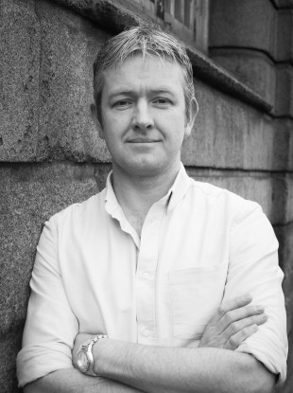
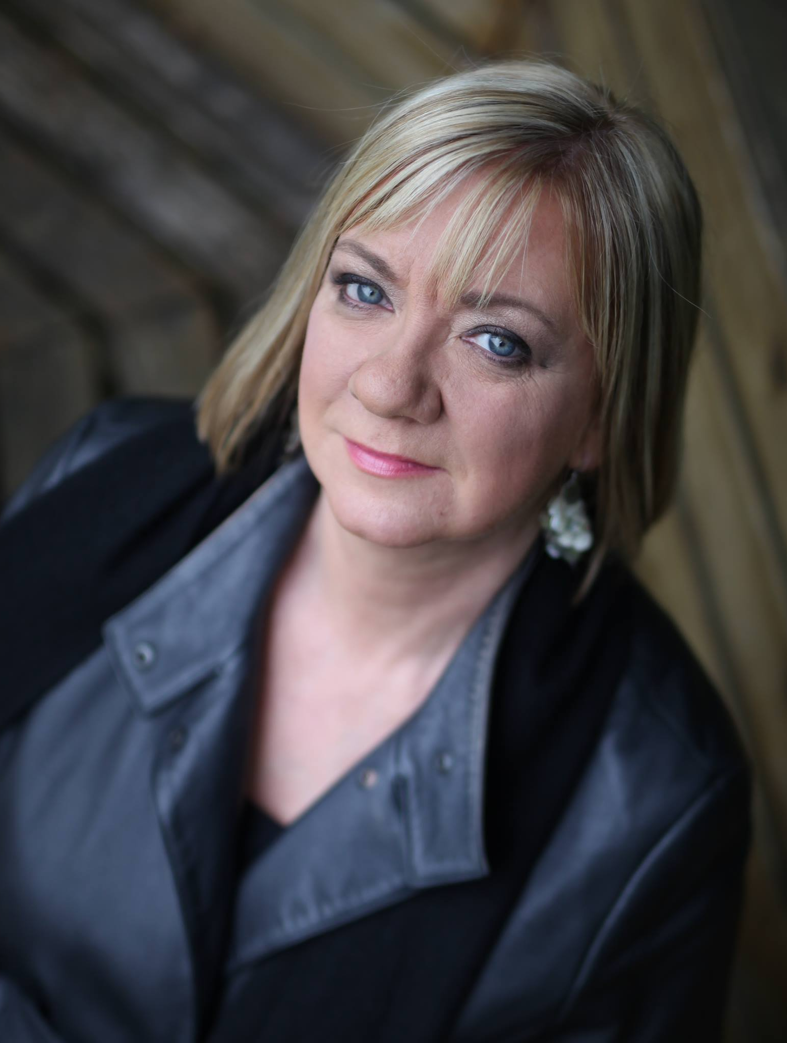
Creative Writing for Adults
In November Clondalkin Library is focusing on Creative Writing.
Creative writing- 2 part workshop with Louise Phillips
12th & 19th November
Dublin-born crime author Louise Phillips is an Irish Times bestselling author of six crime novels, five of which were shortlisted for the Best Irish Crime Novel of the Year in the Irish Book Awards. Her second novel, The Doll’s House, won the award.
‘Spit It Out’ Poetry workshop with Colm Keegan
20th November
Colm Keegan is an award winning Dublin poet, an acclaimed playwright, and one of Ireland’s leading writing facilitators, empowering new voices and inspiring creativity for individuals and organisations throughout Ireland.

Slide 8

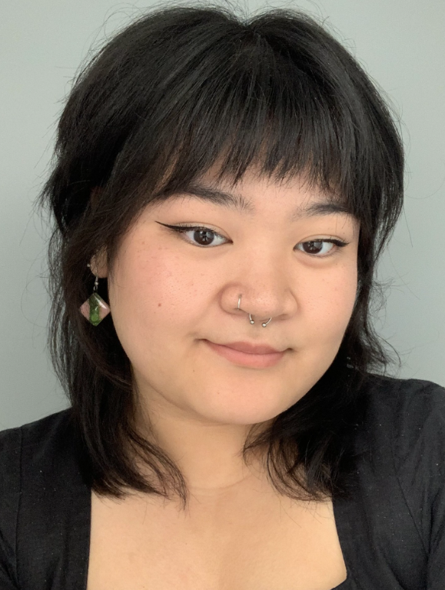
Clondalkin Comics Fest
Clondalkin Library and North Clondalkin Library are collaborating on a programme for Clondalkin Comics Fest this November. Bringing opportunities for our borrowers to explore the ever-growing collection of graphic novels, manga and comics available in their local library.
Digital illustration – 4 week course for age 9-12
Illustrator Karen Harte will pay a visit to our monthly Comic Book Club and talk to them about being a professional illustrator
Zine Making Workshop
Kate Escolin will introduce a secondary school group to the world of Zines and help them to design and make their very own zines.

Slide 9

Science Week 2025
South Dublin Libraries is celebrating Science Week 2025 from 10th – 16th November
Anyone 4 Science will deliver 4 x primary schools workshops at Clondalkin Library:
Colour Families for Junior infants – 1st Class
Geodesic Dome constructions for 5th & 6th Class
We will also host ‘The Secrets of Superhero Science’ family fun show on 15th November.
Dr Barry Fitzgerald will explain the real life science behind our favourite superheroes and their powers. Discover the science behind the flying Iron Man suit, the real-life scientists trying to make artificial spider silk, the technology that can turn you invisible and lots more besides.

Slide 10
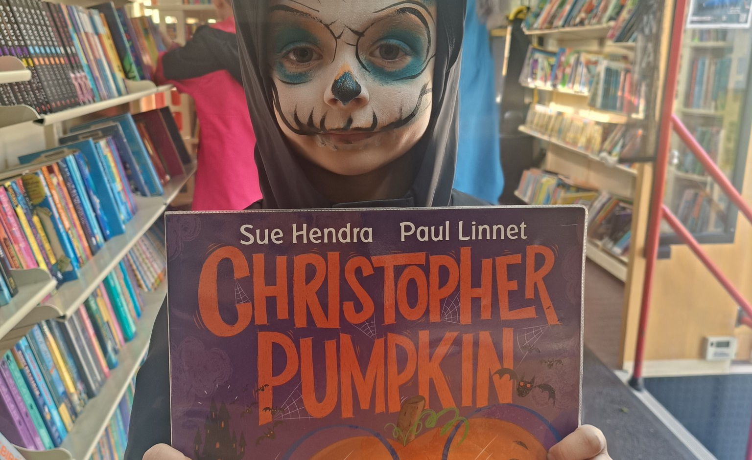
Mobile Libraries
Mobile libraries continue the schools service in November with
visits to 21 schools Monday to Friday
and
32 public stops 2.30pm to 7.30pm Monday to Thursday.
There will be 85 deliveries to the Library at Home patrons.

Slide 11
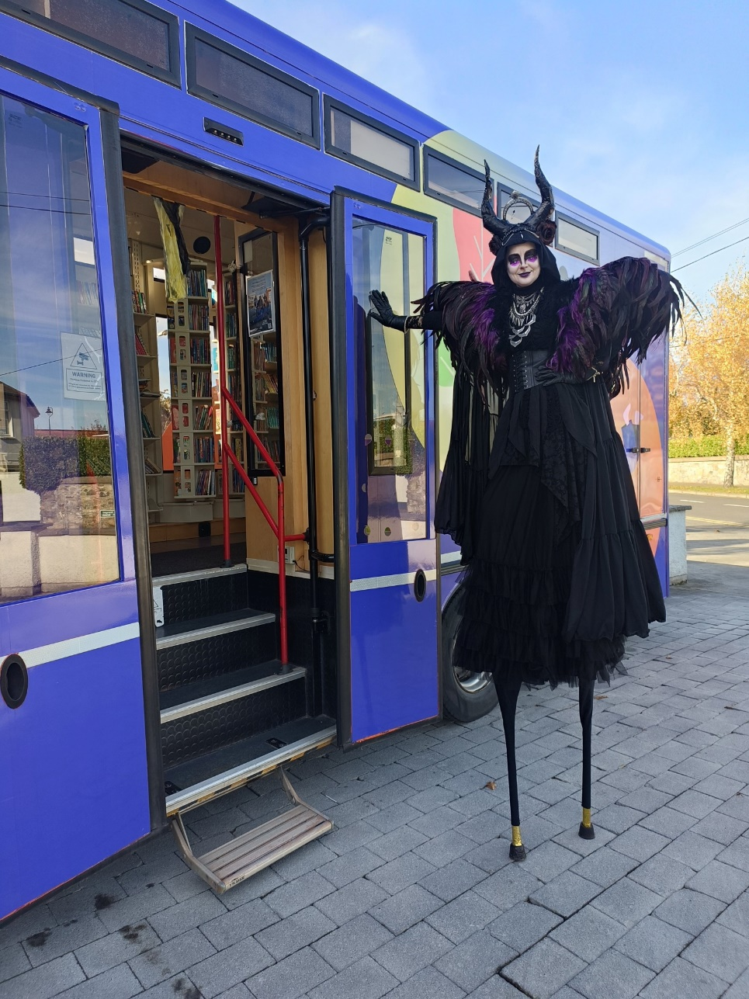
Mobile Libraries Highlights
The monthly visit to Bloomfield Health services is on Saturday 1st November at 3pm.
Sunday 2nd November, mobiles provided a quiet space at the Spookdalkin event at The Round Tower in Clondalkin.
There will be 2 visits to Early Learning Centres in November - An Cosan Preschool in Fettercairn on 6th Nov and the preschool at Firhouse Community Centre on 27th Nov.
17 creches will be visited as part of the creche lending service ton the 3rd and 17th of November
Our second visit to the homeless service at Finnstown House in Lucan will be on Saturday 15th November.

Slide 12
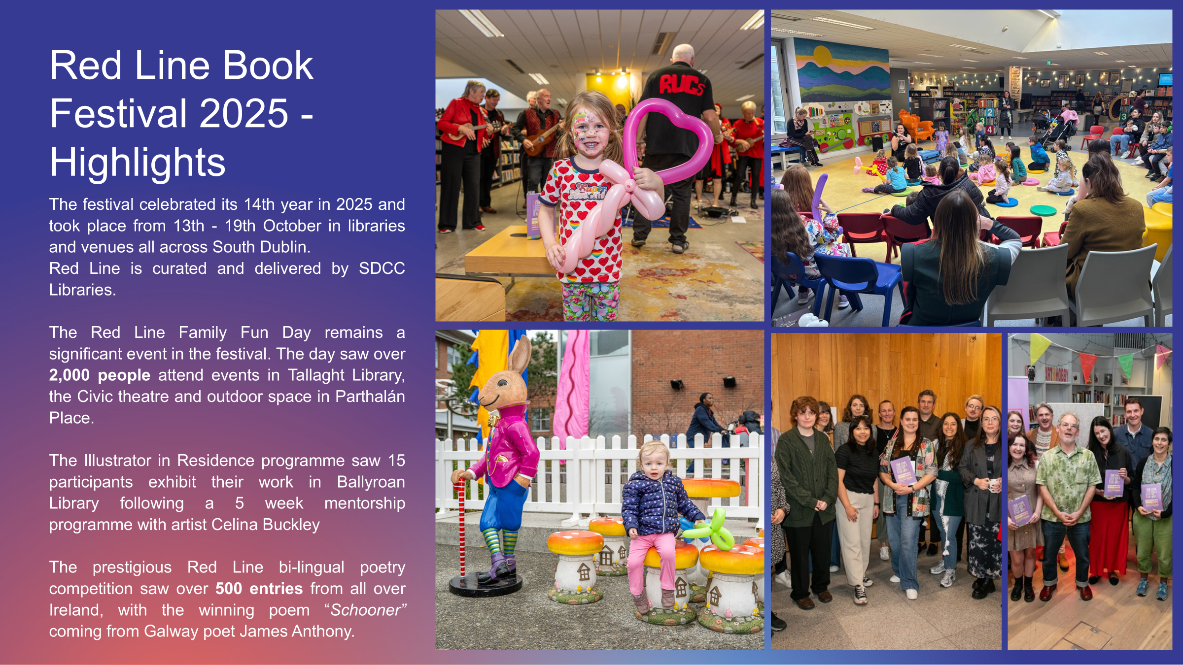

Slide 13

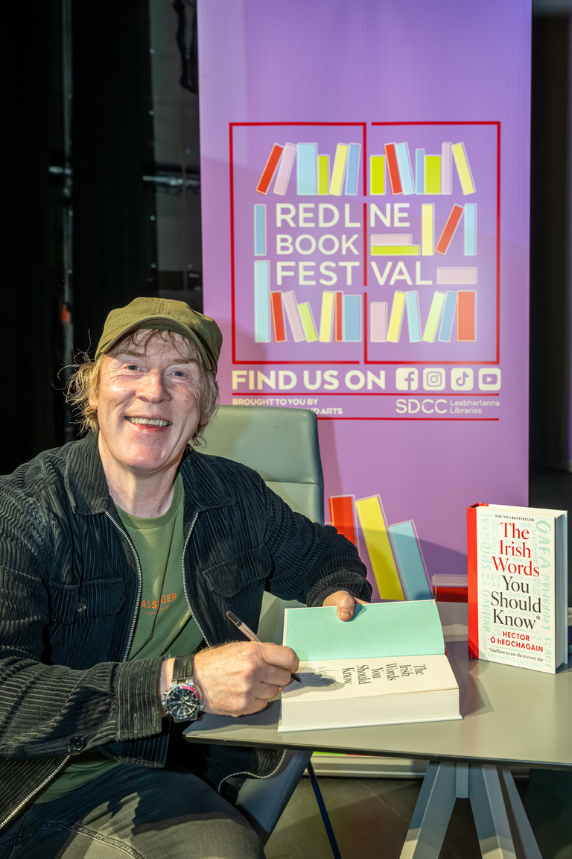
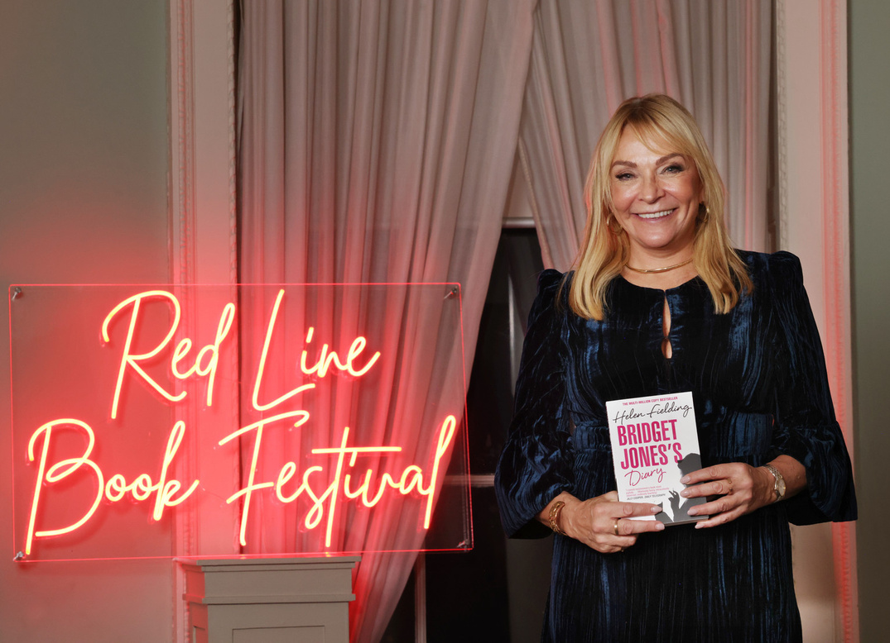


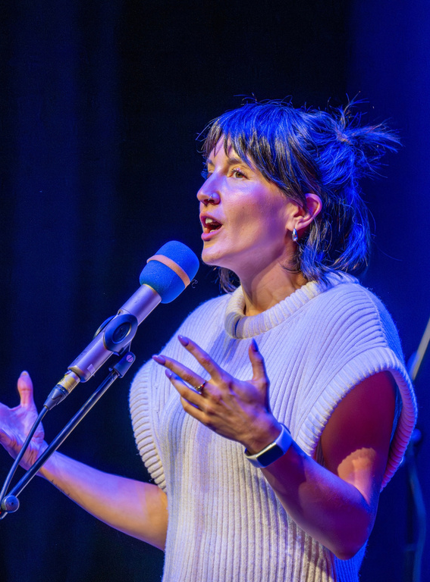
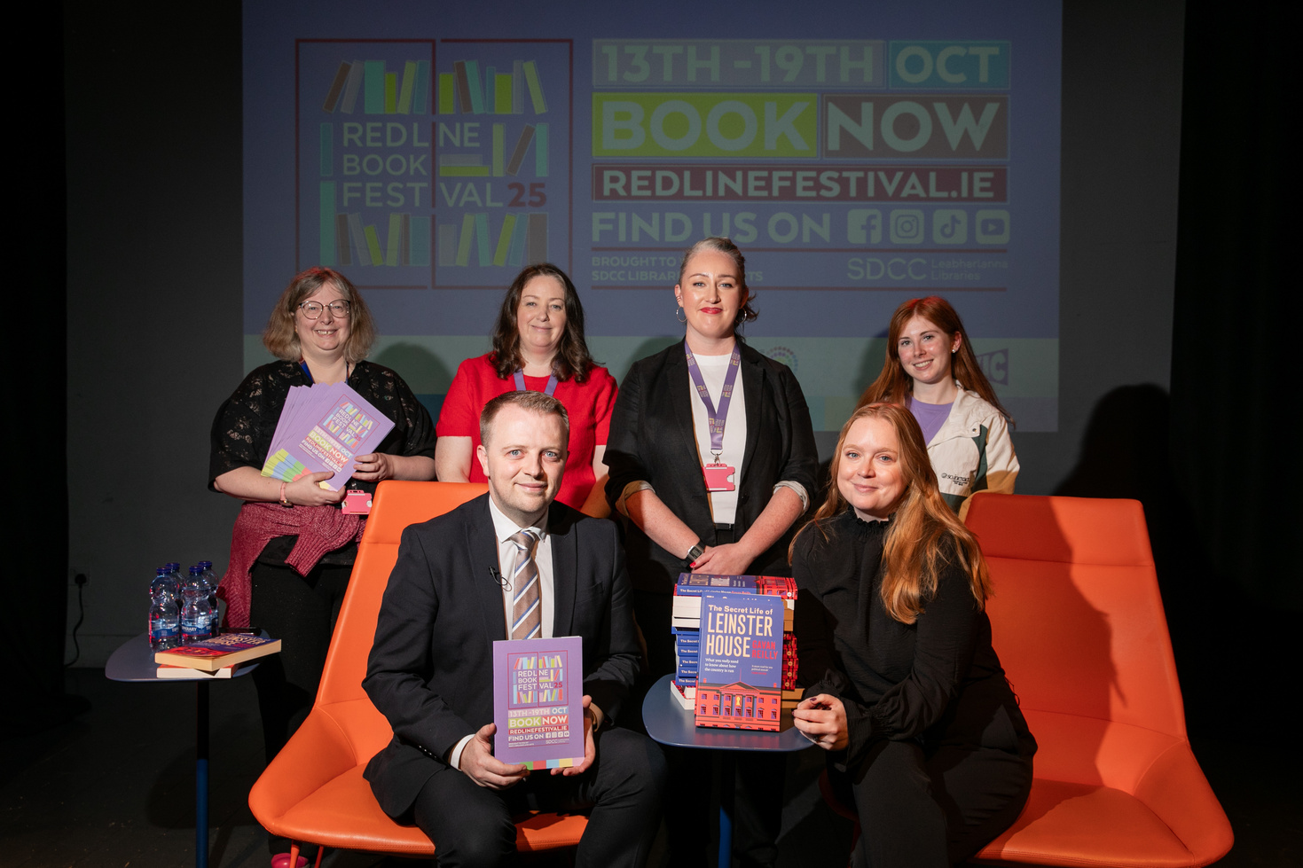
Festival Highlights
The festival lineup featured a host of national and international authors, while also platforming local and emerging writers.
Bridget Jones creator Helen Fielding spoke to a sold out audience in Rathfarnham Castle, interviewed by Tallaght native Vicky Notaro.
Gavan Reilly and Jennifer Bray enthralled a sold-out crowd in Rua Red with tales of Leinster House
Irish language author and advocate Hector O’Eochagáin in conversation with presenter Muireann O’Connell brought the banter to a packed out Civic theatre
The End of the Line: A Spoken Word Celebration featured 10 acclaimed poets from across Ireland in a rousing closing event to the festival

Slide 14
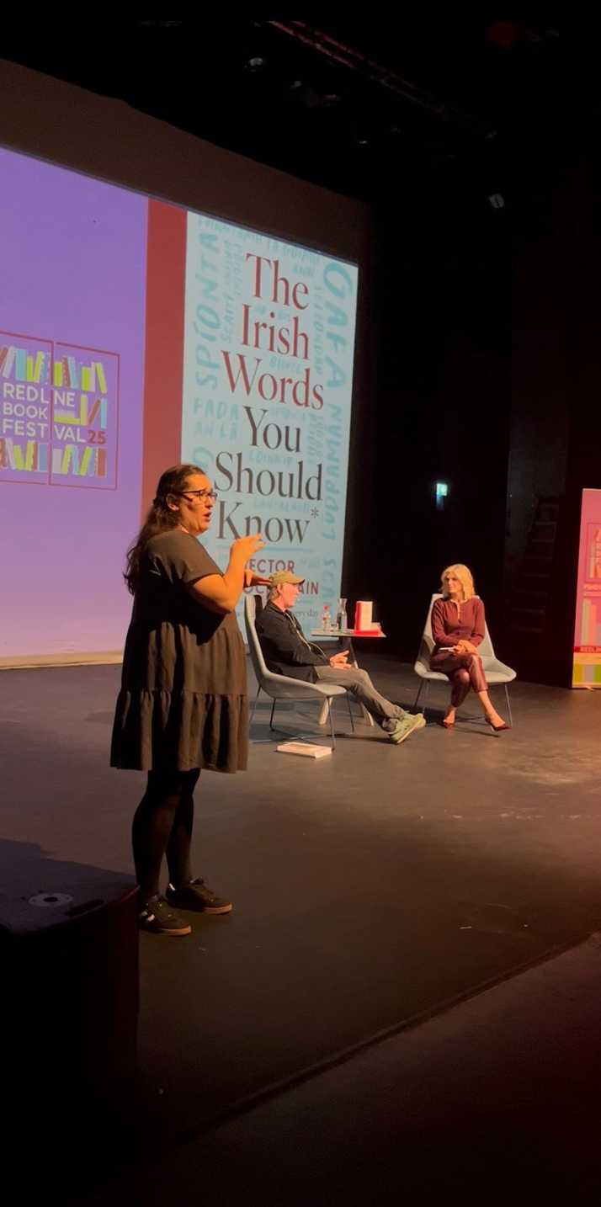
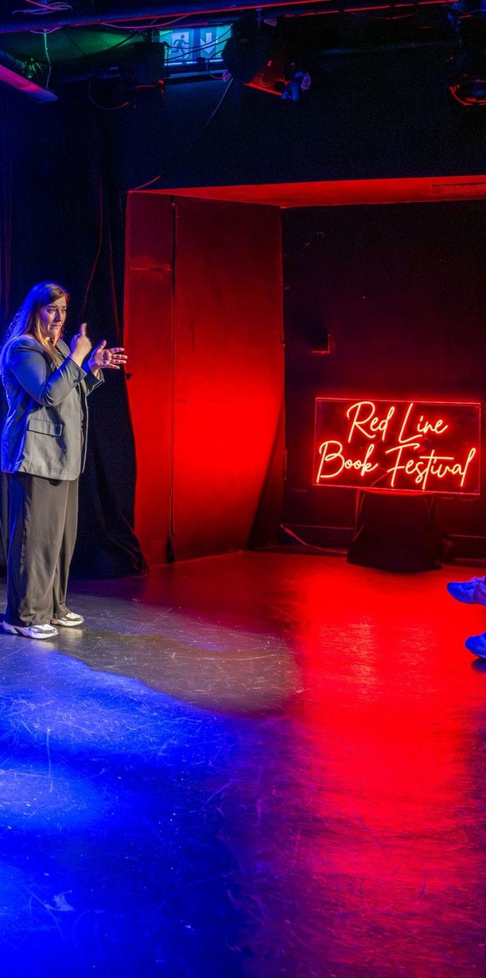
Accessibility
Irish sign language played an important part in increasing accessibility for this year’s festival.
ISL interpretation was provided for 4 main events in the Civic theatre and Rathfarnham Castle.
Feedback for provision of this service was excellent, both from attendees and event participants. We aim to increase the provision of ISL to more events in 2026.

Slide 15
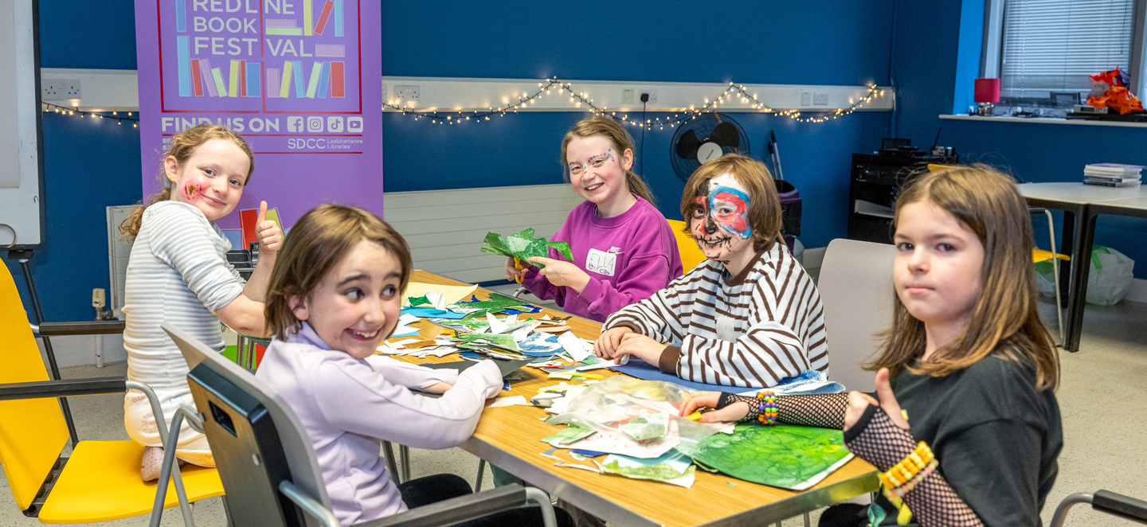
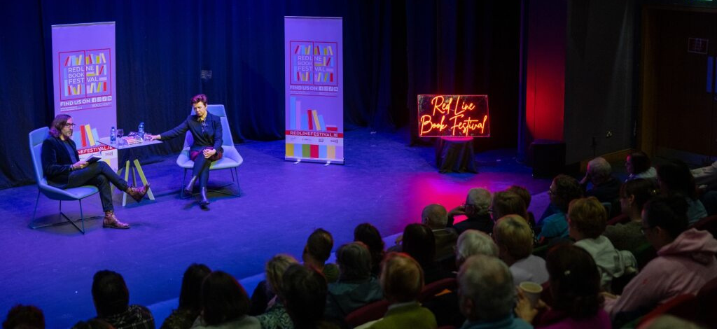
Engagement and Participation
There were 45 events delivered across 12 venues. 17 events sold out.
Total attendance was approx 5,500 people, a 10% increase on 2024.
Social media engagement increased by 31% on select channels. Follower numbers increased by 23%.
Media engagement was significant in 2025, with festival coverage appearing in national outlets including Newstalk, the Sunday Independent, the Irish Times, the Journal and RTE.ie

Slide 16
Thank you

