Slide 1
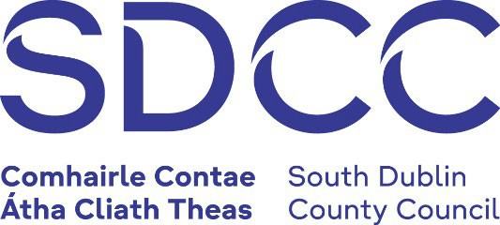

COMHAIRLE CONTAE ÁTHA CLIATH THEAS SOUTH DUBLIN COUNTY COUNCIL
MEETING OF ARTS, CULTURE, GAEILGE, HERITAGE AND LIBRARIES SPC
Wednesday, November 05, 2025
HEADED ITEM NO. 2
IN CONTEXT 5, Strand 2: SDCC’s Public Art programme 2023-26 under the Percent for Art Scheme

Slide 2
SDCC
Arts Office November SPC Report
Created by
Arts Office
Presented by
Richie O’Sullivan

Slide 3
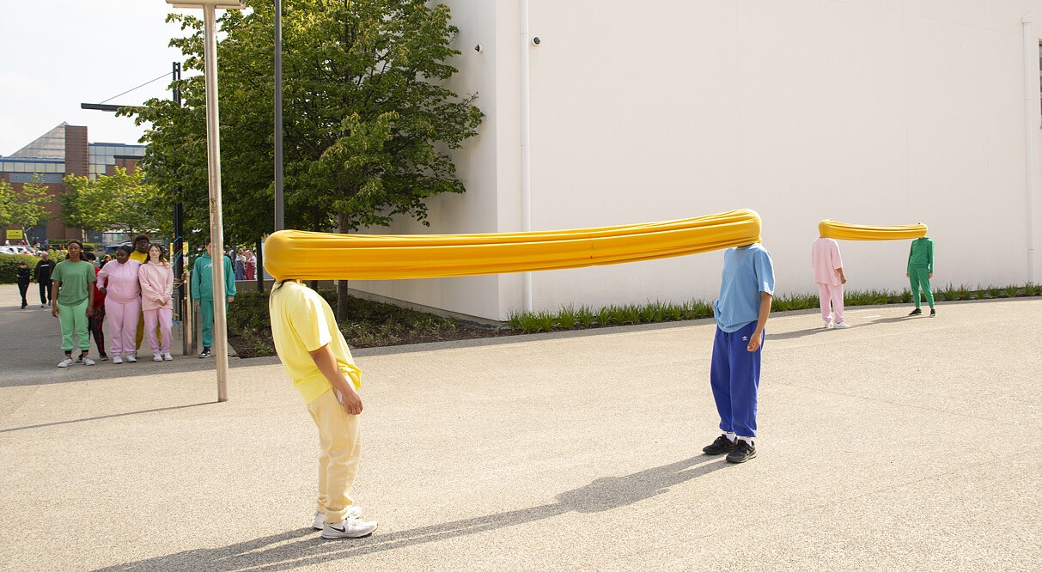
What is the In Context Public Art Programme?
SDCC has been one of the most prolific local authority commissioners of public art since it began its In Context Programmes in 1997. Over 25 commissions have been awarded, some delivering multiple artworks, through the Per Cent for Art Scheme.
The Scheme is a government initiative, first introduced in 1978, whereby 1% of the cost of any publicly funded capital, infrastructural and building development can be allocated to the commissioning of a work of art. Since 1997 this scheme has been made available to all capital projects across all government departments.
The majority of Per Cent For Art commissions are generated from public housing projects (social and affordable schemes) in South Dublin County.

Slide 4
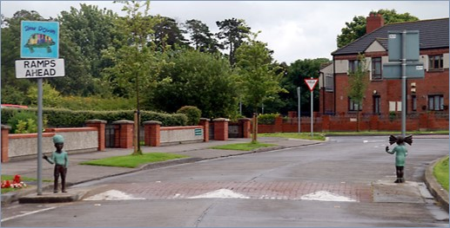
In Context – South Dublin County Council’s Public Art Programme
This is the 5th iteration of In Context since 1997.
27 commissions and projects across the county – temporary, socially engaged, and permanent interventions.
In Context 5 Strand 1:
6 commissions for children and young people
Sugar and Spice, Louise Walsh. St. Finians Estate

Slide 5
In Context Strand 2 Strategy Alignments
Arts Development Strategy 2022- 2026
Climate Action Plan 2024 – 2029
South Dublin County Development Plan 2022 - 2028
Biodiversity Plan 2020 – 2026

Slide 6
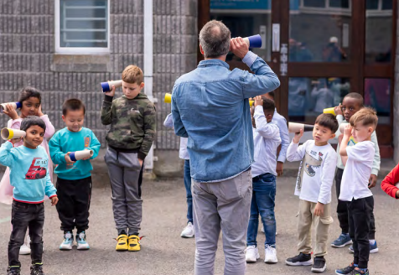
IN CONTEXT 5: Strand 2
32 applications
received
5 commissions
selected
Bang Bang Pop, David Beattie IN CONTEXT 5- Connect
Photo © Louis Haugh

Slide 7
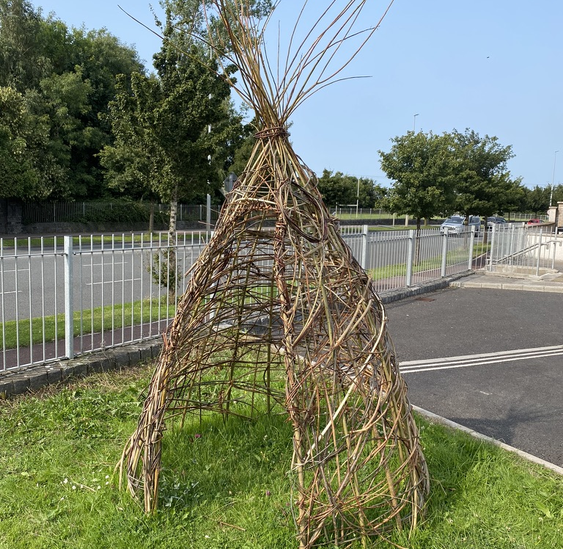
IN CONTEXT 5: Strand 2
FUNDING LOCATIONS & BUDGETS
St Mark’s Avenue, Clondalkin & St Ronan’s Crescent, Rowlagh - €79,000
St Aonghus Green & Old Bawn, Tallaght - €50,000
Templeogue Village & Pearse Brothers Park, Rathfarnham - €44,000
Homeville, Knocklyon - €25,000
Killinardan - €21,000

Slide 8
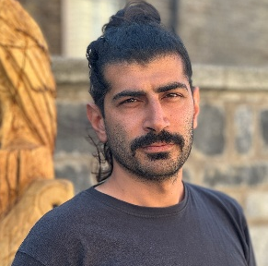
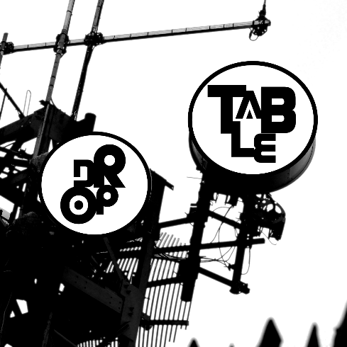
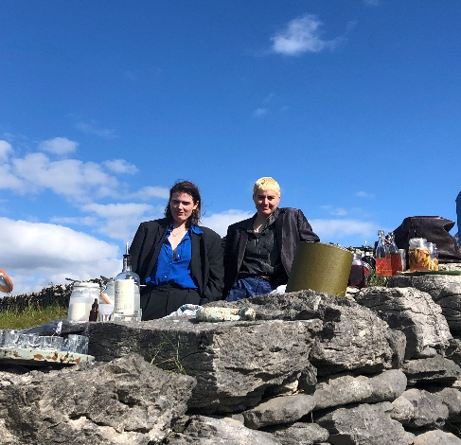
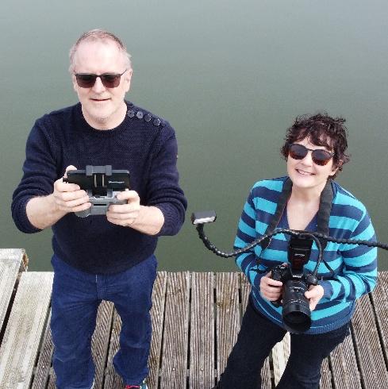
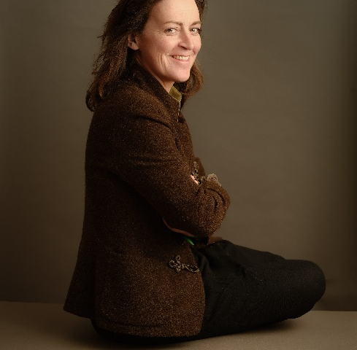
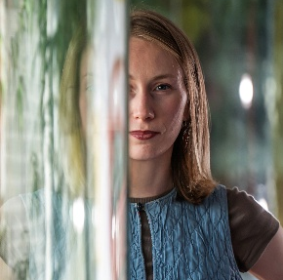
IN CONTEXT 5
STRAND 2 ARTISTS
Gráinne O’Carroll and Ghiath Al Jebawi
Shane Finan and
Drop Table
Katie Watchorn and Áine Mac Giolla Bhríde
Anne Cleary and Dennis Connolly
Sophie von Maltzen
St Aonghus Green &
Old Bawn, Tallaght
St Marks Avenue, Clondalkin &
St Ronan's Crescent, Rowlagh
Homeville, Knocklyon
Templeogue Village & Pearse Brothers Park, Rathfarnham
Killinarden

Slide 9
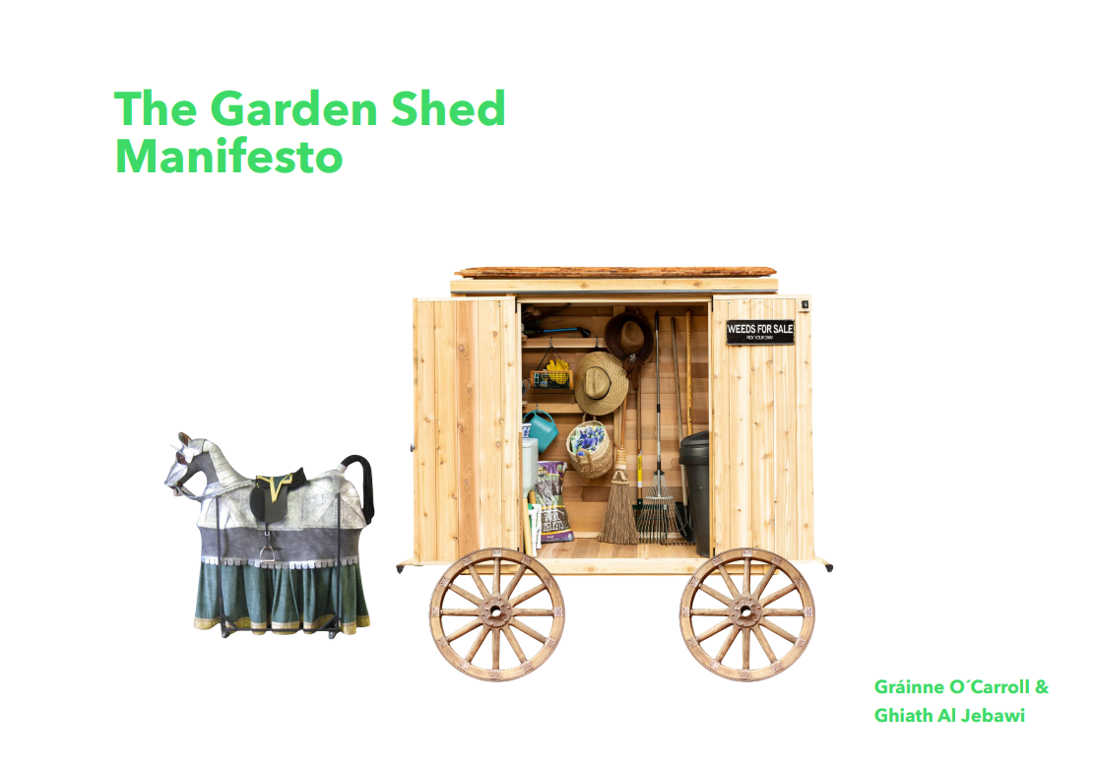
Gráinne O’Carroll and Ghiath Al Jebawi
Area: St Aonghus Green & Old Bawn, Tallaght
Project: The Garden Shed Manifesto proclaims that the suburban garden is not an ornament but an ecosystem, not a private patch but a shared future. The shed is our base: a cart on wheels carrying tools, seeds, stories, and the will to rewild. We reject the lawn as a monoculture of conformity. We embrace the messy, the diverse, the buzzing and the blooming. We believe a shed can be a stage, a classroom, a kitchen, a portal. We believe that soil is not dirt but memory, that a garden is not property but possibility.
Our horse-drawn garden shed will roam Old Bawn hosting workshops, performances, shared meals, and creative experiments throughout Spring - Summer 2026
Image courtesy the artists

Slide 10

Shane Finan and drop table ensemble
Area: St Marks Avenue, Clondalkin & St Ronans Crescent, Rowlagh
Project: Title: Another Infrastructure (AI)
Arts ensemble Drop Table will create works with the community in Clondalkin about how we use technology together. We will run a series of socially engaged arts events about developing agency around our network technologies. These will consider the environmental, ethical and social impact of using commercial technologies that run information through energy-intensive data centres. We will explore how the Clondalkin community can build their own server technologies and self-hosted websites and create a community-run web space. Our team of six artists will run a series of workshops and social events that will develop artworks and documentation for web, and we will then create a low-yield website to host this documentation and these artworks as a final output. This web artwork and any associated objects will be hosted in south Dublin, and the community will decide how it can be accessed (eg. globally or locally accessible).
Image courtesy the artists

Slide 11
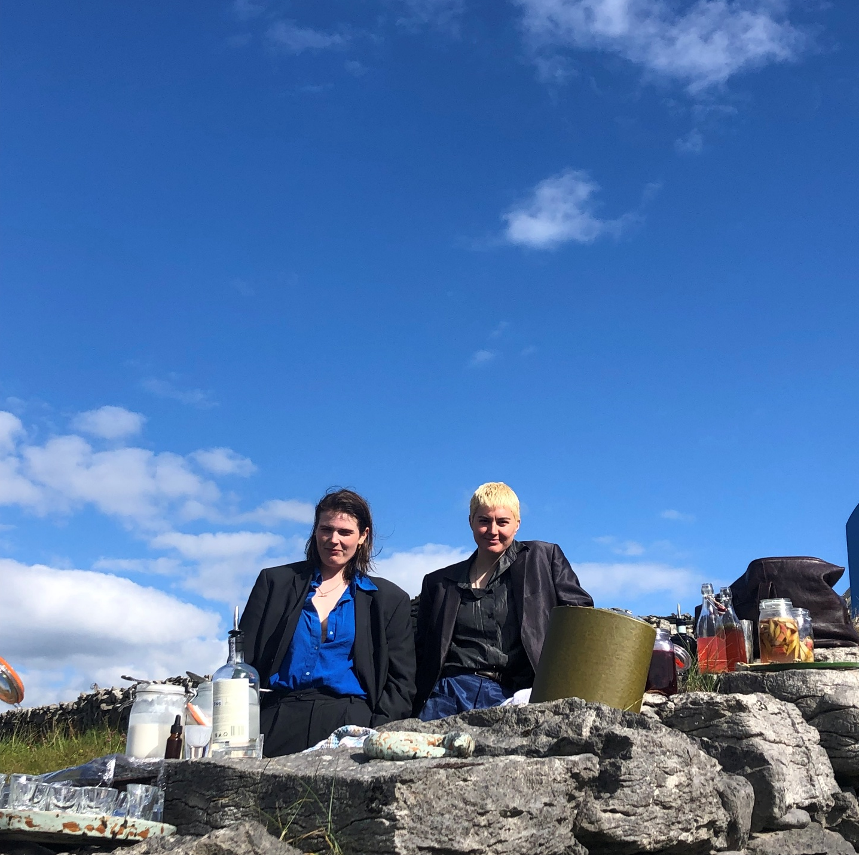
Katie Watchorn &
Áine Mac Giolla Bhríde
Area: Homeville, Knocklyon
Project: Operating under the collaborative moniker of served this project between artists Áine Mac Giolla Bhríde and Katie Watchorn is an artwork rooted in sculpture and performance, using food as a medium for climate action and community connection. Centred on a community garden in South County Dublin, it will explore biodiversity, sustainability, and collective memory through shared sensory experiences. The culmination will be a performative tasting event: an immersive meal shaped by the garden’s yields and participants’ stories.
Presented theatrically—with attention to atmosphere, storytelling, and participation—the meal reframes food not simply as sustenance but as an imaginative, communal act of climate engagement.
Bar Bás in Éirinn, Drop Everything , 2022
Image courtesy the artists

Slide 12

Anne Cleary and
Denis Connolly
Area: Templeogue Village & Pearse Brothers Park, Rathfarnham
Project: In artistic practice, framing is a very important device, focusing attention and elevating the significance of that which is captured within the frame. Frames are used in science too. A quadrat is a square frame that can be placed on site to delineate a small area to survey (i.e. to investigate the abundance of plants and/or animals in a habitat).
Artists Cleary and Connolly propose, with their project, Nature Squared, to take this simple device and use it as an artistic framing device to make art with communities along the Dodder River.
"The artistic possibilities of the quadrat in a natural site are endless" says artist Anne Cleary, "ranging from macro photography, drawing, video, poetry…. the important thing is that the quadrat frames and focuses our attention on the beauty of nature, unleashing the imagination to make art."
The artists hope to demonstrate the important role of art - and particularly art made and shared by citizens - in raising awareness and mobilising public response to the many problems of our environment, nurturing both scientific curiosity and artistic creativity to support and spark positive climate action in the unique and very special context of the Dodder linear park.
Anne and Denis propose to work with numerous communities along the River Dodder and expect multiple artistic outputs to emerge, leading to an exhibition to take place in late 2026 or early 2027.

Slide 13
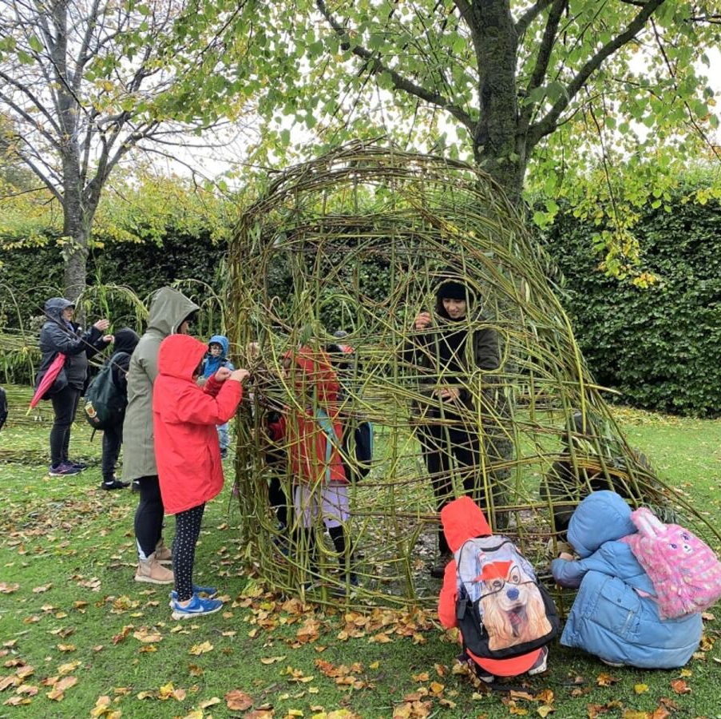
Sophie von Maltzan
Area: Killinarden
Project: Sophie has been engaged with groups in Killinarden Community Centre in undertaking a project called ‘Rooting Resilience’ for In Context 5 Strand 1. She has engaged with people at the centre in activities such as willow weaving, puppet making, and folklore storytelling.
Sophie will continue to work with Killinarden Community Centre for In Context 5 Strand 2 and undertake activities such as a portrait workshops, planting within the grounds of the centre, textile workshops with youth, Mens Shed, and Sisters Shed groups.

Slide 14
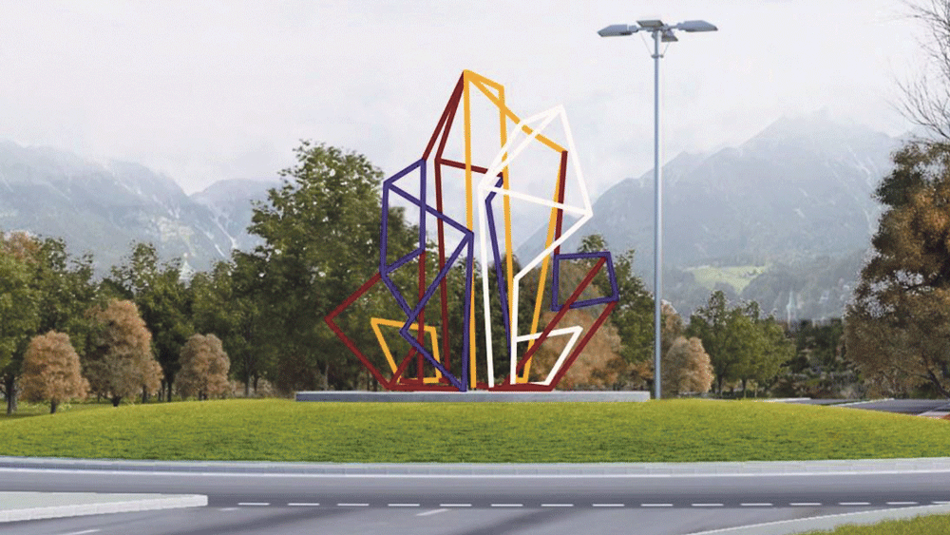
N81 Node
Glenview Roundabout Sculpture Installation
Installation began in October of a new sculpture on the N81 Glenview Roundabout. The artwork was commissioned in 2021 as part of a large scale infrastructure project N81 Landscape Improvement Scheme.
Liam O’Callaghan and Mark Clare were selected following a two-stage open competition and were awarded the commission of €50,000. The selection panel was made up of members of the project team, the Arts Officer, Conservation Officer, Chair of the Tallaght Area Committee, with two independent arts advisors.
The commission process, which followed the National Guidelines for the commissioning of Public Art under the Percent for Art Scheme, was administered through the SDCC Arts Office.

Slide 15
Thank you

