Slide 1



Red Line Book Festival 2025
Created by
{Sarah Elaine McHugh}
Presented by
{Sarah Elaine McHugh}
Nov 2025

Slide 2

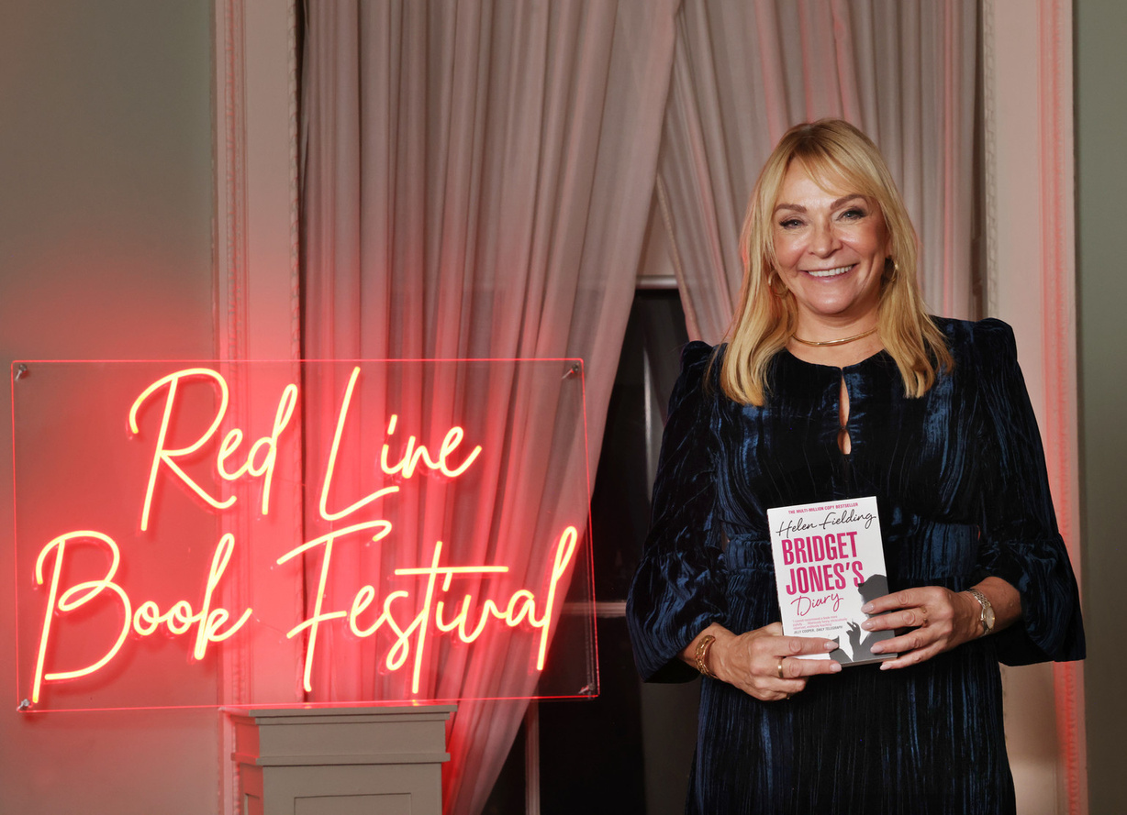

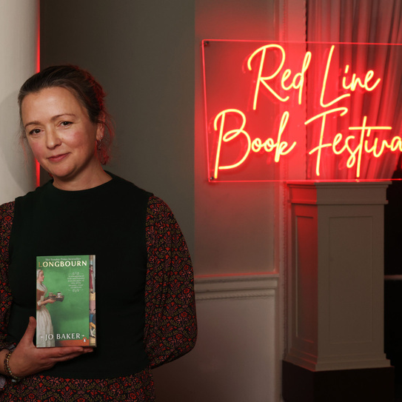
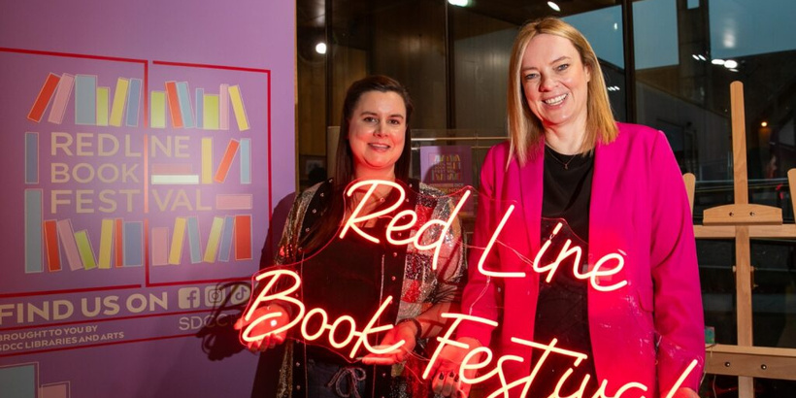
Red Line Book Festival 2025 - Celebrating Stories
The Red Line Book Festival continues to be a flagship cultural event in South Dublin County.
The festival celebrated its 14th year in 2025 and took place from 13th - 19th October in libraries and venues all across South Dublin.
Curated and delivered by the Events and Communications team in SDCC Libraries, the festival highlights creativity and community, while promoting literacy and learning to all ages.

Slide 3
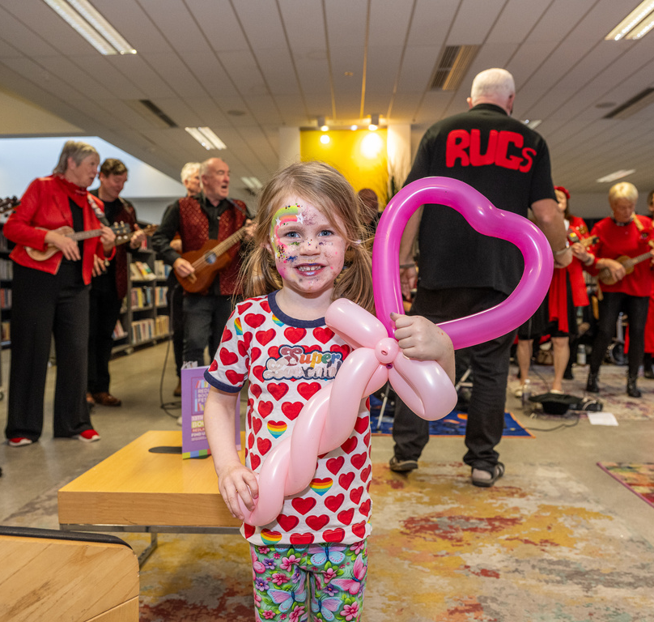
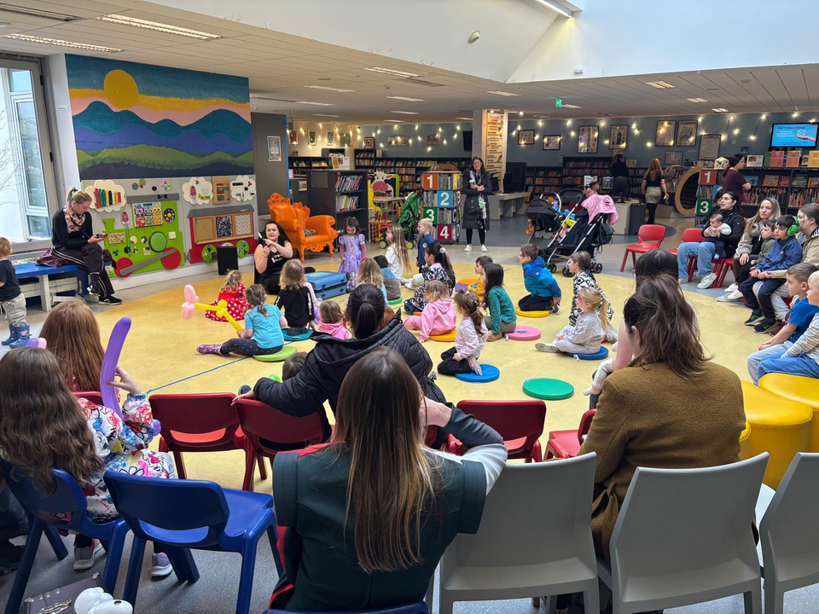
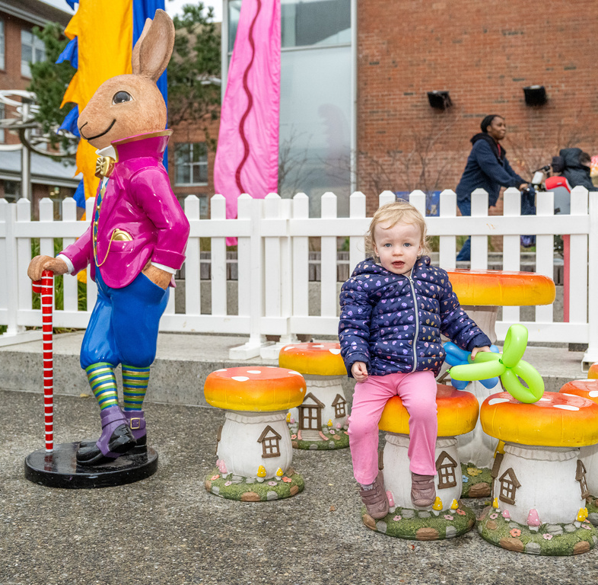
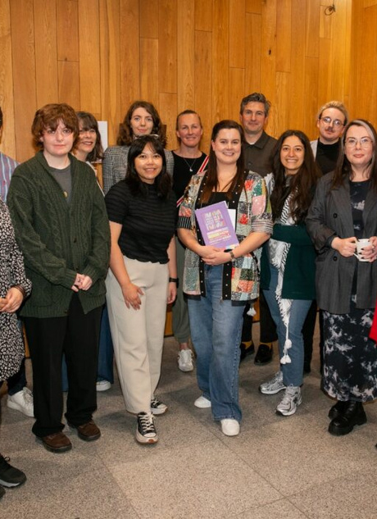
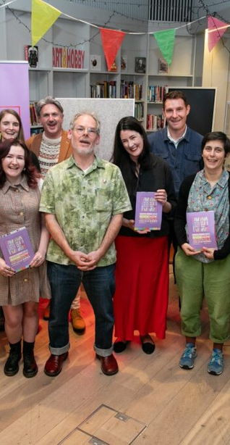
Festival Highlights
The Red Line Family Fun Day remains a flagship event in the festival. The day saw over 2,000 people attend events in Tallaght Library, the Civic theatre and outdoor space in Parthalán Place.
The Illustrator in Residence programme saw 15 participants exhibit their work in Ballyroan Library following a 5-week mentorship programme with artist Celina Buckley
The prestigious Red Line bi-lingual poetry competition saw over 500 entries from all over Ireland, with the winning poem “Schooner” coming from Galway poet James Anthony.
The festival also launched Tallaght: A Welcoming Place - an oral history collection in Tallaght Library.

Slide 4
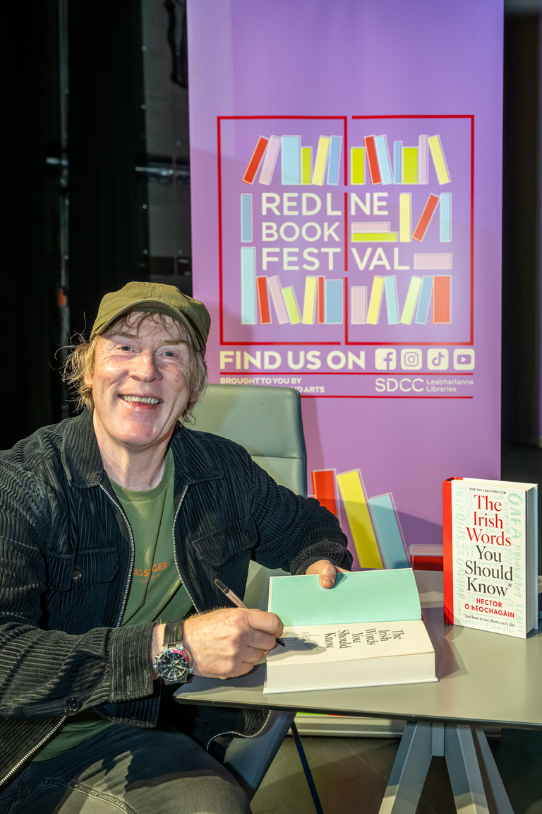

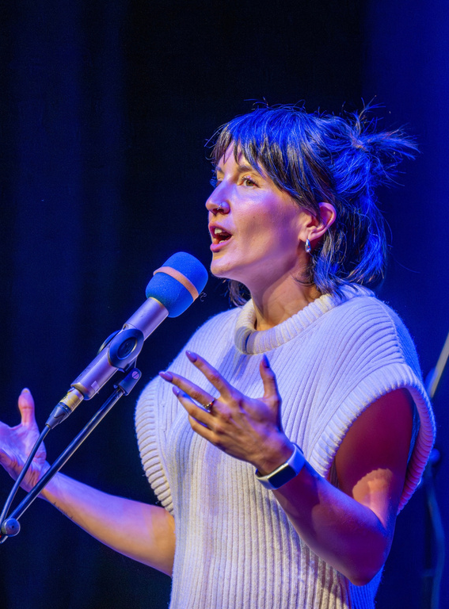
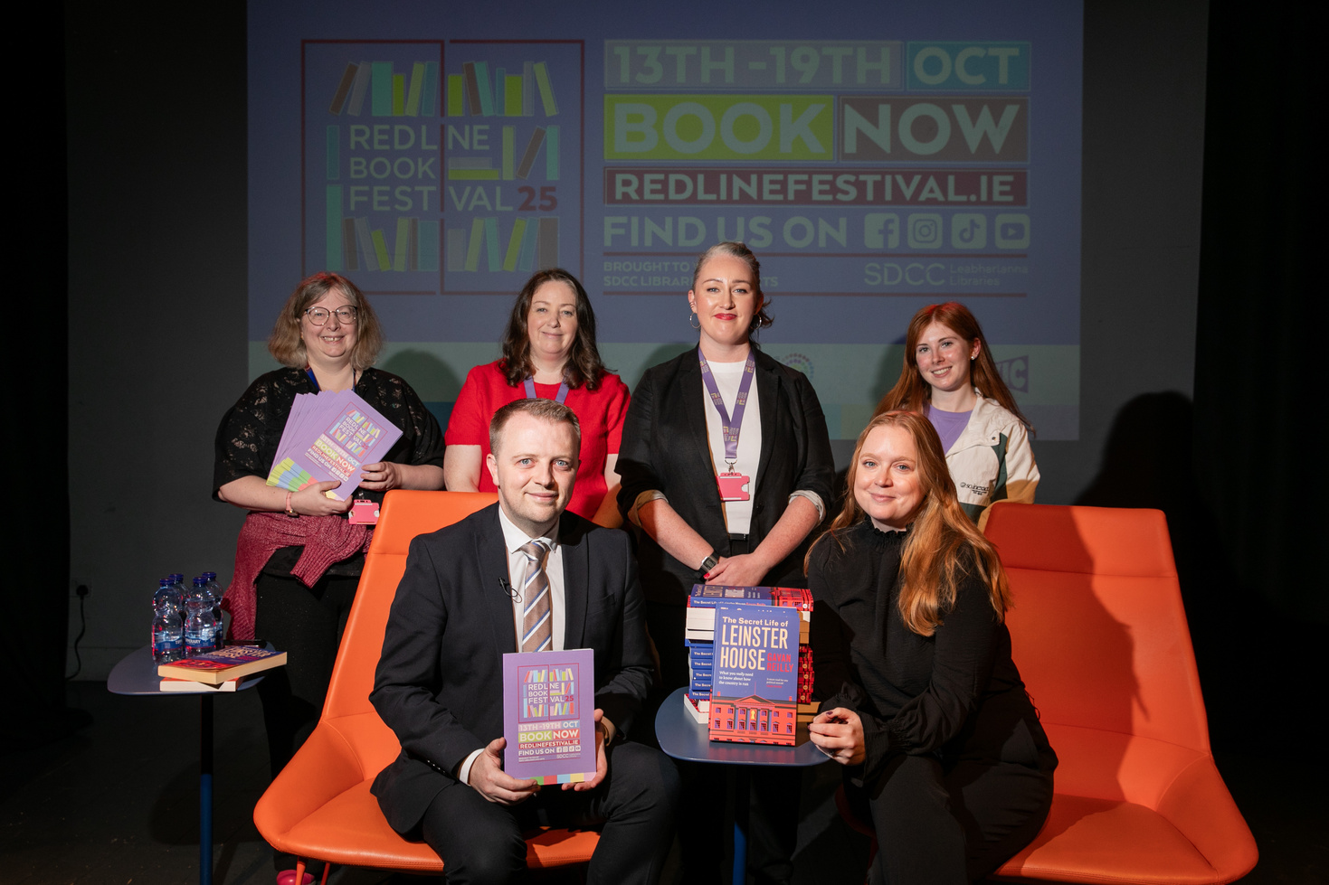
Festival Highlights
The festival lineup featured a host of national and international authors, while also platforming local and emerging writers.
Bridget Jones creator Helen Fielding spoke to a sold out audience in Rathfarnham Castle, interviewed by Tallaght native Vicky Notaro.
Gavan Reilly and Jennifer Bray enthralled a sold-out crowd in Rua Red with tales of Leinster House
Irish language author and advocate Hector O’Eochagáin in conversation with presenter Muireann O’Connell brought the banter to a packed out Civic theatre
The End of the Line: A Spoken Word Celebration featured 10 acclaimed poets from across Ireland in a rousing closing event to the festival

Slide 5
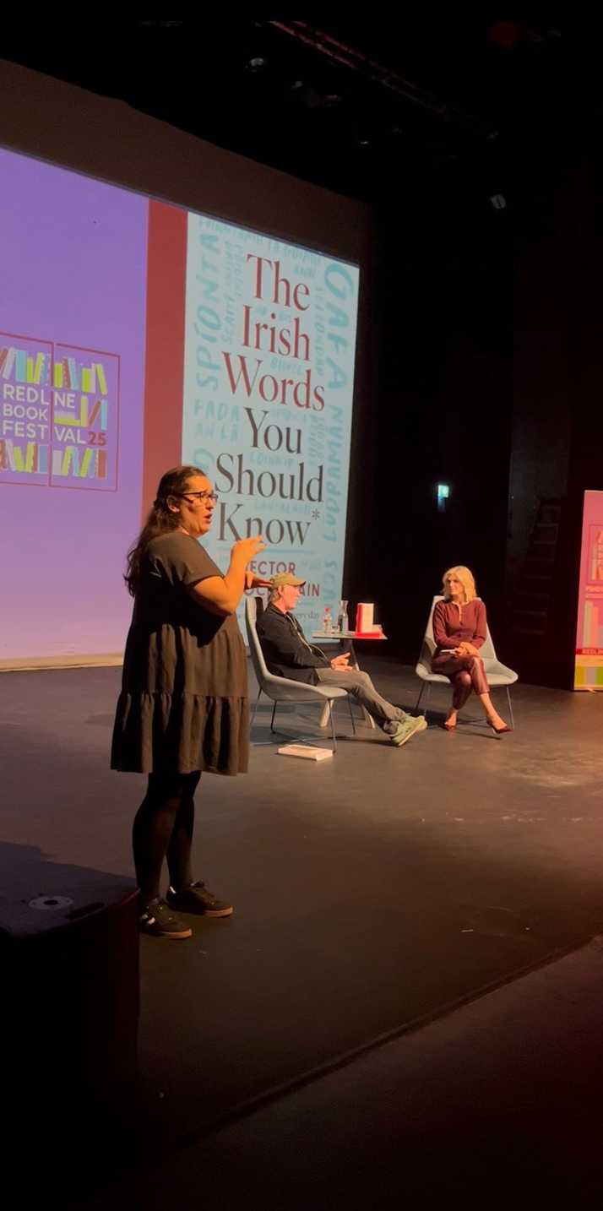
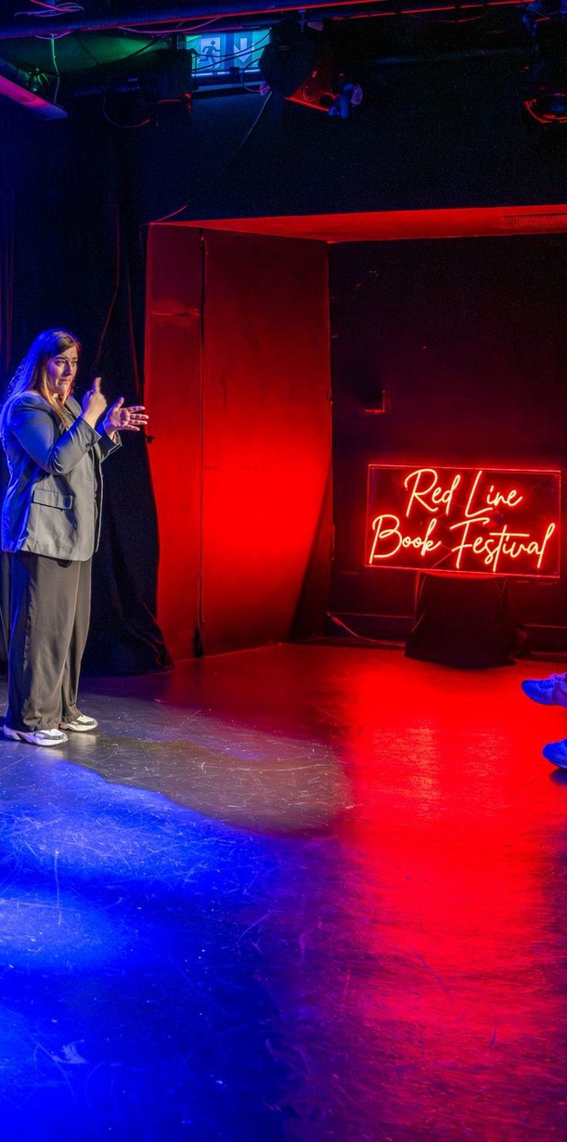
Accessibility and Inclusion
  All events taking place in libraries, and children’s events in the Civic theatre were free of charge. Tickets for events in external venues e.g. Rathfarnham Castle were minimally priced.
  Sensory spaces were available at select events including the Family Fun Day in Tallaght Library.
  Irish sign language played an important part in increasing accessibility for this year’s festival. ISL interpretation was provided for 4 main events in the Civic theatre and Rathfarnham Castle. Feedback for provision of this service was excellent, both from attendees and event participants. We aim to increase the provision of ISL to more events in 2026.

Slide 6
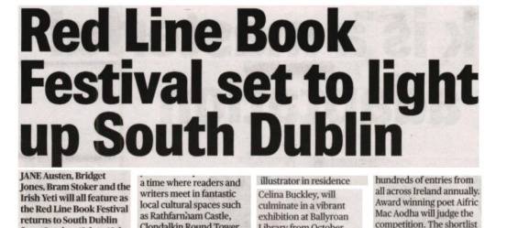
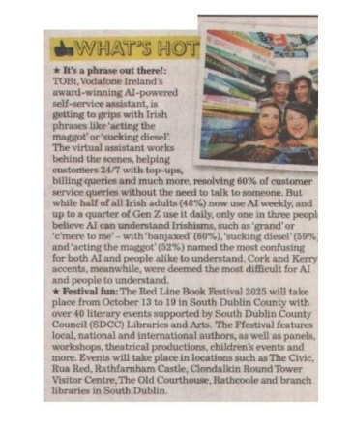
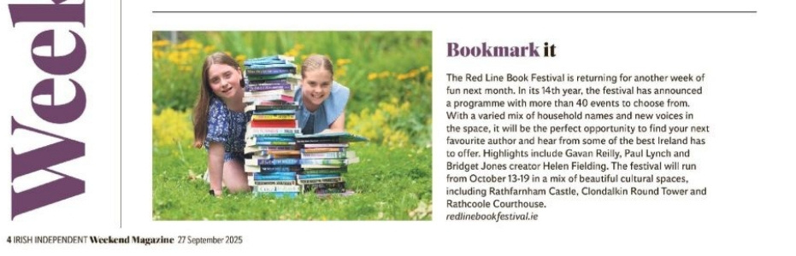
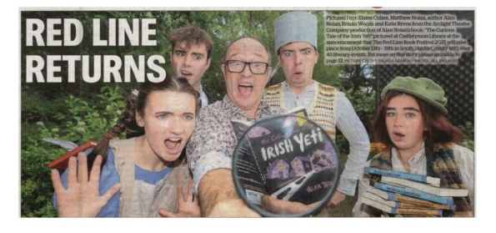
Engagement and Participation
There were 45 events delivered across 12 venues. 17 events booked out.
Total attendance was approx 5,500 people, a 10% increase on 2024.
Social media engagement increased by 31% on select channels. Follower numbers increased by 23%.
Media engagement was significant in 2025, with festival coverage appearing in national outlets including Newstalk, the Sunday Independent, the Irish Times, the Journal and RTE.ie

Slide 7
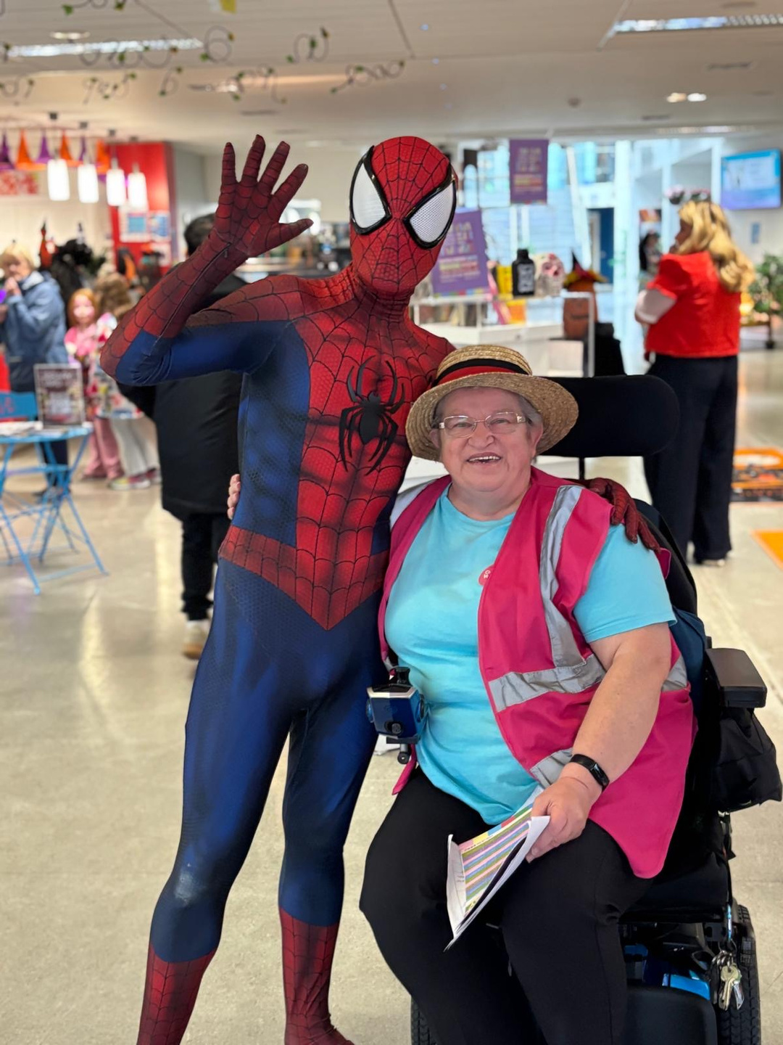
Collaboration and Partnership
Red Line’s continued success is predicated on maintaining strong partnerships with ongoing collaborators, while cultivating new relationships with internal and external stakeholders:
  SDCC Arts Office
  Local Enterprise Office
  OPW
  Rua Red
  Civic Theatre
  South Dublin Volunteers
  Bridge Interpreters
  Publishers, booksellers
  Local writers and writing groups

Slide 8
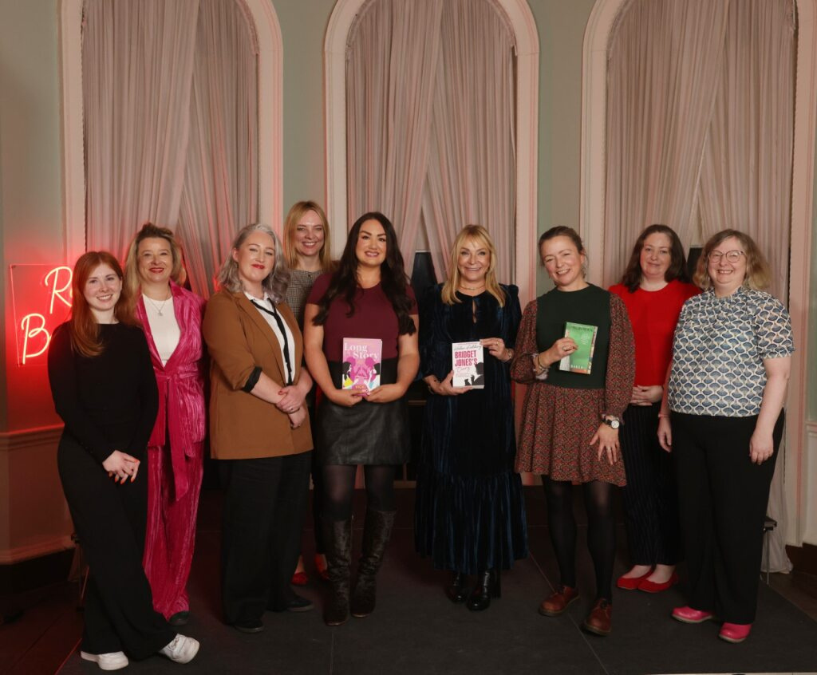
Looking ahead
Red Line 2026 will take place from 14th - 18th October
Focus will be on expanding audience reach, developing accessible programming and deepening relationships with external stakeholders.
Wrap up on 2025 festival includes planning for next year - exploring what worked, what didn’t and what changes can be made in 2026.

Slide 9
Thank you

