Slide 1
Bronntanas

Slide 2
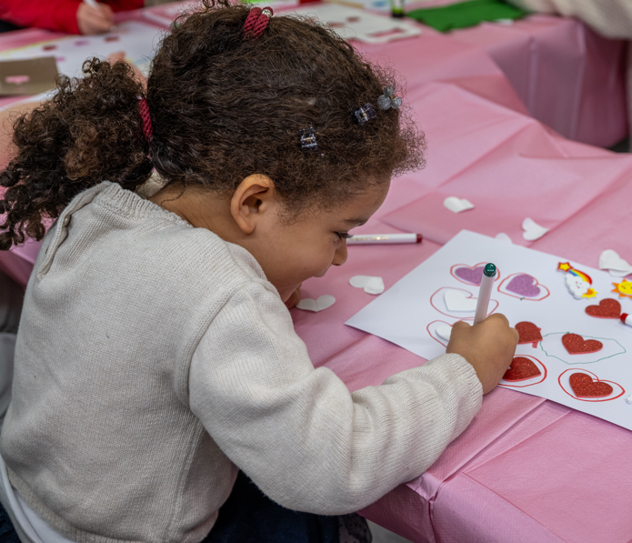
A family arts festival encouraging parents to give the gift of Irish to their children at home
WHAT IS IT?
Bronntanas

Slide 3
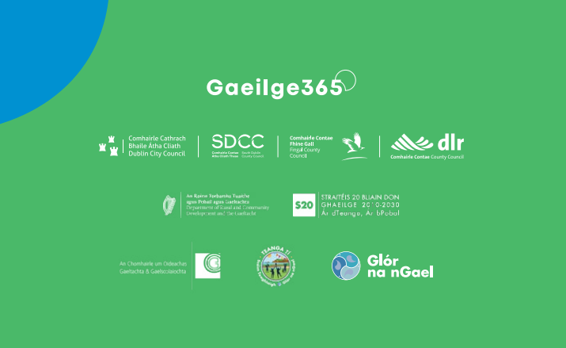
Partners & Collaborators
Gaeilge365 Team
Dublin City Council
South Dublin County Council
DLR County Council
Fingal County Council
The Department of Rural and Community Development and the Gaeltacht
20-Year Strategy for the Irish Language
Glór na nGael
An Chomhairle um Oideachas Gaeltachta agus Gaelscolaíochta
Artists & Community Groups

Slide 4
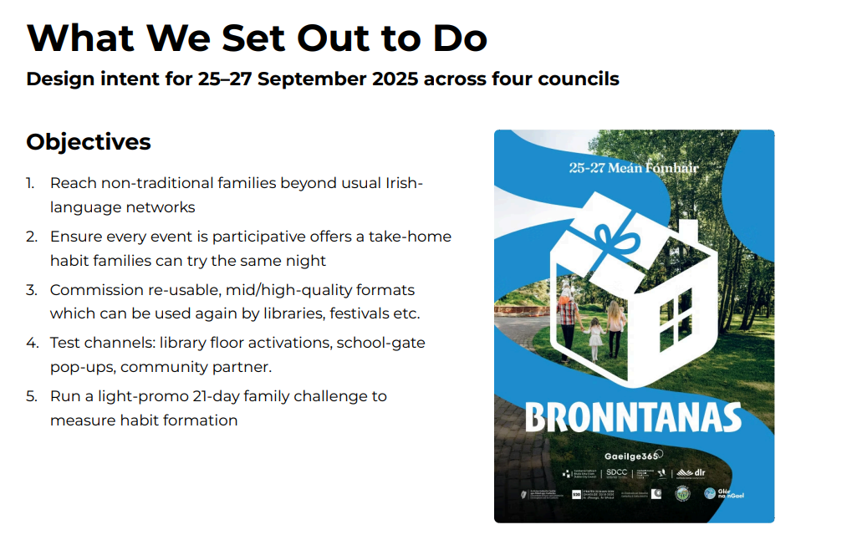

Slide 5
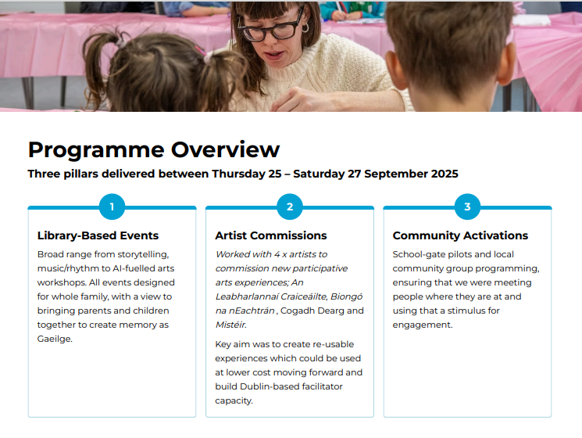

Slide 6
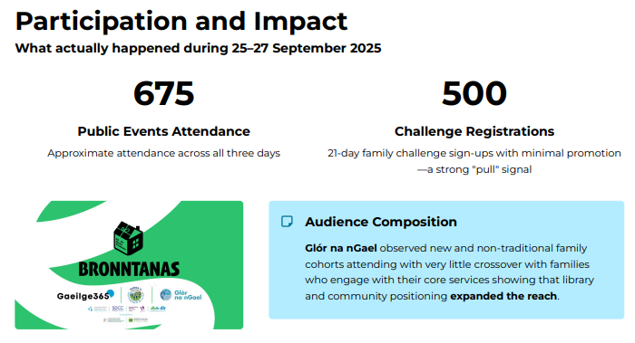

Slide 7
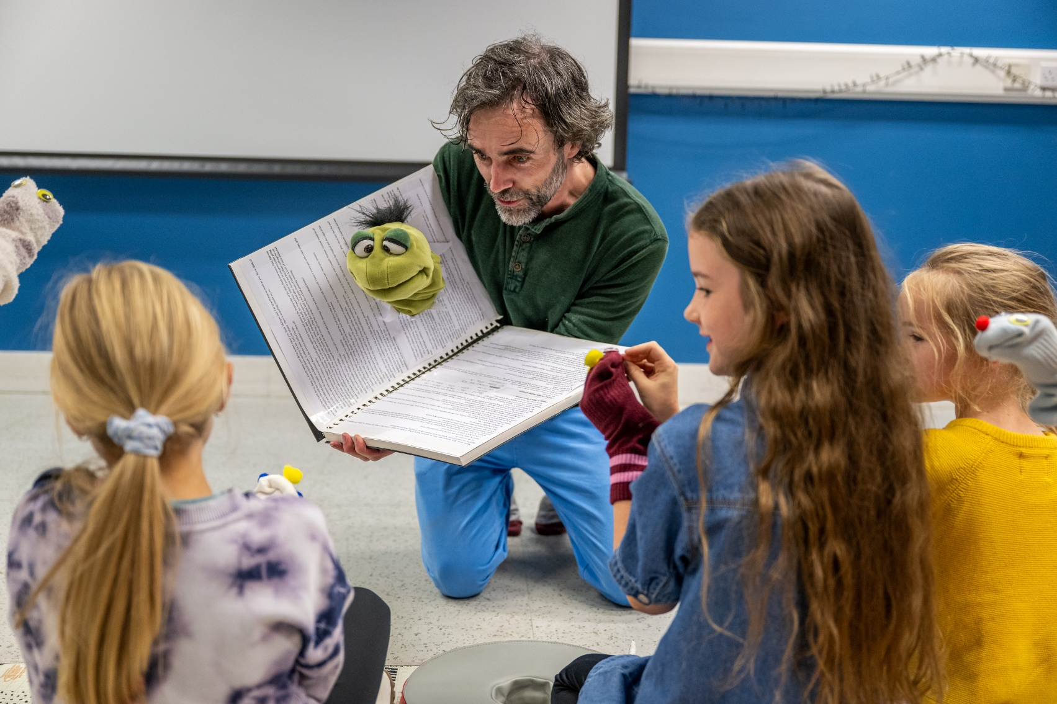
SDCC events
14 events held across:
SDCC Libraries: Tallaght, Clondalkin, North Clondalkin, Castletymon, Lucan & Ballyroan
Áras Chrónáin
Aon Scéal? Café
Tandy’s Lane Park
Approximate attendance for events in SDCC: 171

Slide 8
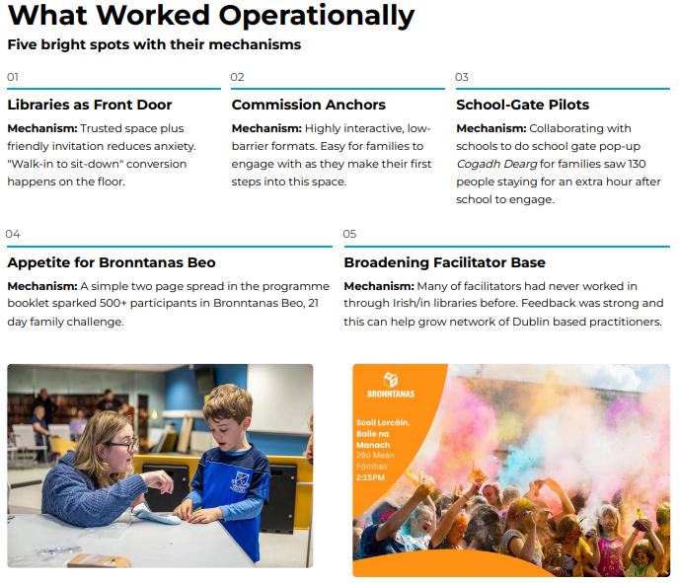

Slide 9
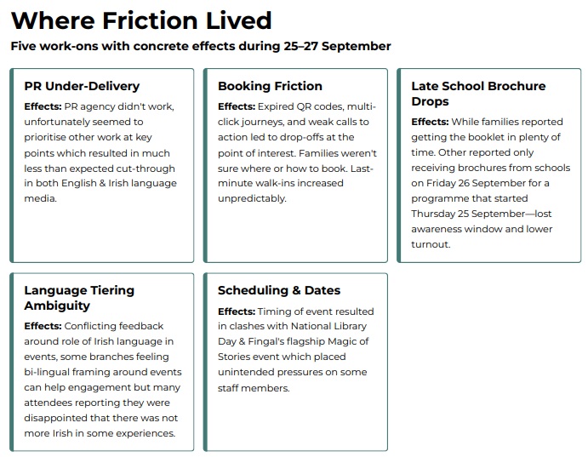

Slide 10
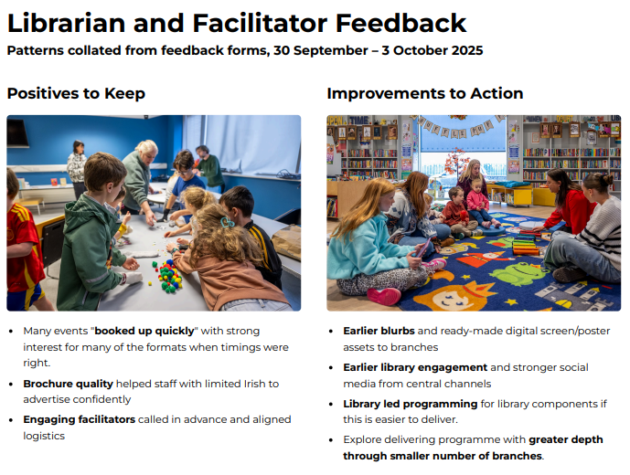

Slide 11
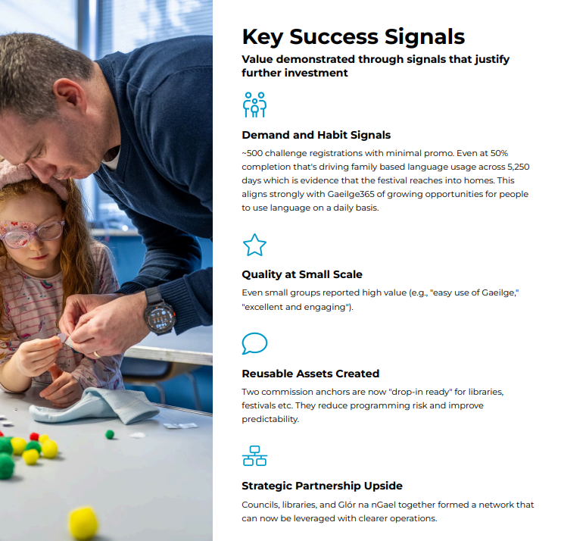

Slide 12
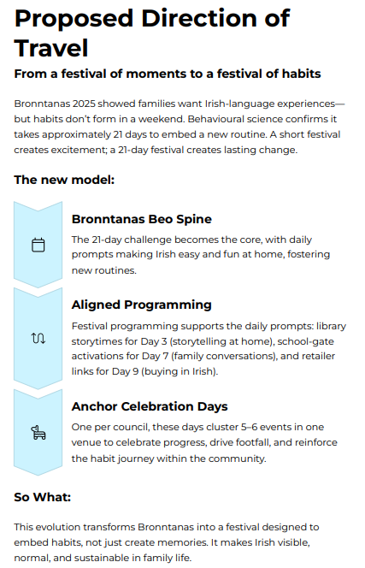
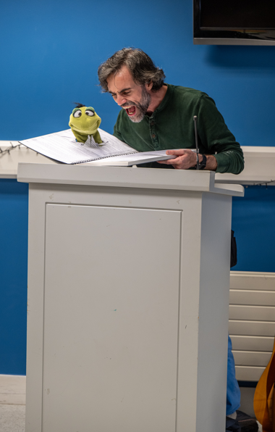

Slide 13
Go raibh maith agaibh

