Slide 1


COMHAIRLE CONTAE ÁTHA CLIATH THEAS SOUTH DUBLIN COUNTY COUNCIL
MEETING OF Tallaght Area Committee
Tuesday 28 October 2025
HEADED ITEM NO. 13
Arts Office Report on 24 October 2025

Slide 2
SDCC
Arts Office October ACM Report
Created by
Arts Office
Presented by
Richie O’Sullivan

Slide 3
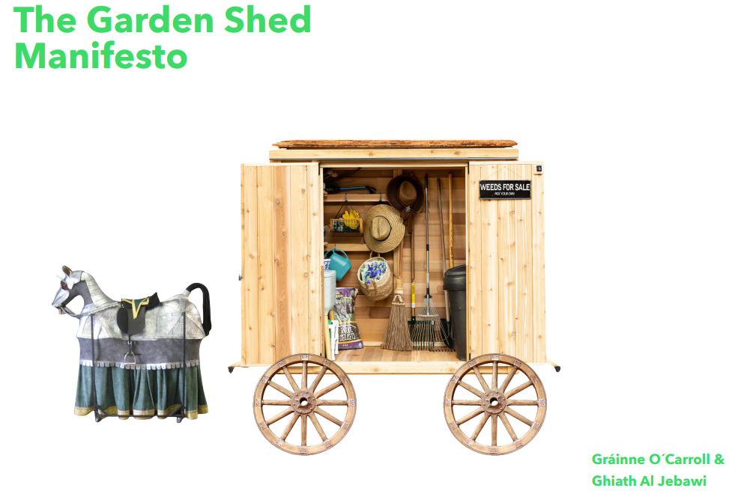
Public Art
In August, Richie O’Sullivan joined the Arts Office in the role of Assistant Arts Officer - Public Art.
In July, four new Public Art commissions were selected following an open call as part of In Context 5 Strand 2.
The theme for this award is a focus on climate action, environment, tackling the urgency of climate change, and champion sustainability and/or biodiversity in the context of South Dublin County.
  Gráinne O’Carroll and Ghiath Al Jebawi have been awarded €50,000 to undertake a socially engaged Public Art project in the areas of St Aongus Green and Old Bawn, Tallaght.
  Gráinne and Ghiath’s project is called the Garden Shed Manifesto and will work with local groups in the areas of sustainability and biodiversity in the creation of a mobile garden shed.
  Sophie von Maltzan is currently undertaking a project with youth groups in Killinarden Community Centre under In Context Strand 1 and will continue to work with these groups under Strand 2 and was awarded €21,000.

Slide 4
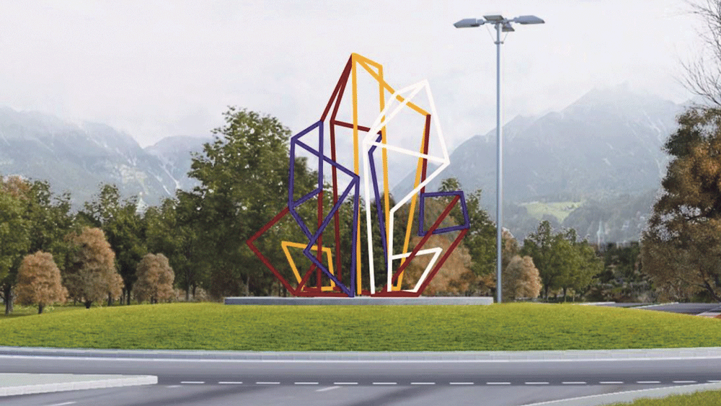
N81 Glenview Roundabout
Sculpture Installation
Installation began in October of a new sculpture on the N81 Glenview Roundabout. The artwork was commissioned in 2021 as part of a large scale infrastructure project N81 Landscape Improvement Scheme.
Liam O’Callaghan and Mark Clare were selected following a two-stage open competition and were awarded the commission of €50,000. The selection panel was made up of members of the project team, the Arts Officer, Conservation Officer, Chair of the Tallaght Area Committee, with two independent arts advisors.
The commission process, which followed the National Guidelines for the commissioning of Public Art under the Percent for Art Scheme, was administered through the SDCC Arts Office.

Slide 5
Thank you

