Slide 1
Winter Maintenance Plan
2025 – 2026 Season
Created by
G. Walsh
Presented by
G. Walsh

Slide 2
Recap of
2024 – 2025 Season
43 Salting Runs on all routes
9 Salting Runs on hill routes only
2200 tonnes of rock salt spread
Lowest recorded road temperature: -4.9ºC
2024 - 2025 season would be considered to have been milder and drier than average.
First 10 days of 2025 was significantly low with daytime temperatures staying below 0ºC. 49.5% of all salt spread in the season was during this period
SDCC escaped severe weather associated with Storm Darragh

Slide 3
2025 – 2026 Season
Starts – Oct 13th
Finishes – April 26th
Gritting Runs will be generally be carried out at 7pm and/or 5am depending on forecast
Standard spread rate will be 10g/m2 but increased in the event of extreme low temperatures or snow.
On routes where brines is being incorporated the standard spread rate will be 8g/m2 and a spray rate of 10ml/m2 of brine.
Snow ploughs available for all routes but snow falls must be greater than 30mm to be effective

Slide 4
Severe Weather Prioritisation
National Routes & Major County Distributors
Normal Routes Not Included in Priority One
Distributor Roads in Urban Areas (No estate roads)
Rural Areas with Highest Number of Residences
Rural Areas with Low Number or Single Residences
This priority will only be altered if we get requests for assistance from emergency services.

Slide 5
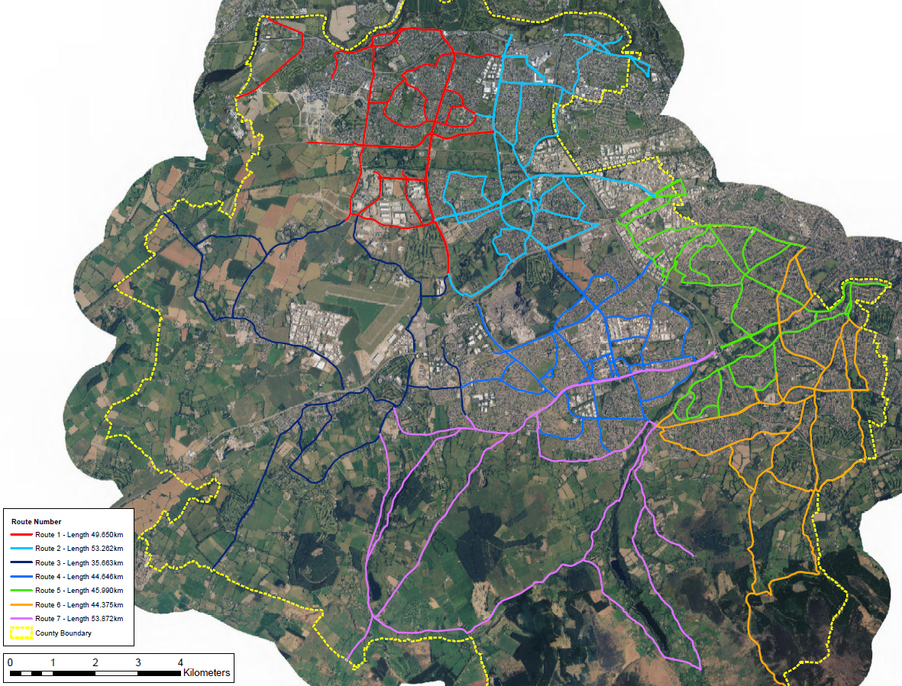
Gritting Routes
7 routes within the county
340km of roads treated

Slide 6
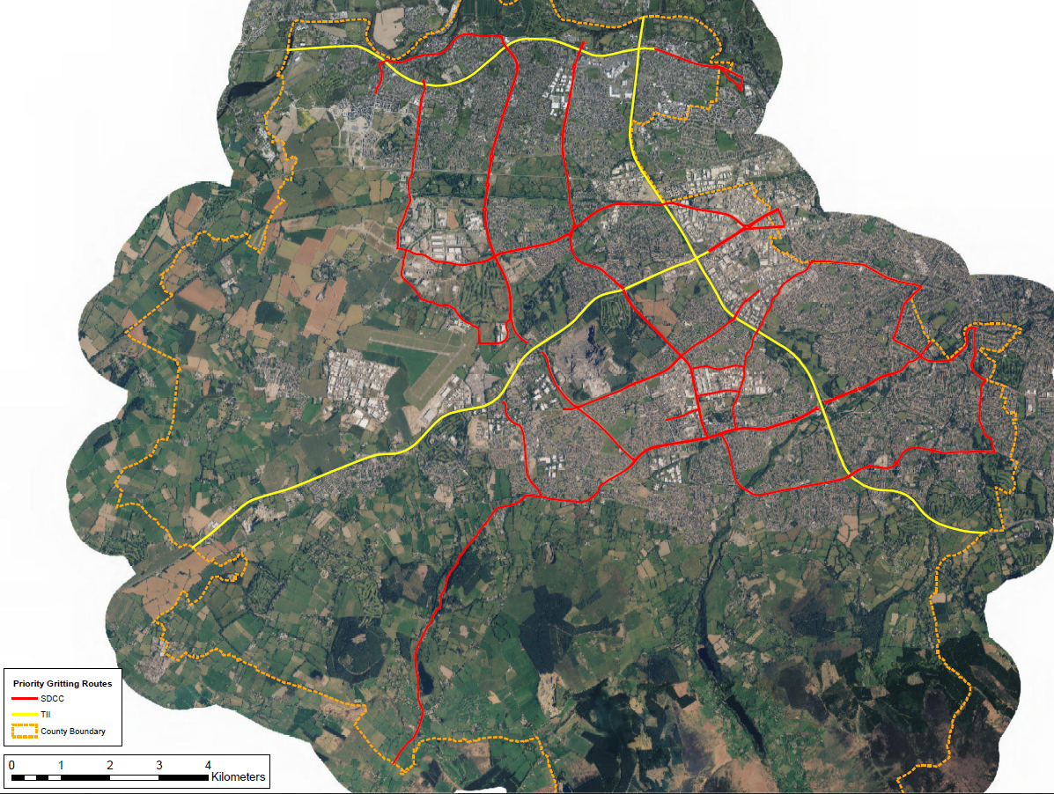
Priority Routes
SDCC Priority Routes
Private Priority Routes
Priority Routes are
the main distributor roads to the county
essential services such as hospitals, airport, emergency services
food distribution points
This is a live document where locations may be added/removed depending on the severity of the weather event

Slide 7
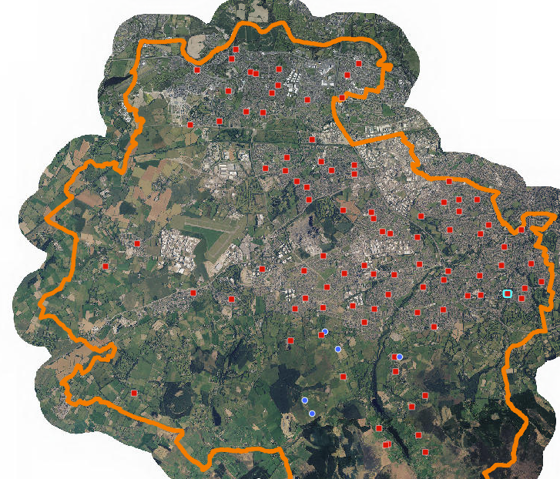
Salt Bin Locations
100 salt bins located throughout the county
Bins restocked at the start of every season and upon request following that
Salt bin locations available on SDCC website
South Dublin Salt Bins 2024 SDCC (arcgis.com)

Slide 8
Thank you

