Slide 1
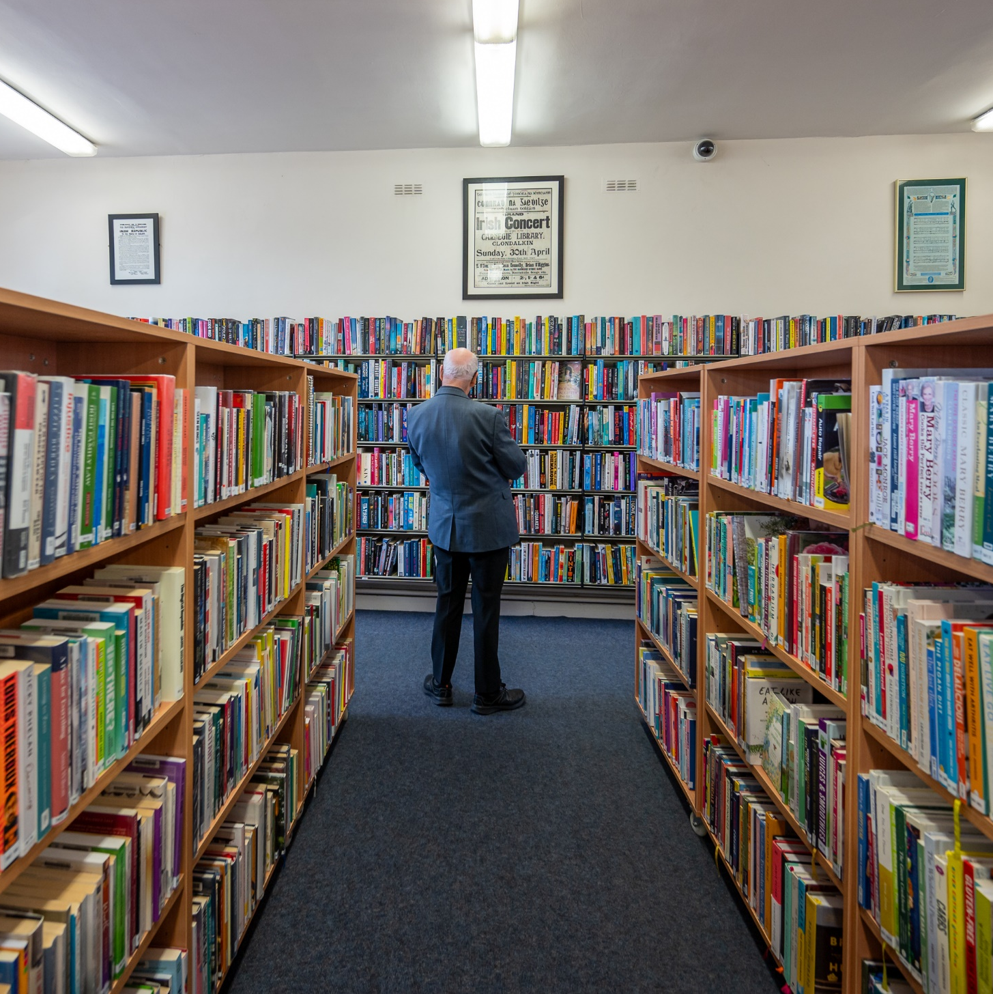
Clondalkin
& Mobile Libraries
ACM Report October 2025

Slide 2
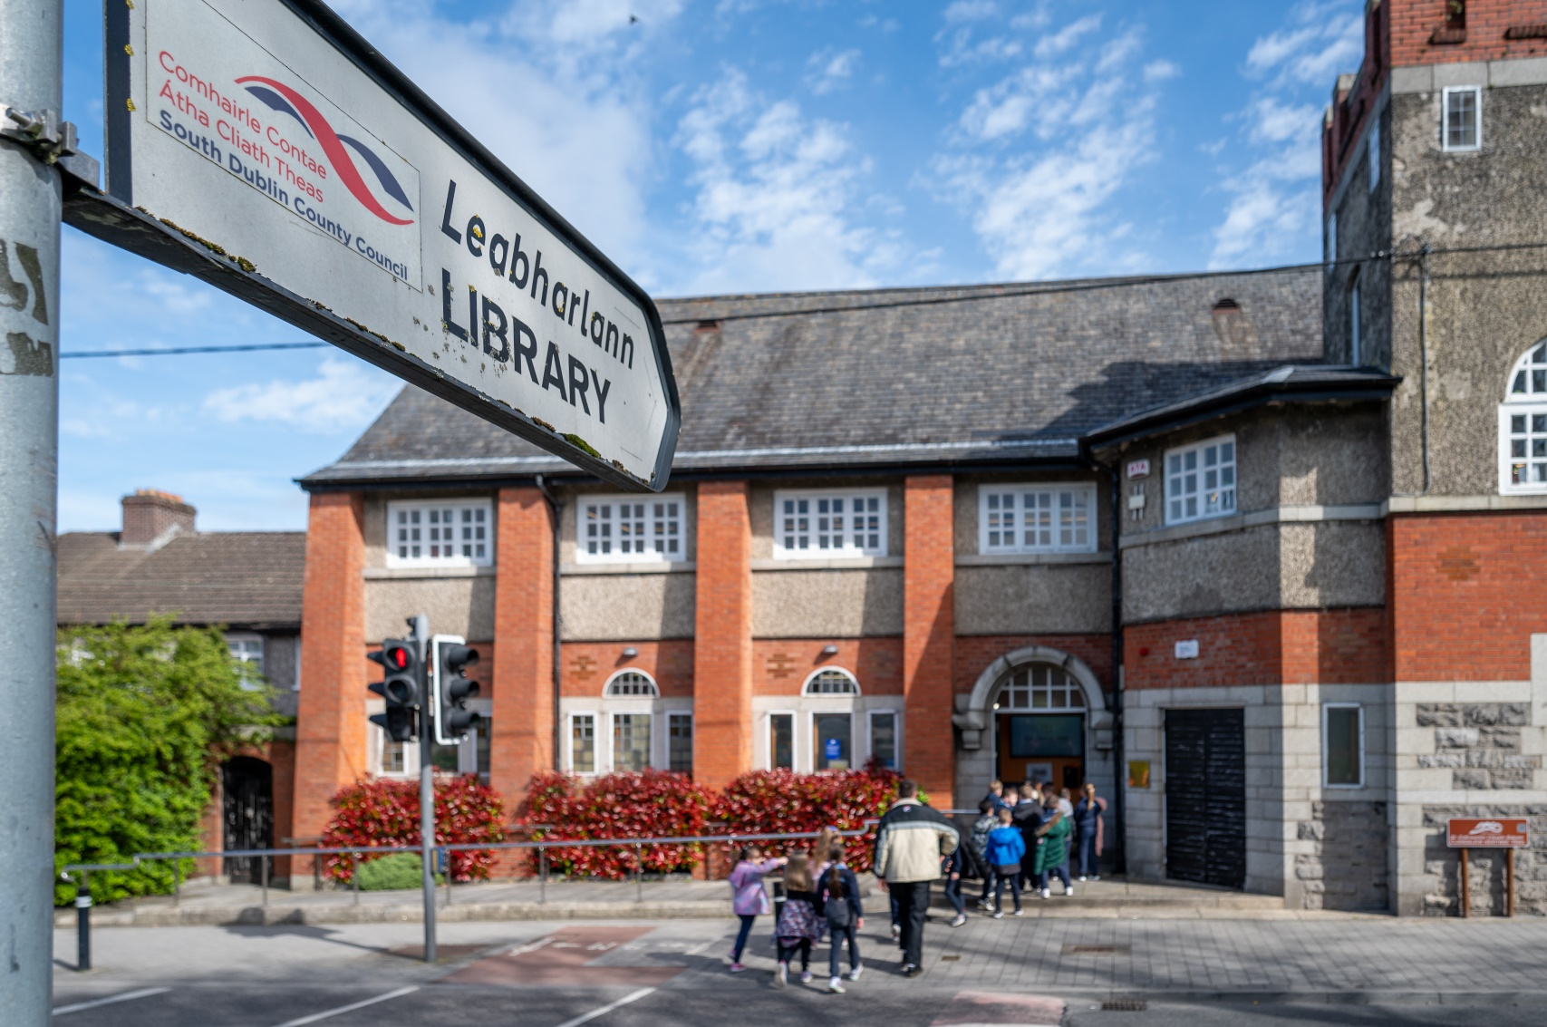
Statistics
September 2025
6716 Visitors
3117 Issues
171 New Members

Slide 3
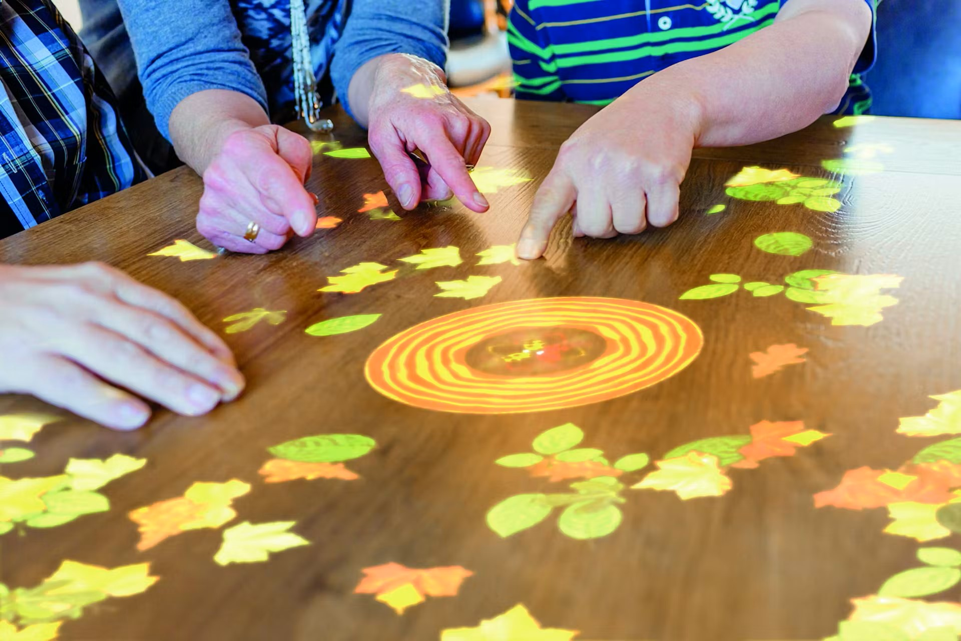
Magic Table
TheMagic Table (or Tovertafel) is an award-winning system that projects interactive games onto any surface, bringing joy to people with cognitive challenges such as dementia or learning disabilities through play.
Designed to adapt to a wide range of care needs, its games are scientifically proven to stimulate on a social, physical and cognitive level.
Clondalkin Library now has our very own portable magic table which can be booked for use by groups in the library. We can also facilitate outreach visits to other venues.
We are delighted to add this state of the art piece of equipment to our sensory and age friendly offerings at Clondalkin Library.
Any groups interested in booking or an outreach visit can simply contact the library to make arrangements.

Slide 4
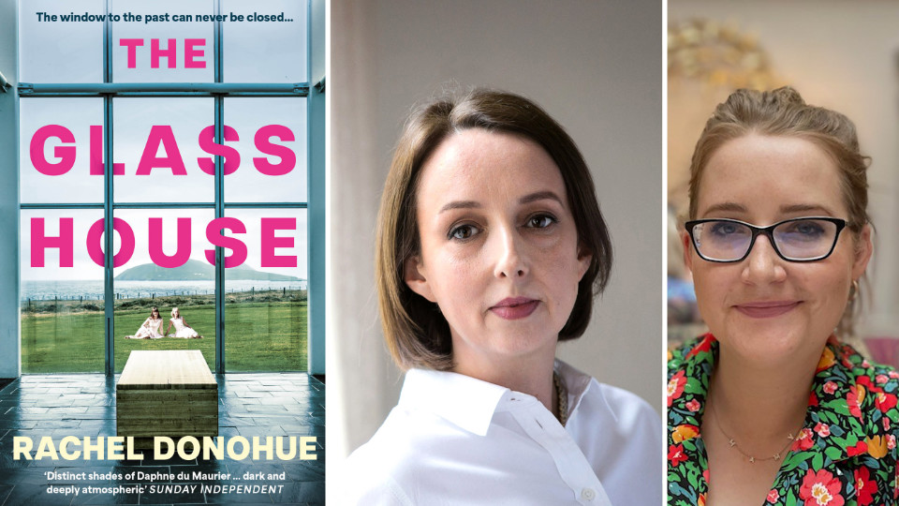
Red Line Festival
The Red Line Book Festival is taking place from 13th – 19th October.
Now in it’s 14th year, this year’s Red Line Book Festival includes over 40 events across the county.
In Clondalkin Library we’re delighted to be hosing the following event:
The Glass House
Rachel Donohue in conversation with Chloe Cowman
Tuesday 14th October 6.30pm

Slide 5
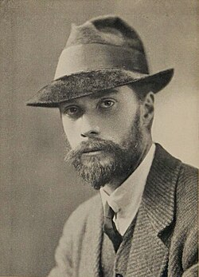
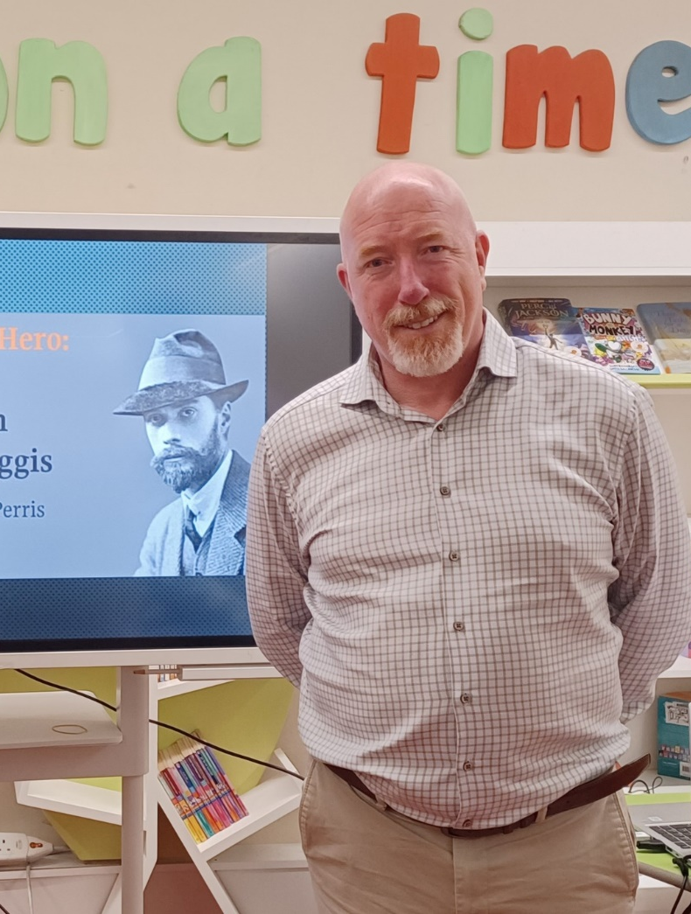
Local History
As part of the Dublin Festival of History Clondalkin Library hosted a talk by historian Albert Perris on 2nd October:
‘Return of the Hero: The life and death of Daryl Figgis’
Poet, Novelist, Playwright, Gun-runner, Activist, Parliamentarian, and T.D. 100 years after his untimely death Albert Perris revisits the life and death of Darrell Figgis, and seeks to appraise the role played and contribution to the birth of a nation, of this most colourful character.
Coming up on 6th November:
‘The Secrets in Dublin Pub Names’ Cathy Scuffil will uncover how the pub names of Dublin present images of history and other events unique to Ireland and Irish life.

Slide 6
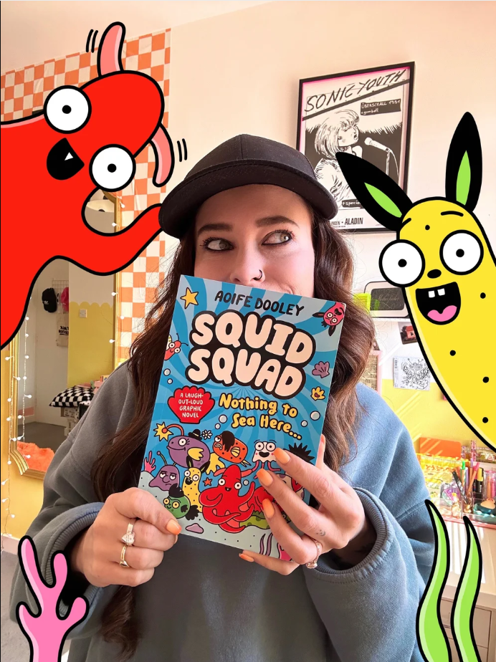
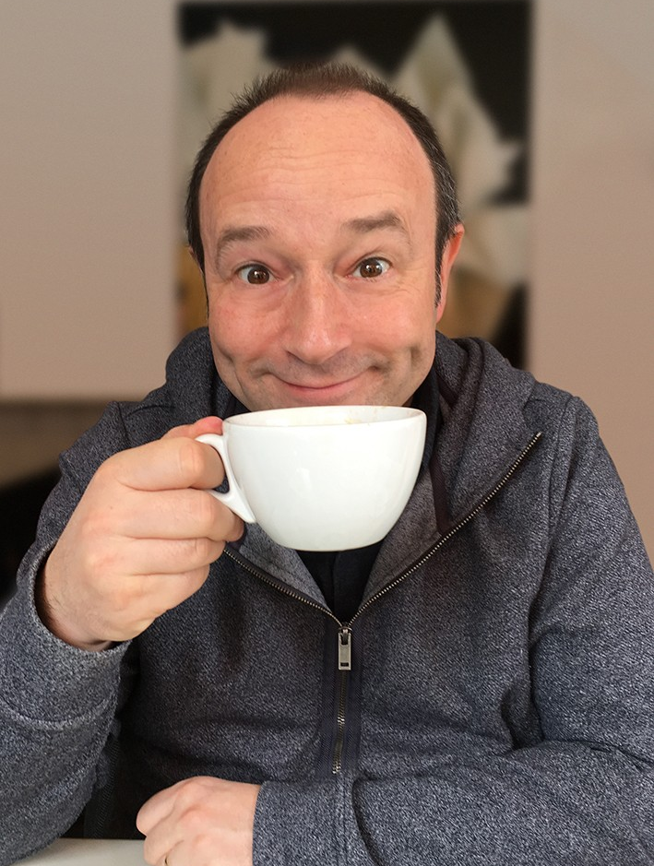
Children’s Books Festival
Children’s Book Festival takes place in Libraries across the country each October.
In Clondalkin Library we are hosting the following events as part of Children’s Book Festival
Monday 20th October
10.00 & 11.15am (3rd – 6th Class)
The Grand Central Cinema Club with Alan Nolan
Join Alan Nolan for a fun and interactive drawing workshop based around his new book The Grand Central Cinema Club.
Wednesday 29th October
3.30pm
Draw along with Aoife Dooley (age 9-12)
Aoife Dooley is an award winning illustrator, writer and comedian. She is also a graphic designer and public speaker.
In 2022 Frankie’s World a graphic novel for children based on Aoife’s real-life experiences of autism was published. Aoife’s latest book is Squid Squad

Slide 7
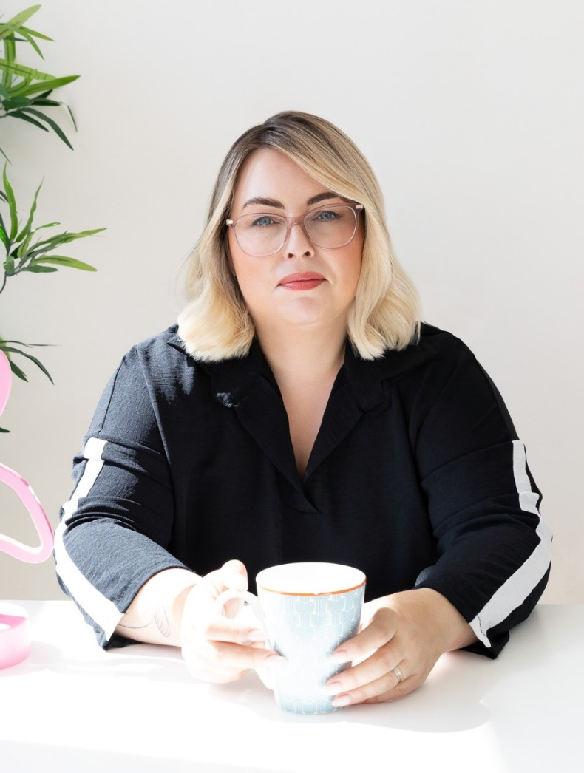

World Menopause Day
As part of the Healthy Ireland at your Library programme we are delighted to welcome Martina Williams to Clondalkin Library for World Menopause Day
October 21st at 6.30pm
A Conversation in Celebration of World Menopause Day
Menopause is a natural and powerful transition that every woman will experience—yet it's often misunderstood or overlooked. Join us for a thoughtful and supportive session with Martina, where we’ll explore the full impact of menopause—not just the physical changes, but also how it touches our emotional and psychological wellbeing.
Martina is a psychologist based in Clondalkin who specialises in women’s mental health.

Slide 8
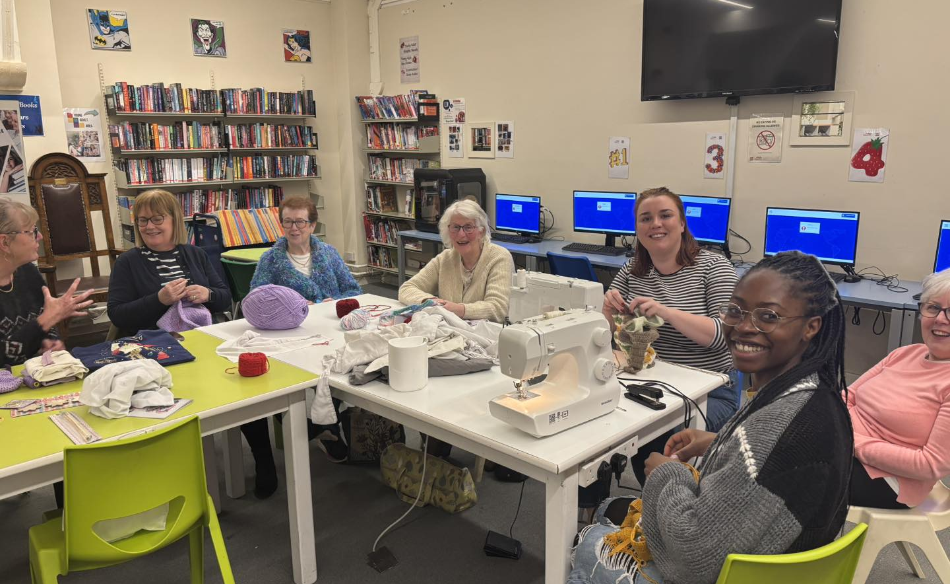
Courses starting September and October
The following courses and classes are commencing in September and October for Adults
Computers and Digital Skills for beginners
(8 weeks from 17th September)
Crochet for beginners and improvers
(4 weeks from 8th October)
Irish for beginners
(6 weeks from 14th October)

Slide 9
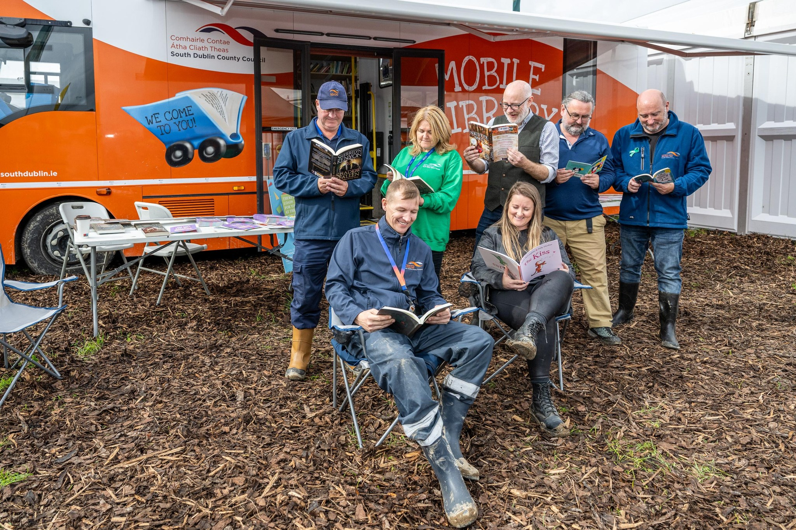
Mobile Libraries
Statistics September 2025
Outreach events
Corkage Park Colour Dash
3 days at The Ploughing Championship (reaching over 1000 visitors)
22 School Visits
9404 Issues
295 New Members

