Slide 1
H-11 - Part 8 report for proposed development of 25 social homes at Stocking Lane & Stocking Avenue, Rathfarnham, Dublin 16
Meeting of South Dublin County Council
13th October 2025

Slide 2
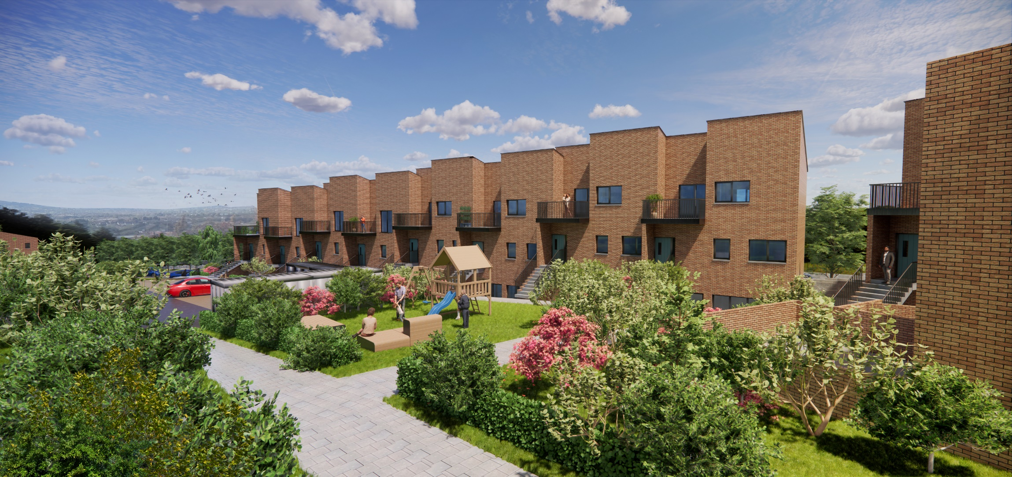

Slide 3
Background and Policy Context
South Dublin County Council Development Plan 2022–2028 - Housing Policy 2: Supply of housing
    H2 Objective 6: To ensure an adequate and appropriate provision of social housing across the County
    H2 Objective 7: To promote integration of all tenure types within communities
South Dublin County Council Development Plan 2022–2028 - Housing Policy 3: Housing for all
    H3 Objective 2: To support housing options for older persons and persons with disabilities
Housing for All – Objective 4
    Increase Social Housing Delivery
South Dublin Housing Delivery Action Plan 2022 – 2026:
Commitment to providing high-quality, mixed typology social housing & achieving increased social integration and tenure mix across all areas of the County
Promoting high-quality living environments and lifetime housing standards through
optimum design, environmental performance and layout in new residential developments

Slide 4
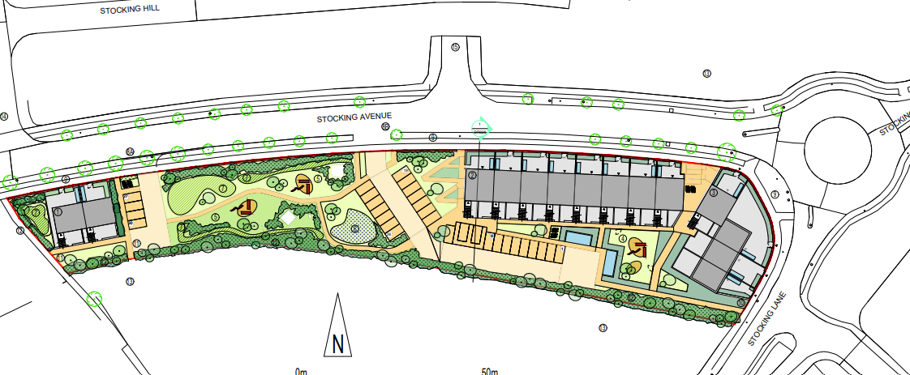
Proposed Development
Three two and three-storey apartment buildings which will comprise:
11 x one bedroom ground floor apartments (Nine of the ground floor units have been designed to Universal Design space standards)
9 x three-bedroom first floor duplex apartments
2 x two-bedroom first floor duplex apartments
3 x two-bedroom houses
Private and shared open-space
30 car-parking spaces (incl. accessible and EV Charging), landscaping and all associated works

Slide 5
Public Consultation- Submissions & Responses
Briefing for RTFB Area Committee in June 2025
6-week formal public consultation period 31st July 2025 – 12th September 2025
4 submissions received relating to:
Public Realm / Open Space
Roads / Traffic/ Parking / Water / Wastewater
Design / Density / Site Location
Environmental Concerns
Statutory Submissions
Responses:
All submissions fully addressed in CE Report
Two variations to the proposal following consideration of submissions

Slide 8
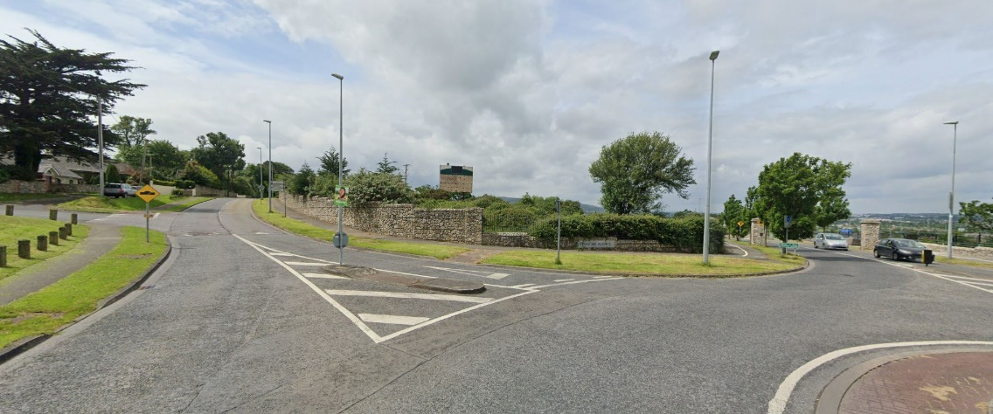
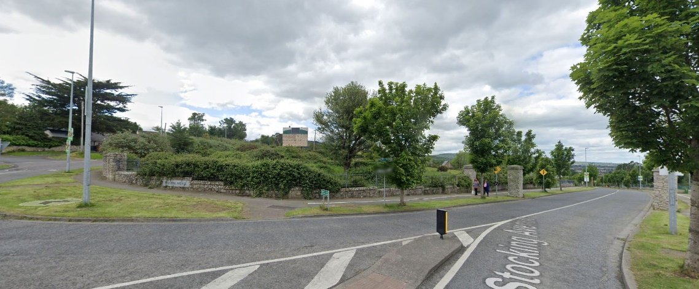
Site from roundabout at Stocking Avenue and Stocking Lane looking west.
Site from junction of Stocking Avenue and Stocking Lane looking west.

Slide 9
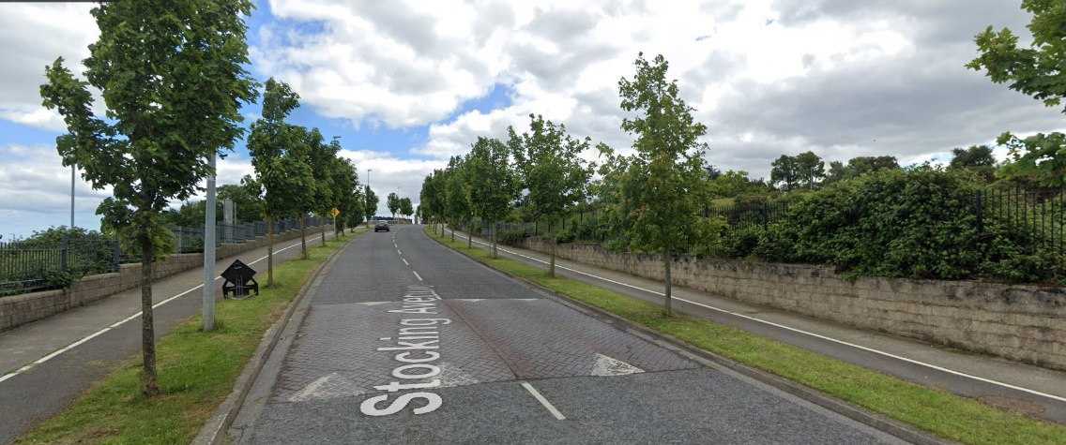
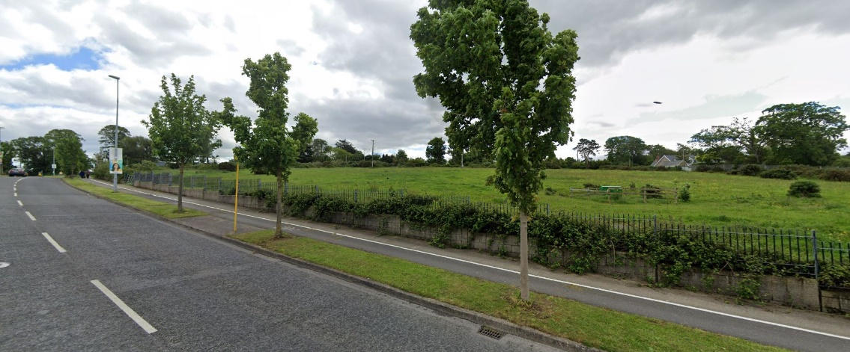
Site on right of image from Stocking Avenue looking east.
View 1.4 – Site from Stocking Avenue looking north-east.

Slide 10
Zoning Map extract from SDCC County Development Plan 2022-2028. Subject site outlined in red –
RES N; ‘To provide for new residential community in accordance with approved area plans'

Slide 14

Artist’s impression of proposed development. View looking south-west.

Slide 15
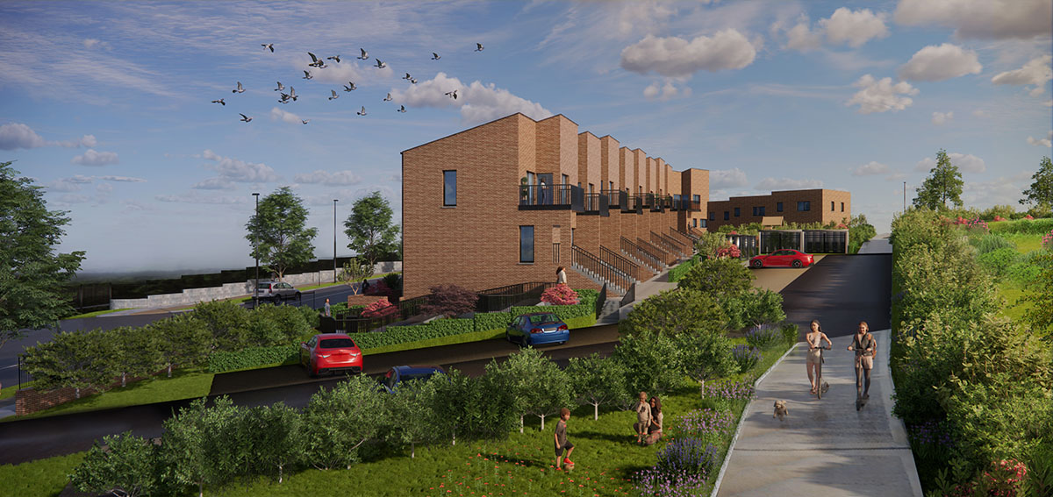
Artist’s impression of proposed development. View looking east.

Slide 16
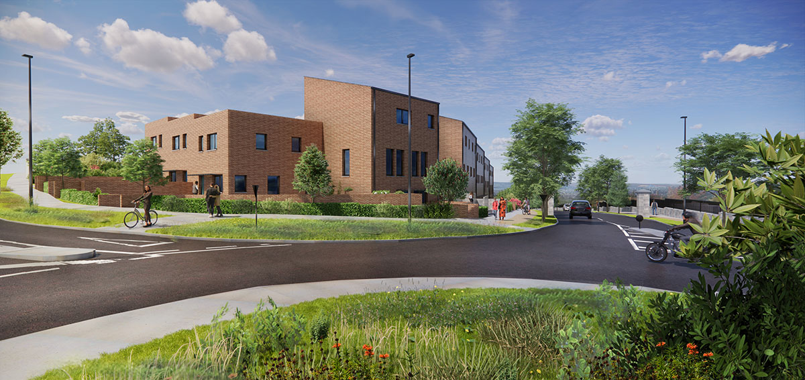
Artist’s impression of proposed development. View from Stocking Lane.

Slide 17
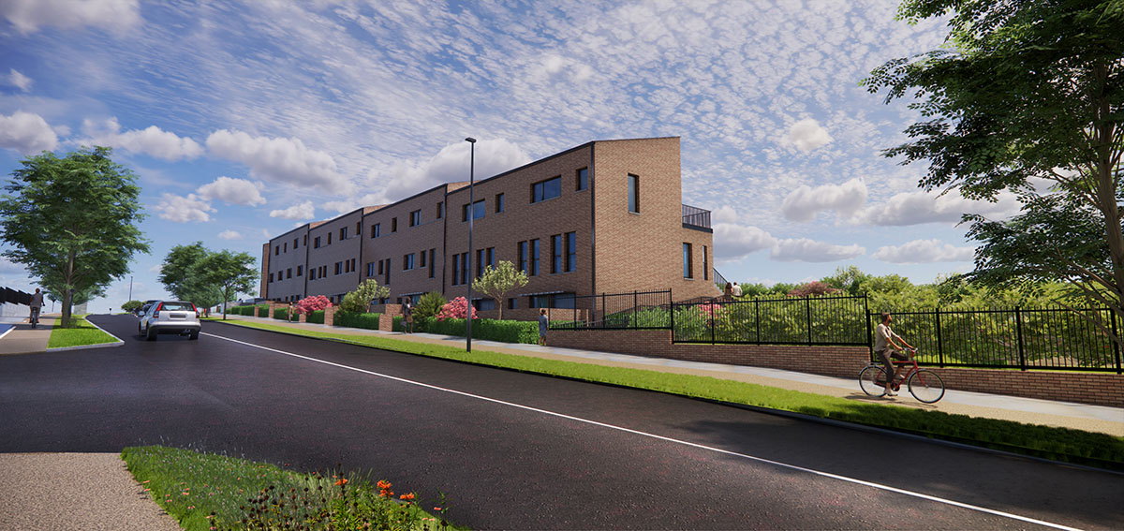
Artist’s impression of proposed development. View from Stocking Avenue.

Slide 18
Recommendation
Overall proposal in accordance with proper planning & sustainable development of area
Recommendation to Council to approve proposed development with amendments as outlined
Next steps if Part 8 approved
Develop detailed design & proceed to tender for contractor to achieve projected construction start in late 2026 for 2028 delivery
Funding applications to DHLGH under Social Housing Investment Programme

Slide 19
Thank you

