Slide 1
NPF Implementation Guidelines– Housing Growth requirements Update
Settlement Capacity Audit
Active Land Management
Planning & Transport

Slide 2
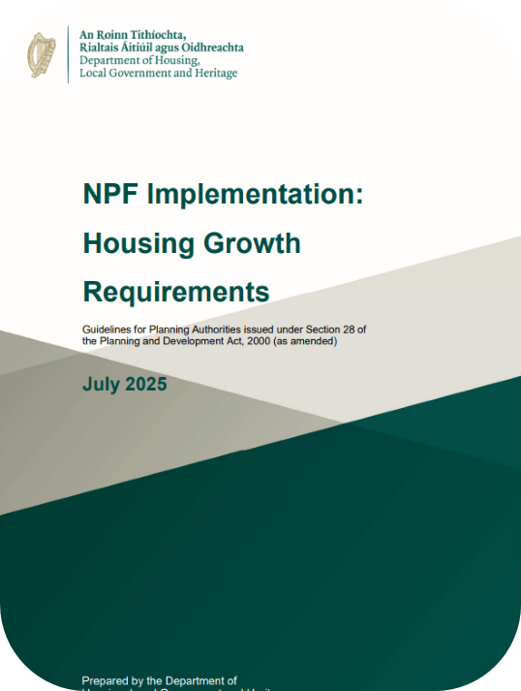
Context
National Planning Framework (NPF) First Revision, April 2025:
  950,000 additional people between 2022-2040
  Retains compact growth targets for housing within built up areas
  Average 50,000 new homes per annum needed to 2040
Section 28 Guidelines - NPF Implementation: Housing Growth Requirements:
Local Authorities are required to, inter alia:
  Review existing land capacity and vary development plans as necessary
  Consider “additional provision” for up to 50% zoned land above baseline housing target
  Plan for current Dev Plan and consider suitability of lands over the subsequent 10-year Dev Plan period
Annual Housing Targets 2025-2040
 | National | SDCC
2025-2034 | 55,598 | 3,270
2035-2040 | 41,312 | 2,414
Total | c.800,000 | c.47,000

Slide 3
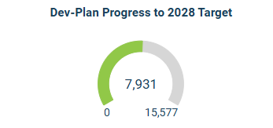
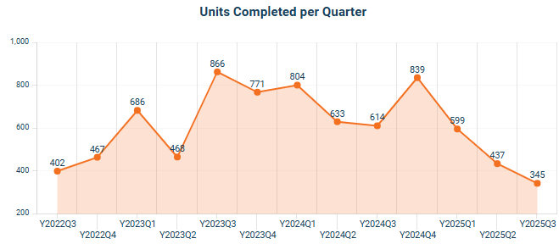
Housing Completed 2022-Present
Current Development Plan housing target 2022-2028:
  15,576 dwellings total
  2,613 dwellings per annum
Completed since 2022 (Q3 2022 to Q2 2025):
  7,931 dwellings total
  2,644 dwellings per annum average
Short-term pipeline:
  5,481 dwellings currently under construction
  Housing delivered in 2025: 1,381 from Q1-Q3

Slide 4
Housing Requirement for SDCC
SDCC Baseline Housing Targets 2025-2040
 | 2025-2028 | 2029-2030 | 2031-2034 | 2035-2040
Annual | 3,270 | 3,270 | 3,270 | 2,414
Total for Period (less already delivered in 2025)* | 11,699 | 6,540 | 13,080 | 14,484
Cumulative Total | 11,699 | 18,239 | 31,319 | 45,803
*SDCC monitoring indicates 1,381no. dwellings completed in 2025 up to end Q3
Additional Provision
The 2025 Guidelines provide for each Local Authority to consider “additional provision” of up to 50% additional zoned land above baseline housing target.
“Additional provision” is to support the achievement of the baseline housing target by providing for flexibility in the supply of new housing and account for a proportion of zoned lands not being activated.
Additional provision should be deliverable within the relevant Development Plan period.
The proportion of Long-Term Strategic Development Areas likely developable over subsequent development plan periods are not “additional provision”.
It does not change the baseline housing growth target as set out in the 2025 Guidelines.

Slide 5
Current Development Potential

Slide 6
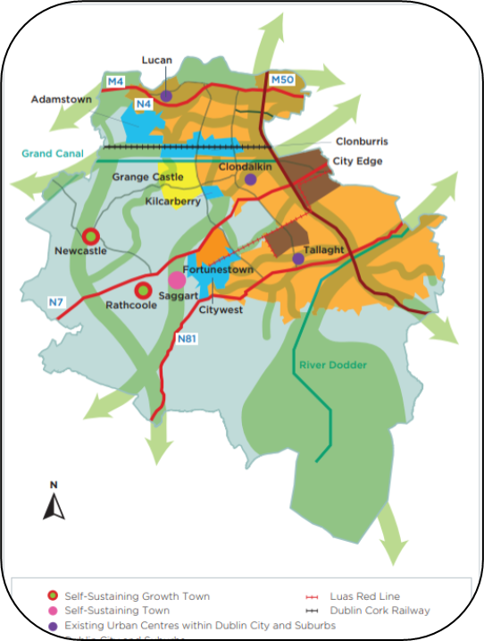
Approach
Settlement Capacity Audit underway to assess current zoned land capacity, deliverability and to identify blockages to development.
Build an understanding of finite lands and competing needs for various uses.
A mapping tool for all lands across the County has been developed which incorporates information to assist in determining the suitability, deliverability and development potential of lands for residential uses.
The tool is linked to the housing supply monitor to provide accurate and up to date information on construction activity and planning status.
Density framework devised to apply appropriate density ranges.
Assumption of net site area for each site to reflect likely developable area.
Infrastructure, planning and sustainability assessment to assess suitability and deliverability of lands.
Stakeholder engagement with various SDCC directorates and key external partners.
Identification of potential future development lands (i.e. not currently zoned for residential use).
Evidence-led criteria-based assessment of lands aligning with local, regional and national policy to identify the most suitable lands.

Slide 7
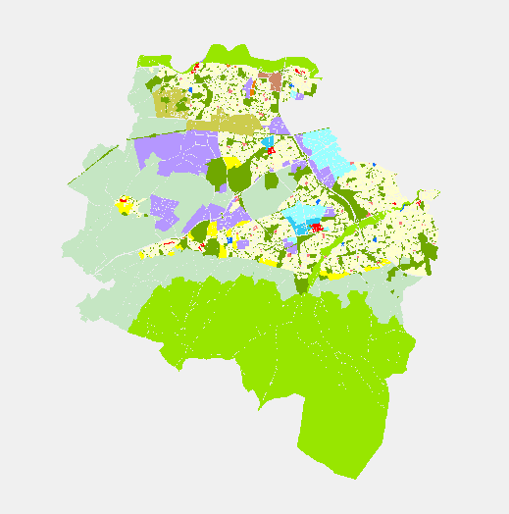
Approach
A spatial overview of land status and development potential under the following classifications:
    None – Lands not considered to have any potential for residential development for the foreseeable future.
    Under Construction – Lands that have a grant of permission, and development has commenced.
    Outstanding Permission - Lands that have a grant of permission, but development has not commenced.
    Zoned Available (Non-Strategic) – Lands zoned and available for residential development outside of identified strategic development areas.
    Zoned Available (Strategic) – Lands zoned for residential development within strategic development areas.
    Long-term Zoned Potential - Lands zoned for residential uses considered to be underdeveloped, but which would require significant intervention/redevelopment.
    Future Potential - Lands not zoned for residential uses, but which may have future potential for residential uses subject to assessment.

Slide 8
Current Zoned Land Capacity
‘SDAs’ are Strategic Development Areas, including:
    Adamstown SDZ
    Clonburris SDZ
    Tallaght LAP
    City Edge
‘Non-SDAs’ comprises of the rest of the County.
‘Total Zoned Land Capacity’ comprises of zoned lands (construction ongoing, permission in place and zoned) considered to be developable in the short/medium-term, subject to more detailed site-specific analysis.
    This includes a proportion of lands within strategic development areas.
‘Long-term Zoned Potential’ comprises of zoned lands considered to be developable over a longer timeframe (up to and beyond 2040) due to, inter alia:
    Gradual regeneration, infill or backland development,
    Anticipated phased delivery of strategic long-term development areas, and
    Significant constraints or infrastructure shortfalls to be addressed.
Further detailed infrastructure and planning analysis (currently underway) is required to estimate the deliverability of these lands to ascertain the adequacy of zoned lands to key milestones of 2028, 2030, 2034 and 2040 in order to respond to the revised housing targets.

Slide 9
Current Zoned Land Capacity
Zoned Land Capacity and Status as of Q3 2025
Status | Total No. Dwellings | Total Area (Hectares) |  | Of which are in: |  | Average Densities
 |  |  |  | SDAs* | Non-SDAs*
Under construction | 5,502 | 96 |  | 3,633 | 1,869 | 57 dph
Permitted | 7,028 | 136 |  | 4,039 | 2,989 | 52 dph
Zoned Available Non-Strategic | 6,260 | 127 |  | 0 | 6,260 | 49 dph
Zoned Available Strategic | 16,926 | 215 |  | 16,926 | 0 | 79 dph
Total Current Zoned Land Capacity | 35,716 | 574 |  | 24,598 | 11,118 | 62 dph
Long-term Zoned Potential (up to and beyond 2040) | 21,825 | 271 |  | 19,170 | 2,655 | 80 dph
Total Long-term Zoned Land Capacity (up to and beyond 2040) | 57,692 | 845 |  | 43,768 | 13,924
*SDAs are Strategic Development Areas
NOTE: These figures are estimates based on high level assessment. This is an ongoing exercise and these figures may change as more detailed analysis is carried out or further information arises.

Slide 10
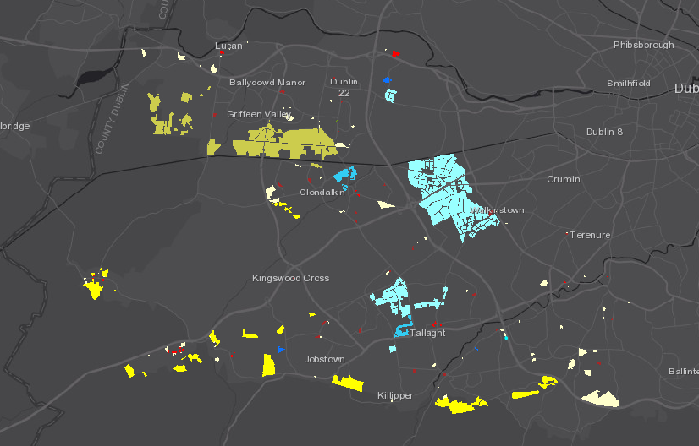
Current Zoned Land Capacity

Slide 11
Estimated Forecast of Land Capacity Delivery
An infrastructure and planning assessment of zoned lands is ongoing to further inform the deliverability of these lands.
While this is ongoing the following assumptions have informed forecasts for estimated delivery of land capacity based on, inter alia:
    planning and construction activity,
    likely timelines for planning/construction,
    potential for permitted lands not to be delivered, and
    possible zoned lands coming forward at a quicker rate.
Non-SDAs:
    All lands currently “Under construction”, “Permitted” and “Zoned Available” forecast to be deliverable between present and 2040.
    It is recognised that some of these lands will not be delivered however, based on past experience, this is likely to be balanced by lands coming forward for development which are not currently identified.
SDAs:
    Various annual rates of delivery estimated based on construction and planning activity to date and anticipated phased delivery of these areas with infrastructure and services.

Slide 12
Estimated Forecast of Land Capacity Delivery
Estimated Forecast of Land Capacity Delivery to 2040 (no. of dwellings)
 | 2025-2028 | 2029-2030 | 2031-2034 | 2035-2040 | TOTAL
SDAs | 7,706 | 4,034 | 7,715 | 5,143 | 24,598
Non-SDAs | 1,869 | 1,542 | 3,083 | 4,625 | 11,118
Forecast Land Capacity Delivery | 9,575 | 5,576 | 10,798 | 9,768 | 35,716
Cumulative Forecast Land Capacity Delivery | 9,575 | 15,151 | 25,949 | 35,716
Cumulative Baseline Housing Requirement | 11,699 | 18,239 | 31,319 | 45,803
% of target | 82% | 83% | 83% | 78%
Estimated Shortfall to Achieve Baseline Target in Relevant Timeline | 2,124 | 3,089 | 5,370 | 10,087
Equivalent Land Requirement (at densities of 40-80 dph) | 26-53 ha | 38-77 ha | 67-134 ha | 126-252 ha
NOTE: Requirement to consider “additional provision” of up to 50% additional zoned land above baseline housing target to support the achievement of the baseline housing target.

Slide 13
Summary to Date
Revised housing targets set out annual housing requirements to 2040 for SDCC:
    3,270 per annum 2025-2034
    2,414 per annum 2035-2040
Detailed land capacity carried out, aligned with national, regional and local policy objectives and Government and local guidelines re density, proximity to public transport and services and high-level view of possible site constraints.
Current zoned land capacity potential: 35,716no. dwellings across 574 hectares of brownfield, greenfield and infill lands.
Long-term zoned land capacity potential, anticipated as up to and beyond 2040, for 21,813no. dwellings across 271 hectares of brownfield, greenfield and infill lands.
Initial estimates of forecast delivery of housing on currently zoned lands indicates a shortfall to achieve baseline targets:
Estimated Forecast of Land Capacity Delivery to 2040 (no. of dwellings)
 | 2025-2028 | 2029-2030 | 2031-2034 | 2035-2040
% of target estimated to be delivered | 82% | 83% | 83% | 78%
Estimated Shortfall to Achieve Baseline Target in Relevant Timeline | 2,124 | 3,089 | 5,370 | 10,087

Slide 14
Next Steps
1.) Land Capacity Study

Slide 15




Settlement Capacity Audit
Ongoing
1) Land Capacity Study
2) Planning Assessment
3) Infrastructure Assessment
4) Deliverability analysis
A Land Capacity analysis to calculate the potential unit yield of:
(i) Undeveloped zoned lands in the 2022-2028 CDP.
(ii) Potential future development lands (i.e. not currently zoned for residential use)
A Planning assessment to evaluate the suitability of these lands for residential development in line with national, regional and local priority objectives relating to, inter alia, sustainability, compact growth, sustainable mobility and climate action
An Infrastructure Assessment to categorise the identified lands into either: Tier i (serviced) or Tier ii (serviceable within the lifetime of the plan).
An evaluation of the practical potential for the delivery of housing and development across the county, over the course of the plan period.

Slide 16

Variation
Report of the Chief Executive to Elected Members (October) detailing:
  The settlement capacity audit of currently zoned lands,
  Intention to cover shortfall in housing targets and the anticipated need and rationale for "additional provision" zoning of land above baseline targets, ​and
  Long-term preliminary planning for achievement of targets to 2040.
  Also provided to the Minister and OPR.
SEA, AA, SFRA
Consideration of options/alternatives
Preparation of detailed Variation
  Briefing to Elected Members​
  Amendments to core strategy, and associated text, and proposed zoning changes to the Development Plan
Variation of County Development Plan (Indicative timeline below, TBC)
  4 weeks Display and Public Submissions
  4 weeks CE Report
  6 weeks Elected Members consider CE Report
  Variation has immediate effect once made, or:
    Material Alterations and further consultation, etc.

