Slide 1
Clondalkin Local Planning Framework Update
SPC 2nd October 2025
Hazel Craigie

Slide 2
Draft Local Planning Framework
Variation no. 1 to County Development Plan
Clondalkin Draft Local Planning Framework

Slide 3
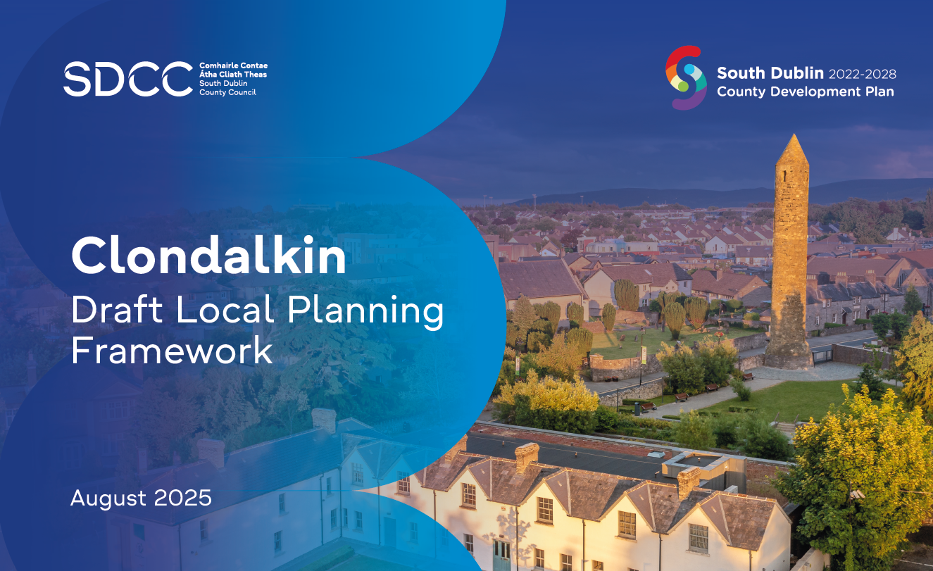
What is in the Planning Framework?
Nine Chapters looking at:
Context
Vision and Strategic Objectives
Climate Action and Infrastructure
Green Infrastructure
Sustainable Transport
Community, Homes and Economy
Conservation and Built Heritage
Urban Design Strategy
Implementation and Monitoring
The framework sets out objectives within each of the chapter headings

Slide 4
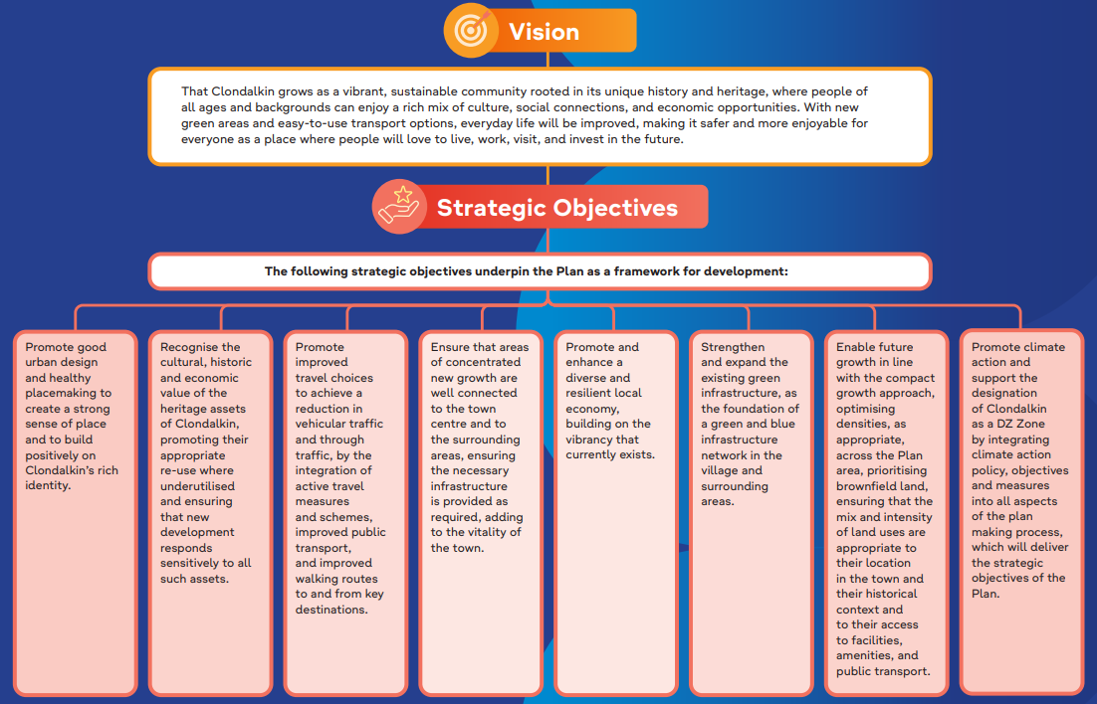
Documents that supported preparation of the LPF
Supporting Documents
The preparation of the Local Planning Framework and its objectives was supported by studies prepared by specialists in their field.
This included:
A Conservation Plan
Architectural Conservation Area Appraisals
A Local Transport Plan
The recommendations from those studies/documents were taken account of in the objectives contained in the LPF.
Environmental Assessments
SEA, AA and SFRA were undertaken on the draft LPF and accompany the variation.

Slide 5
Publication of Draft Framework
2
Clondalkin Draft Local Planning Framework

Slide 6
Public Consultation
Started 26th August and runs to midnight on 29th September
Three information sessions held in Clondalkin, well attended
Submissions can be made online Draft Clondalkin Local Planning Framework | South Dublin County Council's Online Consultation Portal or by post
Approximately 80 submissions to date and rising
The majority are concerned with specific locations identified in the plan as routes to improve access permeability

Slide 7
Variation Process
3
Clondalkin Draft Local Planning Framework

Slide 8
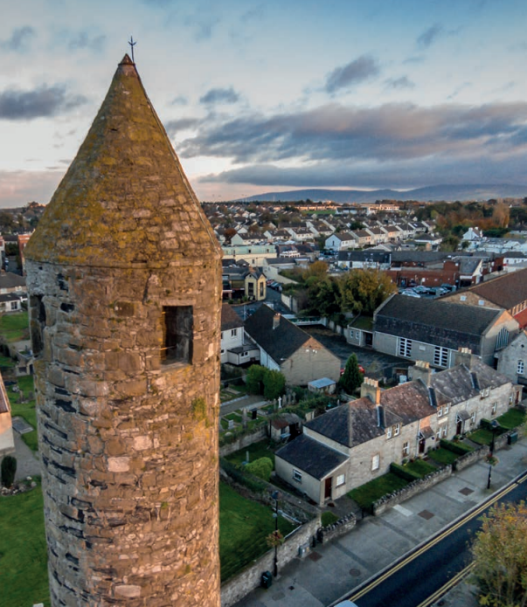
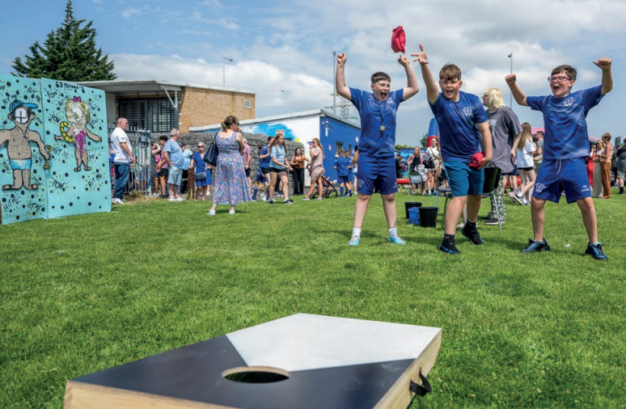
Next Steps
Submissions are reviewed and summarised as part of a Chief Executive’s Report to Members
CE Report will go to all Members in early November (November 4th)
Immediately followed by briefings for all councillors
A special development plan meeting to be held on 11th December 2025
At that meeting the variation (LPF) will be adopted, amended or rejected
If material amendments are made to the variation they will have to go out on public consultation
Members will be giving consideration to the Clondalkin Draft Local Planning Framework and the associated environmental assessments.

Slide 9
Thank you

