Slide 1
Renewable Energy Directive III
Implementation Update
*
Planning & Transport SPC – October 2nd

Slide 2

Background
What is RED III?
The EU’s Renewable Energy Directive (third version) – Europe’s main legislation to accelerate the shift to clean energy.
Purpose of REDIII?
By 2030, nearly half of all energy must come from renewables (42.5% target, aiming for 45%).
What is Ireland’s role?
As an EU Member State, Ireland must update its planning system so renewable projects (solar, wind, heat pumps) can be approved faster and more consistently.
What is S.I. 274/2025?
A Statutory Instrument that came into force on 7th of August 2025.
It brings the REDIII rules into Irish planning law, changing how local authorities handle renewable energy applications.
What Does it mean for SDCC?
New application completeness checks
Fixed decision timelines
Mandatory EIA scoping from October 2025
Stronger legal backing: renewables treated as “overriding public interest”.

Slide 3

July 2025
European Commission opened infringement proceedings against Ireland for failing to fully transpose the REDIII permitting provisions by the May 2025 deadline.
August 2025
Ireland enacted S.I. 274/2025 bringing REDIII’s new requirements into national law and appointing SEAI as the Single Point of Contact.
May 2026
Ireland must implement REDIII’s sectoral targets increasing renewables in transport, heating, industry, and buildings.
REDIII Implementation Timeline

Slide 4
Example REDIII Development Types
Category | Examples
Renewable Energy Generation | Onshore wind farms, Offshore wind projects (incl. ports & grid connections), Solar farms (>50 kW), Rooftop solar PV (<50 kW)
Heating & Cooling | Domestic & commercial heat pumps (air/ground source), District heating schemes (biomass, geothermal, waste heat), Solar thermal panels
Storage & Grid | Battery Energy Storage Systems (BESS), Hydrogen electrolysers (green hydrogen), Grid connection works (substations, overhead lines, cables)
Transport Infrastructure | EV charging hubs powered by renewables, Hydrogen refuelling stations
Repowering & Upgrades | Repowering existing wind or solar farms, Efficiency upgrades to renewable plants

Slide 5

Planning Decision Timelines
Application / Development Type | Deadline | Extended deadline for IROPI Cases
Renewable energy development with an electrical capacity of 150kW or more | 52 weeks | 2 years
Renewable energy development with capacity of less than 150kW and repowering development | 30 weeks | 1 year
Ground source heat pumps and relevant solar energy development | 8 weeks | N/A
Small-scale solar energy equipment or small-scale non-ground source heat pump | 4 weeks | N/A
*Above commences after
Completeness Check (30-45 days)

Slide 6
Changes for Planning Department
Aspect | Before RED III | After RED III (S.I. 274/2025)
Validation | No statutory timeframe | ‘Completeness Check’ – PA must confirm within 45 days (30 days for small-scale heat pumps)
Decision timelines | General statutory period under s.34 PDA 2000 (8 weeks), extendable by FI requests | New maximum statutory periods apply for renewables; flexible FI timelines to keep within prescribed time.
Small-scale solar / heat pumps | Treated like other minor development with normal timelines | Accelerated timelines (4weeks) for <50kW solar & domestic heat pumps; deemed consent if PA misses deadline
EIA Scoping | Optional – applicant could request scoping but not mandatory | Mandatory scoping opinion required for REDIII projects from 1 Oct 2025.
Public interest weighting | Renewables assessed alongside other policies | Renewable energy deemed of ‘overriding public interest’ in AA under Habitats Directive
Renewables Acceleration Areas | No special designation in plans | By Feb 2026, Ireland must designate RAAs; applications here have shorter statutory timelines

Slide 7
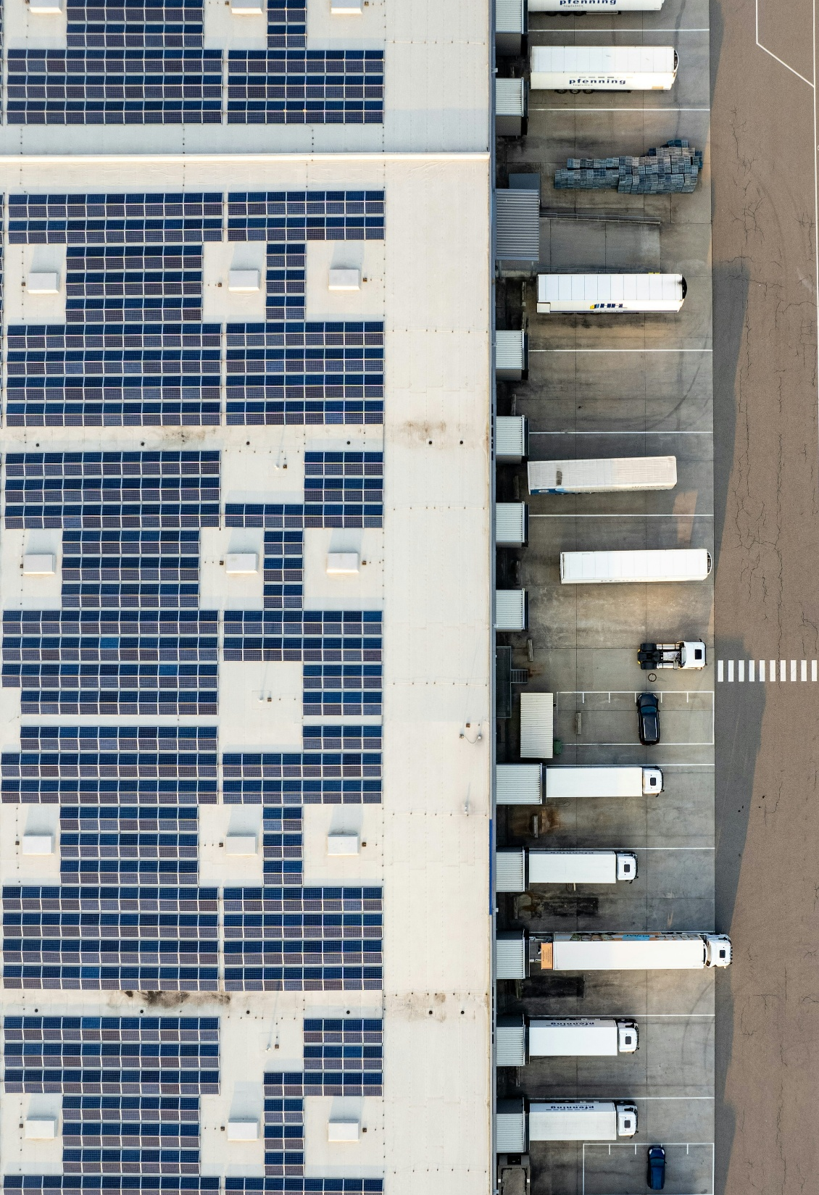
Next Steps
Website updates with guidance on pre-planning, new site notices etc. (application forms unchanged)
Planning Portal – update to reflect new deadlines based on development type / monitor in excel in interim.
Ensure any REDIII applications are noted on Weekly List
Devise reporting system for SEAI
Prepare checklists for mandatory EIAR scoping Oct 1st.
Prepare guidelines for flexible AI timelines.
Continual training across planning and planning administration

Slide 8
Questions
Thank you

