Slide 1
Telecom Duct Strategy
Created by
G. Walsh
Presented by
G. Walsh

Slide 2
OBJECTIVE
Enable cost-effective, future-proof digital connectivity by installing an open access duct network across the SDCC area, supporting multiple operators and fostering competition, innovation, and economic growth.

Slide 3
1. Strategic objective
Digital Inclusion
Market Enablement
Economic Growth
Data Centre Capacity
Environmental Benefits
Maximise Utilisation
Utility Planning

Slide 4
2. Delivery Approach
Map Infrastructure
Phased Rollout
Leverage Public Works
Leverage Third Party Works
Open Access Model
Governance & Ownership
  Where ducts are installed in public land an agreed number of ducts will be installed on behalf of SDCC who will retain ownership of these ducts for their own use, or make them available to other operators in the future.
  Where ducts are installed in SDCC parks all ducts will be owned by SDCC and leased to operators as required.
  These rules of engagement will be embedded in the ROL (Road Open License) processes

Slide 5
3. Partnerships & Stakeholders
South Dublin County Council
Telecom Operators
Utilities & Developers
Community Stakeholders
Funding Sources

Slide 6
4. Success Measures
Increased number of operators using the ducts.
Reduction in average broadband deployment time and cost.
Improved coverage and service competition across the South Dublin Council area.
Improve resident and business satisfaction with digital services.
Commercial requirements are met in line with other SDCC objectives.
Optimise the use of public land.

Slide 7
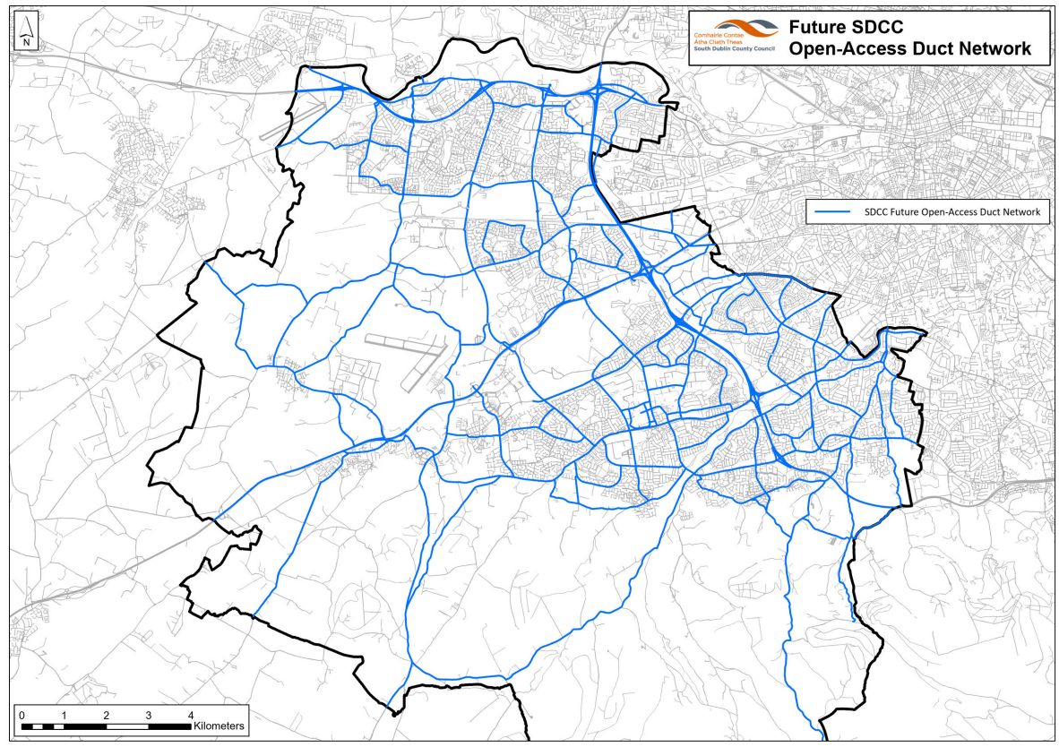
Future Duct Network

Slide 8
Next Steps
(12 Months)
Establish a governance model to control the current and planned projects.
Integrate ducting into selected new public and private works.

Slide 9
Thank you
#TalVES

