Slide 1
SDCC Arts Office September ACM Report
Created by
Arts Office
Presented by
Gerry Horan

Slide 2
Arts Report
Creative Ireland: Schools Culture Award Open for Applications
Creative Ireland South Dublin are happy to announce the Schools Culture Award is now open for applications, this award is open to interested schools located in South Dublin County. The initiative seeks to support primary schools, second level schools and programmes that support early school leavers, to engage with an artist to develop programmes and projects that will enrich arts practice in schools in the county, in the disciplines of Drama, Dance and Visual Arts. Awards will be granted in the region of €500 - €2000. The maximum amount of any award is €2000. Deadline: Completed applications must be submitted no later than 5pm on Friday 26th September.
Creative Ireland LEO South Dublin Film Award
Creative Ireland South Dublin and LEO South Dublin are seeking applications from filmmakers living in the South Dublin County Council administrative area, who have a developed script which has been seen by a Director and has input from a Producer, for the Film Award 2025. The aim of the award to develop talent, creativity, and activity in filmmaking within the South Dublin County. The Award of up to €10,000 will be made to a filmmaker or film company towards the cost of production of a short film (drama or documentary) of 12 – 15 minutes in duration to be shot in South Dublin County administrative area. Applicants must be subscribed to the SCENe Network, for more information on how to become a member, please visit https://www.localenterprise.ie/SouthDublin/Local-Networks/SCENE-South-Dublin-Creative-Economy-Network/
Deadline for applications is Friday 17th October at 6pm
Any queries please contact Creative Communities Engagement Officer, Eithne Swaine: eswaine@sdcublincoco.ie

Slide 3
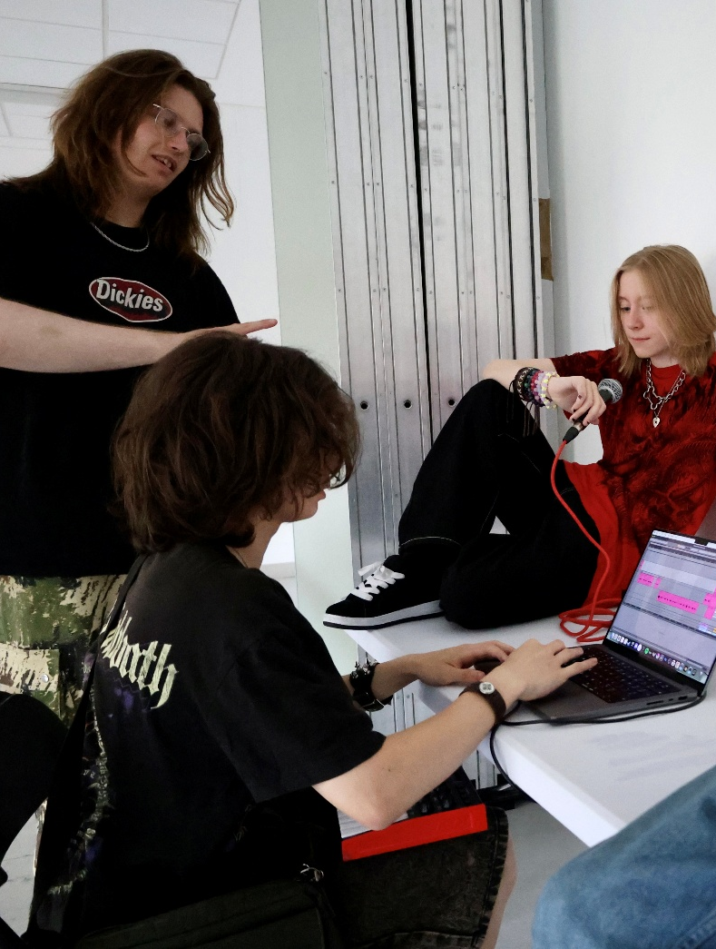
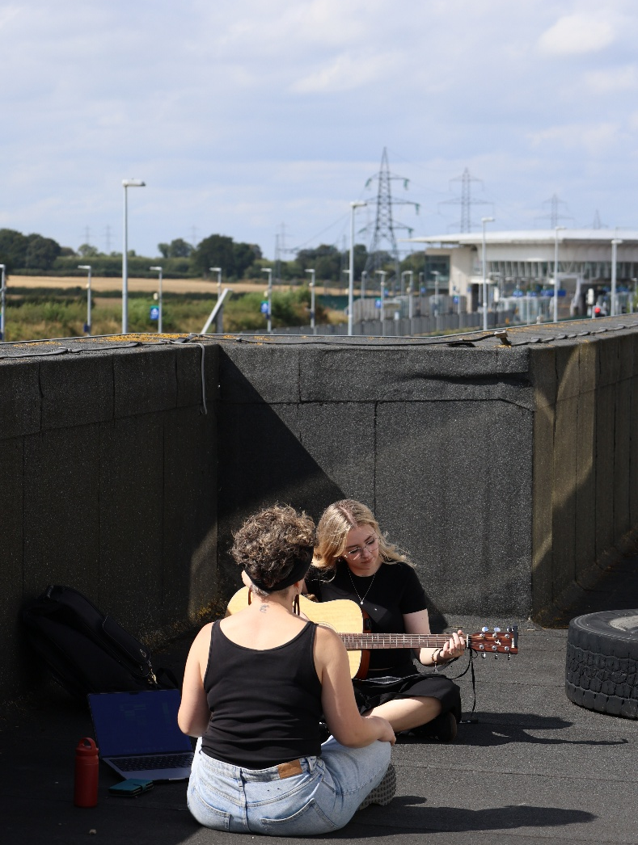
NOISE Music
NOISE Music ran 6-week summer programmes in Quarryvale and Balgaddy which were attended by 18 young people aged from 7 to 12.
The summer programme in Griffeen Youth Centre was attended by 10 young people aged from 14 to 17. This programme also ran for 6 weeks.
In Adamstown, NOISE Music worked with a group of 18 young people aged from 11 to 20 over an 8-week summer programme. This project is funded by Creative Ireland South Dublin’s Project award, and is a collaboration involving Go Dance for Change, Creative Connections, Timing GNSL, the filmmaker Elton Mullally, and Adamstown Youth and Community Centre. Five site-specific performance films – one dance, two music, and two spoken word – are currently being edited and will be launched at an event in Adamstown on Friday 21st November. There will be a social media campaign in the coming months to highlight the work that the group have been creating.
NOISE Music DJs are performing at events in Quarryvale (Colour Run on 20th Sept) and Balgaddy (Glow Disco on 27th Sept. Both events are run by Active Cities.
The next NOISE Music term starts in Griffeen Youth Centre on Fri 26th Sept, and in Quarryvale and Balgaddy in the first week of October.
The Night Belongs To Us, a performance events programme for young people aged 14 – 18, will return in October for monthly events in Griffeen Youth Centre featuring young musicians and DJs performing live for their peers.

Slide 4
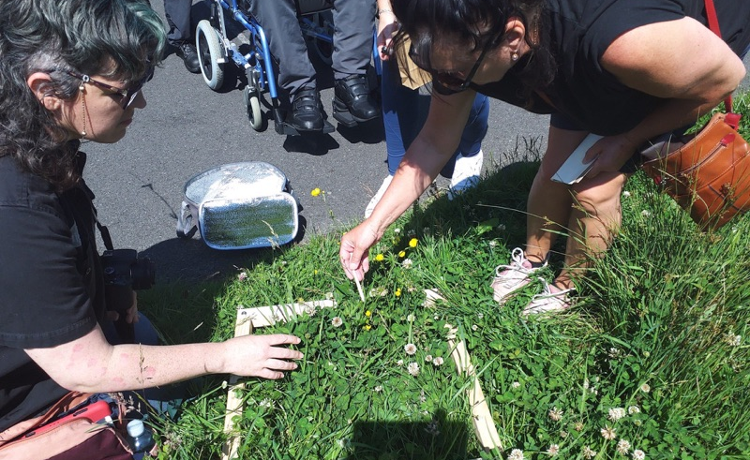
Public Art
In August, Richie O’Sullivan joined the Arts Office in the role of Assistant Arts Officer - Public Art.
In July, four new Public Art commissions were selected following an open call as part of In Context Strand 2.
The theme for this award is a focus on climate action, environment, tackling the urgency of climate change, and champion sustainability and/or biodiversity in the context of South Dublin County.
  Shane Finan has been awarded €79,000 to undertake a socially engaged Public Art project in North Clondalkin and Rowlagh.
  Shane’s project focuses on the impact of technology on climate and the environment. We will support Shane and his team to engage with groups and communities of interest in these areas.

Slide 5
Thank you

