Slide 1
Balgaddy Housing Update
Q2 2025
Housing Maintenance & Estate Management Report

Slide 2
Response Maintenance Q2 2025
Work Order Completed Q2 2025
102
64
69
44

Slide 3
Allocations and Relets Q2 2025
Allocations | 13
Pre - Works | Work in Progress | Ready for Allocation | Allocated | Total
0 | 0 | 6 | 2 | 8

Slide 4
Planned Maintenance
Safety Works
Fire Detection and Alarm works completed within 213 homes.
Works have been issued to contractor to complete a further 141 homes.
Painting Programme
Works completed on 95 units within Méile An Rí and Buirg An Rí.
Painting works completed in communal areas at Meile An Ri Drive.
Stock Condition Surveys
Stock Condition surveys to commence Q1-2026 in Balgaddy.
Drainage works have been completed within Children’s Play Area.
Planned Maintenance

Slide 5
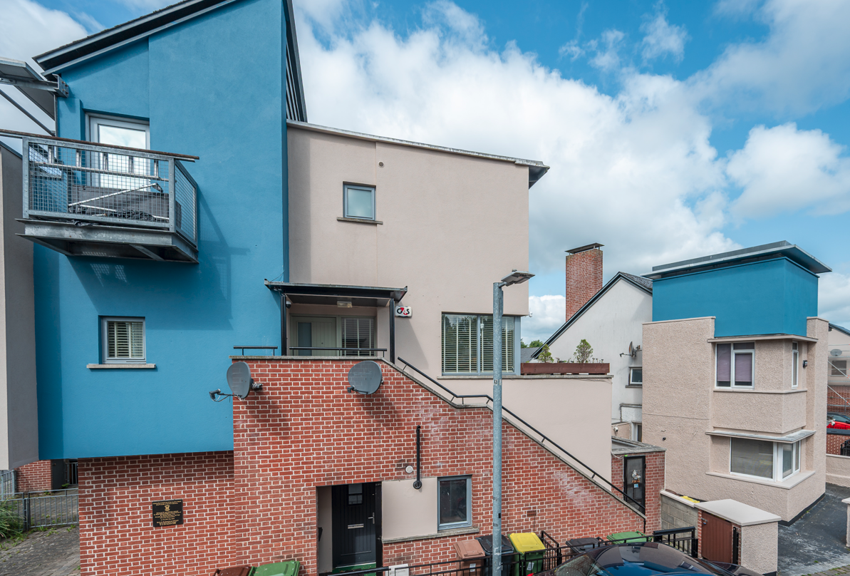
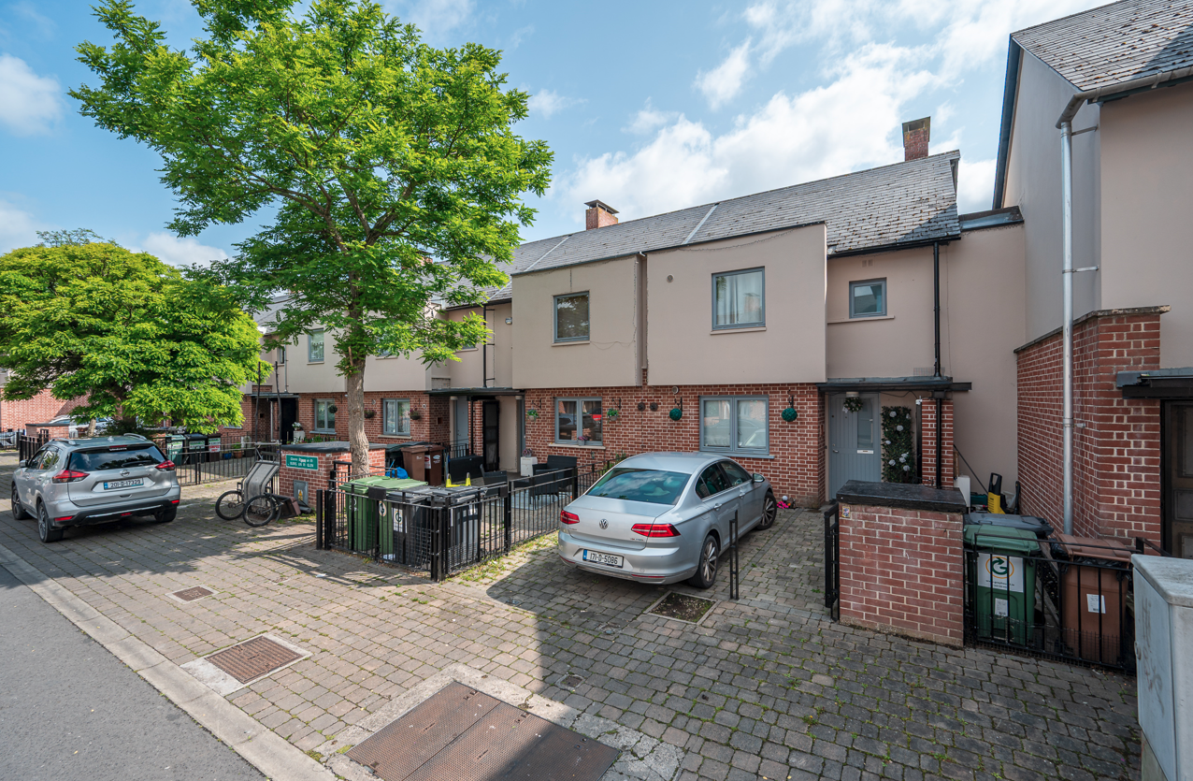
Balgaddy Painting Works

Slide 6
Planned Maintenance cont.
Meter Cover Works
Following a review of gas meter covers, repair and replacement works have been identified at 50 locations within Meile An Ri Road, Park, Drive & View and Foxdene Avenue.
Works are due to be completed Q4-2025.
Drainage works have been completed within Children’s Play Area.
Planned Maintenance

Slide 7
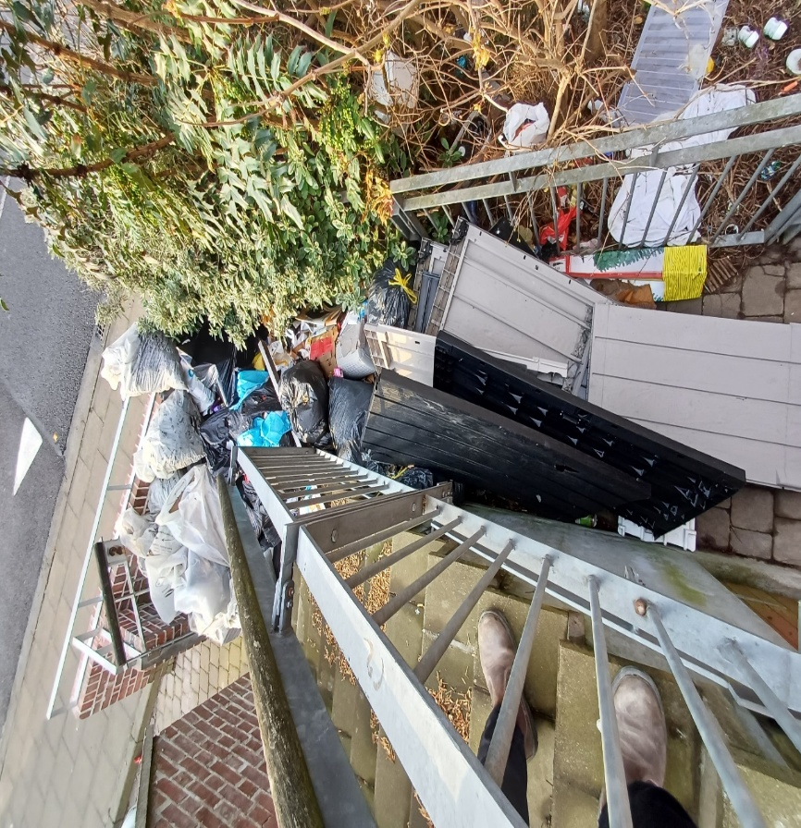
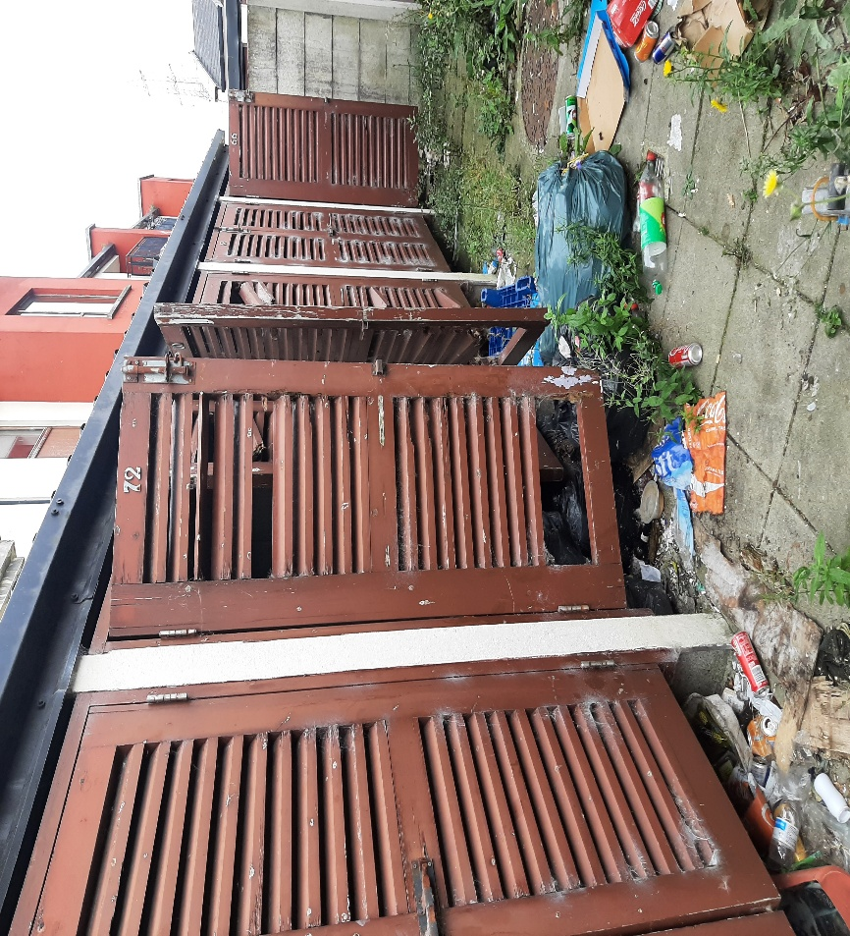
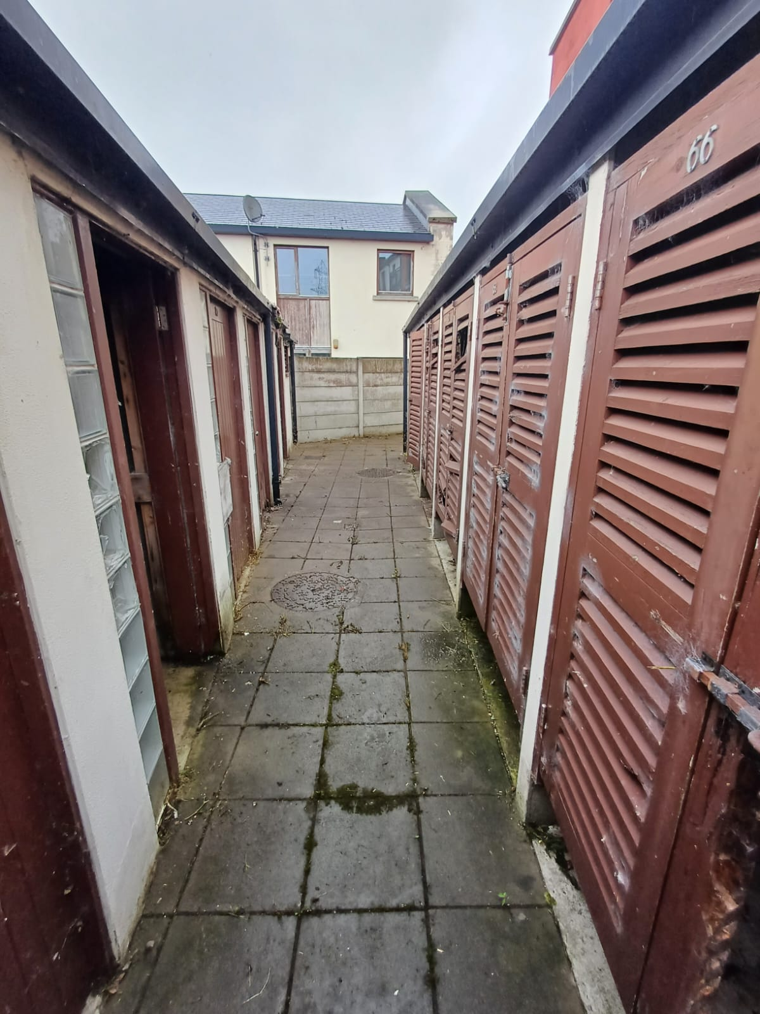
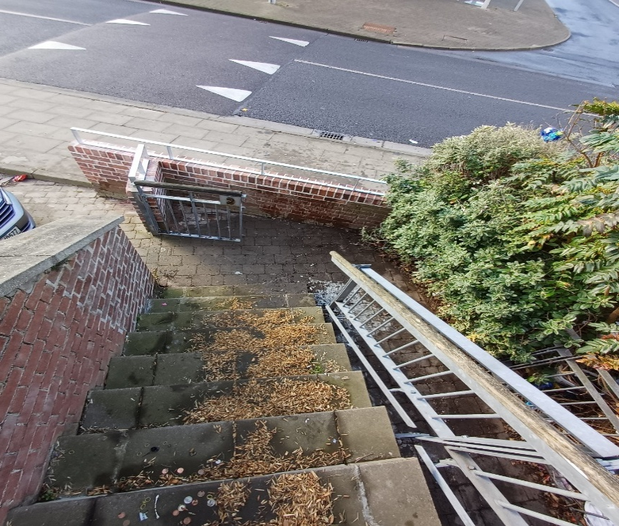
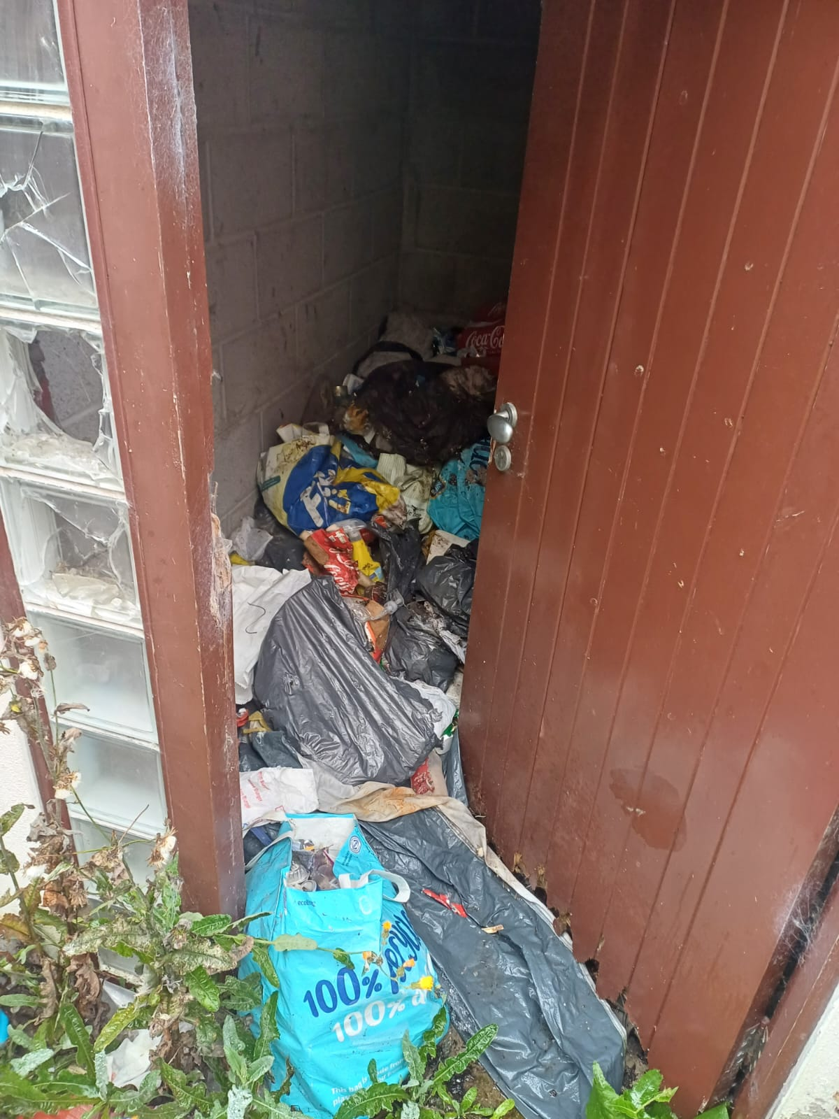
Clean Ups – March, July & August

Slide 8
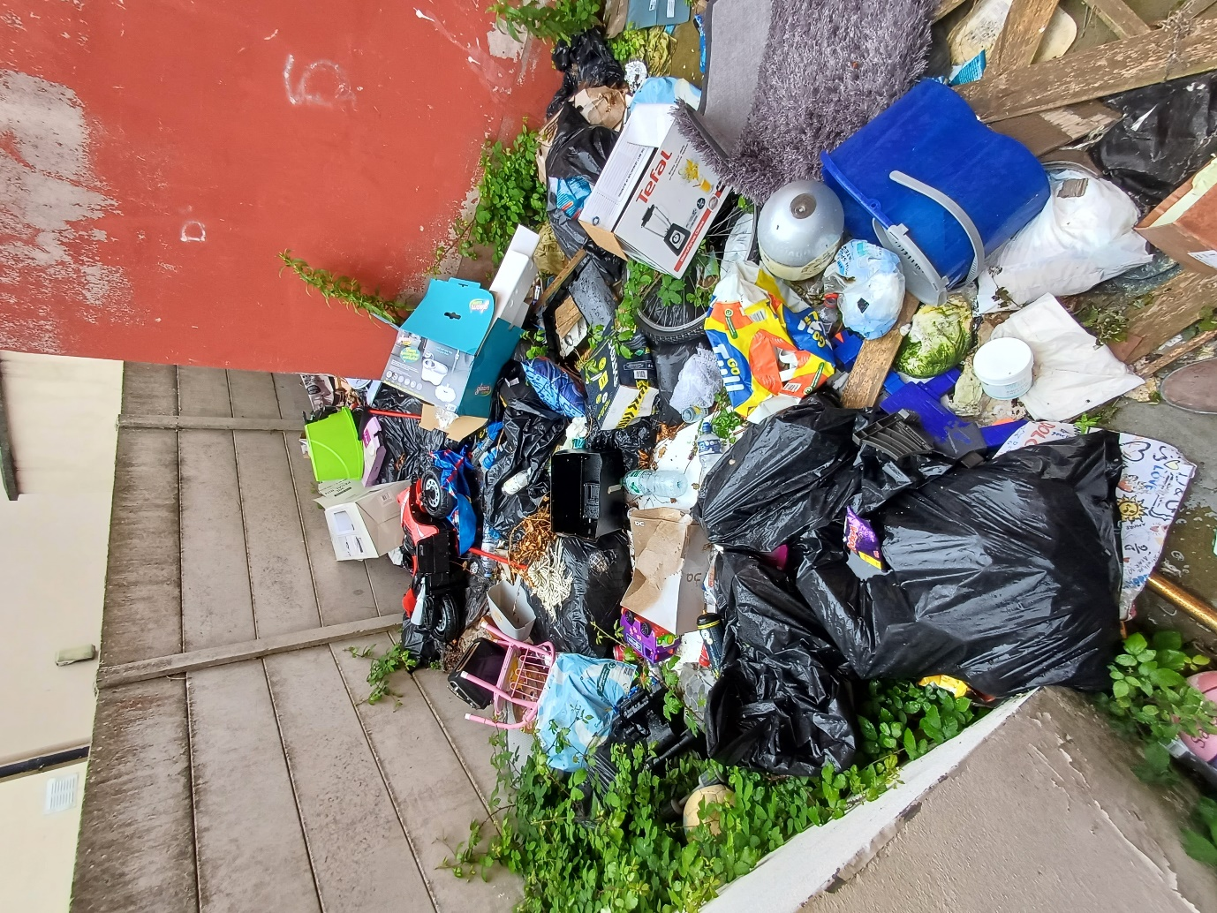
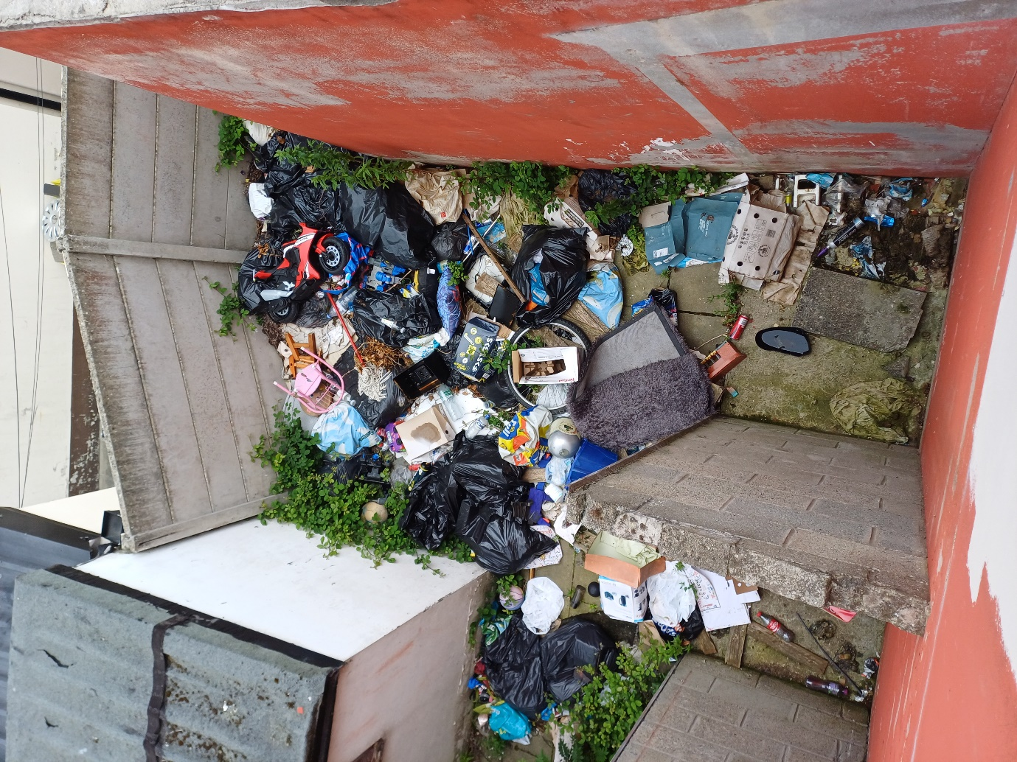
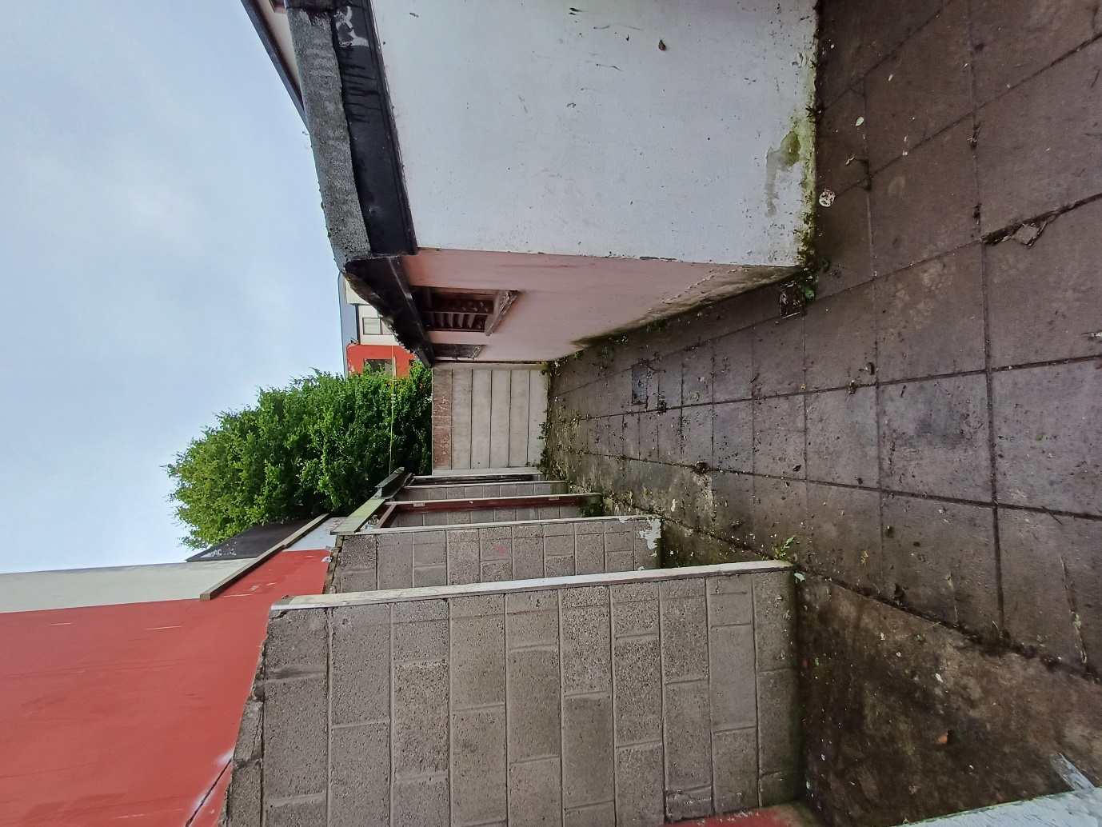

Slide 9
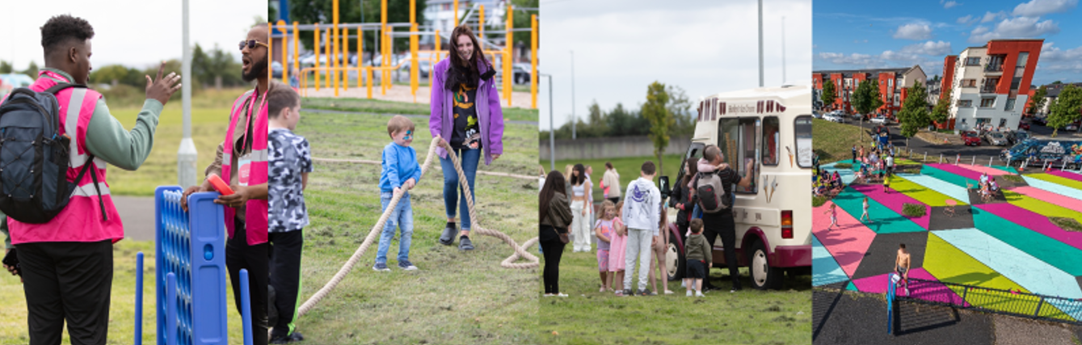
Estate Management Initiatives
Estate Management Section

Slide 10
Estate Management Initiatives
Quarterly information sharing meetings ongoing with Community Development Team.
Estate Management represented on the Balgaddy Action Group and Higher Level Working group with meetings taking place quarterly.
Estate Management and Housing Maintenance liaising with residents regarding planned works to be carried out in Balgaddy.
An onsite meeting with Estate Management and Housing Maintenance took place on 27th August 2025 to identify anti-social hot spots and necessary preventative and improvement works.
Drainage works have been completed within Children’s Play Area.
Joint housing maintenance and estate management approach continue were communal areas are monitored to ensure items do not accumulate. Records are kept and notification/warning letters to issue as appropriate.
Anti-Social Behaviour Community Safety Officers following up on issues regarding unauthorisedd occupiers, vacant properties, arson attacks, feuding and vacant dwellings.
Regular meetings take place with Senior Gardaí to examine ways to combat anti-social behaviour in the estate.
Estate Management team delivered school talks in the Devine Mercy Junior and Senior Schools. Positive feedback from teachers and Principal. Follow-on talks to take place prior to Halloween.
Planned Maintenance

Slide 11
Estate Management Initiatives Contd.
A Day of Action – meeting with the Waste Enforcement section and further discussion with An Garda Síochána to take place in the coming weeks to put the necessary preparations in place.
Tenancy Audit commenced in Balgaddy, following summer months. Staff to recommence audits at end of September/October.
Garda / estate management weekly clinic takes place Thursday mornings in the Bush Centre. Plans to relocate to the community centre in October/November.
Drainage works have been completed within Children’s Play Area.
Family Fun Day took place 26th July 2025 supported by the estate management team.
Ongoing engagement with Housing Welfare in relation to a number of cases.
Community Safety Anti-Social Behaviour Team supporting Gardai in relation to a number of high profile cases.
Preparations underway for Halloween events.
Planned Maintenance

Slide 12
Balgaddy higher Level Working Group
  Independent Chair Liam Casey (Former Inspector Ronanstown Garda Station), with 3 meetings have taken place in 2025 to date.
  Updates
  Successful meeting with South Dublin Partnership, Tusla and AGS to look at options around outreach work, early intervention and gaps in supports in the Balgaddy area. SDCC and South Dublin Partnership will present a proposal to extend Connect 4 programme to the Balgaddy area. Other funding sources are being identified to provide age appropriate short and long term programmes in conjunction with NOISE, Community Department, Slainte Care etc.
  The keys for the completed community facility were handed over to the council in July and while the building is practically complete, the council’s Architectural Services are working with the contractor to close out a small number of items and manage the building snag list.
  The Regional Board Of Management (BOM) – Clondalkin Community Facilities Clg has been formed and the YMCA engaged to become the management agent for the Balgaddy. Neilstown and Rowlagh centres, following the completion of an open Expression of Interest tendering process.
  A temporary Centre Manager and CE participants recruited by the BOM for the Balgaddy centre The Manager with an Operational Sub Committee of the BOM are now initiating the process of opening up the centre and bringing in user groups on a step by step incremental basis over the next number of weeks.
Drainage works have been completed within Children’s Play Area.
Planned Maintenance

Slide 13
Balgaddy Higher Level Working Group
  Unfortunately, the centre has also experienced a certain level of anti-social behaviour and had a pane of glass smashed with a stone (replacement ordered). The BOM and council has liaised with the Garda accordingly. It is hoped when more and more activities are scheduled into the centre, that this will assist in resolving this anti social behaviour.
  The group held their first meeting in the new centre – which present an opportunity to meet with the new manager and team.
  The council’s Estate Management Team to recommence tenancy checks in September / October.
  An Garda Siochána door knocking exercise was successful–a chance for residents to share information and discuss ongoing anti-social issues.
Drainage works have been completed within Children’s Play Area.
Planned Maintenance

Slide 14
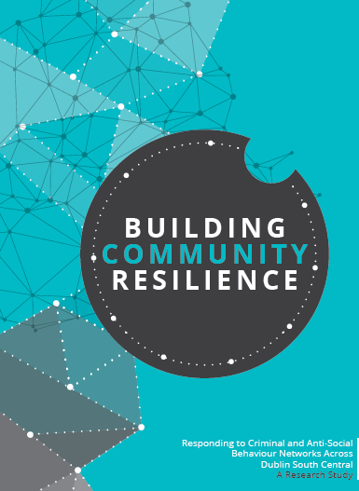
Balgaddy Higher Level Working Group
The Balgaddy working Group was established to implement the recommendations outlined in the Community Crime Impact assessment undertaken in March 2021. Group meets on a quarterly basis.
The membership consists of:
Estate Management and Community Development Teams from SDCC
An Garda Siochana (Ronanstown)
North Clondalkin Community Development Programme
Co- Ordinator from Clondalkin Drugs Task Force
Ronanstown Crosscare
Chair of Local Policing Forum
DDETB
Tusla
South Dublin Partnership
ge works have been completed within Children’s Play Area.
Planned Maintenance
Meeting Dates for 2025
20th February 2025
13th May 2025
23rd September 2025
9th December 2025

