Slide 1
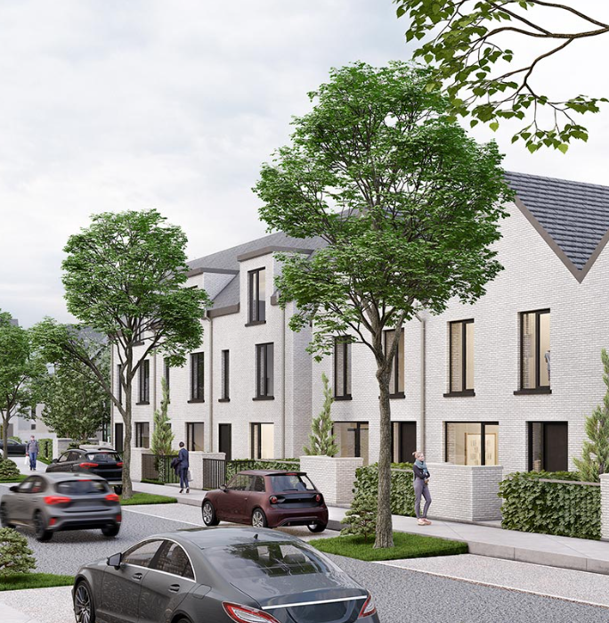
Housing Delivery
Report
Lucan, Palmerstown, North Clondalkin ACM

Slide 2
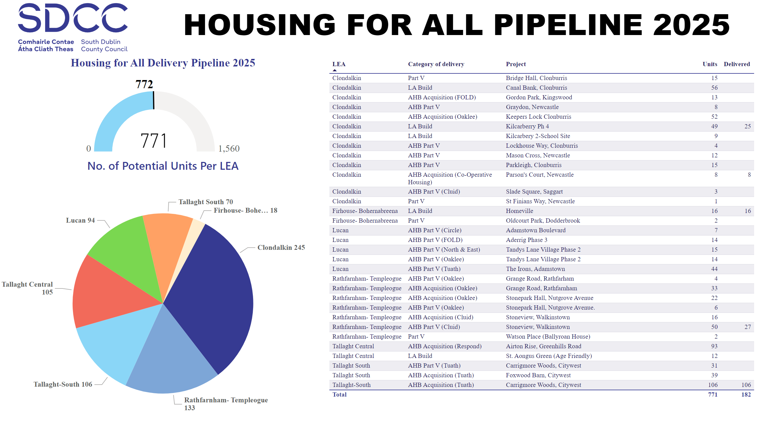
2025
Notes:
textbox
No alt text provided
Housing for All Delivery Pipeline 2025
No alt text provided
Potential Units
No alt text provided
image
No alt text provided
No. of Potential Units Per LEA
No alt text provided

Slide 3
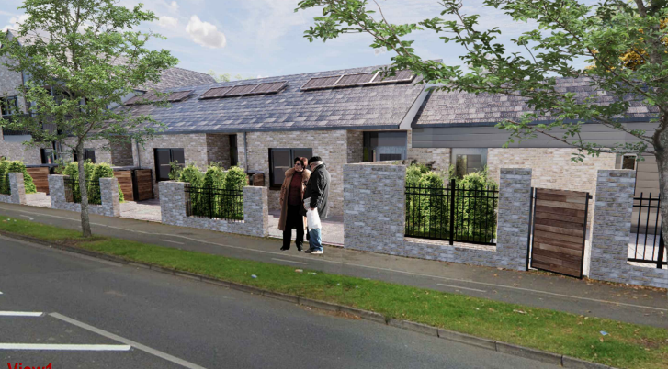
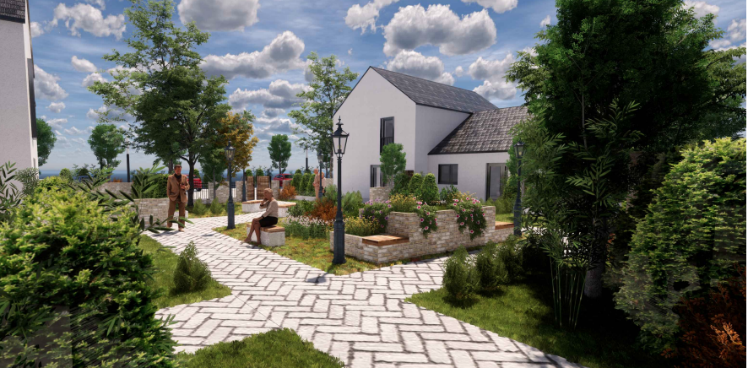
SDCC Build Programme
LEA | Project | Units | Status
Palmerstown - Fonthill | St Ronan’s Crescent (Age-Friendly) | 9 | Contractor on site. Delivery Q4.2026
Lucan | Sarsfield Park (Age-Friendly) | 5 | Contractor on site. Delivery Q1.2026
St Ronan Crescent
Age Friendly

Slide 4
AHB & Part V Delivery
LEA | Project | Expected Units | Status
Lucan | Aderrig Heights Adamstown Part V - FOLD | 14 | Part V negotiations concluded. Handover from Q4.2025.
 | Tandy’s Lane – 2 Part V - Oaklee | 14 | Part V negotiations concluded. Handover from Q2.2026.
 | Adamstown District Centre Part V - Tuath | 44 | Part V negotiations concluded. Handover from Q4.2025.
 | Adamstown Boulevard Part V | 26 | Part V negotiations concluded. Handover from Q4.2025
 | St Helen’s Plaza, Adamstown Part V - Tuath | 80 | On-site. Handover Q1.2027
 | Somerton, Adamstown Part V – Cluid | 68 | On-site – phased delivery from Q2.2026 Age Friendly Development
 | Tandy’s Lane – 2 Part V – North & East | 15 | Part V negotiations concluded. Handover from Q4.2025.
 | Parkview, Adamstown Part V | 35 | Part V negotiations concluded. Handover from Q3.2028

Slide 5
Housing Acquisitions Programme 2025
Acquisitions complete to date
60
Acquisitions in Conveyance
14
Sale Agreed
13
Anticipated Completions for 2025
87

Slide 6
Thank you

