Slide 1
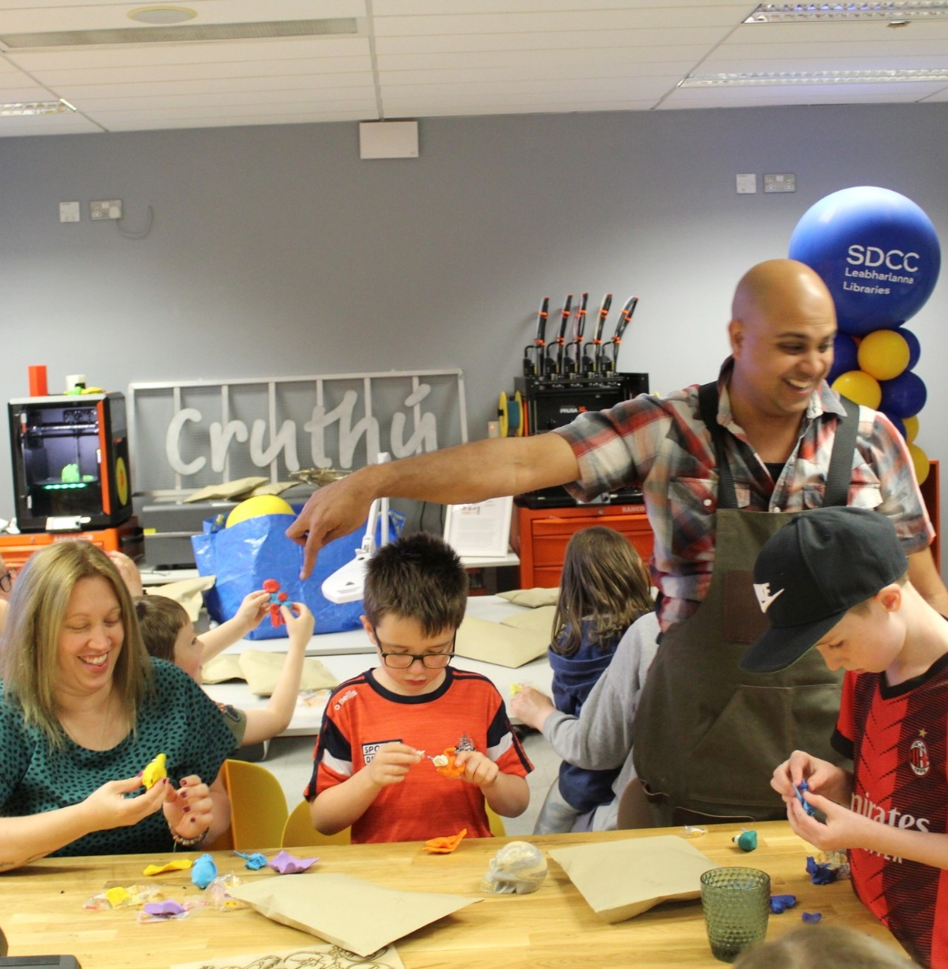
Tallaght, Castletymon and Mobile Libraries
ACM Report

Slide 2
Summer Statistics Tallaght, Castletymon and mobile libraries
Tallaght library
July- Tallaght library had 21,965 visitors and 120 events. 11,53 7 Items were issued and 505 new members were registered August- 18,162 people visited Tallaght library with 97 events taking place, 9345 items were issued, and 529 new members were registered.
Castletymon Library
July - 61 events, took place issued 4712 items, registered 68 new members and had over 6,473 visitors.
August – 3477 items issued, 92 people joined the library and had 5154visitors
Mobile libraries
July 6315 items issued 177 new members registered. There were 1,262 visitors to the mobile libraries in parks during July
August 5777 items issued, and 121 new members added

Slide 3
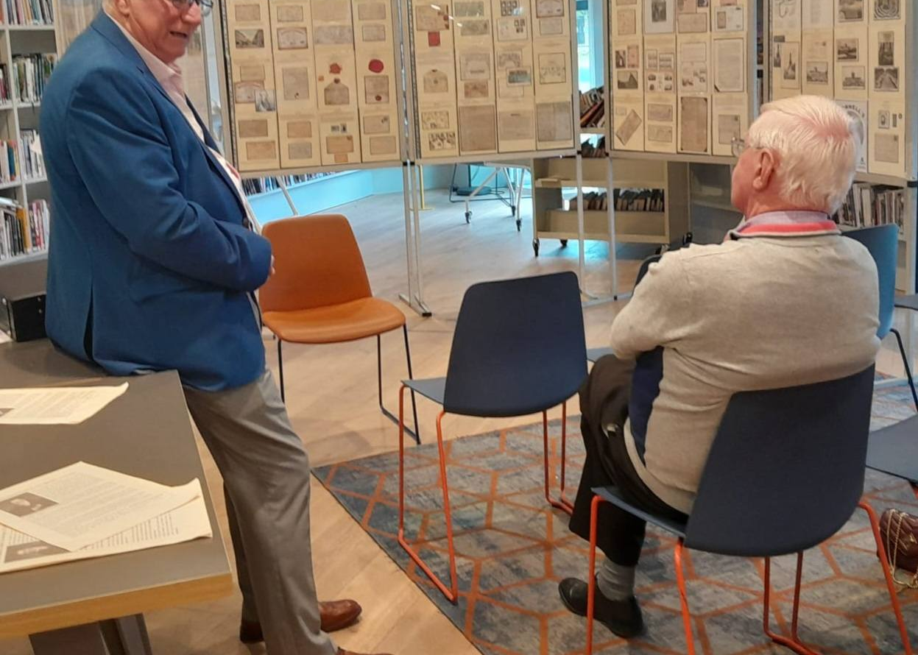
Castletymon Library
Summer Highlights
June
Author Talk: Anne-Marie Allen on her book Serve: My Lost Years at the Heart of Ireland’s Opus Dei.
July
Author Talk: Cathy Scuffil on Flanagan’s Field – very well attended.
Summer Activities for Children: Two weeks of events (14 activities across 10 days), all of which were fully booked.
August – Heritage Week
Hellfire Hill – A Little Tour.
Knight for Hire: Special event for schools.
Exhibition: Daniel O’Connell by John Mullen, marking the 250th anniversary of O’Connell’s birth.
End of August
End of Summer Party:
  For adults: Traditional music session.
  For children: Clay sculpture workshops and How to Draw Pokémon.
Summer Stars: Prize draw and certificate awards.

Slide 4
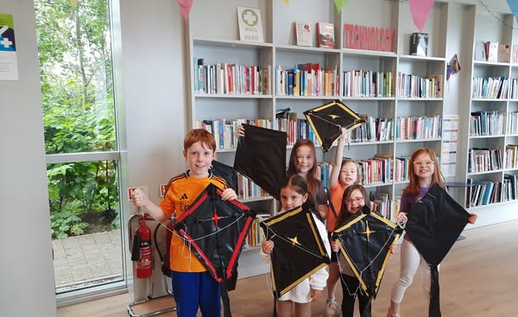
Castletymon Library, September
For Adults
Spanish Classes
  Beginners: Starts 9th September (10 weeks)
  Conversation: Starts 10th September (10 weeks)
Digital Literacy – Computer Classes (with DDLETB)
  Registration: 12th September
  Classes run from 9th September – 21st November
Ukulele Course
  5-week programme starting 9th September
Autumn Watercolours
  Two-part course on 8th and 10th September
Author Talk
  Go Organic: A Beginner’s Guide with Aoife Munn – 22nd September
Culture Night (19th September)
  Castletymon Library hosting a concert by the Firhouse Ukulele Group

Slide 5
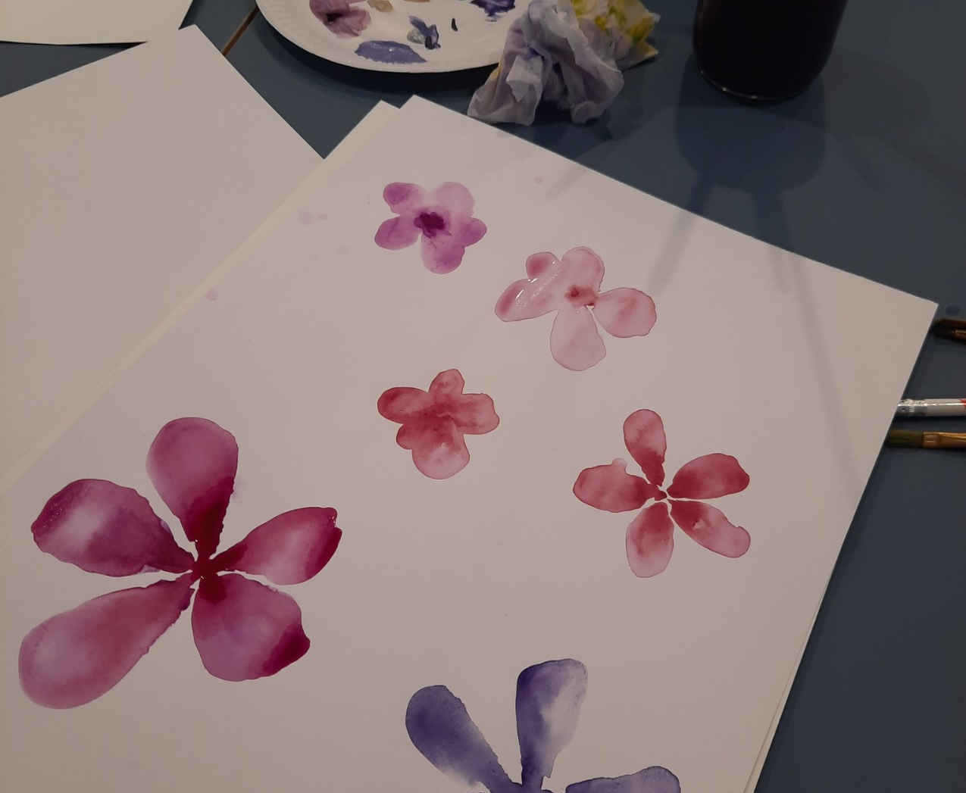
Castletymon Library, September
For Children
The Comics Project
  9-week course for children with additional literacy needs
  Funded by Creative Ireland, facilitated by writer Juliette Saumande and illustrator Elida Maiques
  Children will write, draw, and create their own zine, alongside a professionally printed group zine
  Starts 18th September
Creative Writing Workshop
  How to Get Writing with author Claire Hennessey (TY class) – 23rd September
Baby Boppers & Rhythm Rascals
  With Emma O’Leary – 17th September
Bronntanas & National Public Libraries Open Day
  Special toddler session: Draíocht an Cheol – The Magic of Music – 27th September

Slide 6
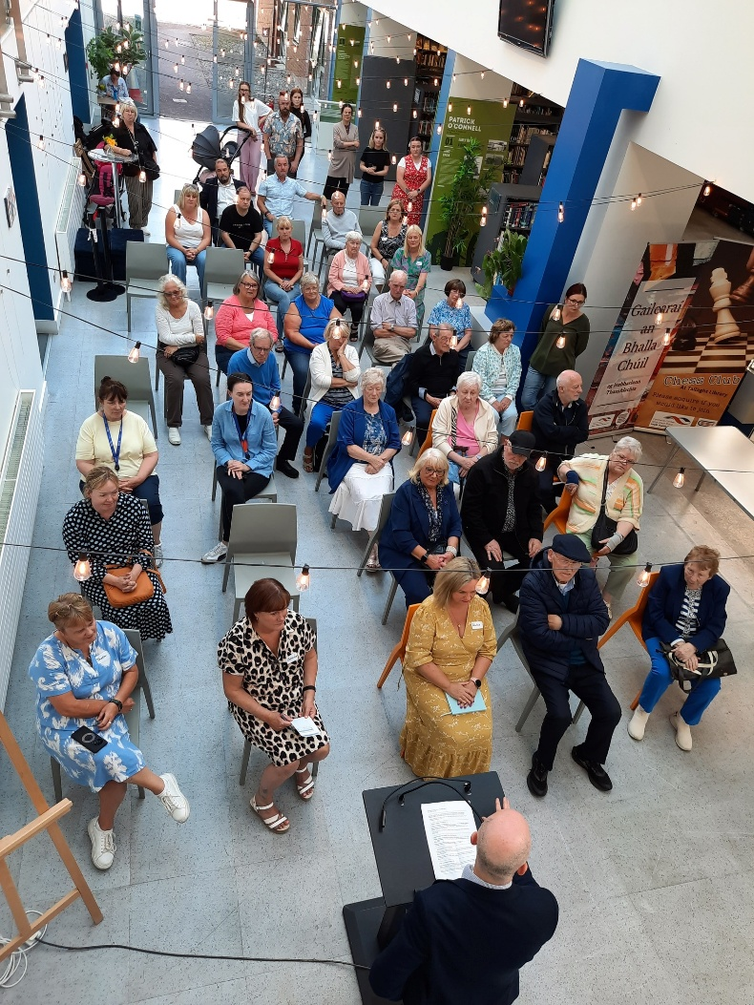
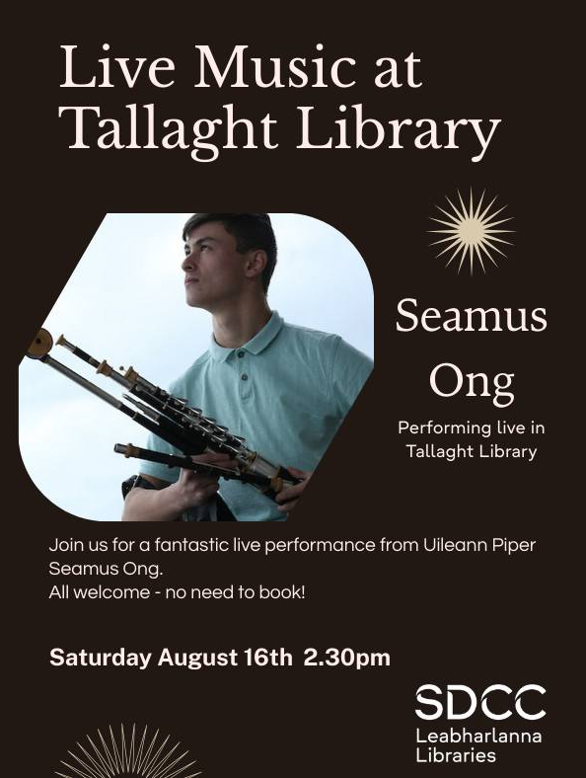
Summer Highlights - Tallaght Library
Summer Sessions
-Live music incl. uileann pipes, jazz and singer Luke Clerkin
Heritage Week – 16th – 24th August
- Genealogy clinics, workshops, talks and more
Summer Stars:
-500+ children signed up
-55 + Events for children
Memory Café
-Very successful launch of the Memory Café

Slide 7
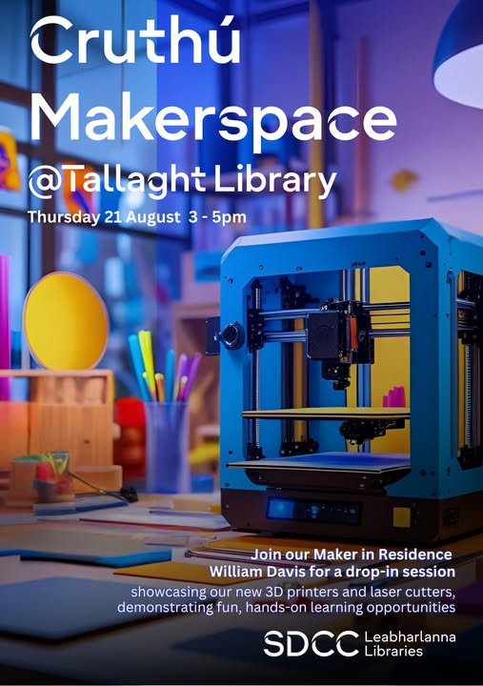
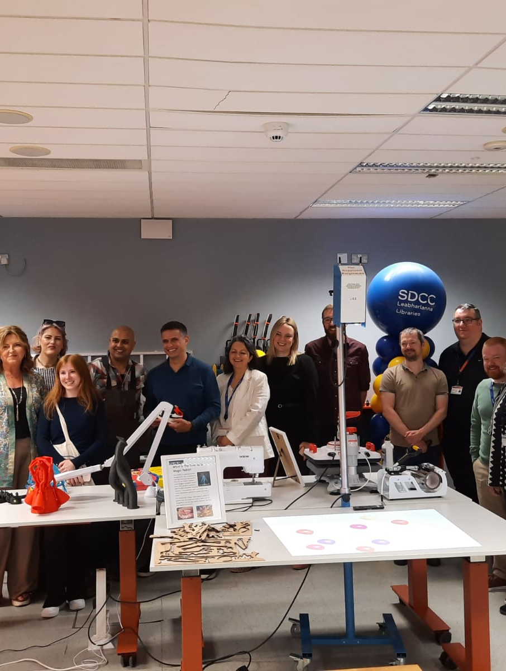
Cruthú Launch
Launch of Tallaght Library’s new Makerspace on 21 August.
Ongoing programme of workshops to showcase our new 3D printers and state-of the-art laser cutters.
Willam Davies, Maker in Residence, is leading on events including:
- Design Your Skateboard
- Design metal or wooden bookmarks
- 3D print Dungeons & Dragons game pieces.

Slide 8
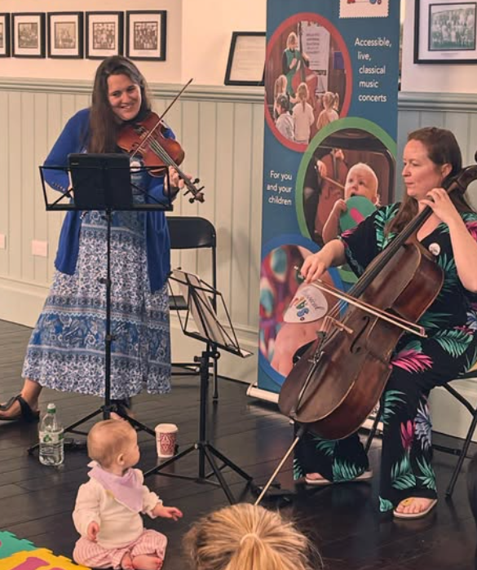
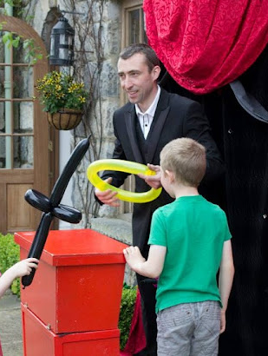
September Highlight – Culture Night
Friday, 19th September
Classical Kids Concert
Magic Show with Murph the Magician

Slide 9
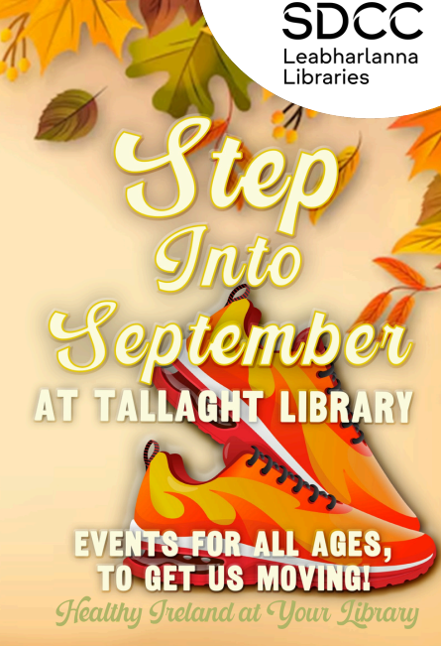
September Highlight
Step Into September, a programme of Healthy Ireland Events:
  Table Tennis
  Stay Calm and Colour
  Sarah Sparkles and Mindfulness for Kids
  Vision boarding for Teens
  Mindful reading session
  Yoga for Kids
  Baby Rave
  Chair Yoga
  Teen Journalling
  Mindful Stitching
  Mindfulness and Stress Management

Slide 10
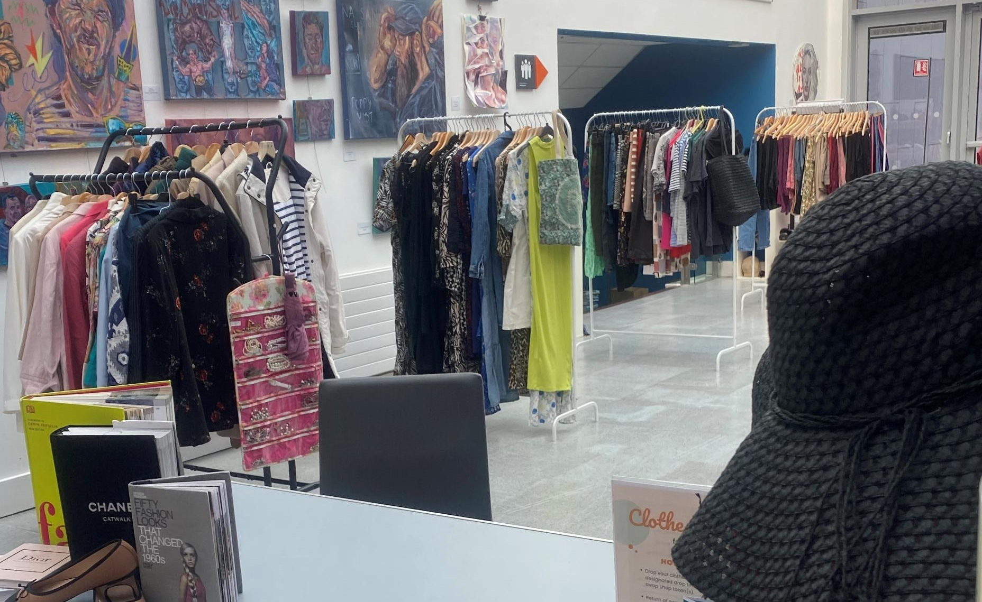
September Highlight - Sustainability
Clothes Swap
Saturday 13th September
MenderMeets
Sessions in the MenderSpace both guided and self-led
Hem Trouser workshop
16th September
Embroidery Workshop
- Starting on Thursday 13 September: 8-week workshop

Slide 11
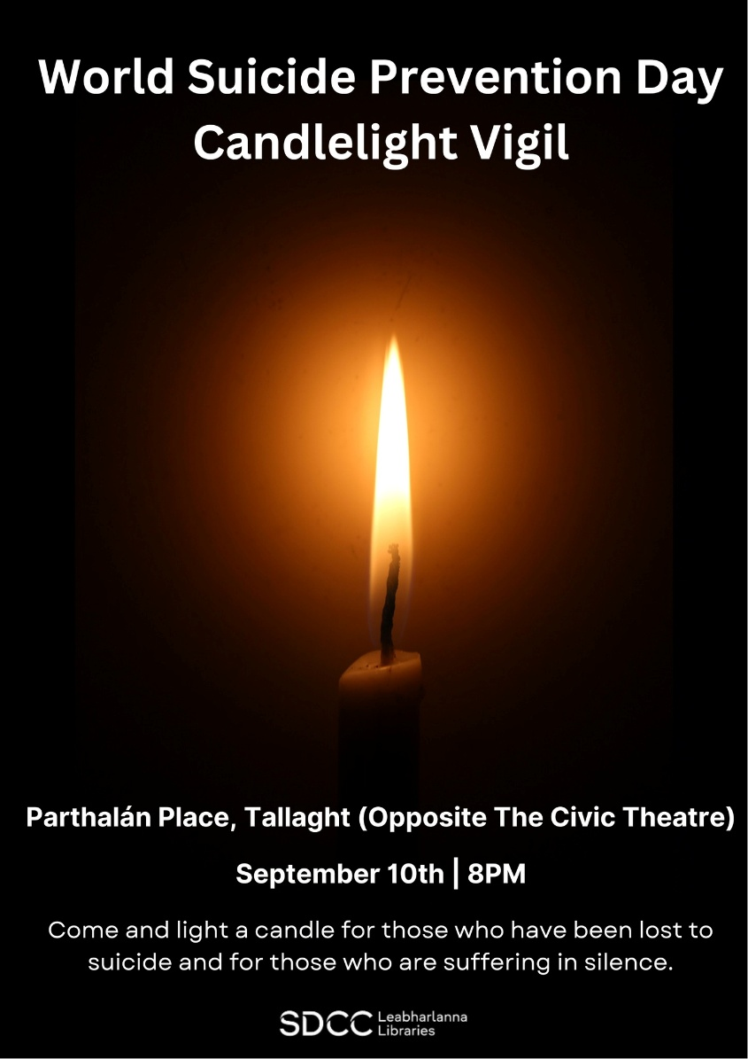
Lots more in September…
World Suicide Prevention Candlelight Vigil
- Sept 10^{th,} Parthalán Place
New Book Clubs
Non-fiction, poetry and neurodiverse
DIY Workshop
Over the course of 6 weeks learn basic DIY skills. Group project that is donated to the community.
Language & Learning
Irish Beginner Courses, Spanish Conversation, Ciorcal Comhrá and Spanish classes for children

Slide 12
October – A sneak peek…
REDLINE BOOK FESTIVAL @ Tallaght Library
- Family Fun Day, Róisín O’Donnell (author of Nesting), Gill Perdue (crime writer) and Equity in the Workplace Panel with Dr Ebun Joseph.
HALLOWEEN CLOTHES SWAP AND PARTY
- 11th October, including silent disco and face painting and balloon making.

Slide 13
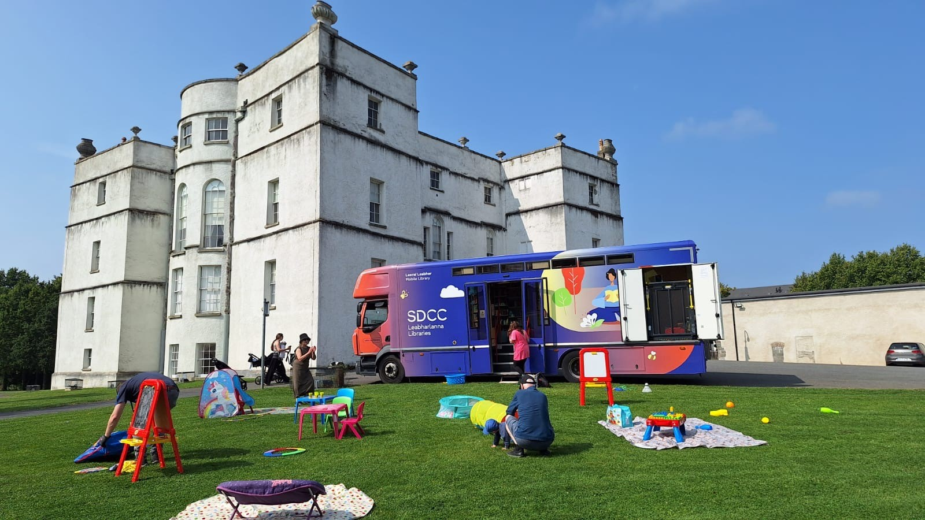
Mobile Libraries
9 Visits to Summer Camps
  Schools, community centres, and preschools
  Included an event with the Nutty Professor at St Brigid’s J.N.S., Brookfield
Library at Home
  Continued throughout the summer
  2 visits to Bloomfield Hospital
  1 visit to St Michael’s House, Templeogue (4th July)
Family Visit
  City Ark IPAS and Citywest Ukrainian Hub (12th July)
Events
Summer Parks Programme
  15 visits to family days, markets, and cinema screenings at Collinstown, Corkagh, Tymon, Waterstown, Jobstown, Airlie, and Adamstown
Community Day at the Square – 19th July
Clondalkin Festival at the Round Tower – 26th July

Slide 14
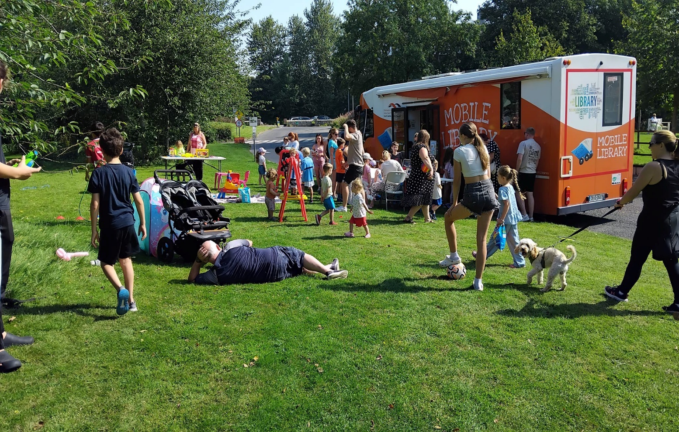
Mobile Libraries – August Highlights
Library at Home
  Continued throughout August
  Regular visits to Bloomfield Hospital
Family Visits
  Respond Family Hub – 6th August
  City Ark Aparthotel & Citywest Hotel Mobile Visit – 7th August
Summer Parks Programme
  7 visits to community/family days, Dublin Markets, and cinema screenings
  502 visitors to the mobile libraries in South Dublin Parks during August
The Big Dig, Rathfarnham – 15th August
Adamstown Festival – 17th August
Dublin Maker Event, Leopardstown
  Showcase of maker equipment led by South Dublin Libraries Maker in Residence
  Visitors created personalised chains using the laser cutter
  3D models from the libraries’ makerspace were on display
Coming in September
Service to schools resumes
Mobile Libraries attending Corkagh Park Colour Dash – 13th September

Slide 15
Thank you

