Slide 1
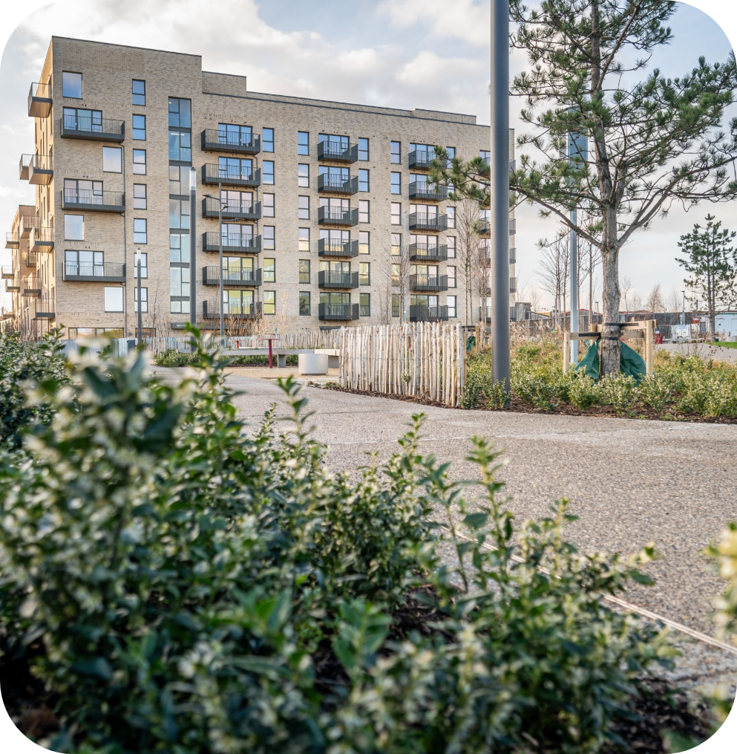
Housing Delivery
Report
Tallaght ACM

Slide 2
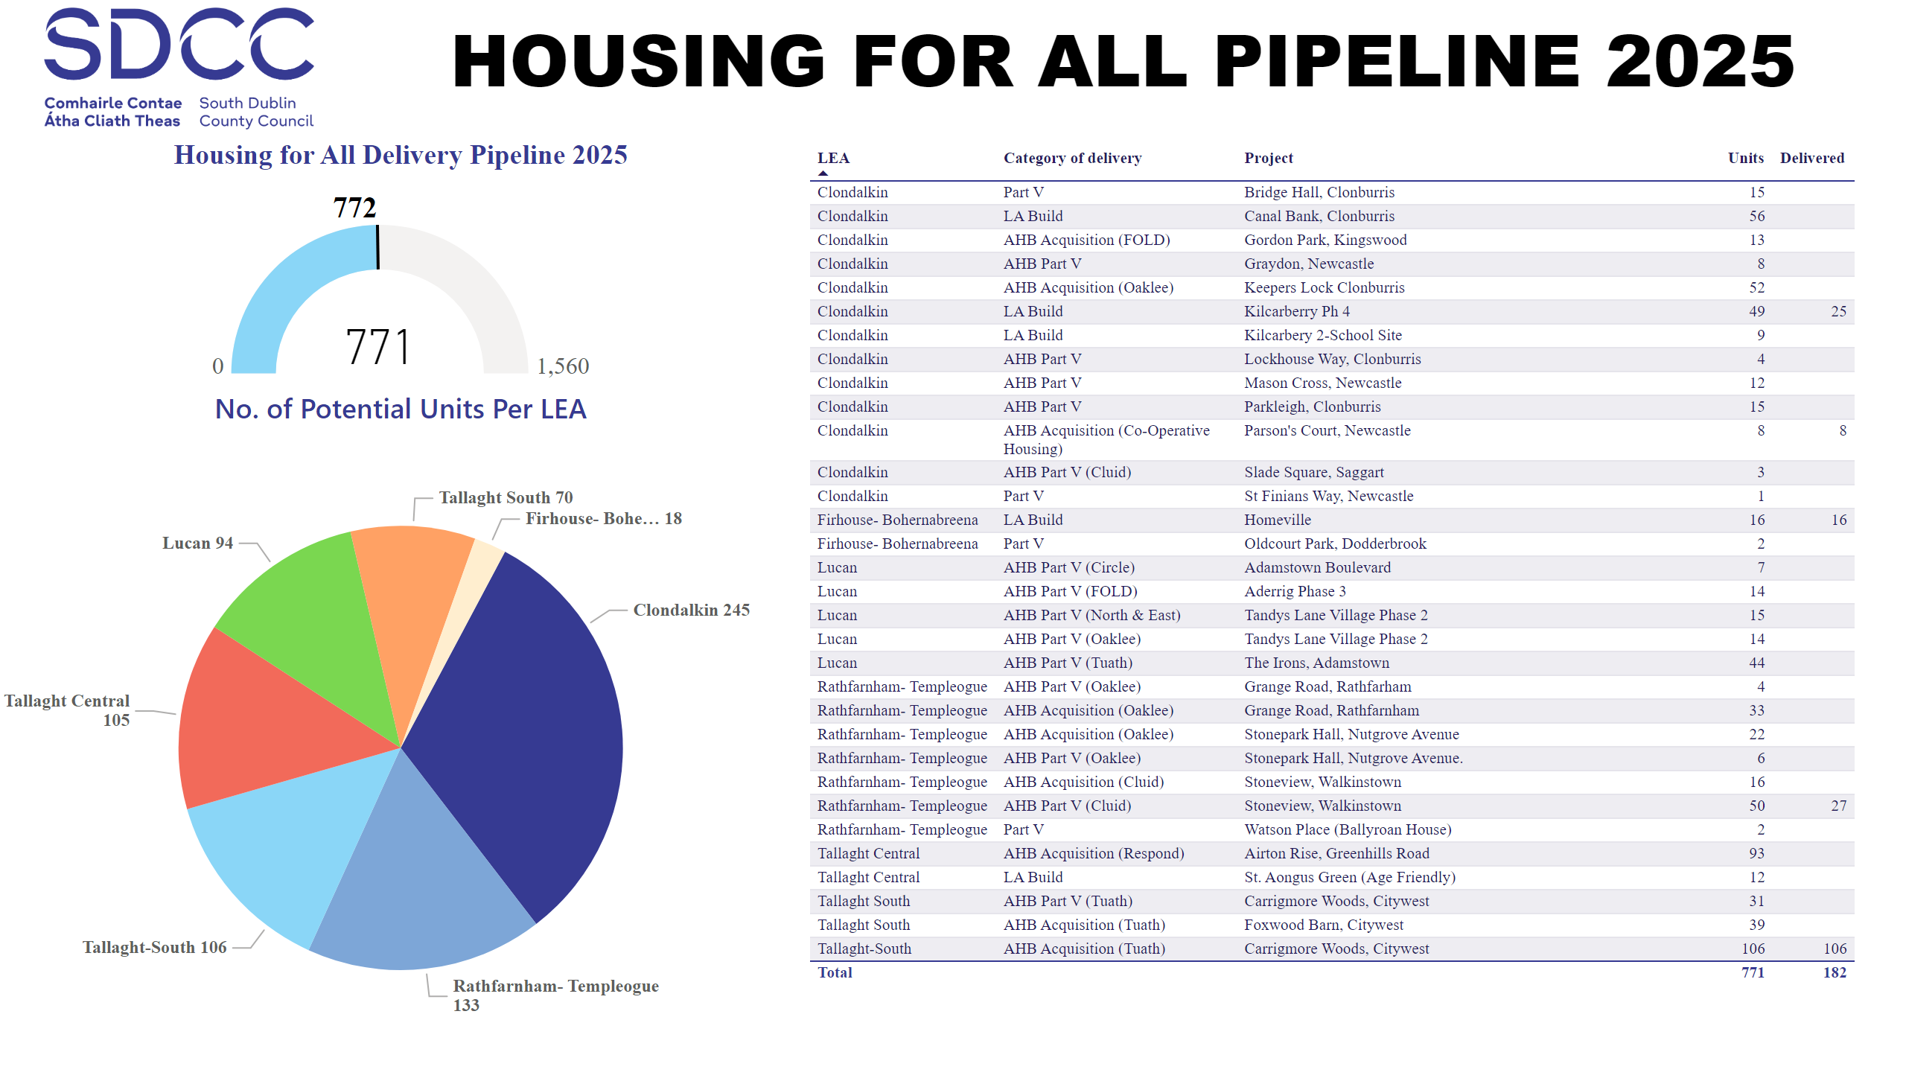
2025
Notes:
textbox
No alt text provided
Housing for All Delivery Pipeline 2025
No alt text provided
Potential Units
No alt text provided
image
No alt text provided
No. of Potential Units Per LEA
No alt text provided

Slide 3
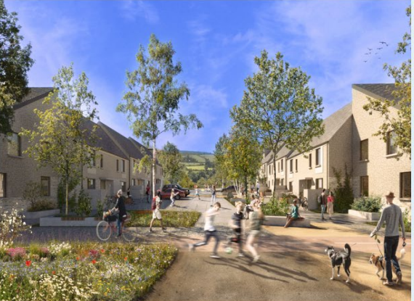
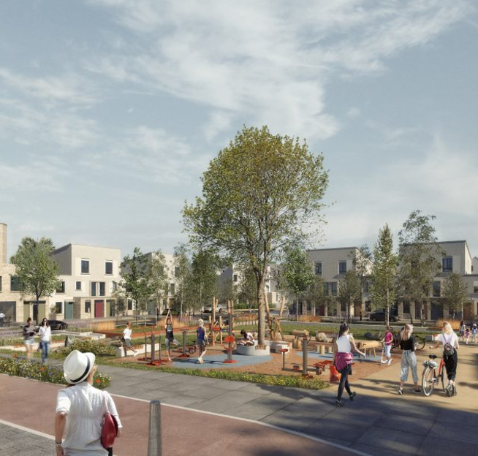
Large Development Update
Killinarden Foothills: 620 homes (including 125 social , 123 Private & 372 affordable purchase)
Contractor on site completing site preparation works. Delivery of the first homes in phase 1 is anticipated for Q1.2027
Killinarden
Foothills

Slide 4
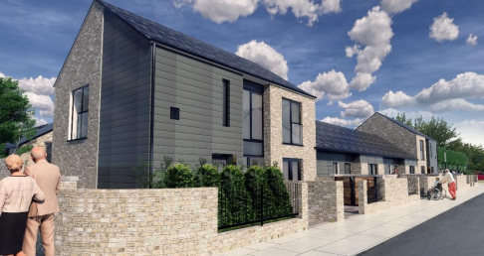
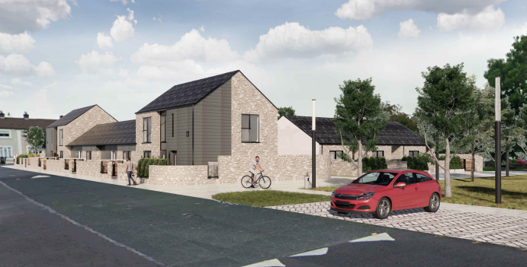
SDCC Build Programme
LEA | Project | Units | Status
Tallaght Central | St Aongus Green (Age-Friendly) | 12 | Contractor on site. Delivery Q4.2025
Tallaght South | Rossfield | 16 | Contractor on site. Delivery Q4.2026
St Aongus
Green

Slide 5
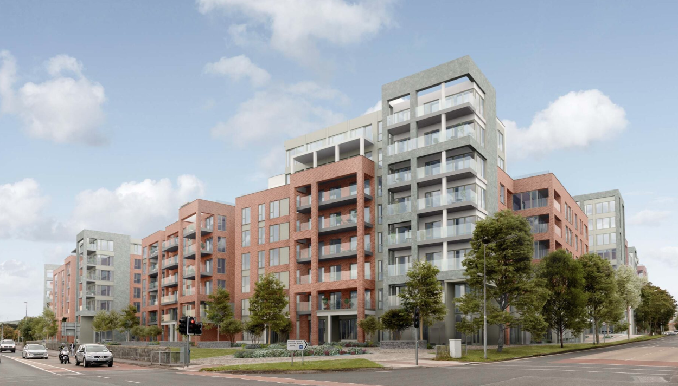
AHB & Part V Delivery
LEA | Project | Expected Units | Status
Tallaght South | Foxwood Barn, Citywest Part V - Tuath | 39 | On-site – due to handover Q4.2025
 | Carrigmore Woods, Citywest. Part V - Tuath | 137 | On-site – phased handover from Q3.2025. 106 handed over July 2025
Tallaght Central | Airton Rise, Greenhills Road. Part V - Respond | 213 | On-site – phased handover from Q3.2025
 | Cookstown House, Cookstown Way Part V | 8 | Part V negotiations ongoing. Completion Q4.2025
Airton Rise

Slide 6
Housing Acquisitions Programme 2025
Acquisitions complete to date
60
Acquisitions in Conveyance
14
Sale Agreed
13
Anticipated Completions for 2025
87

Slide 7
Thank you

