Slide 1










Slide 2














•
•
•
•

Slide 3

















•
•
•
•

Slide 4







Slide 5




Slide 6










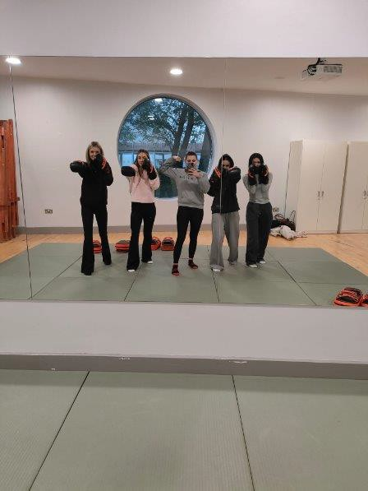
Women’s Only Boxing – St. Maelruins Hall
Led by a student from the SSI Women’s Coaching Academy with a
passion for the sport
Created opportunities for female students to try a new activity in a safe
environment
Uptake was modest(8), participants enjoyed the sessions, felt encouraged to be active.
Benefits for the Student Coordinator
Practical coaching and leadership experience through Student Sport Ireland Women's Coaching Academy
Enhanced skills in programme delivery and student engagement
Confidence gained from coaching practice and working with William Carruth.
Benefits for the University
Supported TU Dublin’s commitment to equality, diversity, inclusion in
sport
Provided unique opportunities for female students to get active
Brought the skills learned into her role as Chairperson of the Boxing
Club.
Benefits for the Wider Community (Now & Future)
Potential to extend sessions to local women and schoolgirls
Inspires more young women to try new activities and stay active
Promotes inclusivity and positive health outcomes in the community.

Slide 7
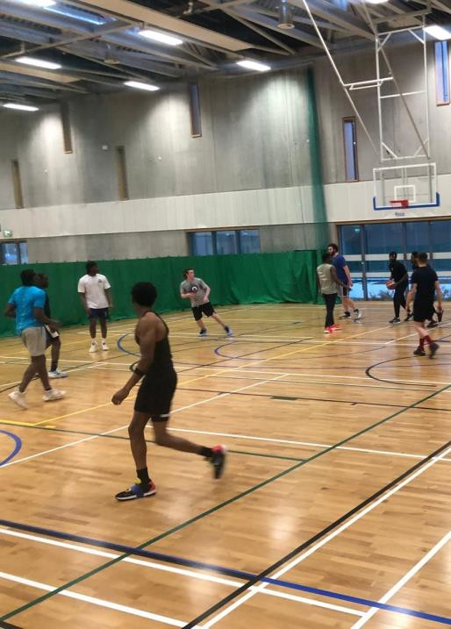
3V3 Basketball for Beginners Tallaght Sports Hall
Led by a Tallaght student with no coaching experience
Hall provided FOC by TU Dublin Sport
Created opportunities for students to try a new activity in a non- competitive environment
Uptake was good(15-20), with drop in weekly over the 6-week
programme.
Benefits for the Student Coordinator
Practical coaching and leadership experience, from initial set up to
marketing and promotion
Worked with experienced TU Dublin Coaches to gain experience to roll out the programme.
Benefits for the University
Provided unique opportunities for students to gain experience in a match situation
Brought the skills learned into his role as secretary of the Basketball
Club.
Benefits for the Wider Community (Now & Future)
Potential to expand this programme creating links to local secondary
schools and clubs
Promoting the sport of 3 v 3 – 2 TU Dublin players now on the National Squad
Promotes inclusivity with minority groups and supports their access to high quality facilities.

Slide 8
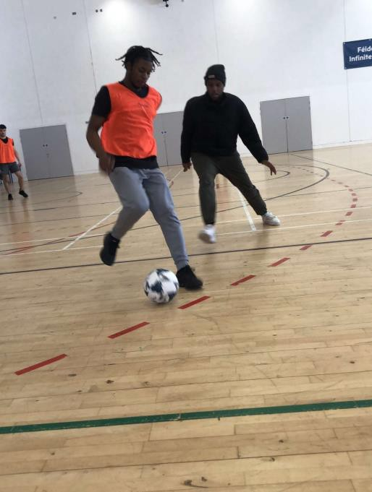
Sports Activator – Social Soccer
Provides a fun, non-competitive way for students across campuses to get active
Over 40 teams took part in our social leagues
Sports Activator coordinates fixtures, results, league tables, and weekly scheduling.
Benefits for the Student Coordinator
Develops organisational and leadership skills
Experience in event and people management
Builds communication and teamwork skills.
Benefits for the University
Promotes student wellbeing and active lifestyles
Enhances student engagement and campus life
Strengthens TU Dublin’s reputation for student sport initiatives.
Benefits for the Wider Community (Now & Future)
Potential to expand to local community participation
Fosters inclusivity in sport for all abilities
Builds stronger connections with other universities and local groups
Encourages lifelong participation in physical activity.

Slide 9
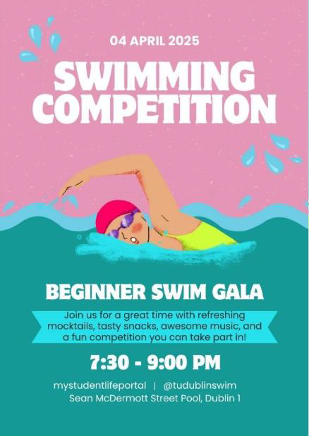
Learn to Swim Programme
Learn to Swim programme, run by TU Dublin Swim Club
Aims to remove the barrier of not knowing how to swim for new students
Delivered by two qualified student instructors (Level 1 & Level 2)
Ended with a fun gala event for participants to showcase their new skills.
Benefits for the Student Coordinator
Hands-on coaching and teaching experience
Builds organisational skills through planning and delivering lessons
Enhances communication and leadership abilities
Provides professional development within sport and fitness.
Benefits for the University
Increases accessibility of the Swim Club to a wider range of students
Encourages participation in sport and campus engagement
Strengthens TU Dublin’s reputation as inclusive and student-focused
Benefits for the Wider Community (Now & Future)
Opportunity to extend swimming lessons to local community and schools
Provides vital life skills and water safety knowledge
Strengthens university–community links through inclusive initiatives
Promotes a culture of health, fitness, and participation.

Slide 10





Social 5 a-side x4 -This was promoting social campus based social league that had fixtures and referees to encourage interaction. City/Tallaght/Blanchardstown
Run the Rainbow -This was an organised a colourful charity run to support Barretstown and foster campus community. Hosted on Grangegorman
Women Only Kickboxing - This was offered for beginner-friendly classes to empower women in a male-dominated sport.
Learn to play Hurling - This was a mixed-gender hurling sessions to teach or refresh basic skills in a relaxed environment.

Slide 11
Learn to play GAA - This was delivered to non-Irish and beginner students the basics of Gaelic football in an inclusive way.
TU Dublin 5v5/3v3 Basketball Programme- This was a small- sided basketball game programme to boost student participation.
Campus Connect- This was created for students involved in the different programmes of Sports, Societies and Volunteering in order to connect with each other and to be feel part of the wider community.

Slide 12
Healthy Eating & Sustainability Campaign- This was creating a poster campaign to communicate sustainable food practices more accessibly.
TU Dublin Chess Tournament- Welcomed local DESH primary students onto campus to learn chess in an inclusive to learn skills and interact.
TU Dublin SVP Society - This was a swap shop for people to bring their clothes that they didn’t wear anymore and to swap for other preloved clothes.

Slide 13
The Queery- This was a news outlet for LGBTQ+ issues, culture, media and recourses for TU Dublin students.
LIFT Engagement Initiative- This was to increase awareness and visibility for a value-based leadership programme that was relevant to student life.
Go To The Sea Pick Up Three- This was beach clean-ups tied to regular sea swims to promote marine conservation.
Scratch Workshops for Primary School Girls- Introduced coding to 5th class students using fun, creative Scratch sessions.

Slide 14

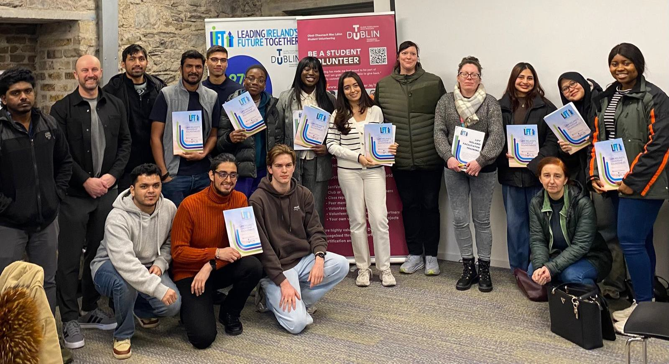

Slide 15



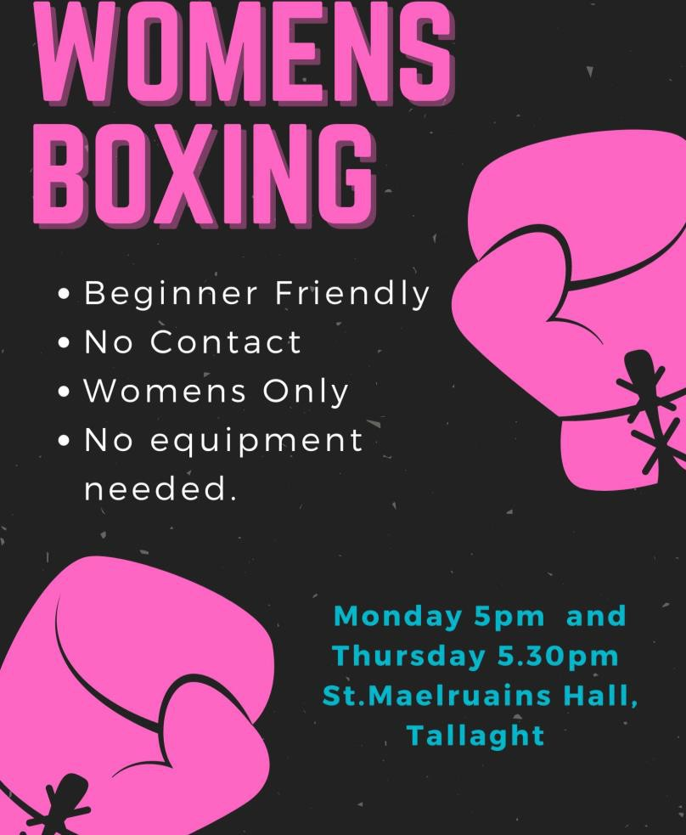
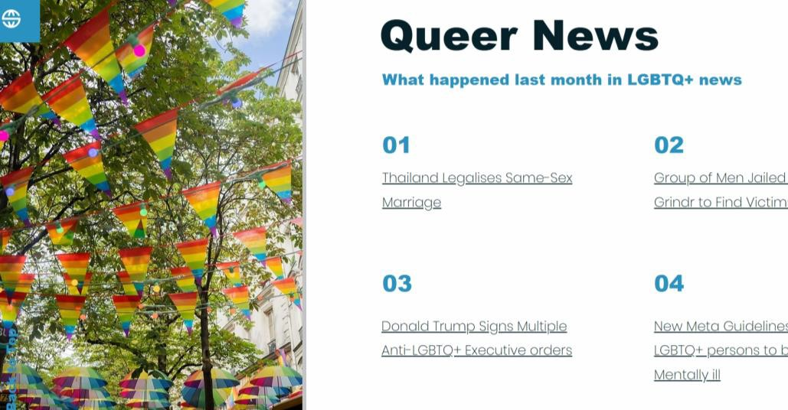

Slide 16
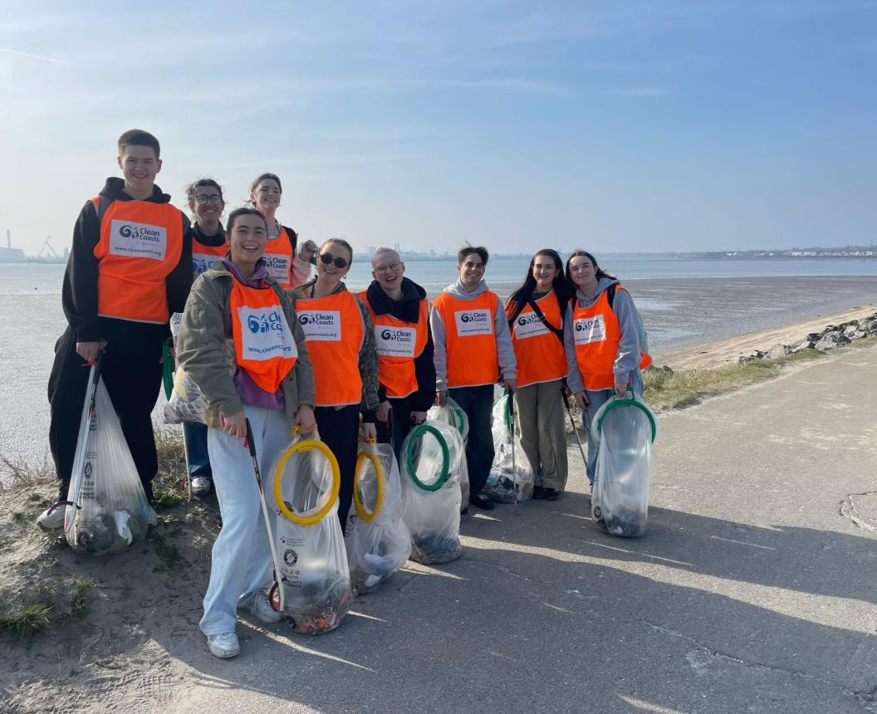
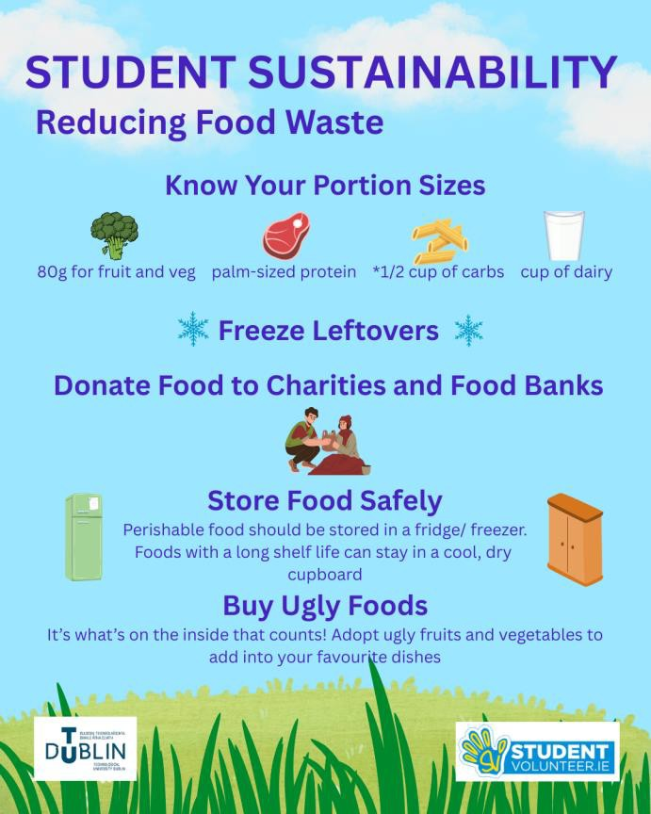

Slide 17
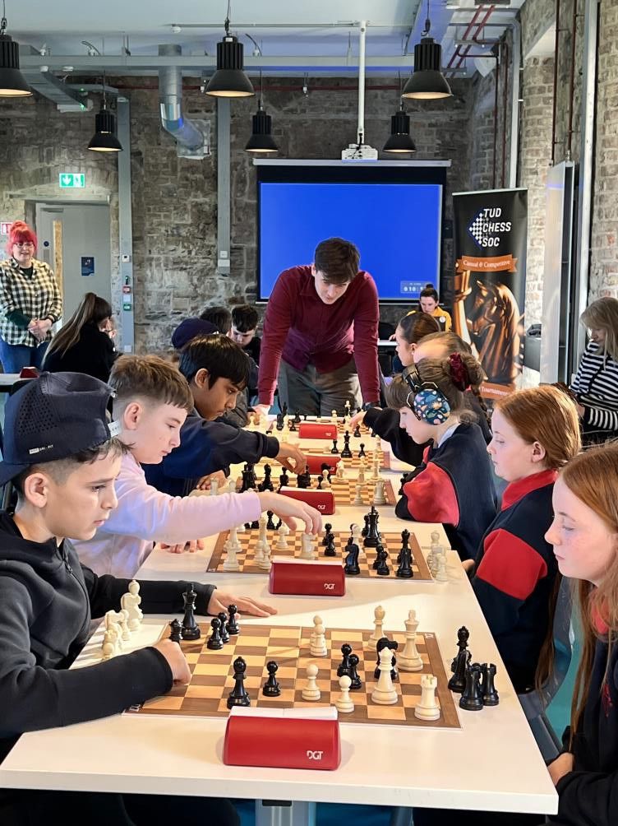
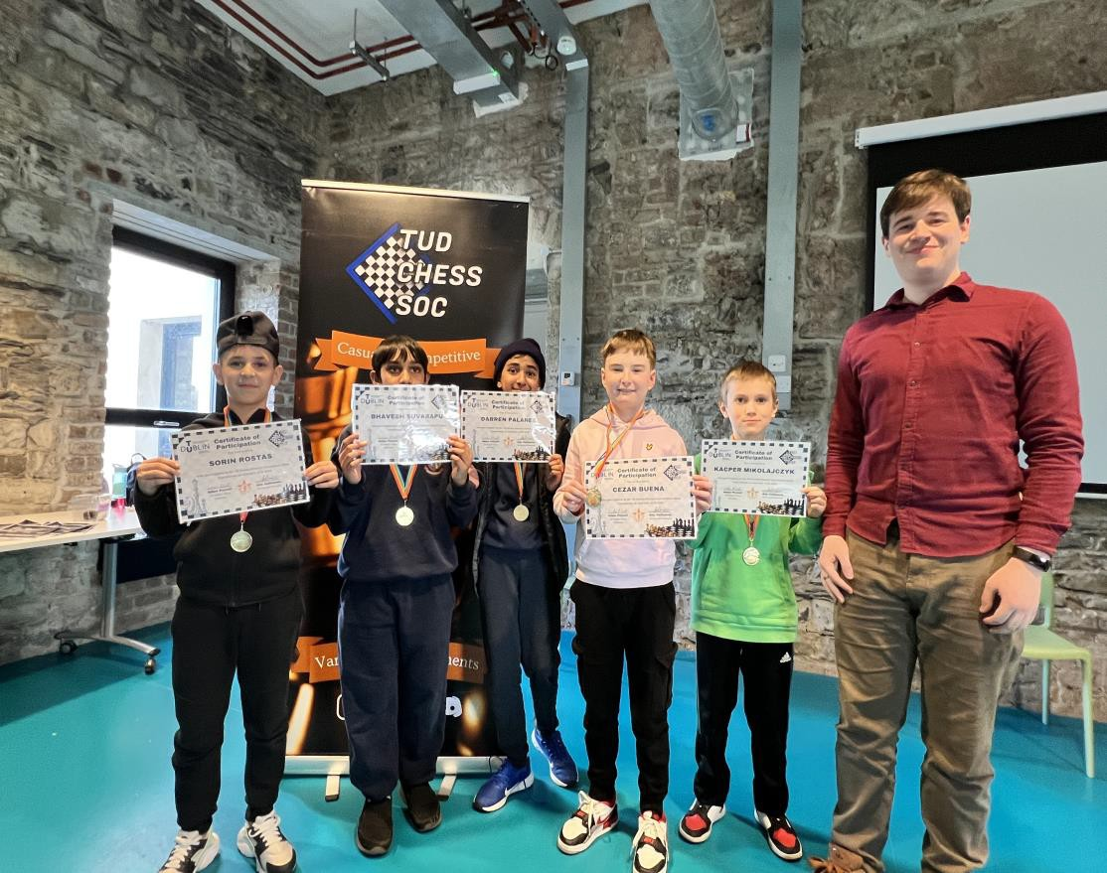

Slide 18
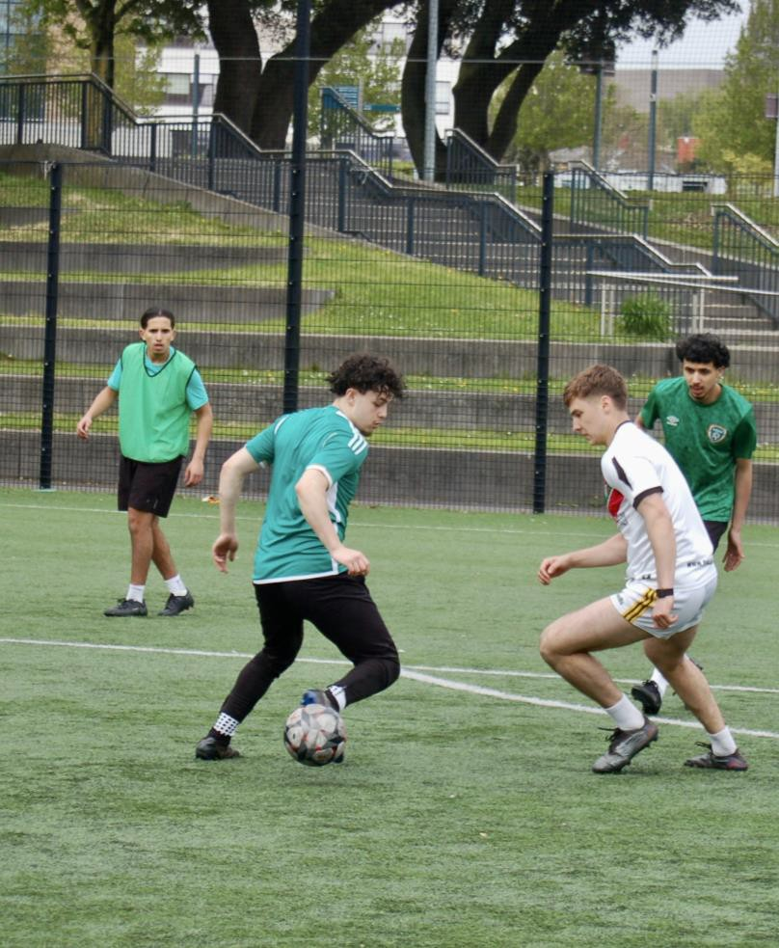
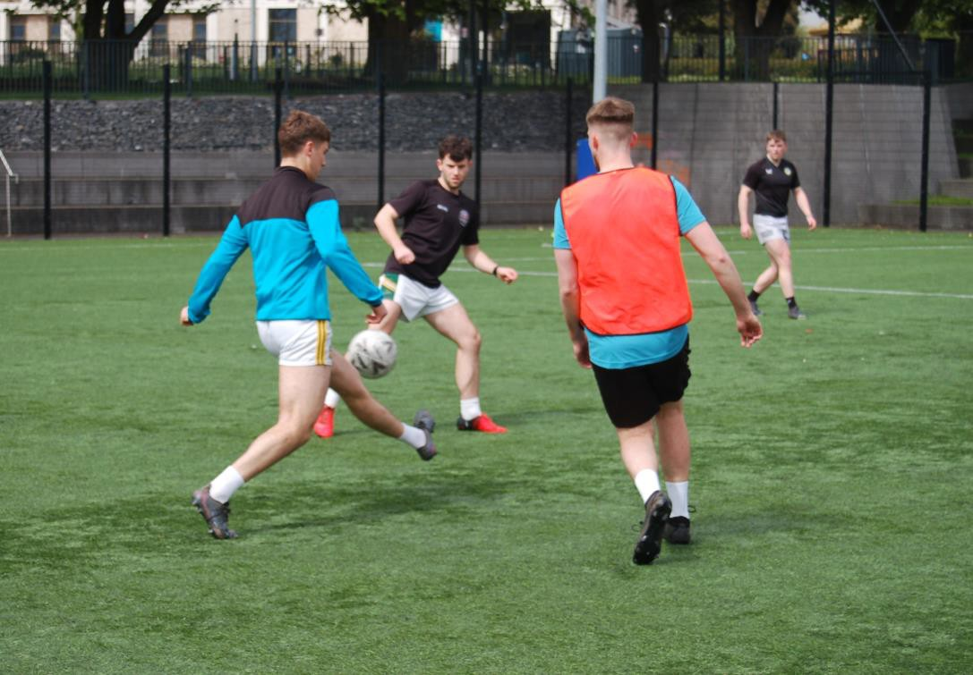

Slide 19
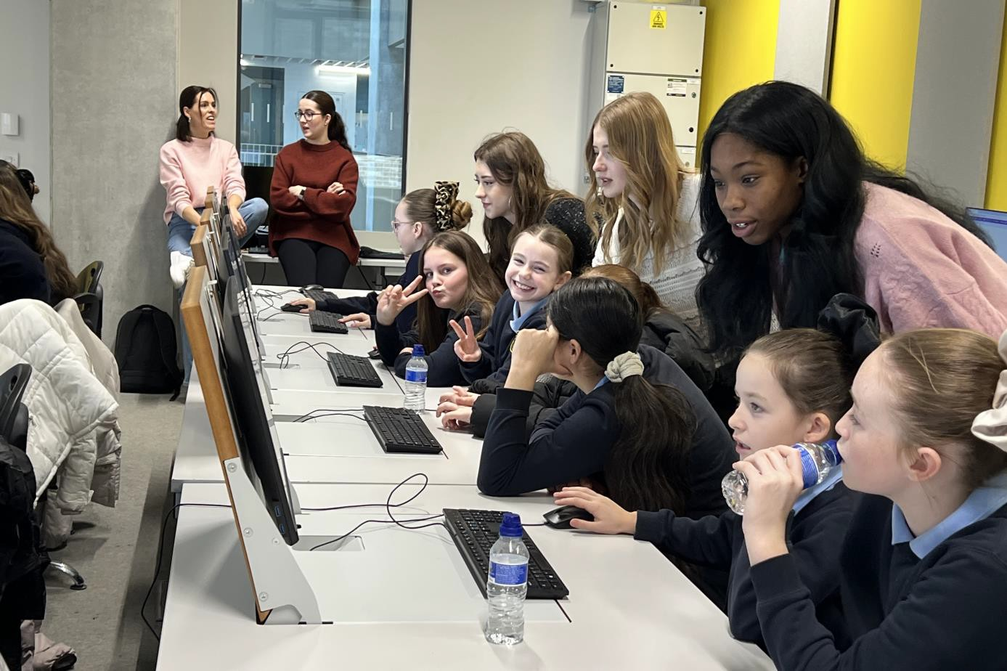

Slide 20
