Slide 1
SDCC/ TUD Education & Student Life Bursary
Created by
Fionnuala Keane
Presented by
Fionnuala Keane

Slide 2
The Programme was established in 2006 between South Dublin County Council & IT Tallaght.
In 2019, IT Tallaght merged into Technological University Dublin (TU Dublin).
Aim of bursary: Encourage students from disadvantaged areas to stay in higher education
Provides funding for additional education-related expenses.
SDCC/ TUD Education Bursary - overview
Community Administration

Slide 3
How it works:
8 awards for first-year students.
8 awards for second-year students (continuing from the previous year).
Value: €2,500 per student.
Second-year payment is subject to successful completion of first year.
.
SDCC/ TUD Education Bursary
Community Administration

Slide 4
Students must be registered on a Level 6, 7 or 8 Programme at TU Dublin.
First-year award: given to the highest Leaving Certificate scorer from selected partner DEIS schools in SDCC area.
Collinstown Park Community College
Deansrath Community College
St Kevin’s Community College
St Aidan’s Community School
Killinarden Community School
St Mark’s Community School
Coláiste de híde
Tallaght Community School
Mount Seskin Community College
*Current Budget for 8 schools – seeking increase due to updated partner Deis School List*
.
Eligibility: SDCC/TUD Education Bursary
Community Administration

Slide 5
Designed to reduce financial barriers to students in higher education.
Focus on local disadvantaged communities in South Dublin County.
Promotes educational progression & achievement.
.
Key Aim: SDCC/TUD Education Bursary
Community Administration

Slide 6
Fifteen students were honoured in 2024: eight first-years starting their studies and seven second-years continuing with programme support. Each received €2,500 for 2024/2025. A runner-up from TU Dublin’s Access Programme also earned a special grant for their dedication.
Cllr Mick Duff, representing the Mayor, thanked TU Dublin for its partnership: “Your support makes this possible, and we look forward to continuing it.” To the students, he added: “Your achievements and places at TU Dublin are commendable. Congratulations to all.
.
Awards Ceremony TUD Education Bursary 2024/25
Community Administration

Slide 7
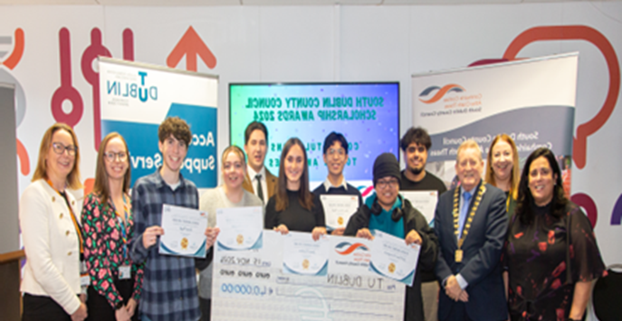


.
Awards Ceremony TUD Education Bursary 2024/25
Community Administration and Finance

Slide 8
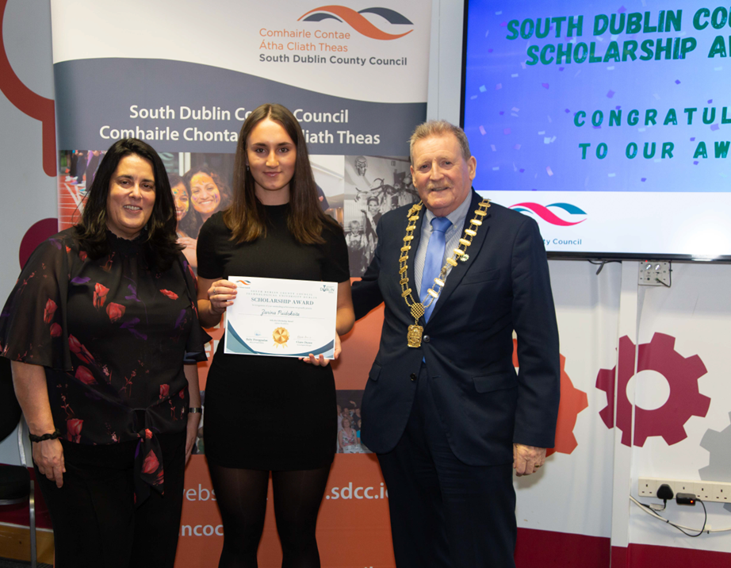
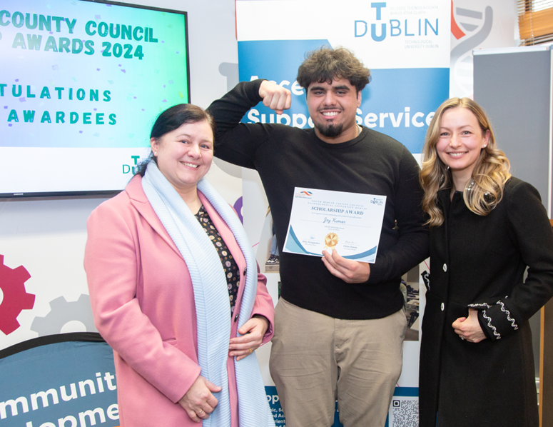
.
Awards Ceremony TUD Education Bursary 2024/25
Community Administration

Slide 9


.
Awards Ceremony TUD Education Bursary 2024/25
Community Administration

Slide 10
*New initiative 2024/2025*
Replaced Sports Bursary Award
This initiative offers an opportunity to enhance student engagement. Through the bursaries, students can develop essential leadership skills, strengthen their professional practice and competencies, and contribute to the ongoing growth and development of sports clubs, societies, and volunteering activities.
Contribution from SDCC is €10,000. Award to individuals is €1000 per person. Total contribution from SDCC is €10,000
SDCC/ TUD Student Life Bursary
Community Administration

Slide 11
What next:
Seeking an Increased budget to facilitate an award to all Partner Deis Schools
Allocating a budget for a possible ‘Deserving Student Award’.
Continuous Review of awards scheme with TUD to ensure most deserving students are in receipt of the bursaries.
.
.
TUD Education & Student Life Bursary 2026/27
Community Administration

Slide 12
Thank you!

