Slide 1


Slide 2
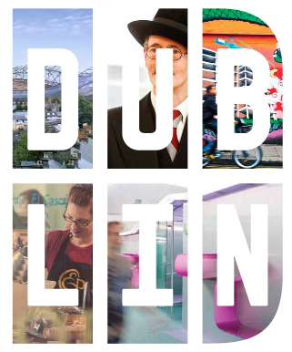

Dublin’s place brand was developed as part of a European place-branding project for Atlantic Arc Cities (Dublin, Cardiff, Liverpool, La Rochelle, San Sebastian & Faro)
Dublin has two brands:
Place (Regional LAs)
Destination (Fáilte Ireland)

Slide 3

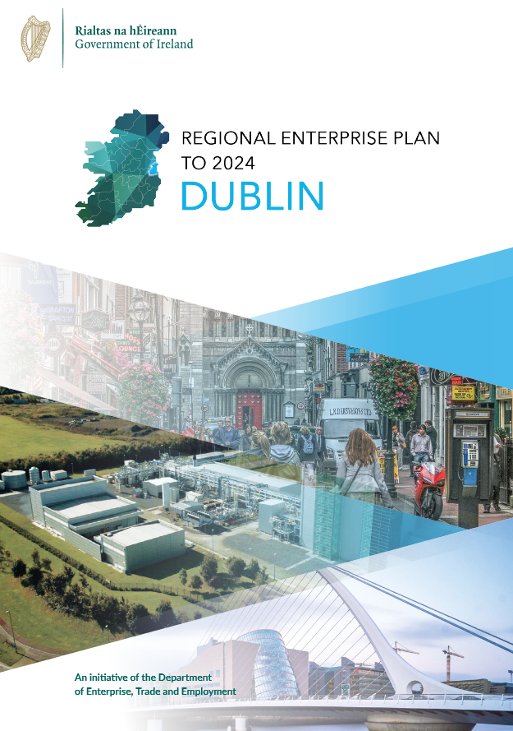
Dublin Regional Enterprise Plan 2020-2025
Advance a shared brand vision for Dublin
  Stakeholders that already promote Dublin agree a shared vision.
  This shared vision is informed by research & insight from targeted audiences.
  A shared brand vision enables any organization, both public & private, to promote the region with a consistency that optimises spend and messaging.

Slide 4
A dedicated marketing team
Five key staff members who have proven experience in delivering large scale, impactful campaigns.
  Campaign/project management
  Stakeholder engagement
  Social / OOH / print advertising
  Graphic design
  Website management
  Branded Merchandise
Work with contracted agencies to deliver and have the knowledge to feedback on suggested creative.
All campaigns are reviewed after execution to find out what went well and what we can learn from.

Slide 5
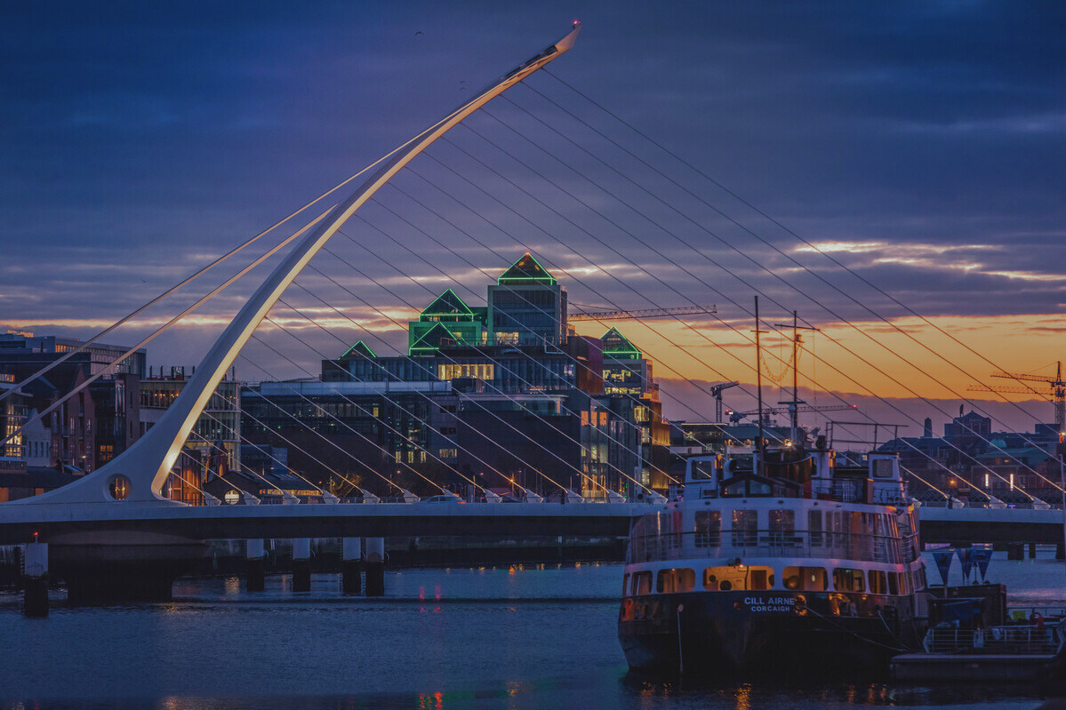


LIVE
STUDY
WORK
INVEST
WHAT’S ON
9
digital platforms
9
campaigns
since
2020
OOH
&
event brand activations

Slide 6
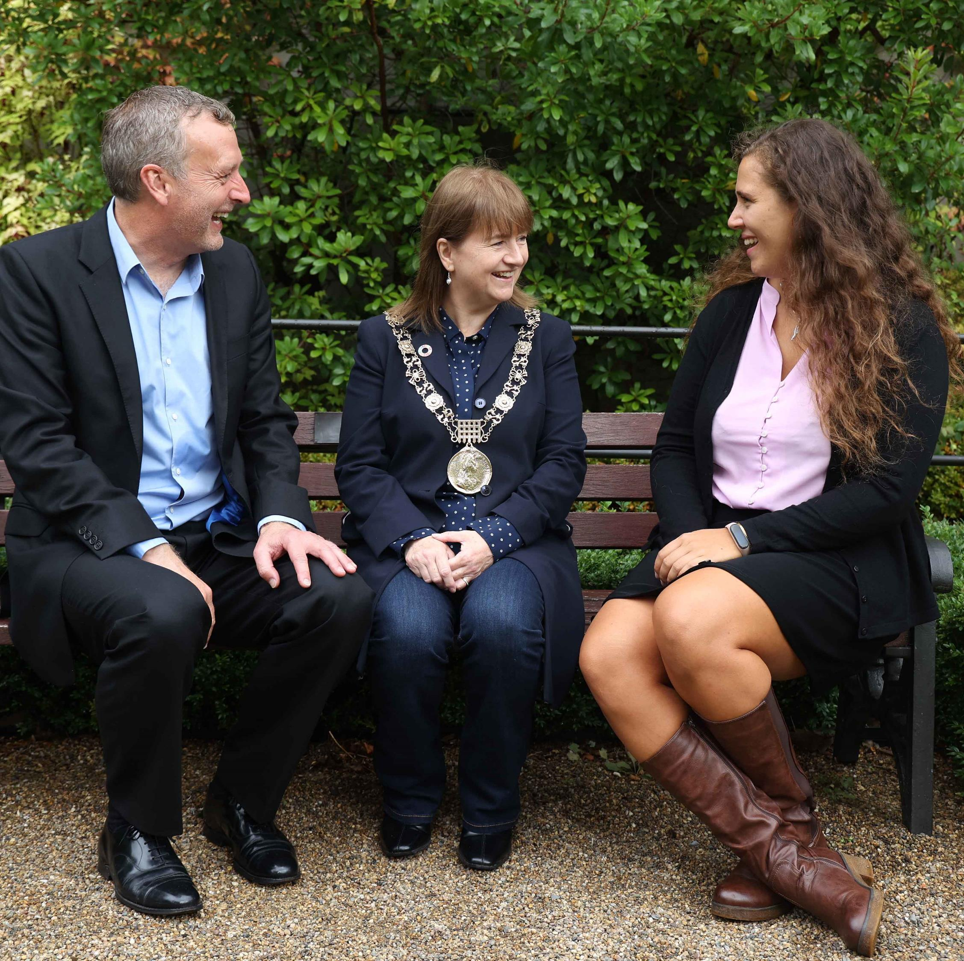
Dublin Postgraduate Scholarship
Joint project with Education in Ireland and HEIs in Dublin
Targeted at France, Italy, Germany & Spain
Across digital platforms and newsletters
1400 entrants, resulting in 3000 leads for the HEIs

Slide 7
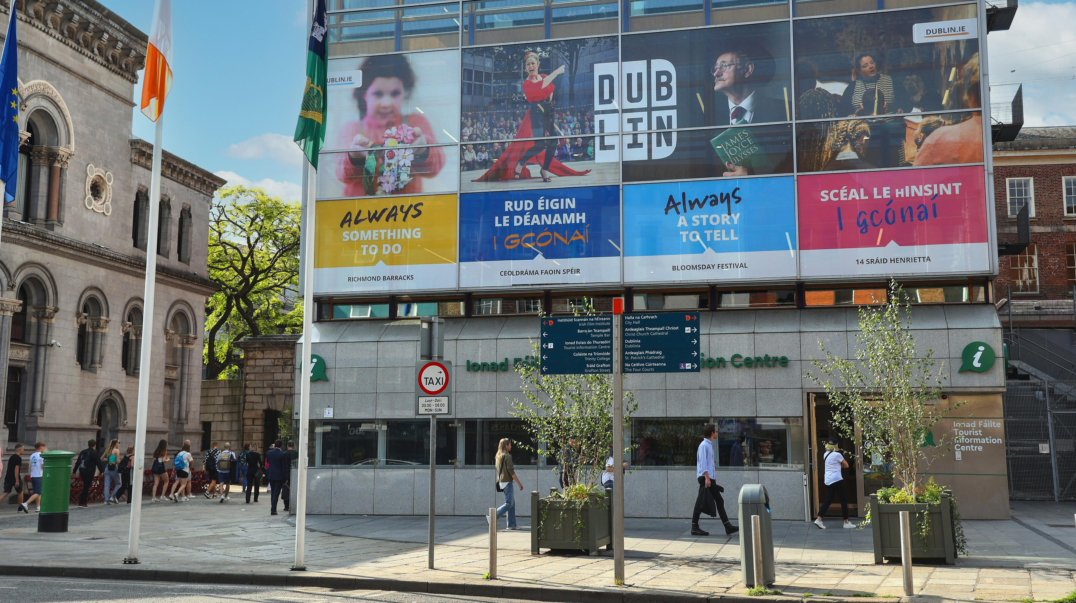

Slide 8
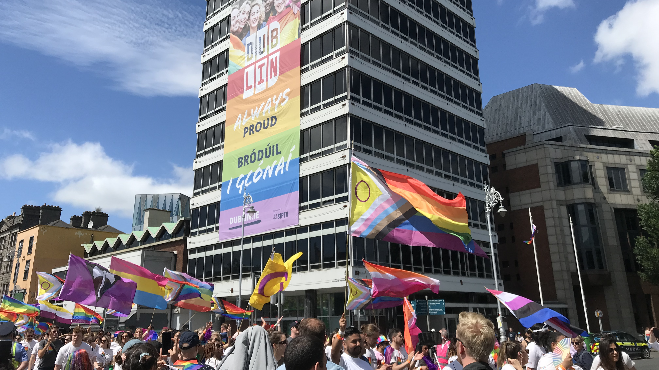

Slide 9
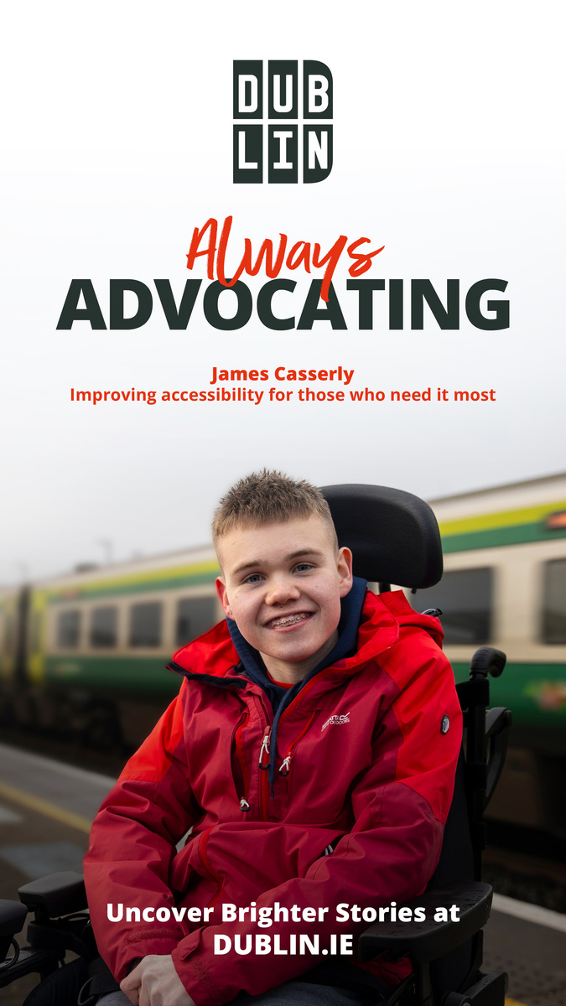
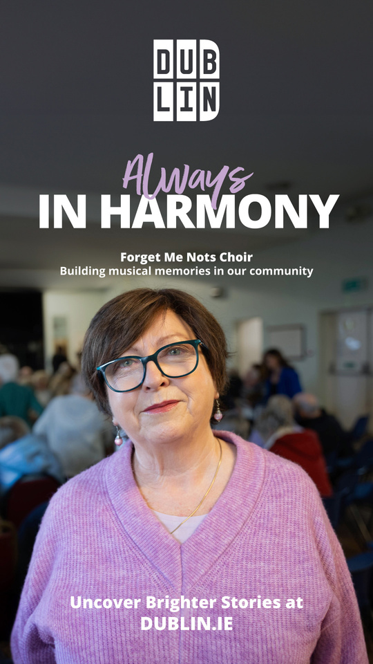
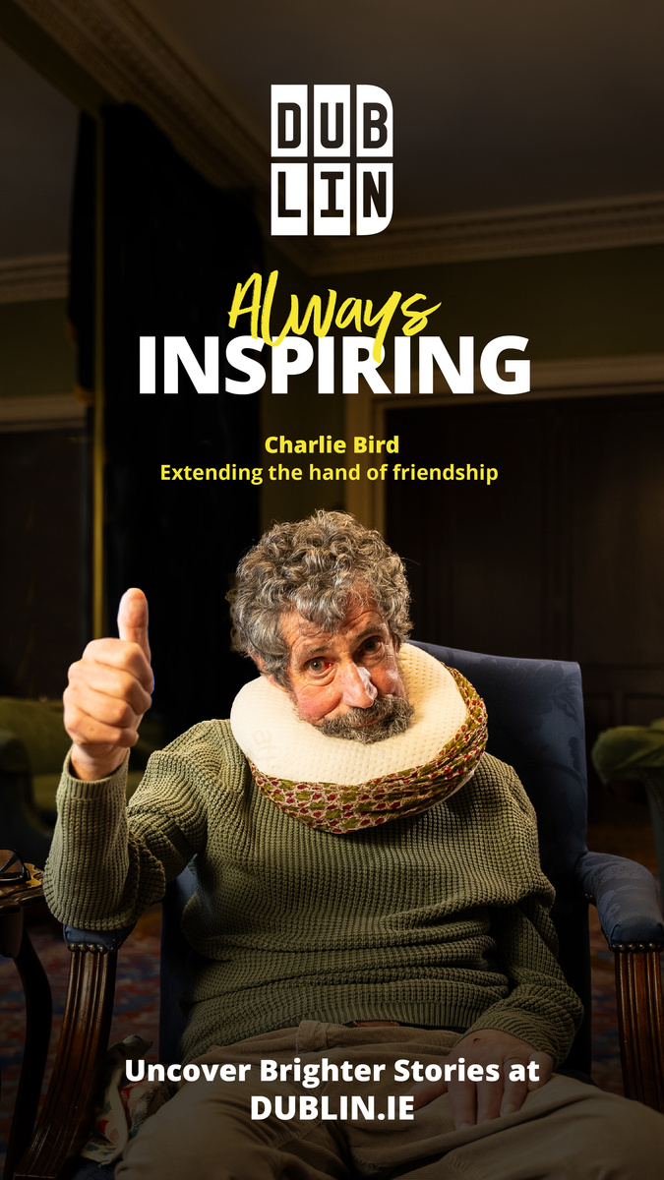
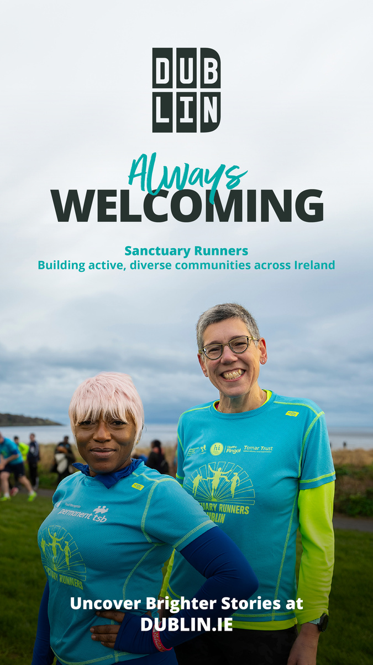
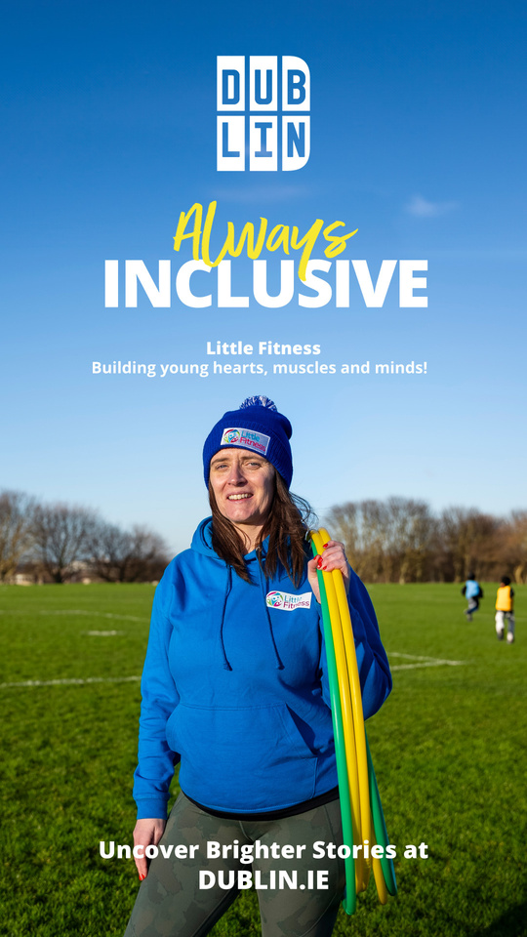
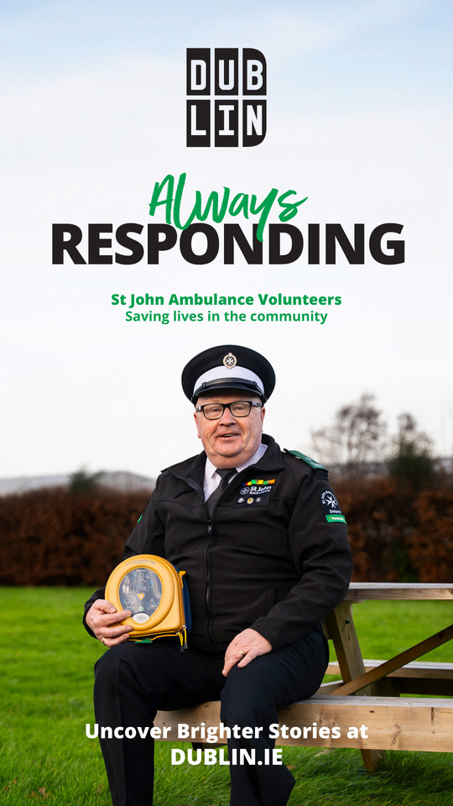
Always Brighter Stories
Showcasing real-life stories of community kindness

Slide 10

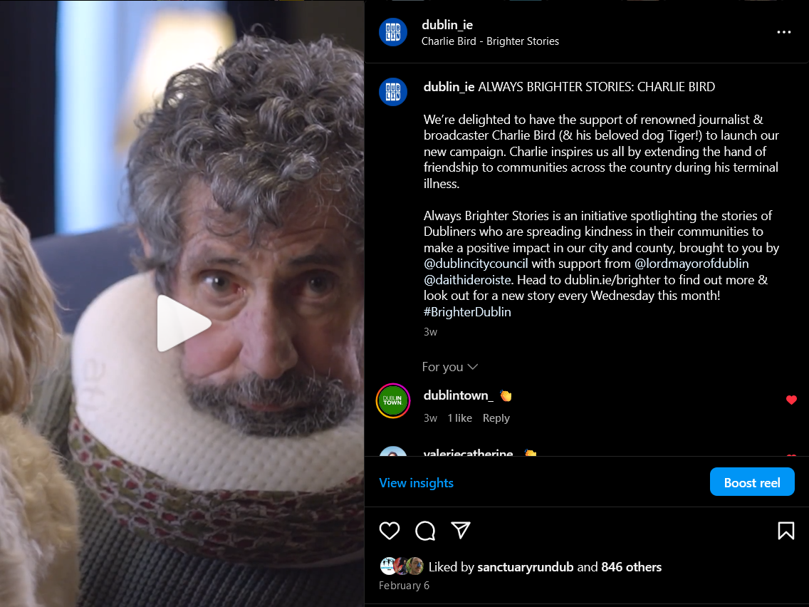
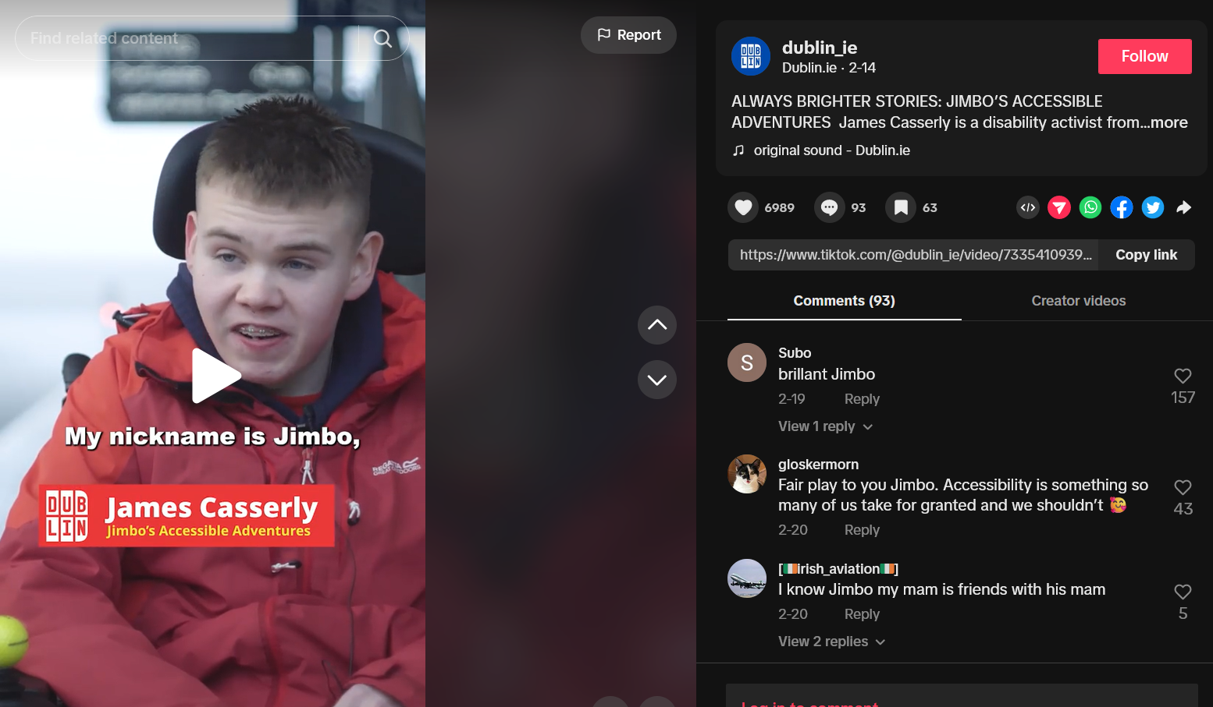
7
content
pieces
over
7m
video
views
4 weeks of
OOH
placements
€63k
total
spend
published on
6
digital
platforms

Slide 11
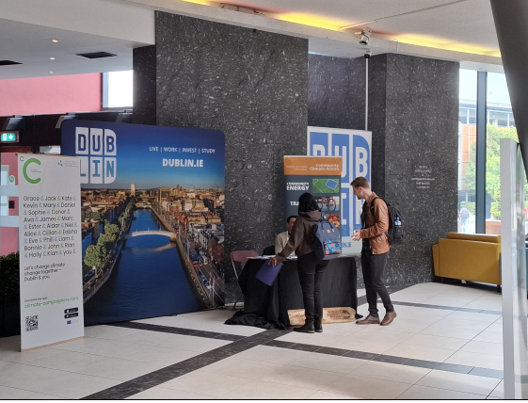
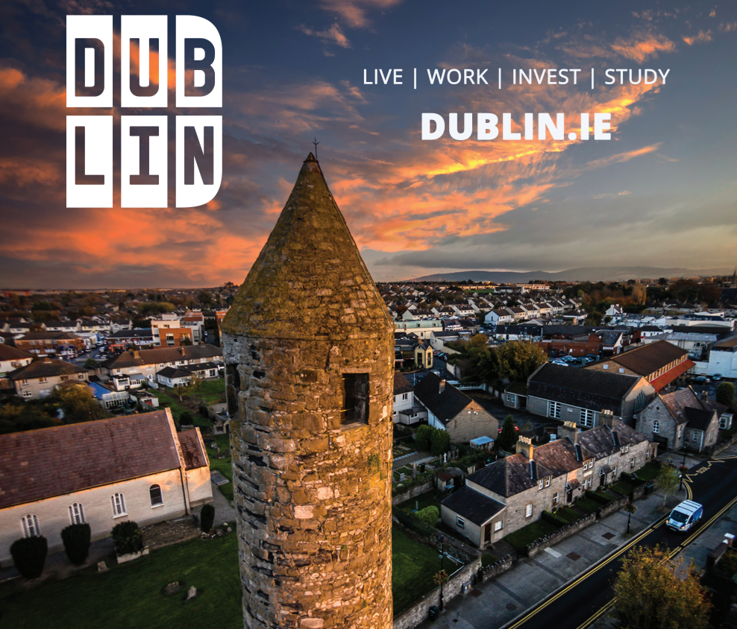
Brand presence
In the public realm:
Need to rollout the brand across OOH on a consistent basis.
Large outdoor sign: Coming Q1 2026.
Event and attraction signage:
Large expo stands have been given to DLRCC, Fingal CC and SDCC.

Slide 12
Invested in Dublin: Local ambition, global success
A campaign focused on the success of foreign direct investment (FDI) across the region.
First collaborative brand campaign between the Dublin LAs.
In the form of:
  Testimonial videos from: Walkers, Salesforce, Microsoft, Amgen, MSD, Dublin Fields.
  Regional video for Dublin.
  New content on Dublin.ie.
Rolled out across LinkedIn, out of home and print in March/April 2025.

Slide 13
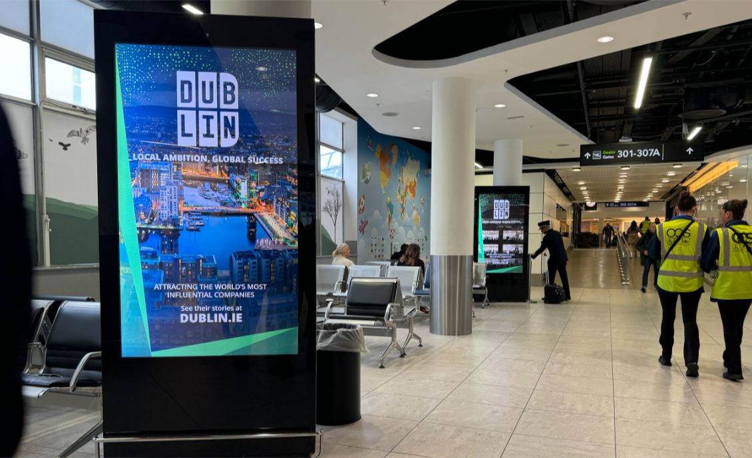
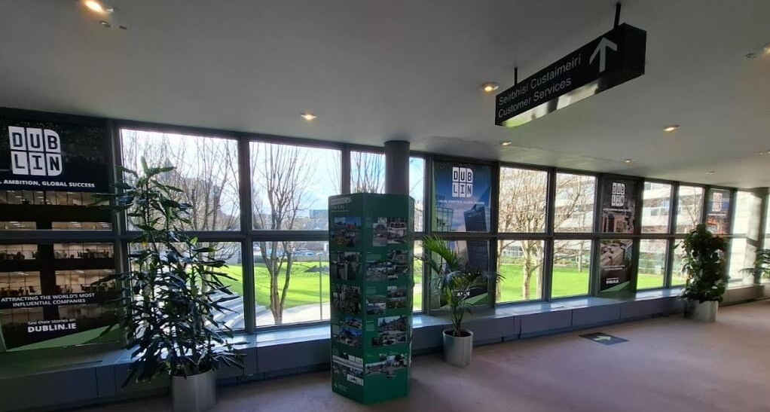
Dublin Airport
Civic Offices

Slide 14
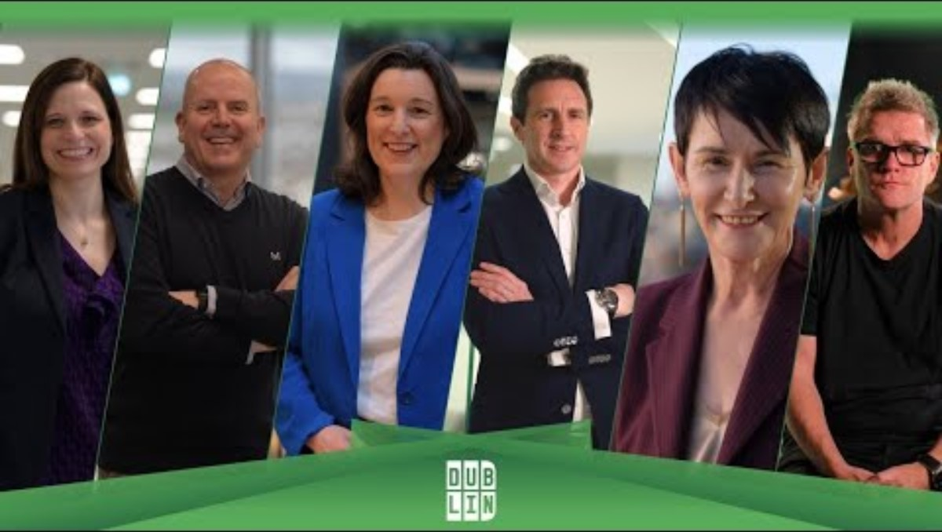

Slide 15
Campaign results
395k accounts reached on LinkedIn.
  244k internationally: Copenhagen, Barcelona & Munich focused on Life Sciences industry.
  135k domestic in the Leinster region.
806k video views.
Overall impressions for the paid campaign totalled 1.3 million, which exceeded predicted impressions.
Effective creative assets meant that the cost required to reach each viewer was lower than expected.

Slide 16
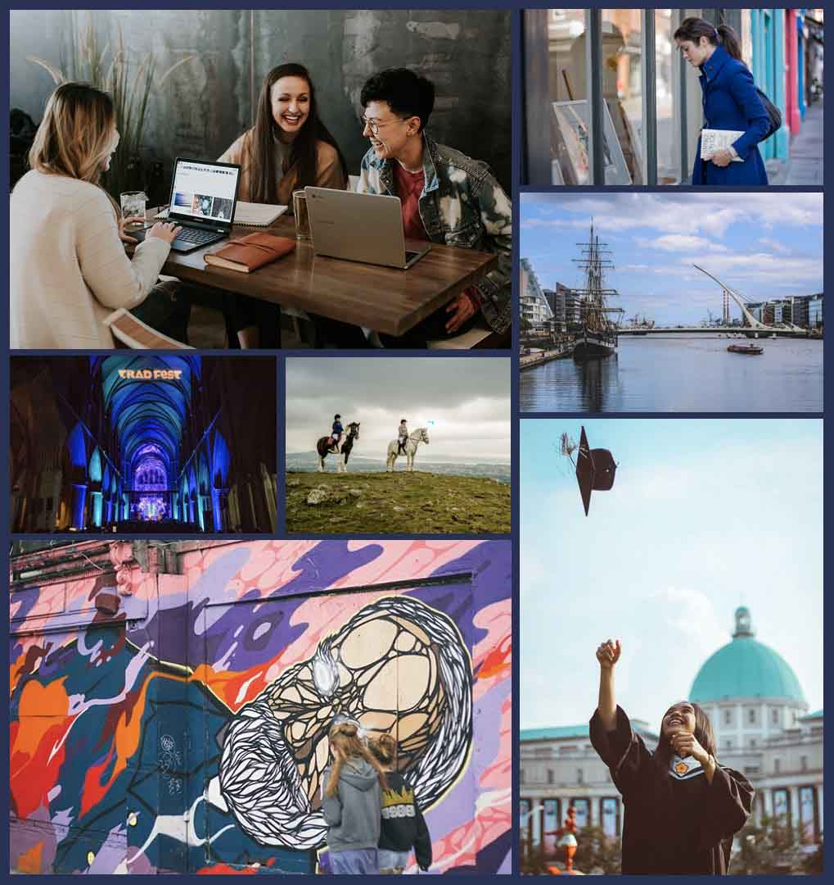
Thank you for your time.
Happy to take any questions.

