Slide 1
The Nature Of Play
South Dublin County Council
Play Policy 2025 - 2030
Presented by
Suzanne Furlong

Slide 2
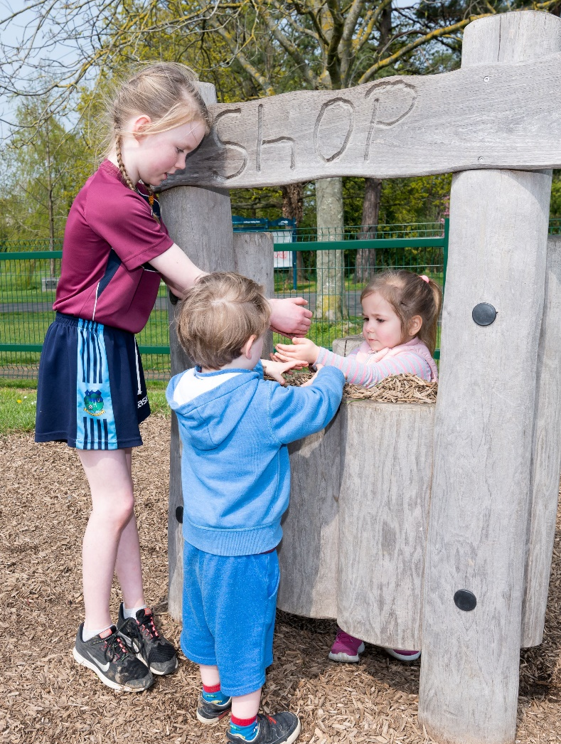
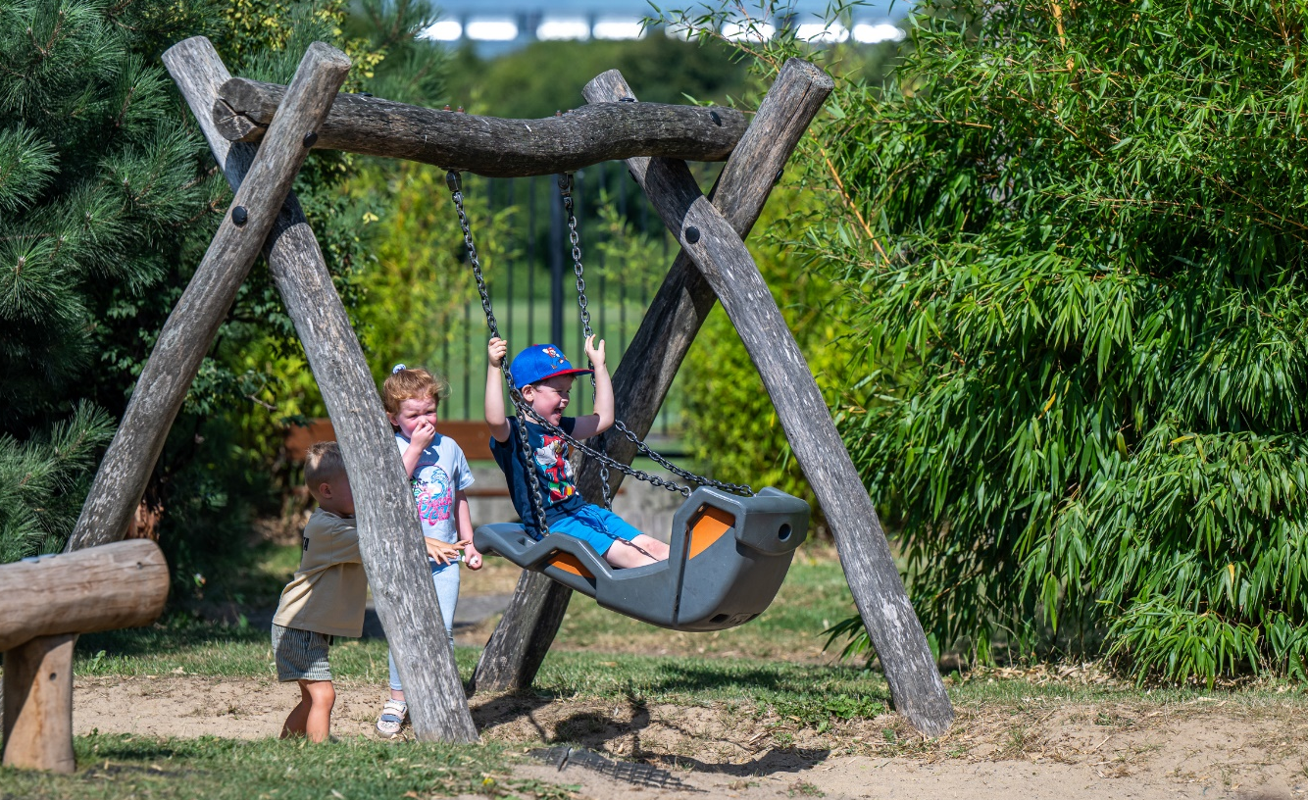
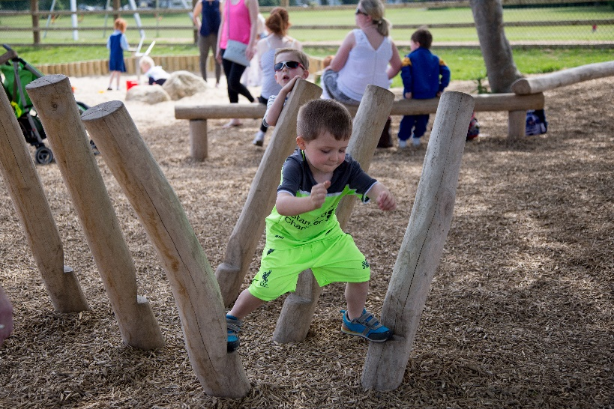
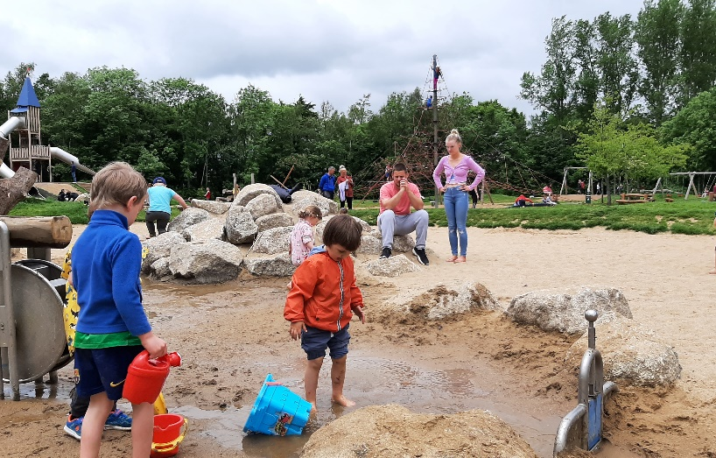
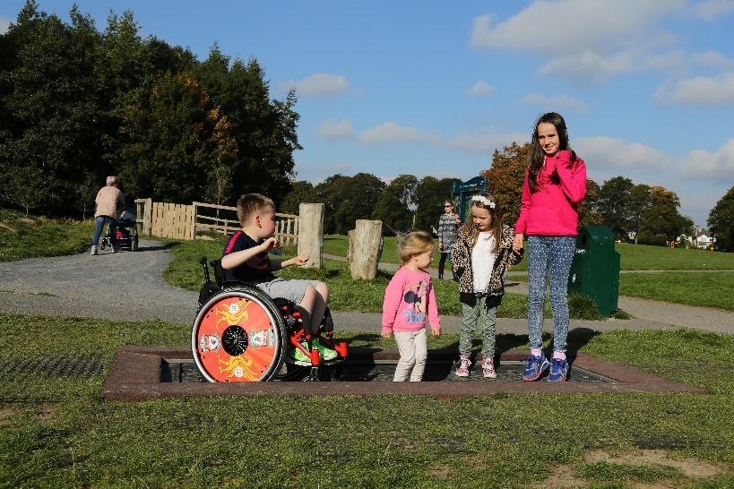
Why Play Matters: physical and mental health, socialisation, learning, creativity, independence, friendships, happiness, strong communities
The Nature Of Play

Slide 3
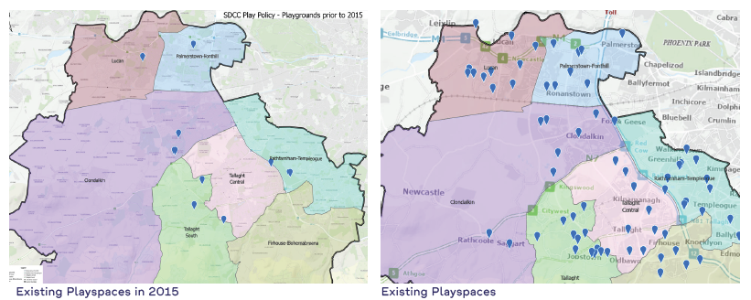
Background- Playground Construction Programme
The Playspace Programme in South Dublin County Council from 2014 to 2019 was proposed as a five-year programme aimed to address the deficiency of play opportunities across the county. It was an innovative programme based on encouraging children back into the outdoors to engage in active, imaginative, constructive and social play. The playspaces were designed to adapt to the place where they were installed. They focus on creating appropriate settings for play (rather than equipment for children to play with); are located closer to where children live, with the emphasis on natural playspaces; which focus on the type of play that is most important to younger children.
From 9 to over 70 play areas including Teenspaces
€6.25 million capital investment
More Inclusive, accessible and nature-based play.
Community Engagement to ensure local needs are met
The Nature Of Play

Slide 4

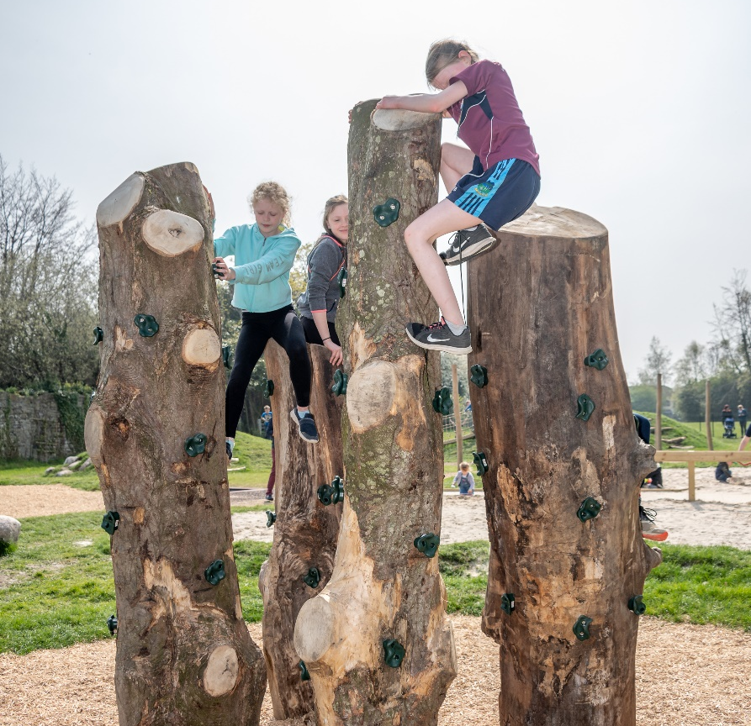
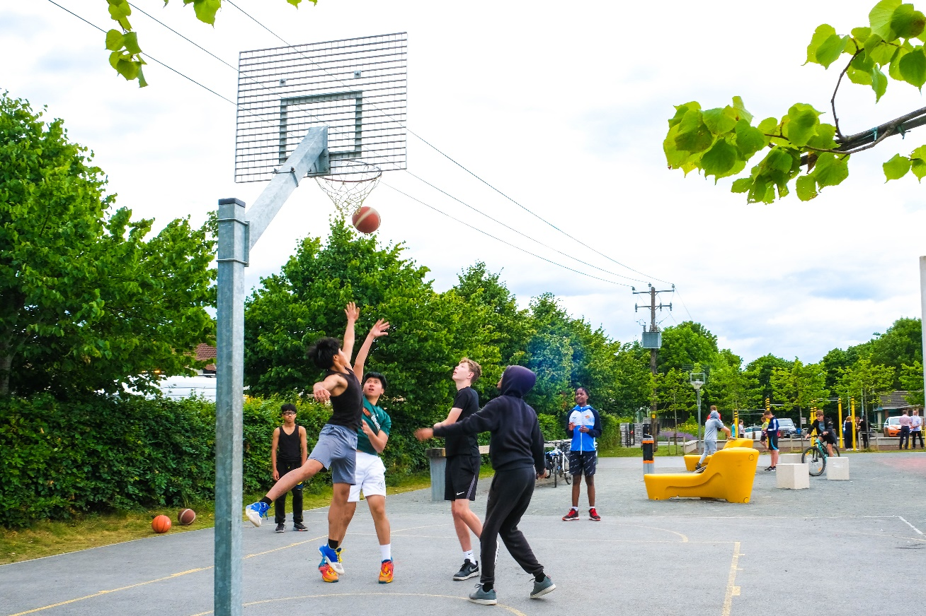
SDCC envisions a County where all children have access to safe high-quality playspaces close to home that are inclusive, nature-connected and supportive of their health, happiness and wellbeing.
Vision
The Nature Of Play

Slide 5
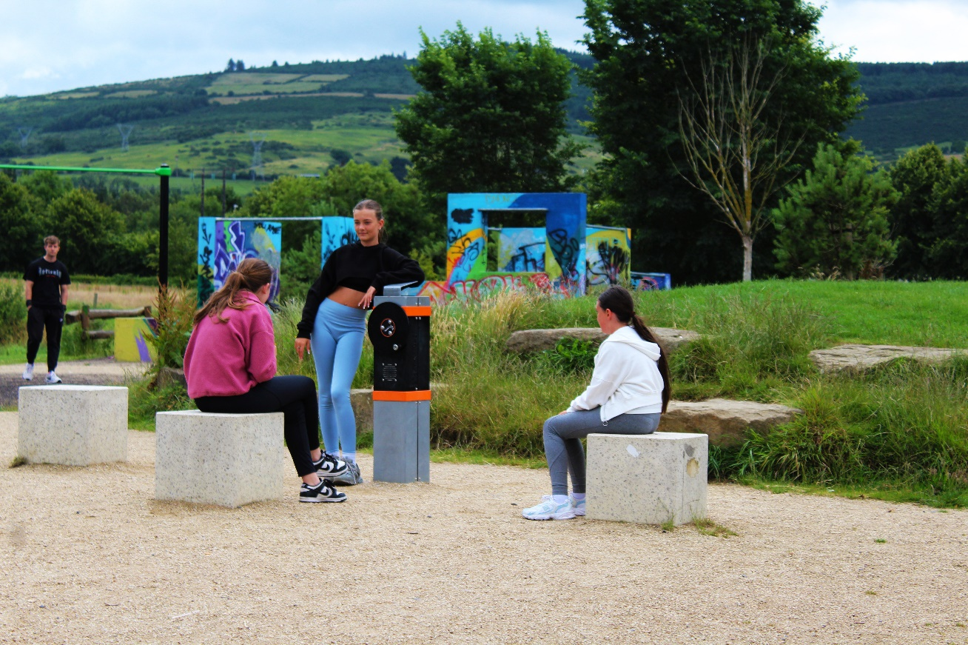
Key Policy Framework
Guidelines based on the Fields in Trust (FIT) standard. This sets out an evidence-based standard for play provision.
Play Provision in New Developments→Guidance for planners & developers
Clear objectives: Accessibility, universal design, nature-based play
Commitment to equitable distribution across all communities.
A strong emphasis is placed on community engagement, ensuring that new and upgraded play facilities reflect the needs and priorities of local people.

Slide 6
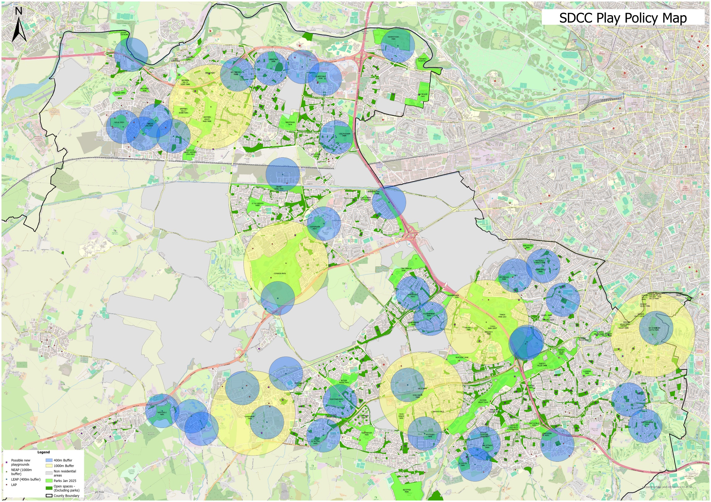
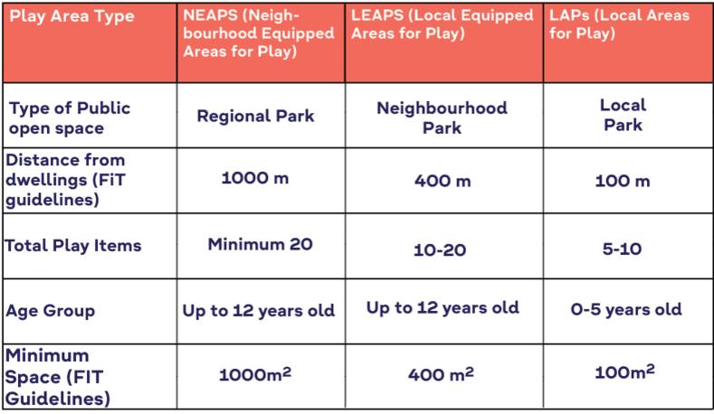
The Nature Of Play

Slide 7
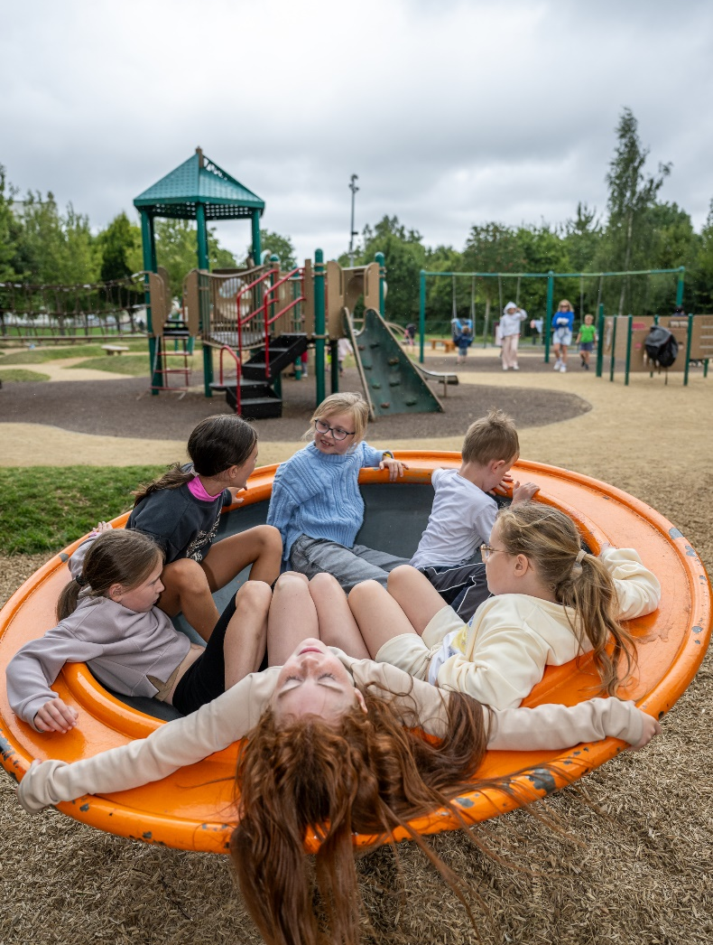
Next Steps
The next stage of this policy will focus on:
Analysing mapping data to identify where there are deficits in play provision.
Engaging with communities to establish local demand and priorities.
Developing a clear plan for the delivery of new play facilities where both a need and a demand have been identified.
Using this information to inform a new Playground Construction Programme.
Finally, this Play Policy is a living document. To remain relevant and responsive, it will be reviewed every five years, ensuring that play provision continues to evolve in line with demographic changes, community needs, and best practice standards.
The Nature Of Play

