Slide 1
SDCC Arts Office September ACM Report
Created by
Arts Office
Presented by
Richie O’Sullivan

Slide 2
Arts Grants for Approval
Knocklyon Literary Festival 2025
Knocklyon Literary Festival are seeking financial support for their 2025 Literary Festival. Over three evenings and four days, in September 15 artists, writers, and facilitators representing the diversity of the literacy community in Ireland, will participate in the festival progrqamme.
Creative Workshops will be provided for adults, with an emphasis on writing for wellness with special events aimed at promoting the beneficial effects of writing, on mental health. Their director Carolann Copland, already and accomplished author and facilitator will curate this specialist area.
The Arts Office recommends that a grant of €2,900 be allocated to Knocklyon Literary Festival towards the cost of engaging workshop facilitators, rental of venues, and advertising/Marketing for their festival.

Slide 3
Arts Report
Creative Ireland: Schools Culture Award Open for Applications
Creative Ireland South Dublin are happy to announce the Schools Culture Award is now open for applications, this award is open to interested schools located in South Dublin County. The initiative seeks to support primary schools, second level schools and programmes that support early school leavers, to engage with an artist to develop programmes and projects that will enrich arts practice in schools in the county, in the disciplines of Drama, Dance and Visual Arts. Awards will be granted in the region of €500 - €2000. The maximum amount of any award is €2000.
Any queries please contact Creative Communities Engagement Officer, Eithne Swaine: eswaine@sdcublincoco.ie
Deadline: Completed applications must be submitted no later than 5pm on Friday 26th September.

Slide 4
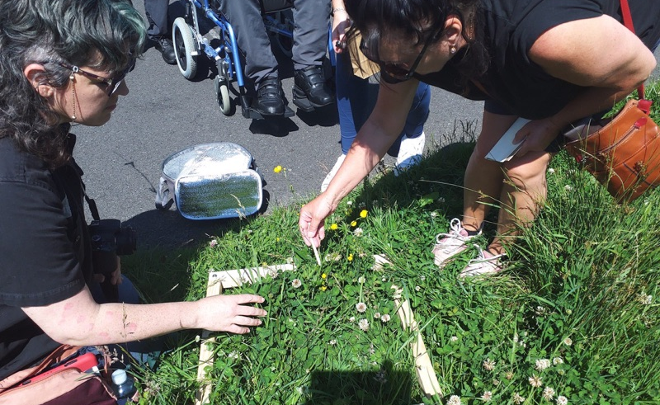
Public Art
Public Art
In August, Richie O’Sullivan joined the Arts Office in the role of Assistant Arts Officer - Public Art.
In July, four new Public Art commissions were selected by peer panel as part of In Context Strand 2 following an open call. The theme for this award is a focus on climate action, environment, tackling the urgency of climate change, and champion sustainability and / or biodiversity in the context of South Dublin County.
  Dennis Connolly and Anne Cleary have been awarded €44,000 to undertake a Public Art project in Templeogue and Rathfarnham. They are also currently engaged in a project centred around the Dodder.
  Katie Watchorn and Áine Mac Giolla Bhríde have been awarded €25,000 to undertake a Public Art project in the Knocklyon.
  Over the coming month, we will support Dennis, Anne, Katie, and Áine to engage with groups and communities of interest in these areas.

Slide 5
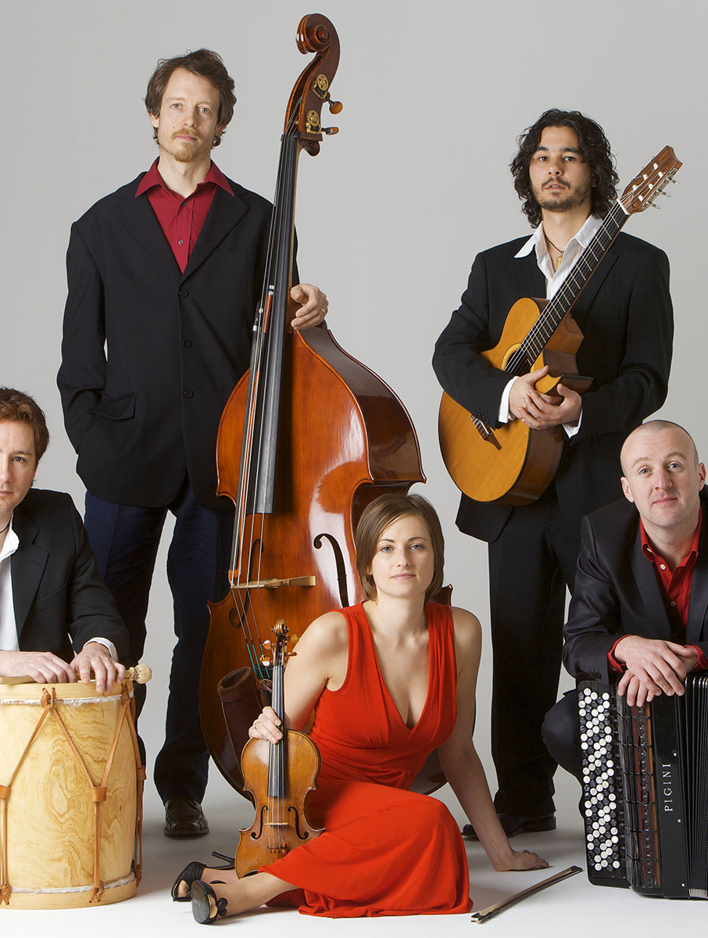
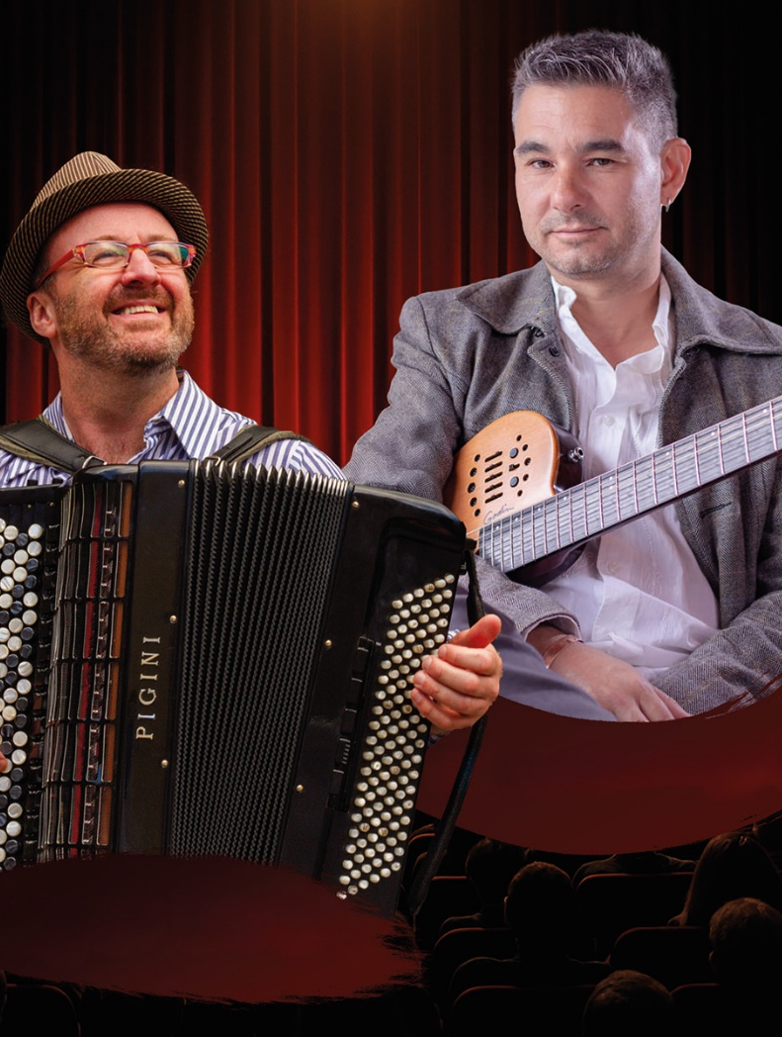
South Dublin Live
Sunday 28 September, 3-4.30pm.
Following the successful South Dublin Live events in Rathfarnham Castle in August by Dunne & Hernandez and Linfardia, Rathfarnham Concert Band will perform Jazz, Classical and Music from Musicals & Film with a full orchestra at Rathfarnham Castle Park from 3pm to 4.30pm on Sunday 28th of September.
Soth Dublin Live also supported a series of outdoor film screenings across the county this Summer including Rathfarnham Castle on 7th Jun and the Park Community Centre on the 23rd of Aug, providing music before the screenings.

Slide 6

Friday 19th September 2025
Openness | Discovery | Celebration | Belonging
Rathfarnham Castle celebrates Culture Night.
Visit between 4pm -8pm Learn about the sixteenth-century origins of this historic building before exploring some of the finest rooms in Georgian Dublin.

Slide 7
Thank you

