Slide 1
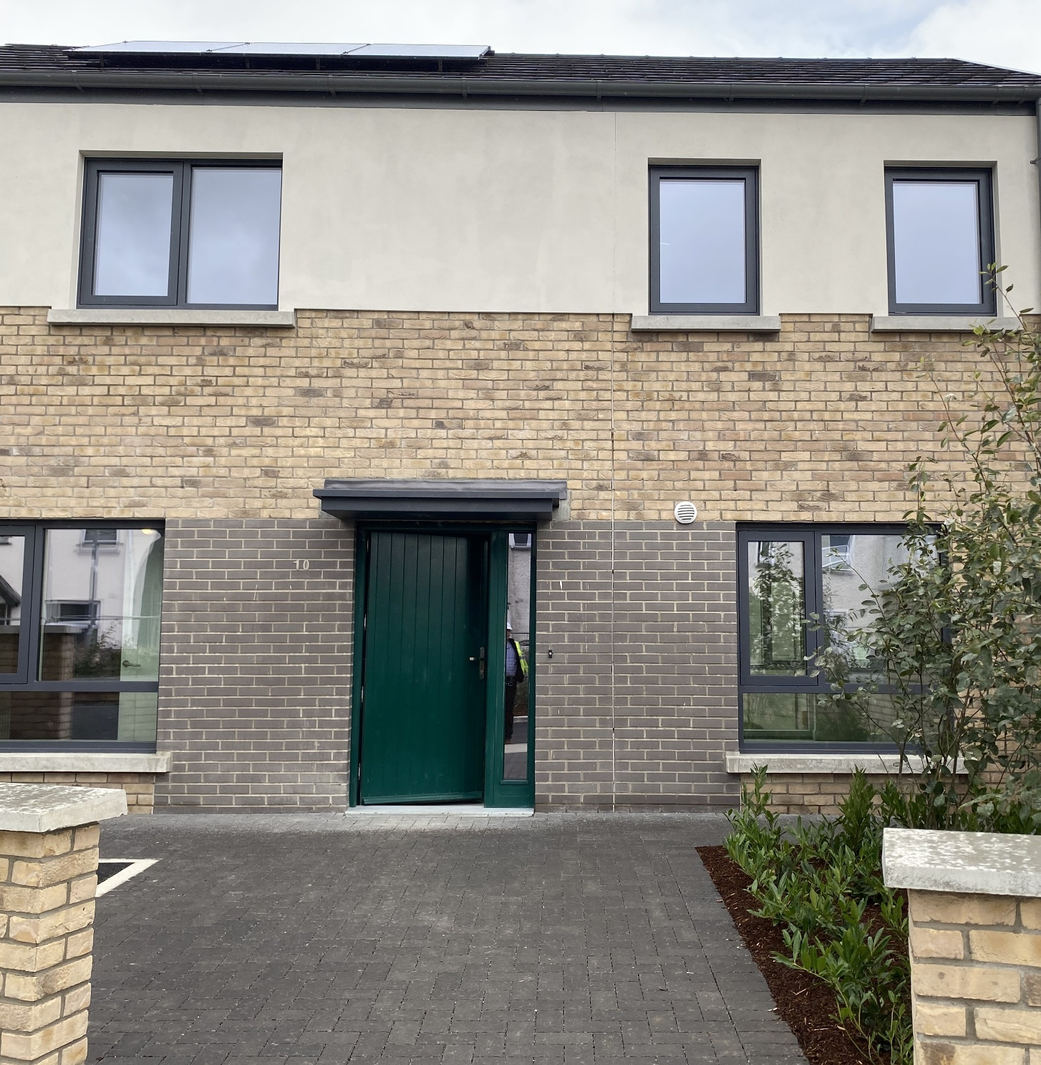
Housing Delivery
Report
Rathfarnham Templeogue Firhouse Bohernabreena ACM

Slide 2
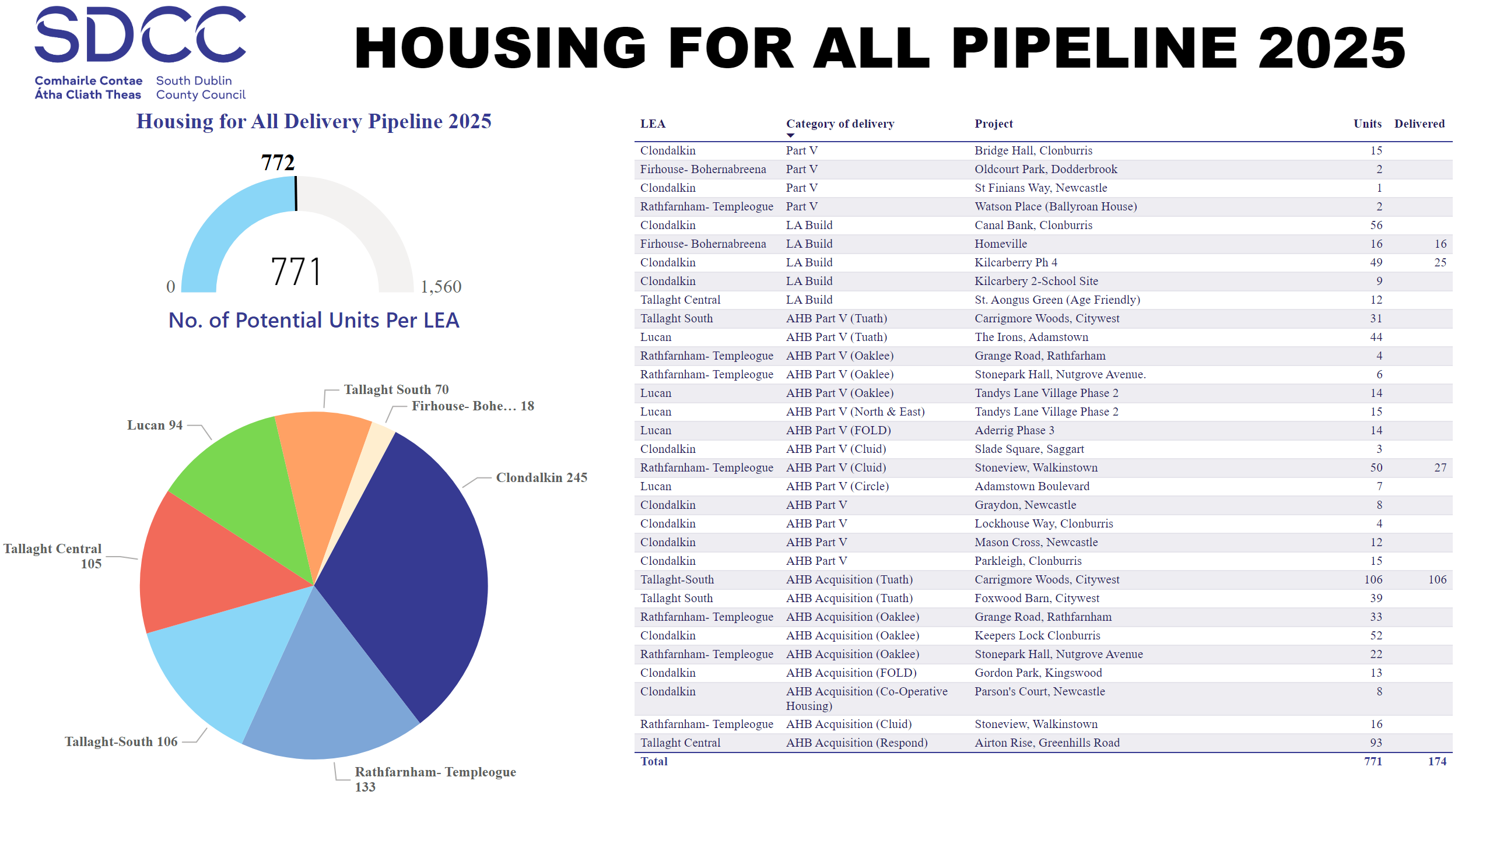
2025
Notes:
image
No alt text provided
Potential Units
No alt text provided
textbox
No alt text provided
No. of Potential Units Per LEA
No alt text provided
Housing for All Delivery Pipeline 2025
No alt text provided

Slide 3
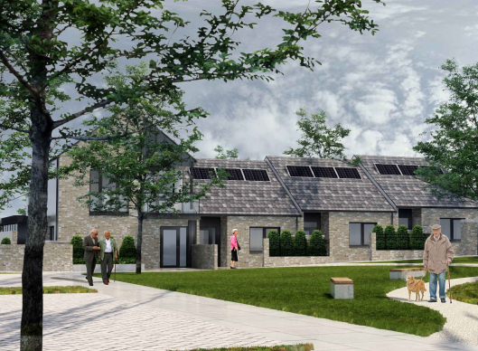

SDCC Build Programme
LEA | Project | Units | Status
Firhouse – Bohernabreena | Homeville – Watercourse Grove | 16 | Complete July 2025 – Allocations progressing
 | Pearse Brothers Park | 10 | Construction ongoing. 15 month programme. Age-Friendly Development
 | Stocking Avenue | 25 | Part 8 advertised July 2025 – closing September 2025
Pearse Brothers Park
Watercourse Grove

Slide 4
AHB & Part V Delivery
LEA | Project | Expected Units | Status
Rathfarnham – Templeogue | Grange Road, Rathfarnham Part V & AHB Acquisition – Oaklee | 37 | 37 units complete. EDD September 2025
 | Walkinstown House Part V & AHB Acquisition – Cluid | 66 | On site. 27 units complete August 2025. Balance due for delivery September 2025.
 | Stone Park Hall, Nutgrove Avenue Part V & AHB Acquisition – Oaklee | 28 | On-site. EDD December 2025
 | Watsons Place, Ballyroan Part V | 2 | On-site. EDD December 2025
 | Whitehall Road West AHB Build - Focus Ireland | 13 | On-site. Delivery from Q2.2026. Age Friendly Development
Firhouse – Bohernabreena | Oldcourt Park, Dodderbrook Part V | 2 | On-site. EDD November 2025. Part V negotiations ongoing
 | St Winnows, Stocking Lane Part V | 25 | On site. Due for delivery Q3 2026. Part V negotiations ongoing.
 | Firhouse Inn Part V | 15 | On site. Due for delivery Q4 2026. Part V negotiations ongoing.

Slide 5
Housing Acquisitions Programme 2025
Acquisitions complete to date
60
Acquisitions in Conveyance
14
Sale Agreed
13
Anticipated Completions for 2025
87

Slide 6
Thank you

