Slide 1
Rathfarnham, Templeogue, Firhouse, Bohernabreena ACM,
September 2025
Created by
{Library Events and Communications}
Presented by
{Mark Ward}

Slide 2
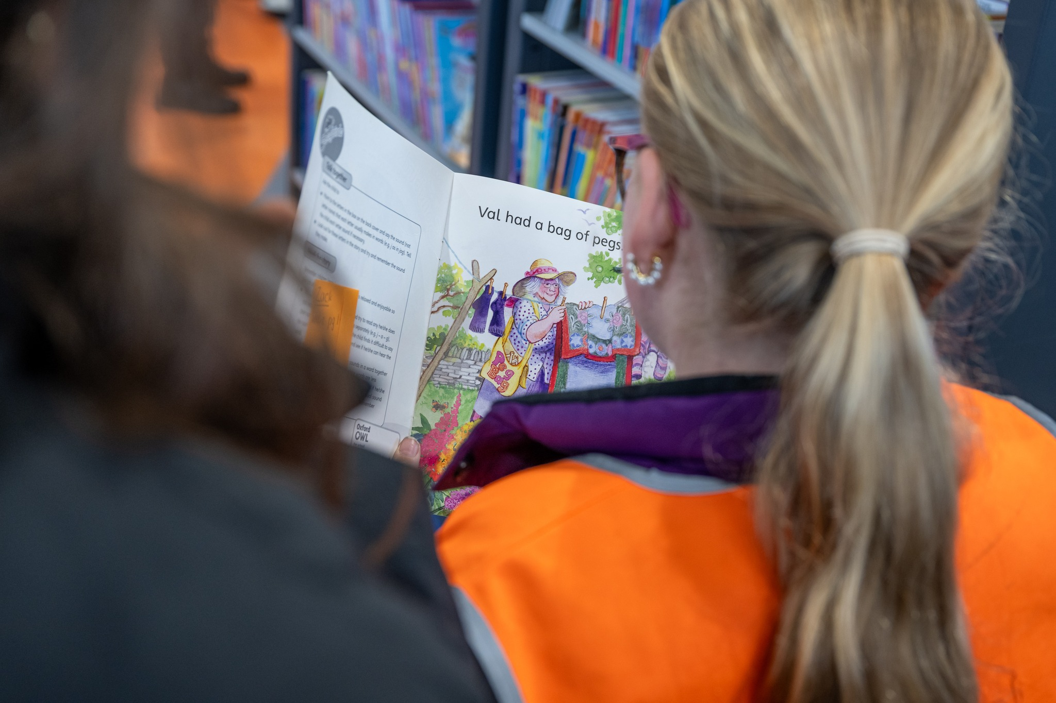
July Stats Ballyroan,
Castletymon & Mobile Libraries
Ballyroan had 83 events attended by 1860 people, issued 19,000 items and registered 656 new borrowers and had 20,117 visitors.
Castletymon Library had 61 events, issued 4374 items and registered 68 new borrowers and had over 3,000 visitors.
Mobile Libraries issued 6119 items and registered 177 new borrowers.
There were 1,262 visitors to the mobile libraries in parks during July

Slide 3
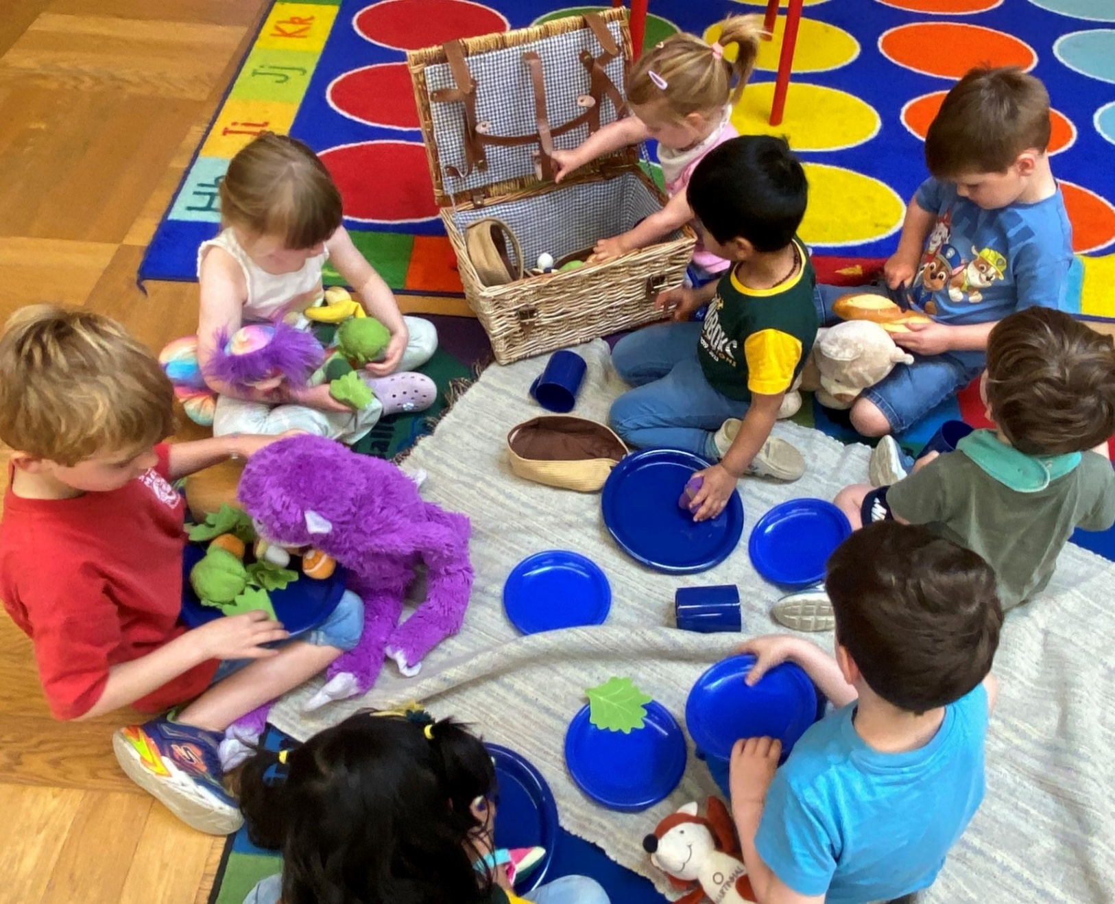
Ballyroan Summer Highlights - Children, Teens and Families
July
8th July – Teddy Bear Hospital
16th July – Family Snap Circuits Morning
22nd July – Dogman Day (220 attended)
24th July – Bear Hunt in Rathfarnham Castle in association with Parks Department (270 attended)
August
14th August – Marbling Inks Workshop
16th August – Teen Clothes Swap
20th August – Family Workshop on the Celts and Viking Age for Heritage Week (120 attended)
Ongoing / Multi-Session Programmes
Make a Book Workshop – 4-week course
Neurodiverse Play Sessions – 4 sessions
Teen Sublimation Printing Sessions – 2 workshops in the makerspace (July & August)
Teen Write, Act, Action Workshop – 6-week programme on writing for theatre and performance with author Maeve Devoy

Slide 4
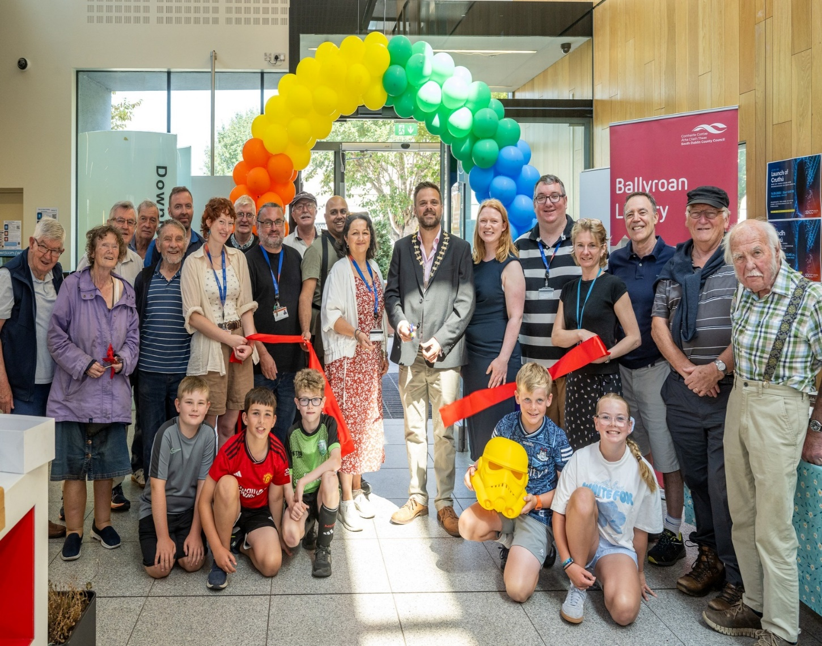
Ballyroan Summer Highlights - Adults
July
8th July – Book Swap
28th July – Golden Moments Summer Quiz (42 attended)
August
12th August – Whodunnit: Celebrating crime and thrillers with author Zoe Miller
16th August – Launch of new Cruthú Makerspace
19th August – A History of the Irish Language with Gary Bannister
26th August – Ireland’s Curious Places with Michael Fewer
Exhibitions
June – DSPCA: Pets in the Community
July – Nature in Our Midst from Dodder Photography Group and Rathfarnham Village Tidy Towns
August – Ireland from Maps, on loan from the National Library of Ireland

Slide 5
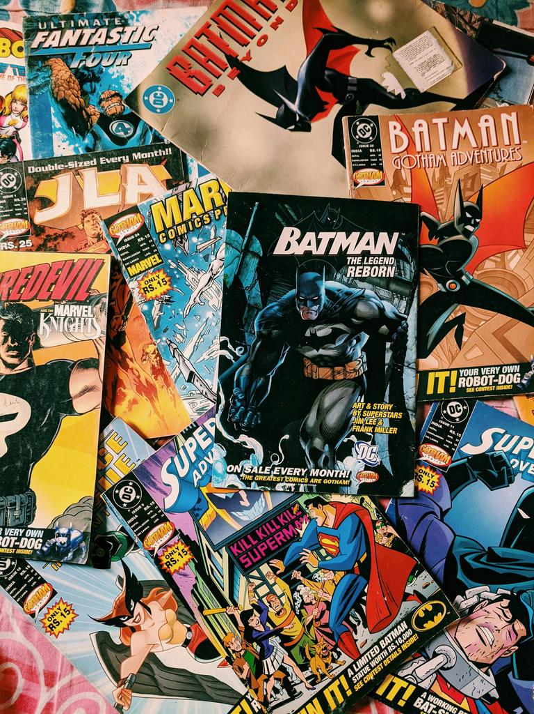

Ballyroan - September
We will be hosting events again this year as part of the Knocklyon Literary Festival.
Tuesday 16th at 6:30pm – Teen Illustration Workshop
Thursday 18th at 3:30pm – Storytime and Doodle Fun with Dolores Keaveny (family event)
Thursday 18th at 6:30pm – Book Speed Dating for Adults
Saturday 20th at 11am – Storytime and Crafting for 7–9 year olds with Helen O’Sullivan
All events are free. Full details and booking information are available on the Knocklyon Literary Festival website.

Slide 6
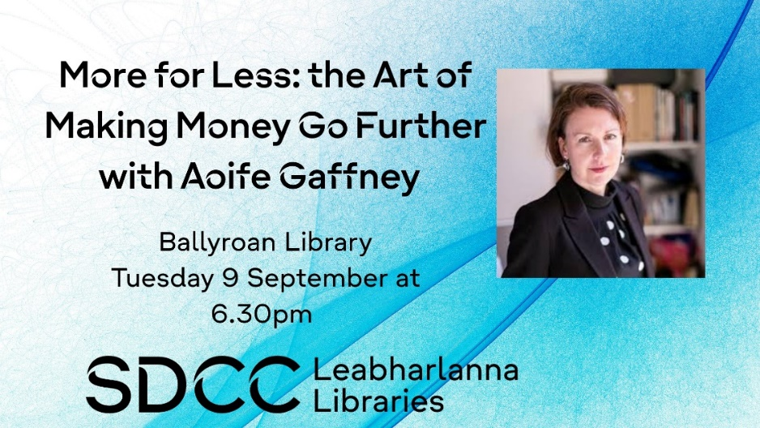
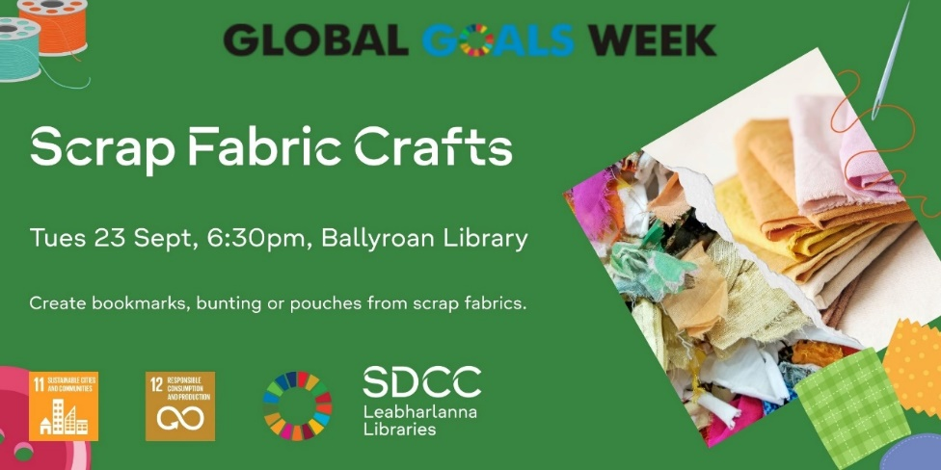
Ballyroan – September Highlights for Adults
Tuesday 9th at 6:30pm – More for Less: The Art of Making Money Go Further – a financial literacy talk with Aoife Gaffney
Saturday 13th at 11am – MakerSpace Drop-in Session: Meet the maker-in-residence and explore our MakerSpace
Tuesday 16th at 2pm – Golden Moments Club: Getting Started with Family History Research – a talk by Cathy Scuffil
Monday 22nd at 6:30pm – An Club Ghaelacht
Tuesday 23rd at 6pm – Global Goals Week: Scrap Fabric Workshop for Adults
Tuesday 23rd at 6:30pm – Rathfarnham & Ballyroan Historical Society Lecture: Patrick Pearse, a talk by Brian Crowley
Tuesday 30th at 2:30pm – Introduction to Basic DIY and Home Maintenance – Adult Education Course with the DDLETB
Regular Events Continue:
Stitched Together, Ciorcal Cainte, History Hub, Film Club, and Craic agus Ceol.

Slide 7
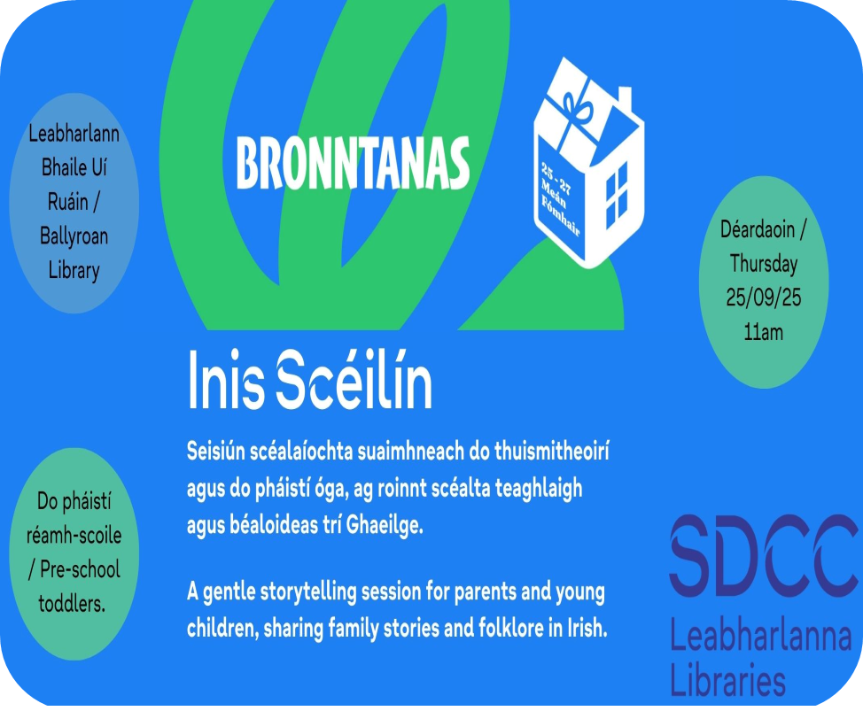
Ballyroan – September Highlights for Families, Children and Teens
Tuesday 2nd at 5pm – Teen Creative Writing Club
Saturday 6th at 2pm – Relaxed Movie Screening (Moana 2), suitable for children with additional needs and their families
Saturday 13th at 10am – Celebrate Roald Dahl Day with a special storytime and take-home activity book
Tuesday 16th at 5pm – Claire Hennessy Writing Workshop for Teens
Thursday 18th at 10am – Baby Sign Classes (4-week course) commence
Thursday 25th at 11am – Inis Scéilín, Irish language storytelling for children, as part of Bronntanas Festival
Saturday 27th – National Public Libraries Day
  Bunny vs Monkey scavenger hunt (all day)
  Bunny vs Monkey draw-along at 2:30pm
Monday 29th from 6pm – Teddy Bear’s Sleepover
Regular Events Continue:
Weekly: Storytime, Sensory Time, Toddler Time
Fortnightly: Coder Dojo

Slide 8
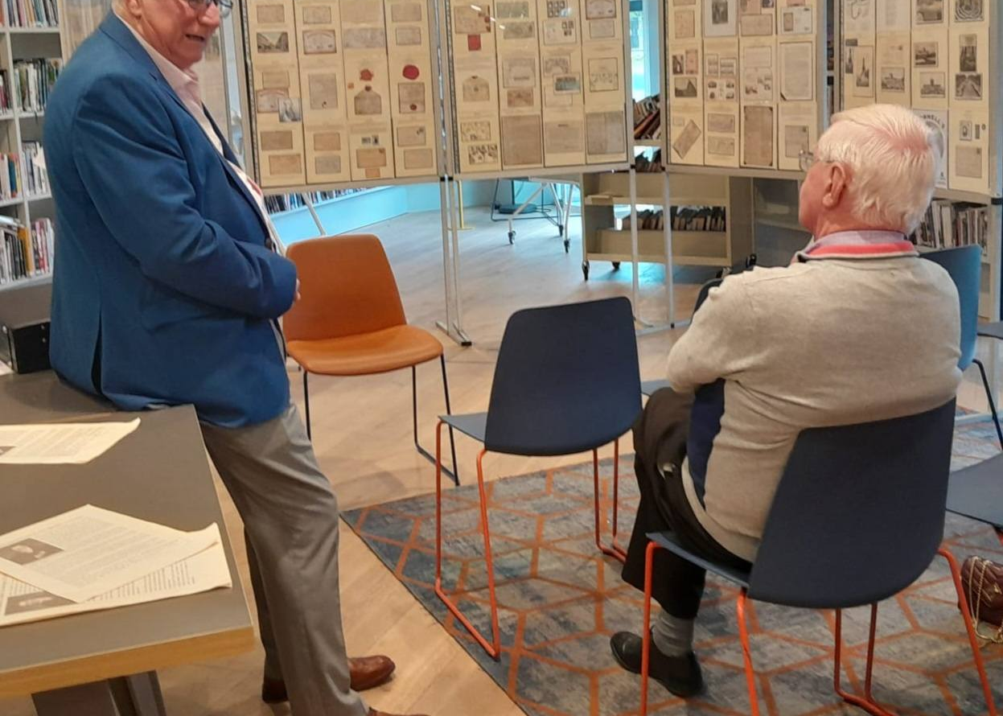
Castletymon Library
Summer Highlights
June
Author Talk: Anne-Marie Allen on her book Serve: My Lost Years at the Heart of Ireland’s Opus Dei.
July
Author Talk: Cathy Scuffil on Flanagan’s Field – very well attended.
Summer Activities for Children: Two weeks of events (14 activities across 10 days), all of which were fully booked.
August – Heritage Week
Hellfire Hill – A Little Tour.
Knight for Hire: Special event for schools.
Exhibition: Daniel O’Connell by John Mullen, marking the 250th anniversary of O’Connell’s birth.
End of August
End of Summer Party:
  For adults: Traditional music session.
  For children: Clay sculpture workshops and How to Draw Pokémon.
Summer Stars: Prize draw and certificate awards.

Slide 9
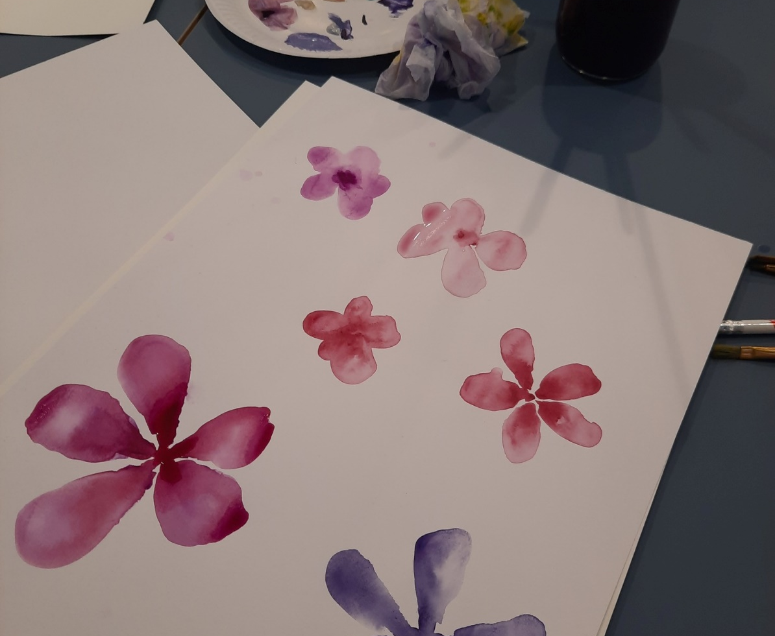
Castletymon Library, September
For Adults
Spanish Classes
  Beginners: Starts 9th September (10 weeks)
  Conversation: Starts 10th September (10 weeks)
Digital Literacy – Computer Classes (with DDLETB)
  Registration: 12th September
  Classes run from 9th September – 21st November
Ukulele Course
  5-week programme starting 9th September
Autumn Watercolours
  Two-part course on 8th and 10th September
Author Talk
  Go Organic: A Beginner’s Guide with Aoife Munn – 22nd September
Culture Night (19th September)
  Castletymon Library hosting a concert by the Firhouse Ukulele Group

Slide 10

Castletymon Library, September
For Children
The Comics Project
  9-week course for children with additional literacy needs
  Funded by Creative Ireland, facilitated by writer Juliette Saumande and illustrator Elida Maiques
  Children will write, draw, and create their own zine, alongside a professionally printed group zine
  Starts 18th September
Creative Writing Workshop
  How to Get Writing with author Claire Hennessey (TY class) – 23rd September
Baby Boppers & Rhythm Rascals
  With Emma O’Leary – 17th September
Bronntanas & National Public Libraries Open Day
  Special toddler session: Draíocht an Cheol – The Magic of Music – 27th September

Slide 11
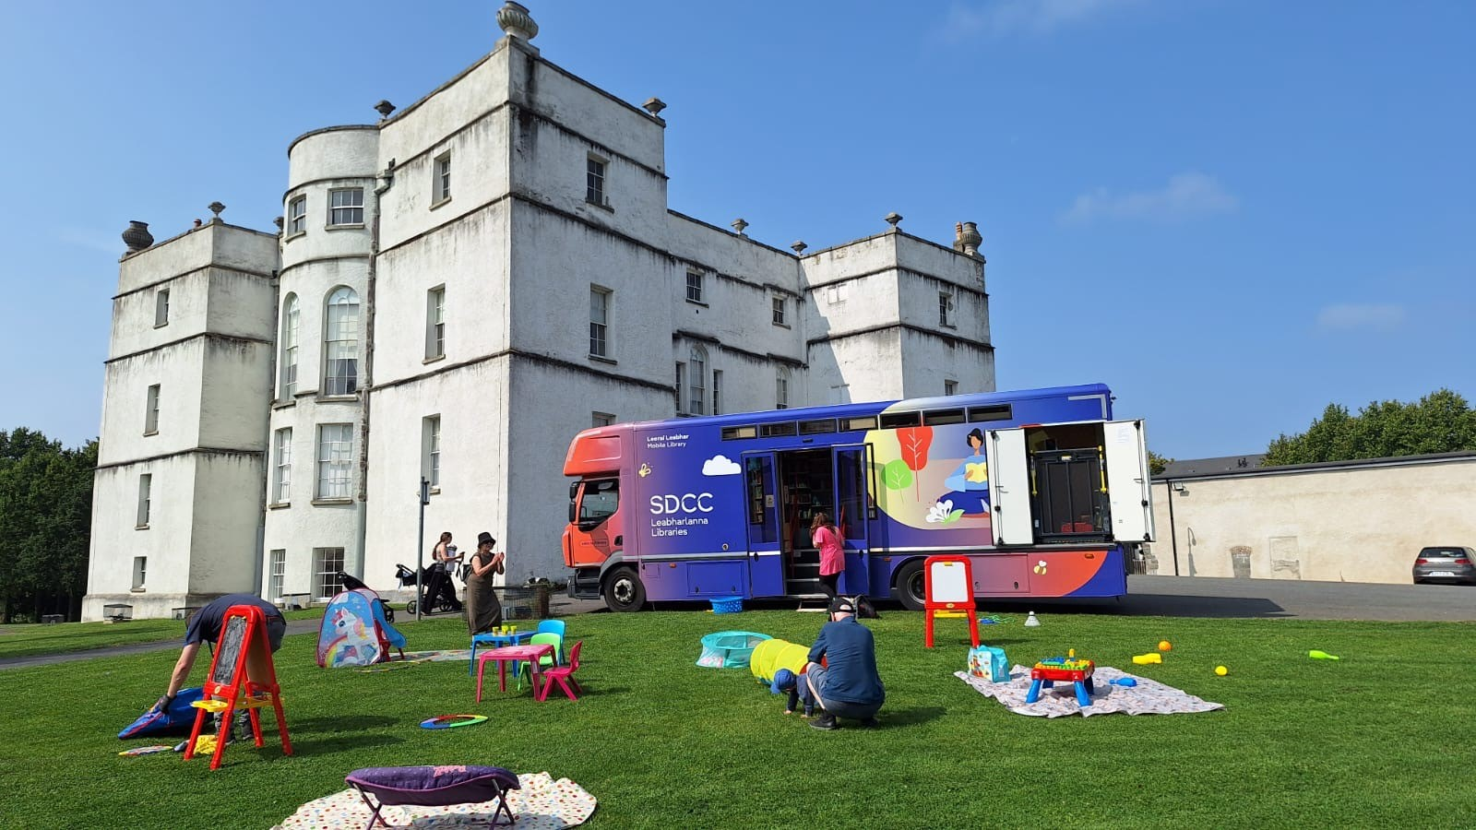
Mobile Libraries
9 Visits to Summer Camps
  Schools, community centres, and preschools
  Included an event with the Nutty Professor at St Brigid’s J.N.S., Brookfield
Library at Home
  Continued throughout the summer
  2 visits to Bloomfield Hospital
  1 visit to St Michael’s House, Templeogue (4th July)
Family Visit
  City Ark IPAS and Citywest Ukrainian Hub (12th July)
Events
Summer Parks Programme
  15 visits to family days, markets, and cinema screenings at Collinstown, Corkagh, Tymon, Waterstown, Jobstown, Airlie, and Adamstown
Community Day at the Square – 19th July
Clondalkin Festival at the Round Tower – 26th July

Slide 12
Mobile Libraries – August Highlights
Library at Home
  Continued throughout August
  Regular visits to Bloomfield Hospital
Family Visits
  Respond Family Hub – 6th August
  City Ark Aparthotel & Citywest Hotel Mobile Visit – 7th August
Summer Parks Programme
  7 visits to community/family days, Dublin Markets, and cinema screenings
  502 visitors to the mobile libraries in South Dublin Parks during August
The Big Dig, Rathfarnham – 15th August
Adamstown Festival – 17th August
Dublin Maker Event, Leopardstown
  Showcase of maker equipment led by South Dublin Libraries Maker in Residence
  Visitors created personalised chains using the laser cutter
  3D models from the libraries’ makerspace were on display
Coming in September
Service to schools resumes
Mobile Libraries attending Corkagh Park Colour Dash – 13th September

Slide 13
Thank you

