Slide 1
Ballyroan Community and Youth Centre
Part 8
Presentation to Council Meeting
8th Sept 2025
Presented by
Edel Clancy

Slide 2
Project Brief
Ballyroan Community and Youth Centre

Slide 3
Additional space needed for additional staff offices, meeting rooms and childcare
Summary of Proposed Works:
  Rearrangement /upgrade of the community centre interior - to create a new meeting room and reception area at the building entrance, new accessible WC and additional office space.
  New single-storey flat roof extension (area GFA 75 m²) – for additional childcare accommodation, designed to meet Tusla requirements.
  Accessibility enhancement works to the existing community centre entrance – to comply with current Building Regulations (Part M) requirements, and new accessible entrance to the rear of the centre to serve the proposed childcare accommodation.
  Minor alterations to existing parish boiler house.
  New external screened community centre bin store – to relocate existing bins out of the children’s play area to accommodate the new extension.
  New solar panels to south facing pitched roof – to help meet SDCC climate targets for 2030.
  Refurbishment /upgrade of the existing concrete pavers to the south and west of the community centre building

Slide 4
Project Cost and Budget Provision
Ballyroan Community and Youth Centre

Slide 5
Estimated Project Costs
Refurbishment of 7 internal areas €356,900
New extension €206,250
Demolition/relocation work €55,000
Landscaping €19,665
Resurfacing and pipework on parish land €70,000
Fit out/furniture – hall storage €18,900
Technical fit out €15,000
New bin store area €13,000
.

Slide 6
Estimated Project Costs
Estimated total project cost is €1,142,963
This cost includes :
Vat on works of 13.5%
Design fees €70,000 plus Vat at 23%
Inflation allowance of €90,000
Contingency to the value of €85,000
A full cost review will be undertaken upon securing Part 8 permission and as part of the detailed design process.

Slide 7
Budget Provision
Current budget in the 3 year Capital :
€750,000
Levies contributions of €450,000 in 2025 and €300,000 in 2026
The Church of the Holy Spirit are contributing €32,000
PV panel installation to be carried out under separate SDCC Contract
Further support from Community Capital Reserves if required

Slide 8
Site Plan and Proposed Works
Ballyroan Community and Youth Centre

Slide 9
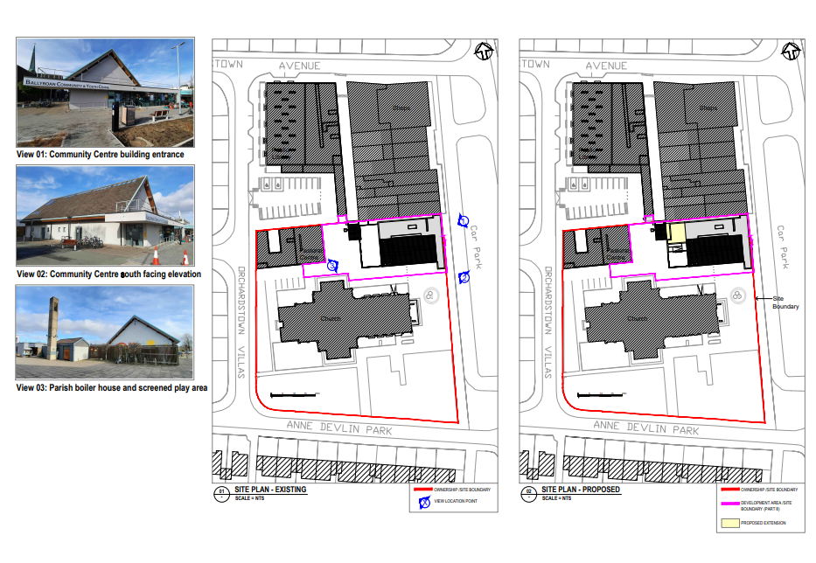

Slide 10
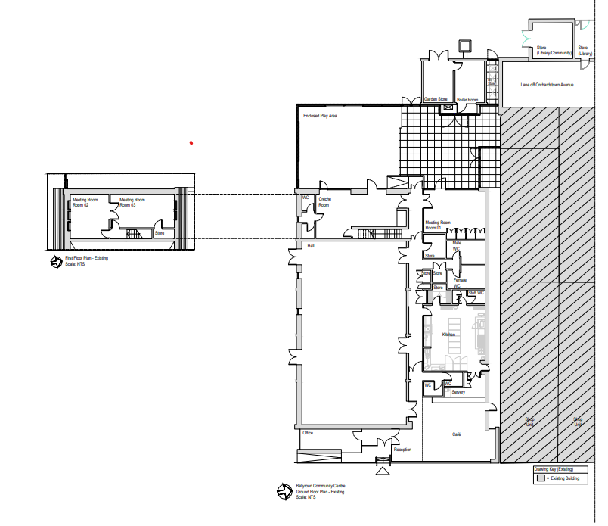
Current Internal Layout

Slide 11
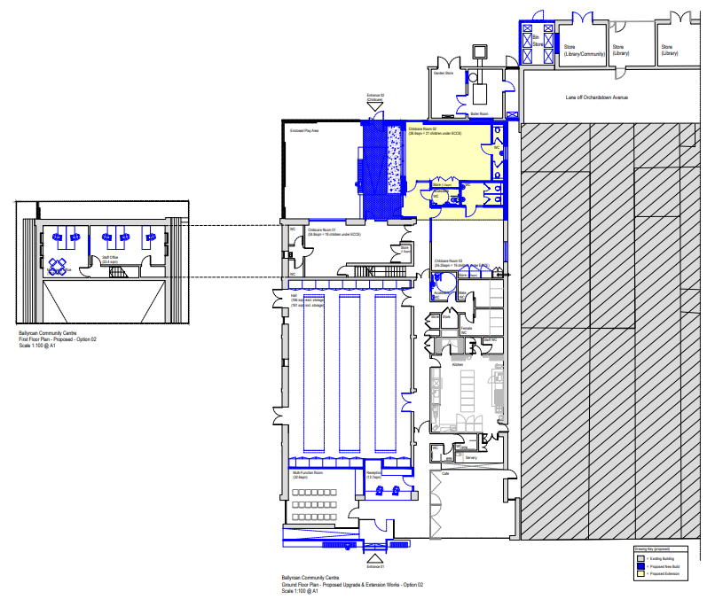
Proposed Internal Layout incl Extension

Slide 12
Part 8 Consultation
Ballyroan Community and Youth Centre

Slide 13
June 10th - Presented to RTFB ACM
26th June 2025 - Issued notice of Part 8 for the proposed development
26th June to 11th August - Public consultation period
Submissions:
9 submissions received during the public consultation period
Submissions received from Uisce Éireann and South Dublin County Childcare Committee were technical in nature and indicated no objections to the proposals.
7 valid submissions received all raised concerns regarding the potential impact of the proposed external screened bin store on Ballyroan Men’s Shed

Slide 14
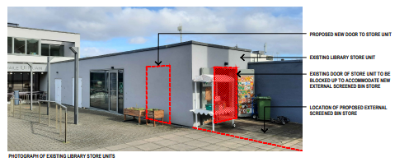
Submission Report
Ballyroan Men’s Shed have an informal arrangement with libraries to operate out of one of the library storage units
Multiple options for the relocation of the bins were considered
Due to numerous site constraints, the area to the south of the library storage unit is the only practical option
The internal floor area of the storage unit is not diminished by the relocation of the doors.
SDCC are happy to explore options with the Men’s Shed representatives as a separate future project.
The development of the proposed bin store to the south of the library storage unit, does not preclude other options for the future use of this space

Slide 15
Thank you

