Slide 1
Rathfarnham Stables Part 8
Council Presentation
14th July 2025

Slide 2
Rathfarnham Stables Project Timeline
Shaffrey Study
Conservation / Visitor Destination
Operator Tender
McHugh Group
Thrive Funding
€7m Application
2016 -2018
2018
2023
2024
2025
2025
Development Partner Process
No Partner Secured
Masterplan
Public Consultation Process (1,000+ Submissions)
Part 8 Public Consultation
179 Submissions
July Council Meeting
Policy Context
South Dublin Tourism Strategy 2015 – 2020
County Development Plan 2016 - 2022
County Development Plan 2022 – 2028
South Dublin Tourism Strategy 2024 - 2029

Slide 3
Part 8 Public Consultation: 179 Submissions
Key Themes
Sean Keating Garden
Car Parking
Support For RCRA Proposal
Rathfarnham Village
General Support (In Part) For Part 8

Slide 4
Existing Context

Slide 5
Part 8 Proposal

Slide 6
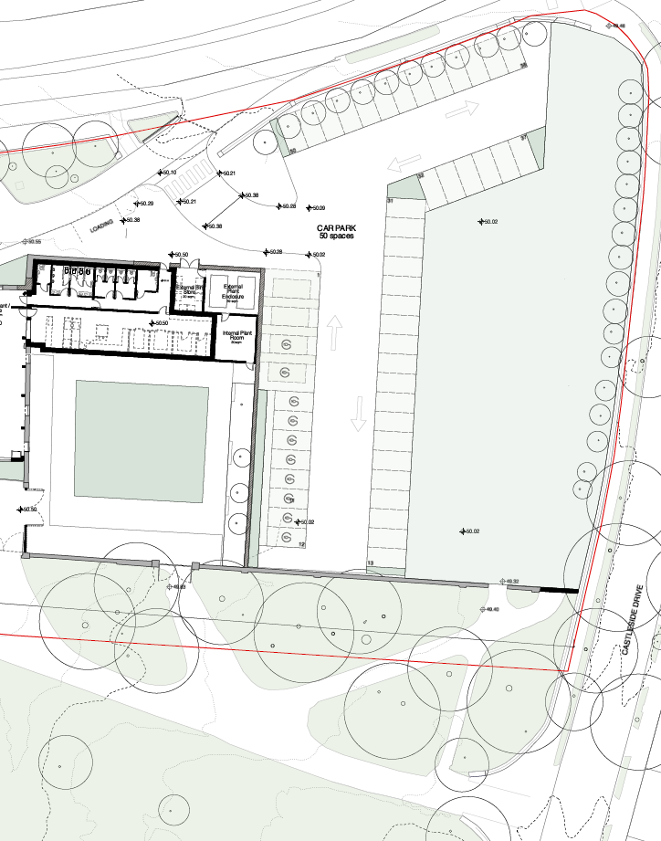
Proposed Amendment
The proposed Sean Keating Garden space and car-parking area shall be modified to provide for a more uniform public open space design, where the proposed park element shall be enlarged in a northern and southern direction, thereby reducing the northern and southern directional footprint of the proposed car park. This will serve to increase the usable footprint and functionality of the open space, providing for an enhanced level of public amenity. Following this change, the proposed car parking area shall be reconfigured accordingly, with the access arrangements and parking situated on the most southern and western sides of the redesigned Sean Keating Garden area. Prior to commencement of development, full details of the revised Sean Keating Garden and parking design shall be agreed with the Planning Authority.

Slide 7
Thank you

