Slide 1
Health Assets and Needs Assessment (HANA) in Tallaght project – Round 3
South Dublin County Council – Tallaght Areas Committee Meeting
Catherine Darker, Kaye Stapleton, David Loughrey, Noel McCarthy
23rd June 2025

Slide 2
Funders and partners
Research team
Trinity College Dublin
Funders
HSE Dublin & Midlands (formerly CHO7) & the Adelaide Health Foundation
Community partners
HSE (Health Intelligence Unit, Public Health and Health & Wellbeing), Tallaght University Hospital, the Childhood Development Initiative, South Dublin County Council and South Dublin County Partnership

Slide 3
Round 1
Key impacts
Respiratory consultant post in TUH
Mary Mercer Health Centre funding

Slide 4
Round 2
Key Impacts
Community radiology in Tallaght Cross for x-rays, ultrasounds and scans
TUH/CHO7 funding applications under Sláintecare (e.g., Integrated Care for Older Persons; HSE’s Enhanced Community Care)
Creation of ‘Patient Community Advisory Council’
Funding for TLC Out of Hours service
Informing planning by SDCC
Funding for Local Sports Partnerships, supporting active and health communities
ExWell programme (e.g., exercise programme targeting chronically ill)
HANA = still used during staff induction in TUH!

Slide 5
Thirteen electoral divisions of Tallaght
Electoral Divisions (ED’s)
Belgard,
Glenview,
Kilnamanagh,
Kingswood,
Millbrook,
Oldbawn,
Springfield,
Avonbeg,
Fettercairn,
Jobstown,
Killinarden,
Kiltipper, and
Tymon

Slide 6
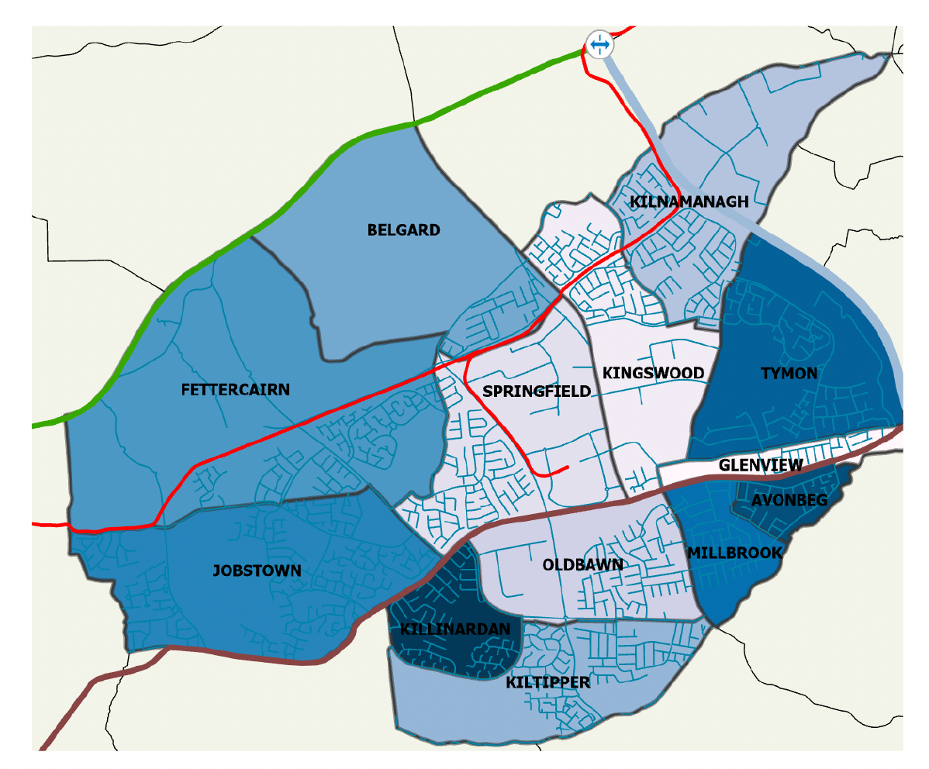
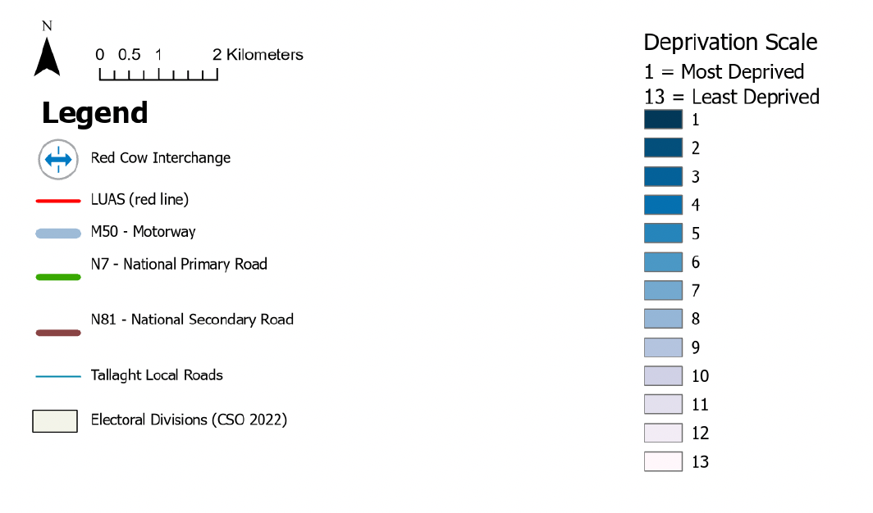
Tallaght Electoral Divisions by scale of deprivation

Slide 7
What we did
Update findings of 2001 (Round 1) and 2014 (Round 2) HANA projects
Survey 13 electoral division of Tallaght
Letters sent to 420 randomly selected households; survey takes place in the home
A total of 274 (65%) of households participated
Data were collected on 755 individuals residing in these households
Use of Deprivation Index (R1 & 2 = SAHRU; R3 = Pobal)

Slide 8
HANA survey topics
Comparability over time - Benefits of same methodology and same questions (mostly!)
Demography
Lifestyle (e.g., physical activity, smoking etc)
Chronic Illness and disability
Service utilisation and opinions on quality and access
Tallaght University Hospital (TUH)
General Practice
Community services
Round 3 - New additions:
Dental services
Social prescribing
Teen mental health
Financial concerns/debt

Slide 9
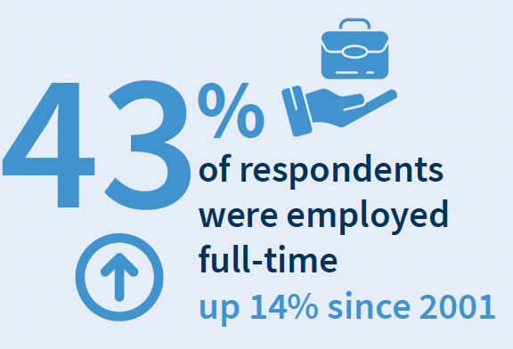
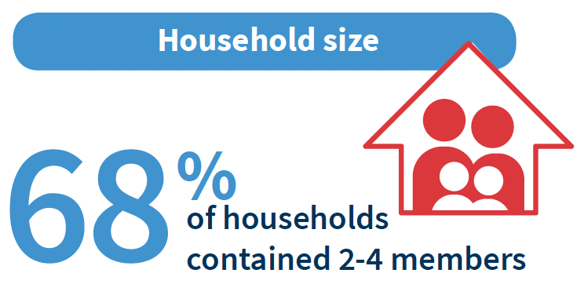
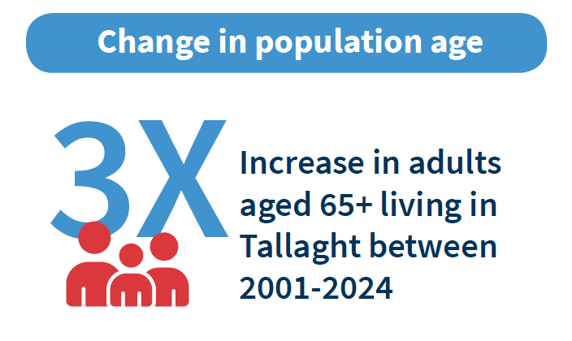
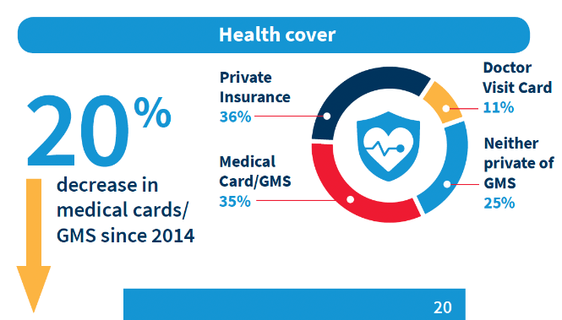
Demography
39% of respondents lived in Tallaght for less than 10 years; 28% have resided in Tallaght for over 30 years

Slide 10
What we found

Slide 11
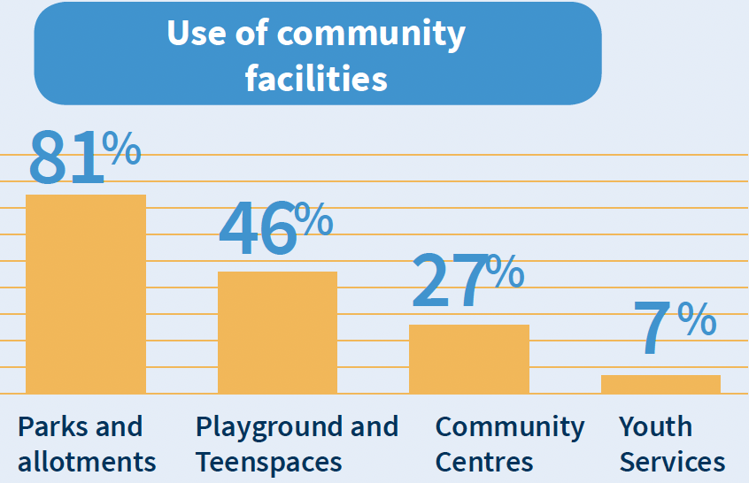
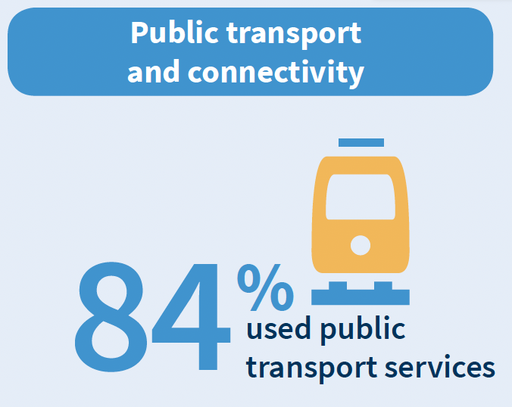
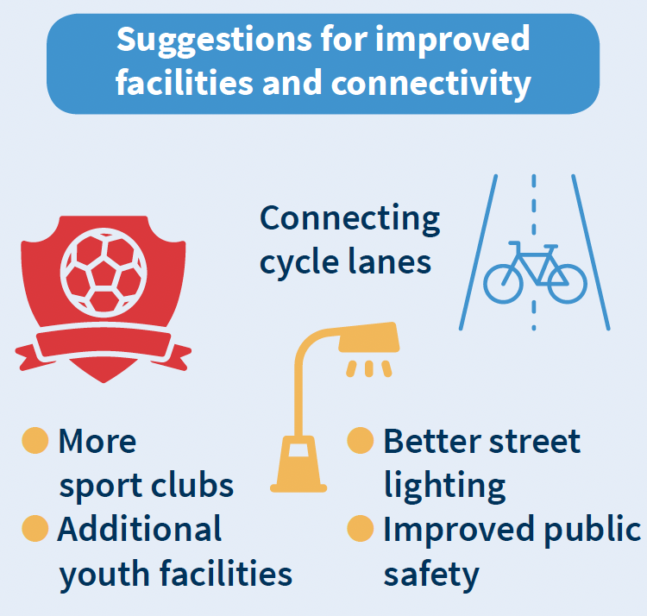
What we found
Health & Wellbeing Assets - Built environment

Slide 12
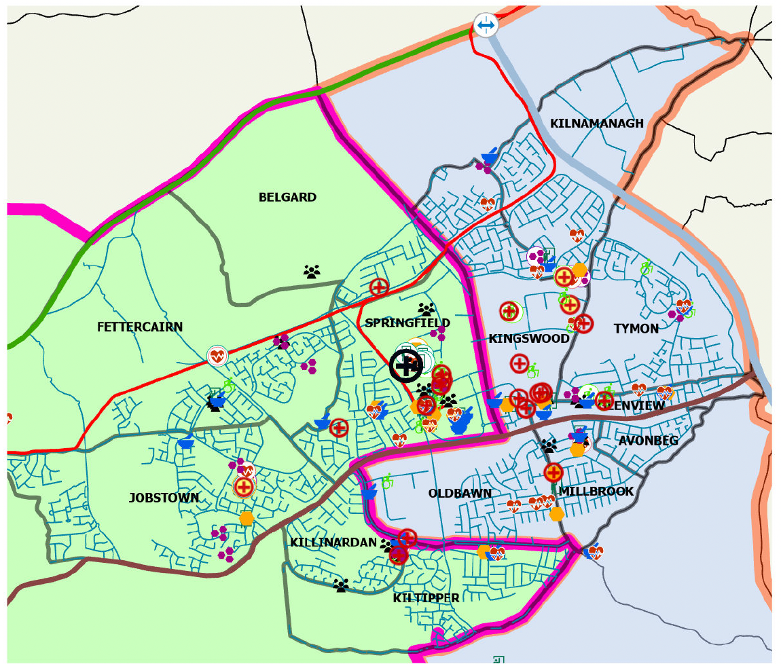
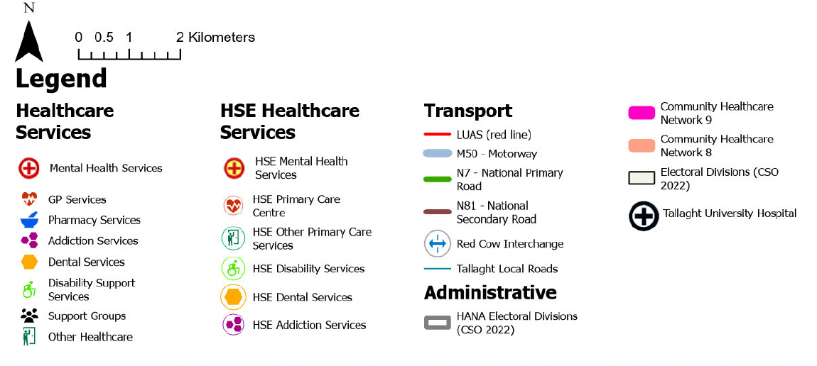
Total health services and facilities
13 Electoral Divisions of Tallaght

Slide 13
Maps – All assets in Tallaght*
Healthcare Services
GP Services
Dental and Mental Health Services
Disability Supports
Playgrounds and Teen Spaces
Parks and Allotments
Churches and Places of Worship
Youth Services
Community Services
Community Supports
Sport and Hobby Facilities
Libraries
SDCC Walking Paths and Cycle Ways
* This is not an exhaustive list of all assets in Tallaght, but those relevant to the project.

Slide 14
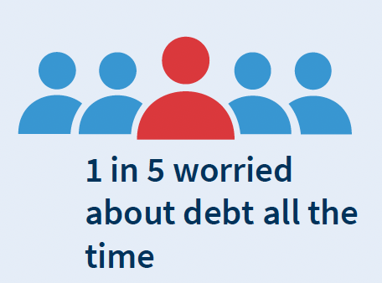
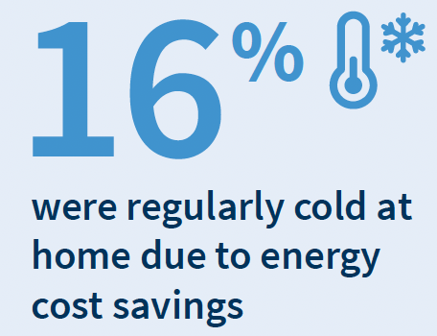
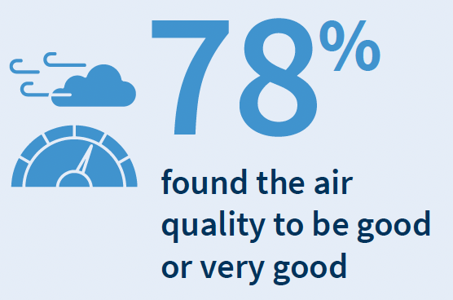
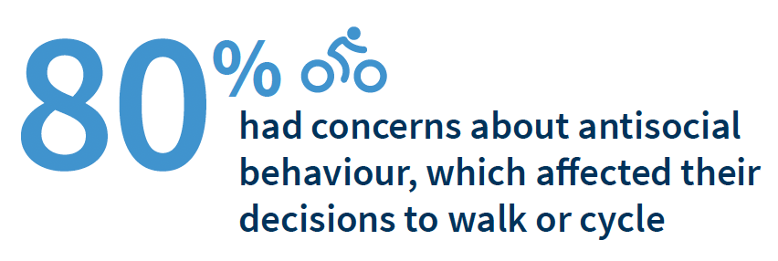
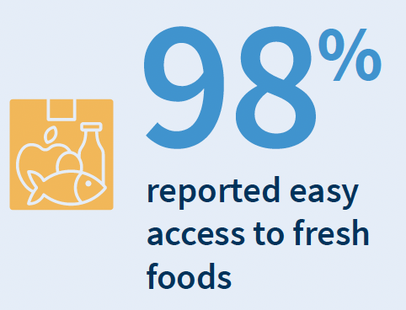
What we found
Quality of life

Slide 15
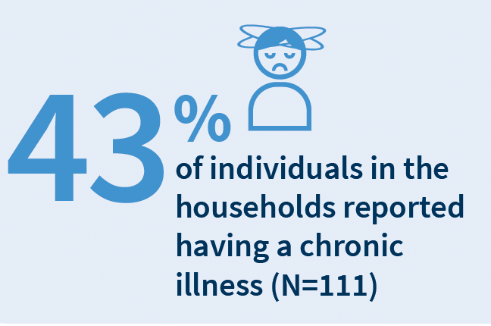
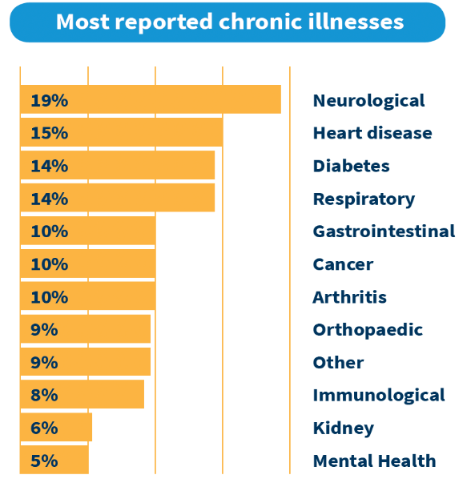
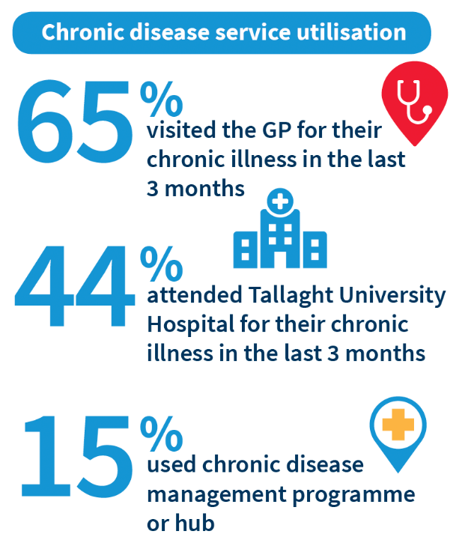
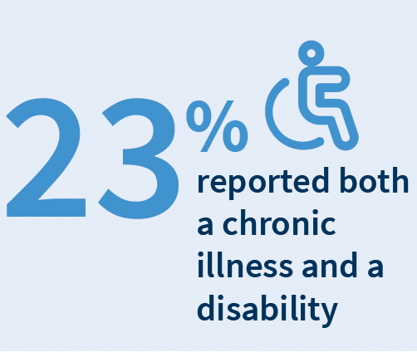
What we found
Chronic disease and disability

Slide 16
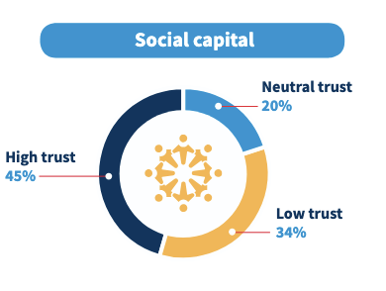
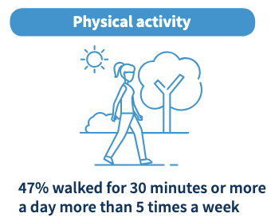
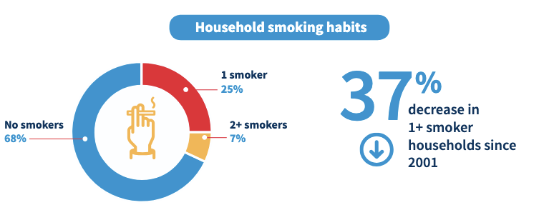
What we found
Physical and social wellbeing

Slide 17
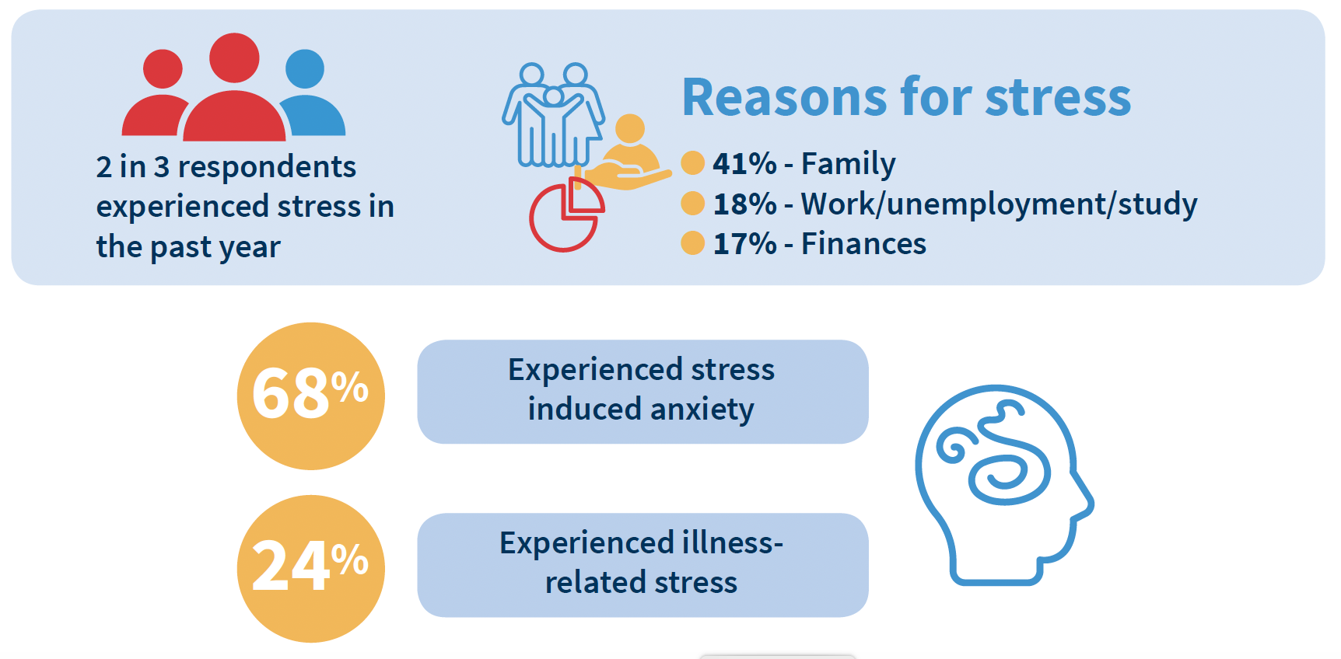
What we found
Stress and Loneliness

Slide 18
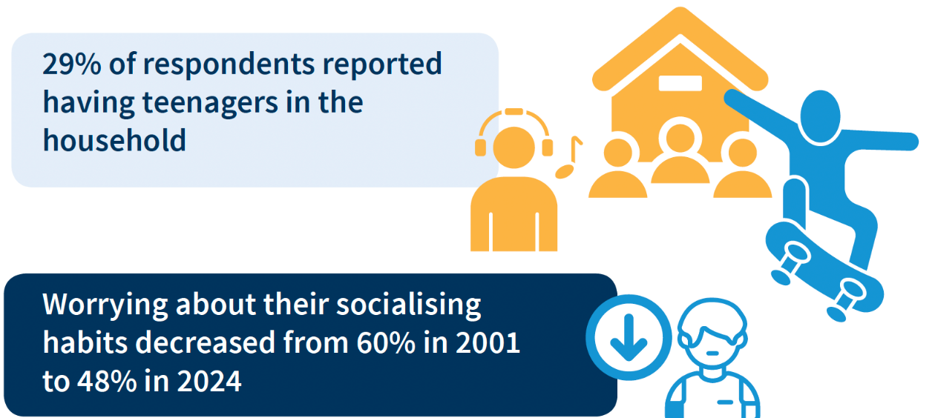
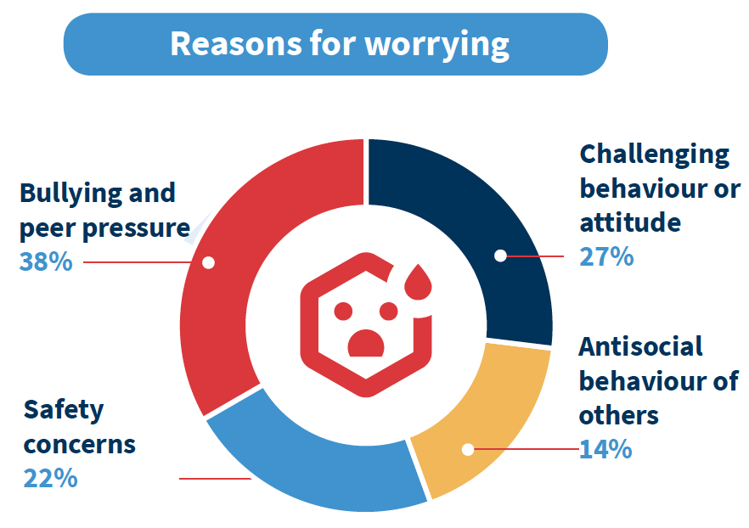
What we found
Teenage behaviour and family dynamics

Slide 19
Practice and Policy Implications

Slide 20
23 Recommendations
Healthcare access, infrastructure, and service improvement (x11)
Community engagement, social support, and safety (x6)
Health, wellbeing and environment (x6)

Slide 21
Tallaght Community Health Event Feedback (February 2025)
Prioritise the 23 recommendations
Mental health & stress management
Housing policy
Affordable and accessible healthcare
Explore actionable steps with community involvement
Aim of the event
Gather community perspectives

Slide 22
Next Steps: Tallaght HANA Collaborative
Months 1-4
Months 5-18
Months 19-24
Phase 1: Planning and preparation
Phase 2: Implementation and engagement
Phase 3 Monitoring, Evaluation, and Sustainability

Slide 23
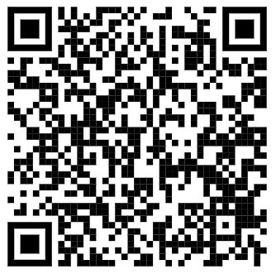
Where to get copies of the report?
https://www.tcd.ie/medicine/public-health-and-primary-care/research/hana/

Slide 24
Thank You Email: catherine.darker@tcd.ie

