Slide 1
School Works Update
Lucan ACM June 2025
Active Travel

Slide 2
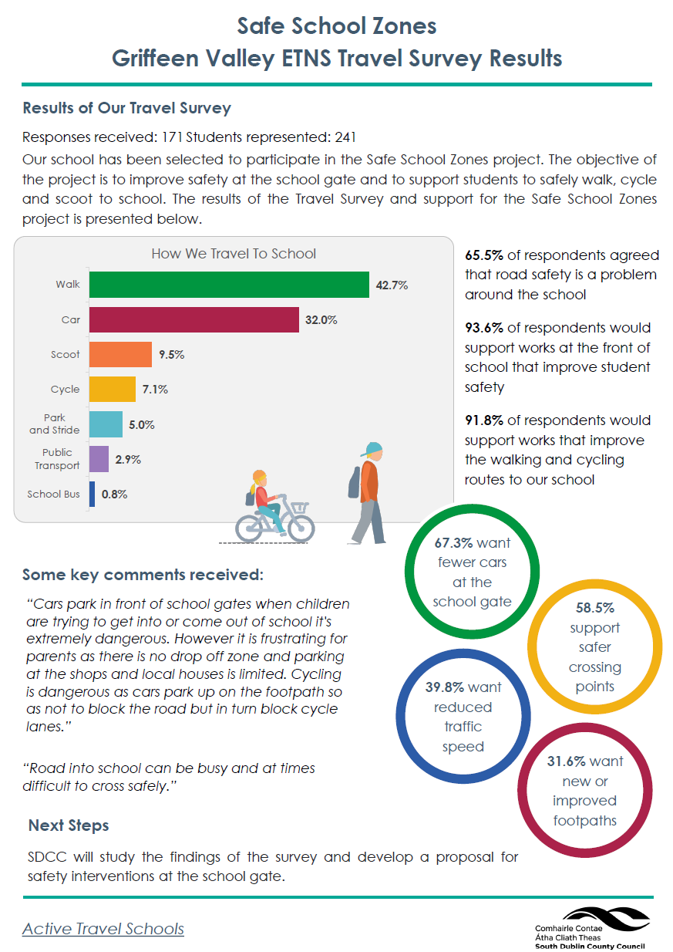
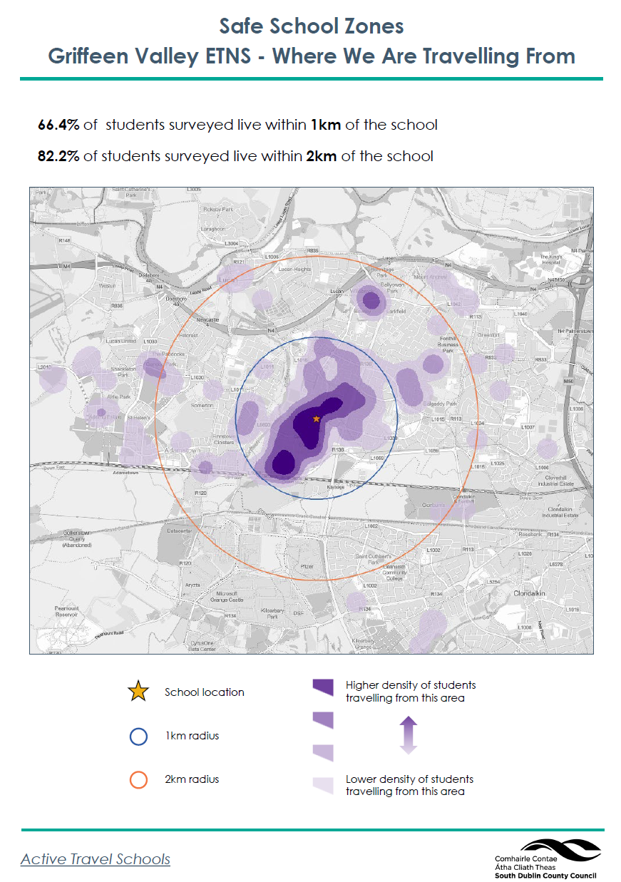
Safe School Zone Update
10 Schools Applied for Works
2 will receive future SRTS works
8 Schools took part in the Travel Survey
The works will take place over multiple years
5 schools will receive works this year including 1 in the LPF Area:
  Griffeen Valley Educate Together National School
Works to St.Peter Apostle JNS, Neilstown will take place when further funding becomes available.

Slide 3
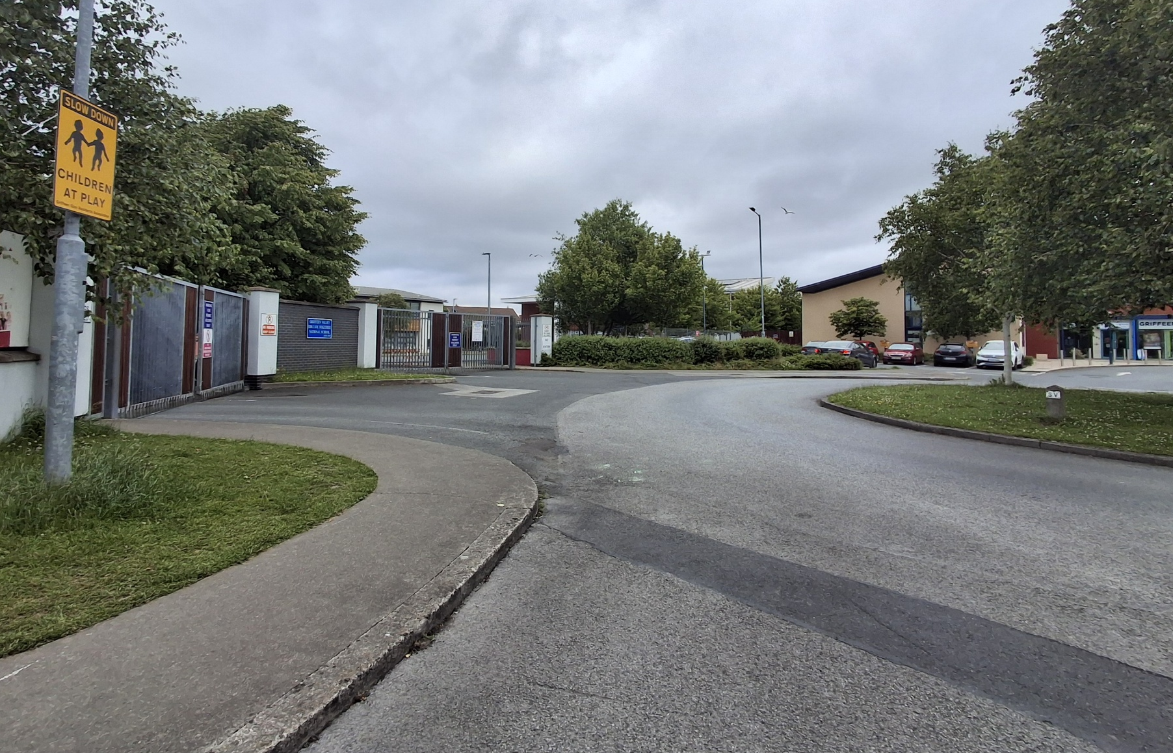
Safe School Zone Programme
Griffeen Valley ETNS
Site visit - January 2025
Preliminary Assessment - February 2025
Travel Survey Carried Out – April 2025
Design developed – May 2025
Consultation with school – June 2025
Non-statutory consultation – June 2025
Section 38 approvals – June / July
Appoint contractor – July / August

Slide 4
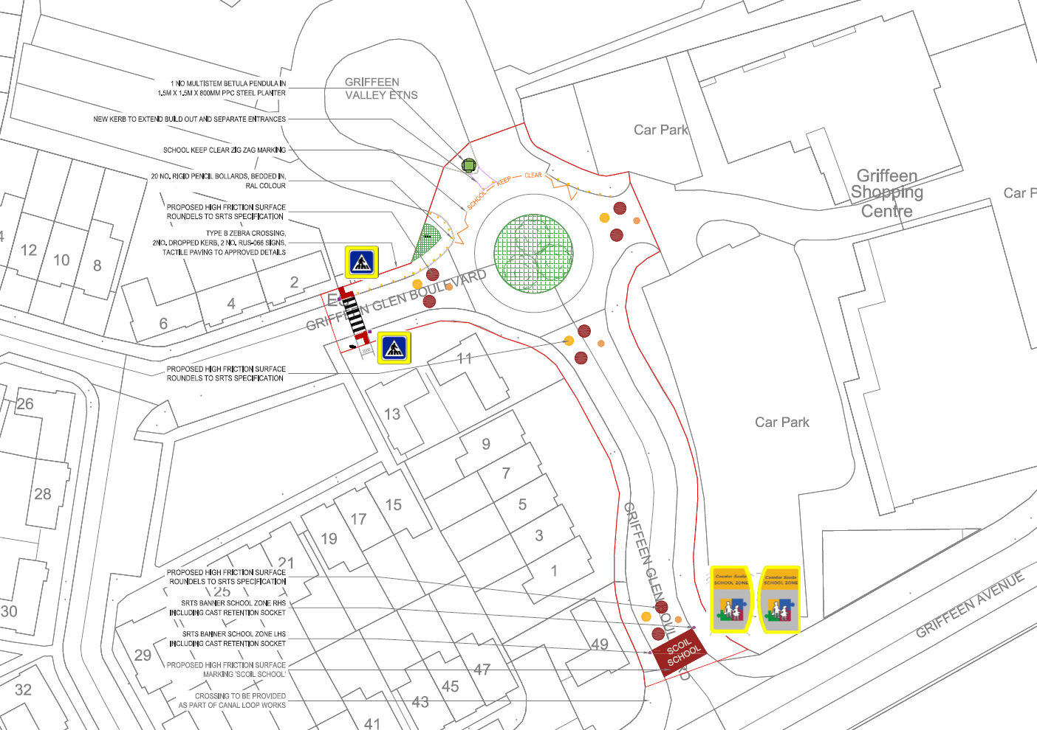
Safe School Zone Programme
Griffeen Valley ETNS
Site visit - January 2025
Preliminary Assessment - February 2025
Travel Survey Carried Out – April 2025
Design developed – May 2025
Consultation with school – June 2025
Informal consultation – June 2025
Section 38 approvals – June / July
Appoint contractor – July / August

Slide 5
Thank you

