Slide 1
School Works Update Tallaght ACM June 2025
Active Travel

Slide 2
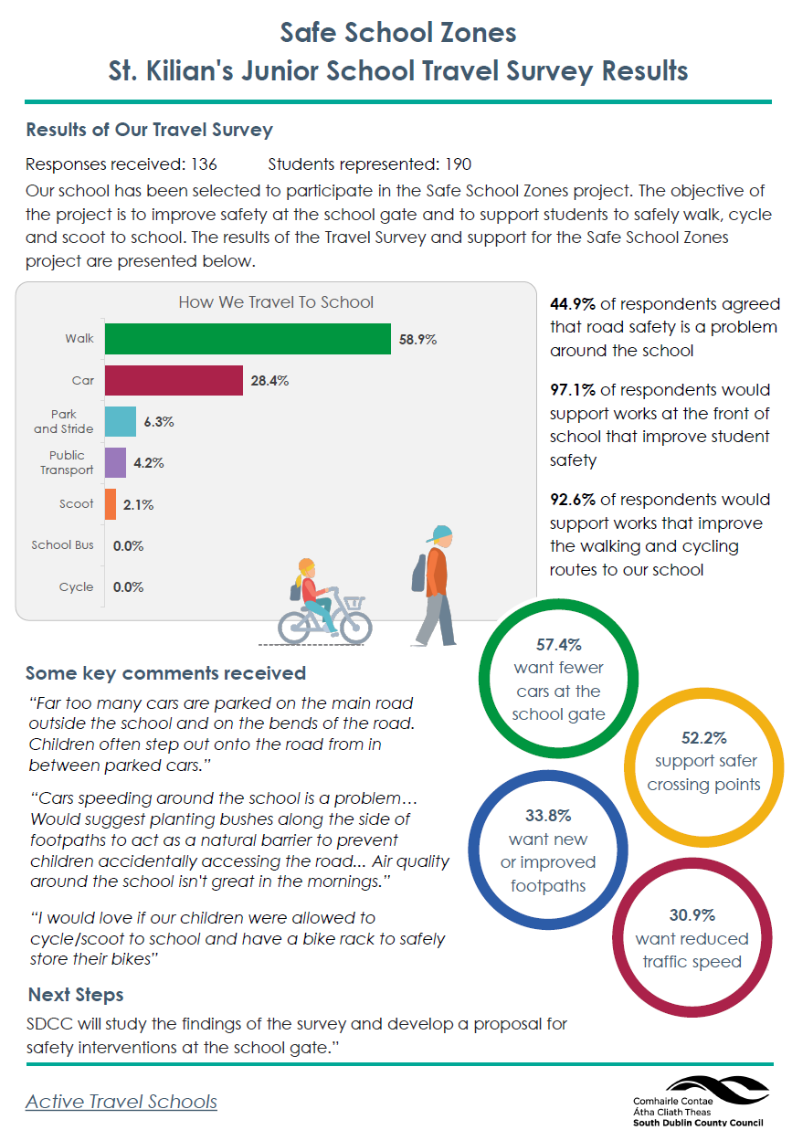
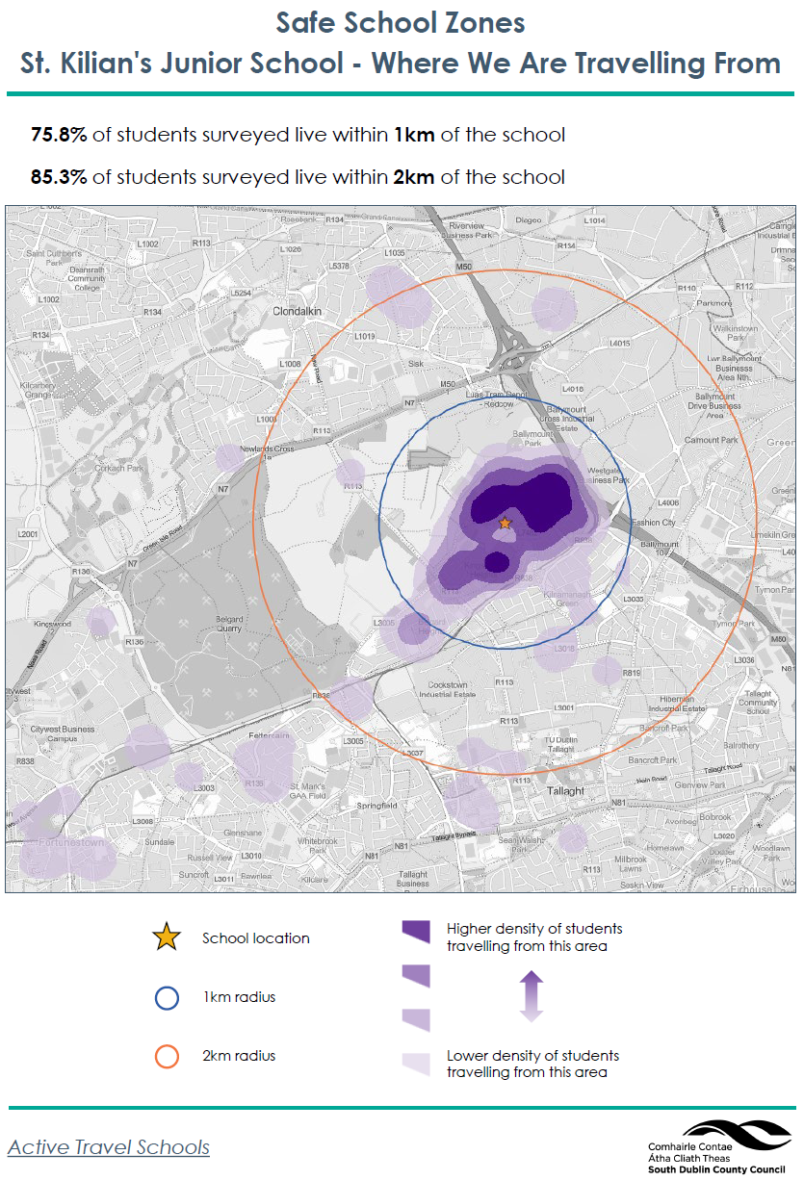
Safe School Zone Update
10 Schools Applied for Works
2 will receive future SRTS works
8 Schools took part in the Travel Survey
5 of these were in Tallaght
The works will take place over multiple years
5 schools will receive works this year
3 of these include:
St. Anne’s Primary School, Fettercairn
St. Killian’s JNS, Kingswood
Tallaght Community College

Slide 3
Safe School Zone Programme
St. Anne’s Primary School, Fettercairn
Site visit - January 2025
Preliminary Assessment - February 2025
Travel Survey Carried Out – April 2025
Design developed – May 2025
Consultation with school – June 2025
Non-statutory consultation – June 2025
Section 38 approvals – June / July
Appoint contractor – July / August

Slide 4
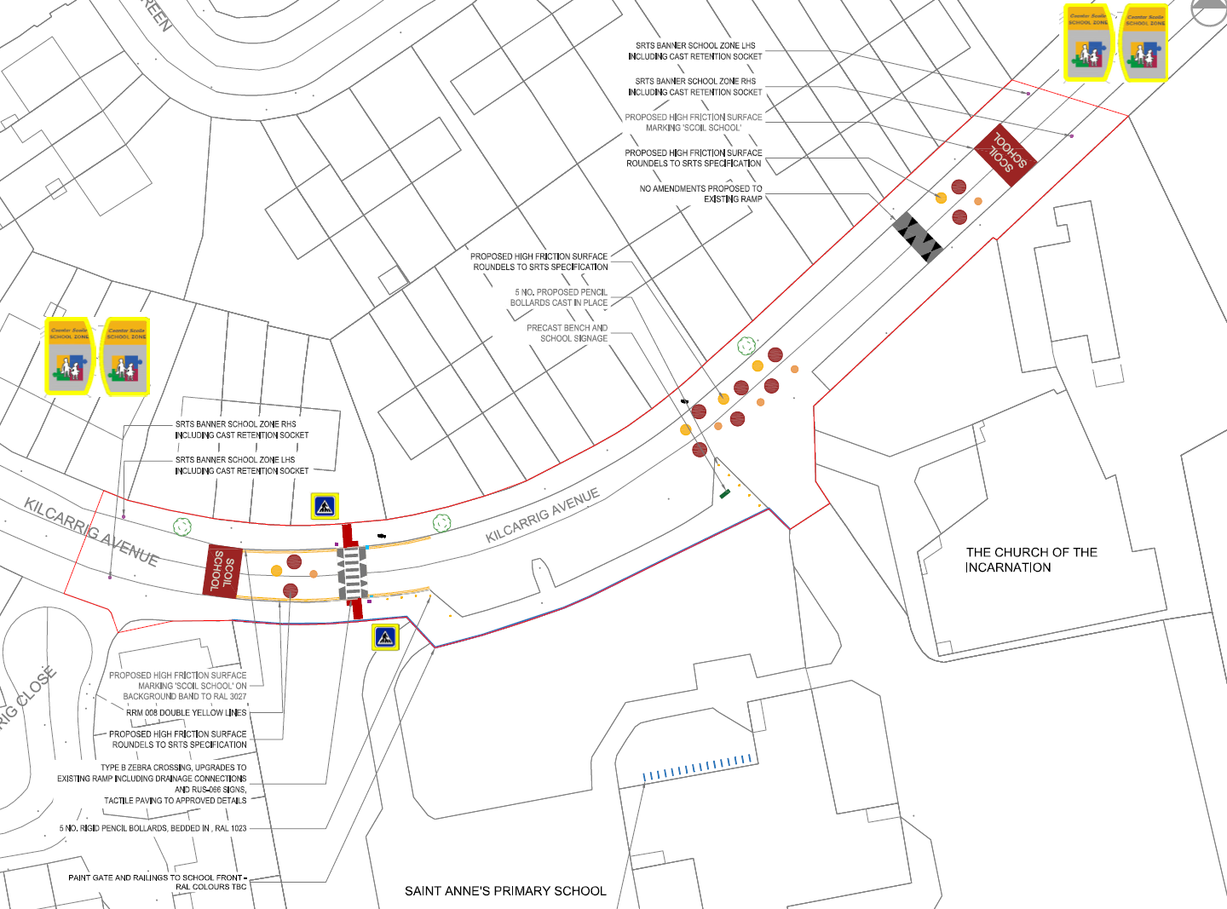
Safe School Zone Programme
St. Anne’s Primary School, Fettercairn
Site visit - January 2025
Preliminary Assessment - February 2025
Travel Survey Carried Out – April 2025
Design developed – May 2025
Consultation with school – June 2025
Non-statutory consultation – June 2025
Section 38 approvals – June / July
Appoint contractor – July / August

Slide 5
Safe School Zone Programme
Tallaght Community National School
Site visit - January 2025
Preliminary Assessment - February 2025
Travel Survey Carried Out – April 2025
Design developed – May 2025
Consultation with school – June 2025
Non-statutory consultation – June 2025
Section 38 approvals – June / July
Appoint contractor – July / August

Slide 6
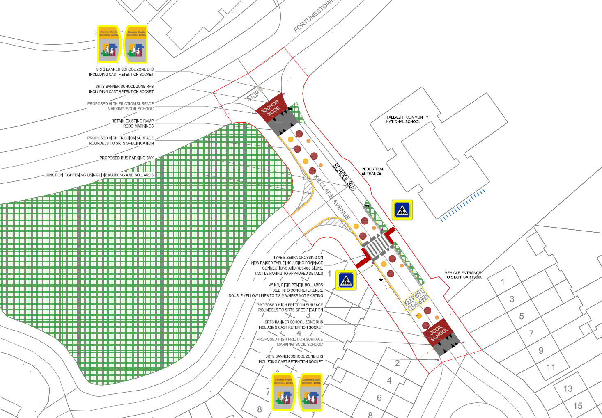
Safe School Zone Programme
Tallaght Community National School
Site visit - January 2025
Preliminary Assessment - February 2025
Travel Survey Carried Out – April 2025
Design developed – May 2025
Consultation with school – June 2025
Non-statutory consultation – June 2025
Section 38 approvals – June / July
Appoint contractor – July / August

Slide 7
Safe School Zone Programme
St. Kilian’s JNS, Kingswood
Site visit - January 2025
Preliminary Assessment - February 2025
Travel Survey Carried Out – April 2025
Design developed – May 2025
Consultation with school – June 2025
Non-statutory consultation – June 2025
Section 38 approvals – June / July
Appoint contractor – July / August

Slide 8
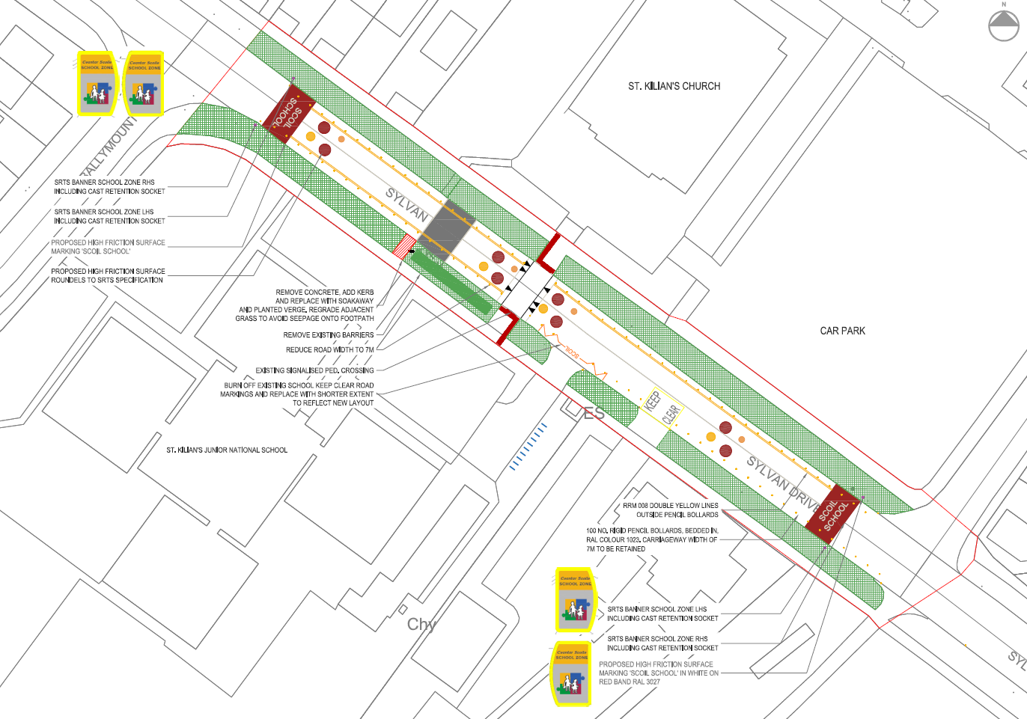
Safe School Zone Programme
St. Kilian’s JNS, Kingswood
Site visit - January 2025
Preliminary Assessment - February 2025
Travel Survey Carried Out – April 2025
Design developed – May 2025
Consultation with school – June 2025
Non-statutory consultation – June 2025
Section 38 approvals – June / July
Appoint contractor – July / August

Slide 9
Thank you

