Slide 1
School Works Update
Clondalkin ACM June 2025
Active Travel

Slide 2
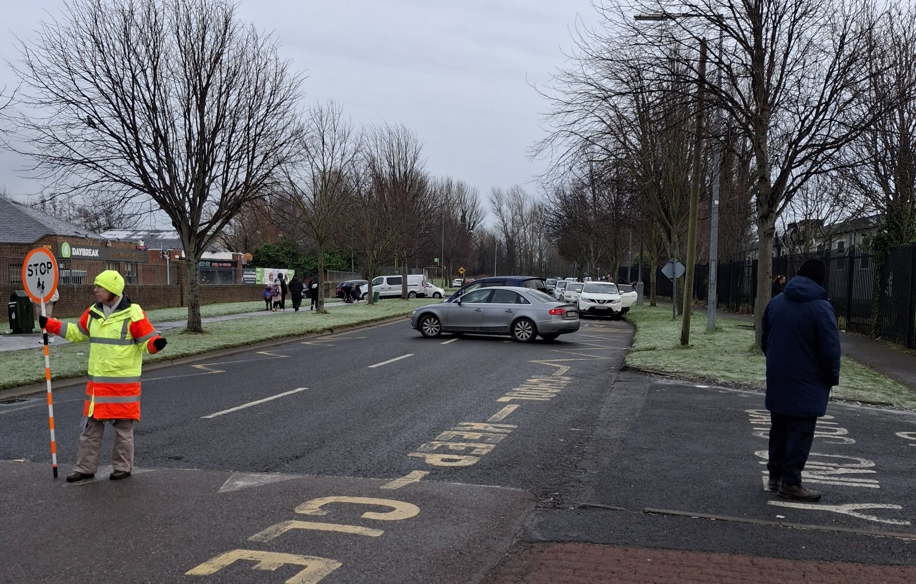
Safe School Zone Programme
St. Ronan’s National School, Deansrath
Site visit - January 2025
Preliminary Assessment - February 2025
Travel Survey Carried Out – April 2025
Design developed – May 2025
Consultation with school – June 2025
Informal consultation – June 2025
Section 38 approvals – June / July
Appoint contractor – July / August
Nano Nagle Junior National School and Talbot Senior National School in Bawnogue have now applied for similar works.

Slide 3
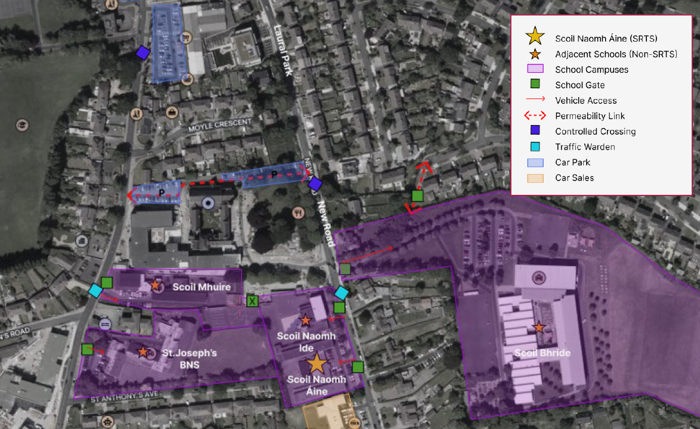
Safe Routes to School Programme
Scoil Naomh Áine, New Road, Clondalkin
Safe Routes to School Travel Survey and Front of School Audit carried out.
Draft Delivery Plan issued by An Taisce.
Consultation with school (and neighbouring schools) underway.
SDCC will appoint a consultant to design works to improve safety and reduce speeds and congestion on New Road, Clondalkin and coordinate with the aims of the Clondalkin LAP.
Works will also benefit neighbouring schools Scoil Naomh Íde and Coláiste Bhríde

Slide 4
Thank you

