Slide 1
Lucan House & Demesne Masterplan
Meeting of South Dublin County Council
9th June 2025

Slide 2
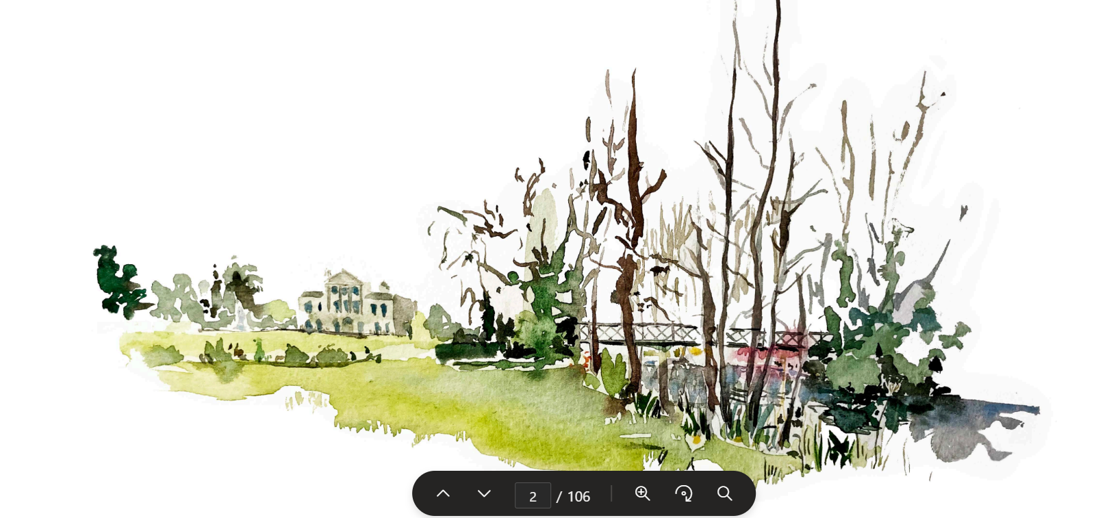
Lucan House & Demesne Masterplan
Reimaging Lucan House & demesne as a vibrant, inclusive & sustainable public asset
Adaptive reuse of buildings, community/cultural programming & access to natural spaces
Site-specific interventions responding to identified community priorities
Objectives
Conserve & enhance key buildings
Develop a cultural, civic & tourism hub
Improve accessibility, circulation & landscaping

Slide 3
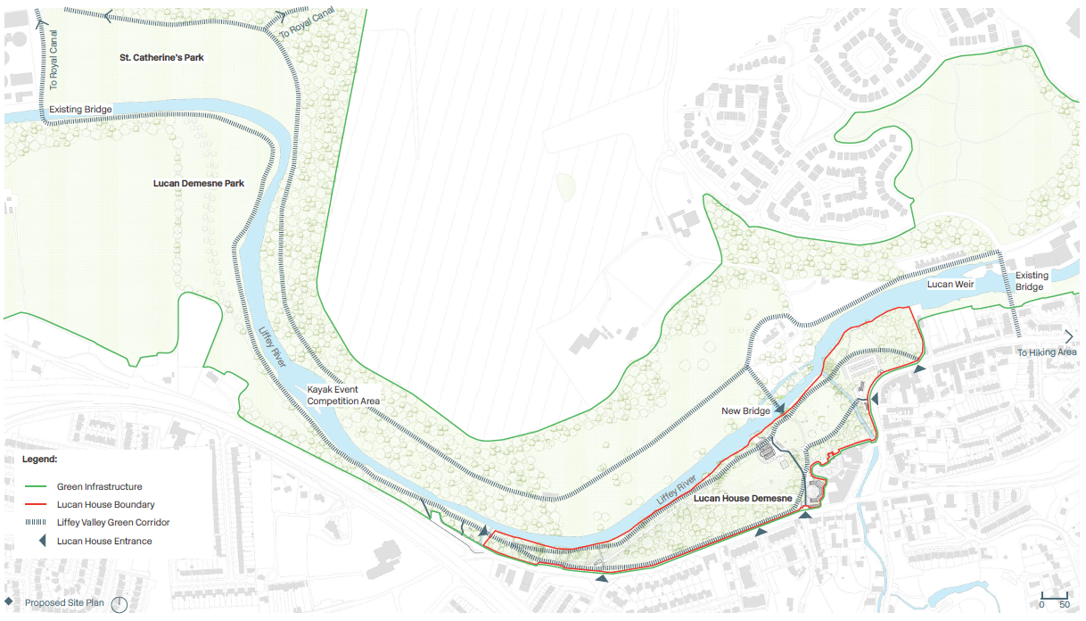
Strategic Approach
Connections:
Accessible & ecologically-rich corridor
Improve circulation & links:
Connectivity-Royal Canal & Grand Canal
Regional greenway potential: Lucan House, Lucan Demesne, St. Catherine’s Park & River Liffey
Pedestrian bridge: walking & cycle access with St. Catherine’s Park
5 pedestrian/cycle gates & 2 restricted vehicle entries
Bus stop integrations at main access points
Design:
Minimal intervention with natural finishes
Pathway materials, local stone & riverfront character
Lighting & furniture to support year-round usability

Slide 4
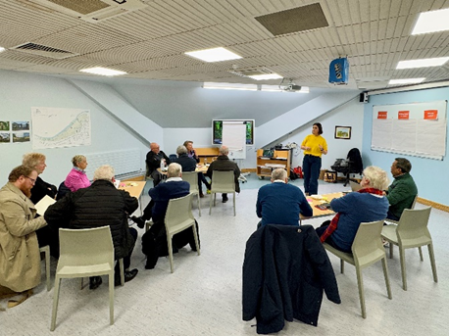

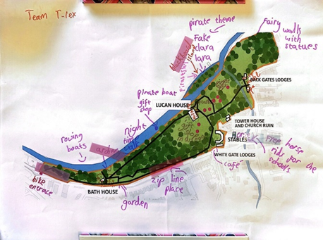

Community Involvement
Everyday Use, Not Just Events
Inclusion & Access
Connected Green Infrastructure
Living Heritage
Vibrant Community Spaces
Balanced Transport Strategy
72 in-person attendees across 8 workshops
336 online survey submissions

Slide 5
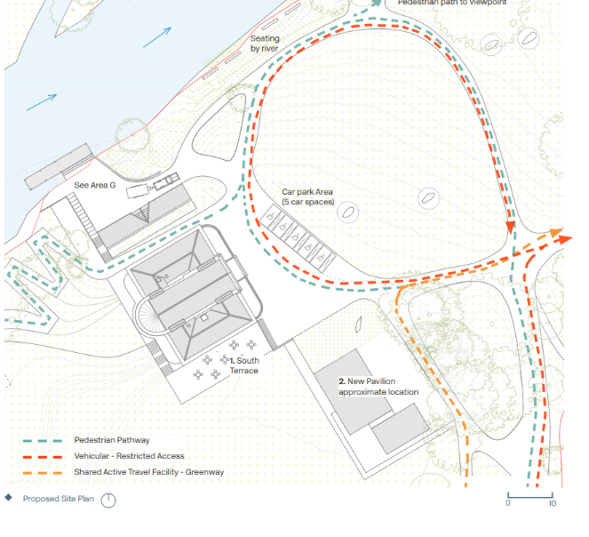
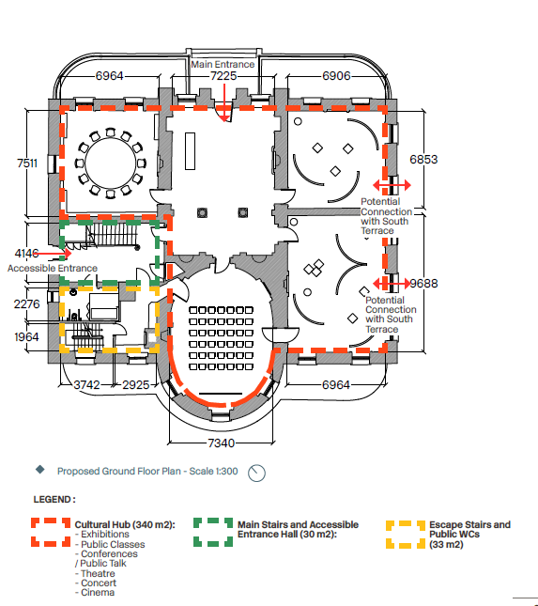
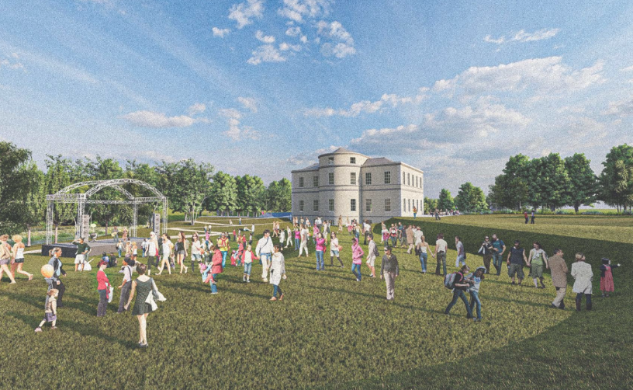
Lucan House
Proposed Uses
Basement: kitchen services, water sport facilities, & storage
Ground floor: exhibition/event space
First & second floors: community/heritage, cultural/creative/wellness uses, meeting rooms, co-working, lounge area
Accessible entrance hall and changing place facility
Outdoor Interventions
Accessibility: drop-off zone / disability parking at front entrance & ramps / level paths
Terraces & lawns: pavilion structure (200-person capacity) on rear west lawn & seating for passive use & cultural spill-out
Riverfront area: natural outdoor amphitheatre overlooking river
Boat Storage: architecturally light storage facility

Slide 6
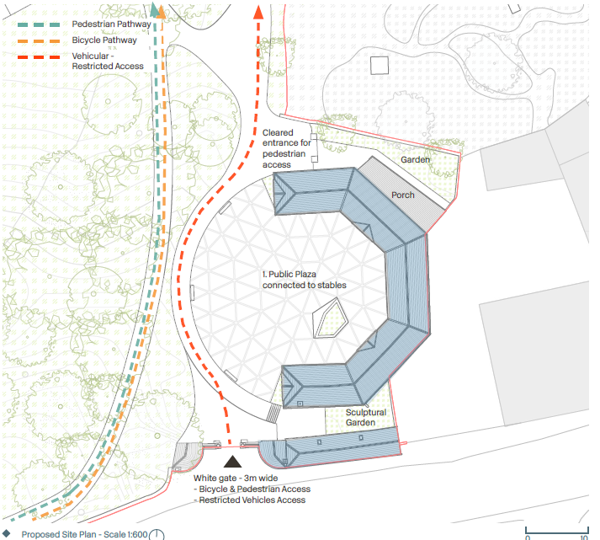
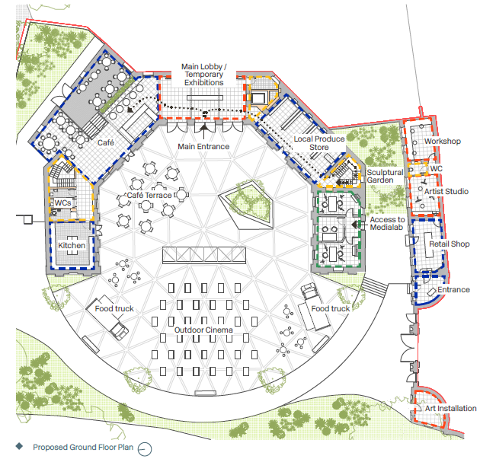
The Stables
Repurpose stables & outbuildings into dynamic cultural & commercial hub
Proposed & potential uses:
Ground floor: retail, café, media lab, artist studios, services
First floor: interpretative exhibition space, children’s library, community/event rooms
Exterior layout & public realm :
Entrance plaza: markets, festivals & pop-up events
Rear yard: café terrace space
Bicycle & pedestrian priority via White Gate
Universal access with levelled surfaces & distinct traffic zones.
Seamless connection to Lucan Main Street

Slide 7
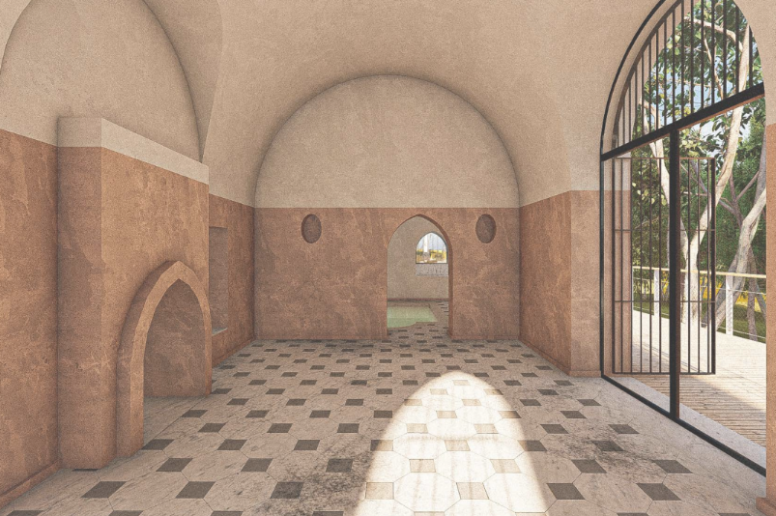
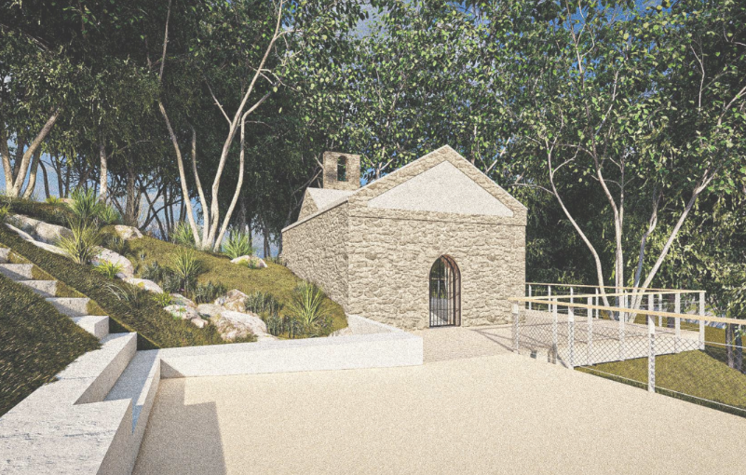
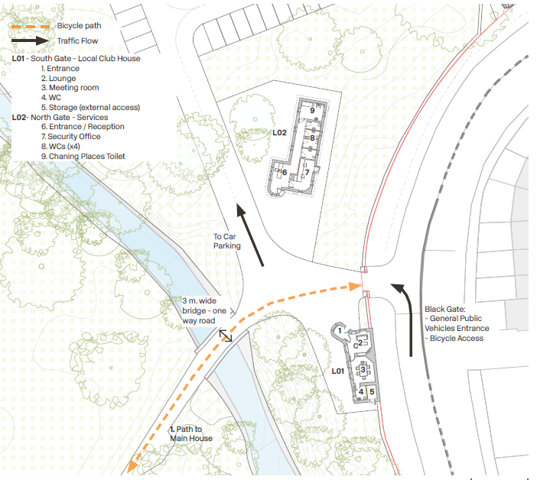
Bath House & Gate Lodges
Bath House
Structural conservation of stone façade
Pathway upgrades & lighting
Interpretation signage & some guided public access
Surrounds enhanced with natural seating zones, riverside greenway & picnic areas
Gate Lodges
Entry, community & security functions:
Lodge 1: community house with lounge, meeting room, accessible WC & storage
Lodge 2: reception, four public WCs, changing places toilet, security office & canteen

Slide 8
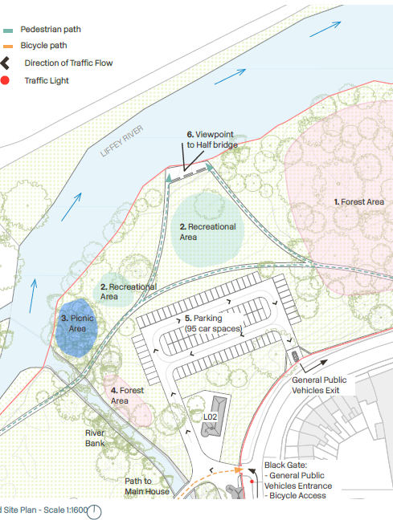
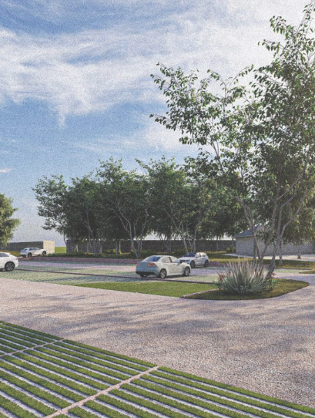
North Field
Key to sustainable access:
95-space carpark with ecological buffers (10-30m from river)
Minimal hard surfacing to reduce ecological impact
Amenities: picnic grove, riverside trail, forest play zone
Path with native planting around wooded edge
Main vehicular entrance through Black Gate, one way access with new exit

Slide 9
Indicative Timelines & Costs
Timeline | Preliminary Stages
Q2/Q3 2025 | Finalise masterplan & procurement for Part 8 & detailed design work
Q4 2025-Q1 2026 | Part 8 public consultation & decision
Timeline | Proposed Works | Indicative Cost
From Q2 2026 (Subject to Part 8 approval) | Commencement of priority works including, fit-out of main house & lodges at Black Gate, landscaping, amphitheatre, recreational features & car/bicycle parking | c. €9 million
2027/2028 (Subject to Part 8 approval) | Basement of main house, bath house, boat house, stables/outbuildings/plaza, bridge & west lawn pavilion | c. €11 million
 | Total Potential Cost (including VAT & design fees) | Up to €20million
Potential Funding Opportunities & Sources
Fáilte Ireland
Conservation Grants (DHLGH)
THRIVE (Town Centre First Heritage Revival Scheme) European Regional Development Fund
SDCC levies & reserves

Slide 10
Thank you

