Slide 1
Anti-Social Behaviour
Strategy 2025-29
Meeting of South Dublin County Council
9th June 2025

Slide 2
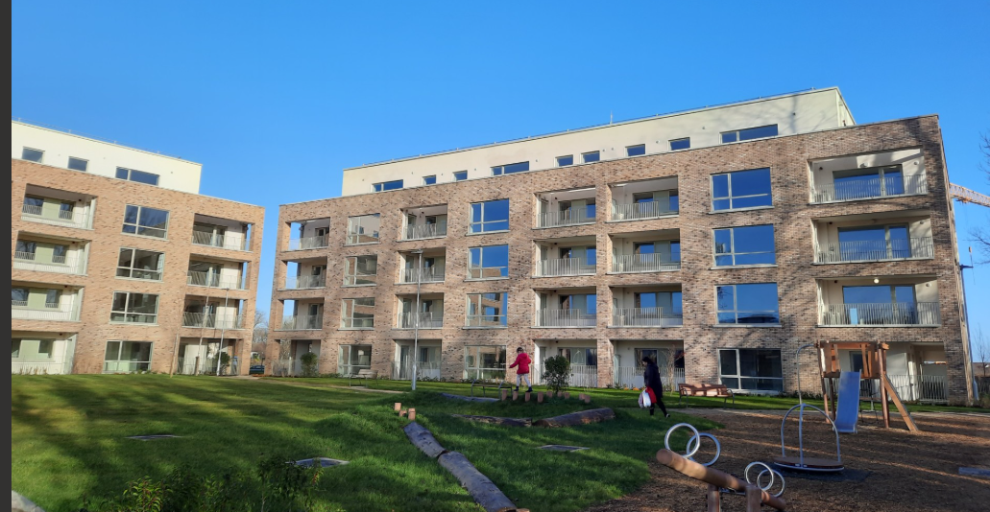
Alignment with Corporate Plan 2025-29
It is critical for successful management of over 10,800 social housing tenancies that our anti-social behaviour strategy is aligned to key corporate goals:
Quality Housing: provide quality social & affordable homes for everyone who needs them
Connect Communities & Citizens: support our communities to be integrated, inclusive & safe
Citizen –first: be a citizen centred organisation

Slide 3
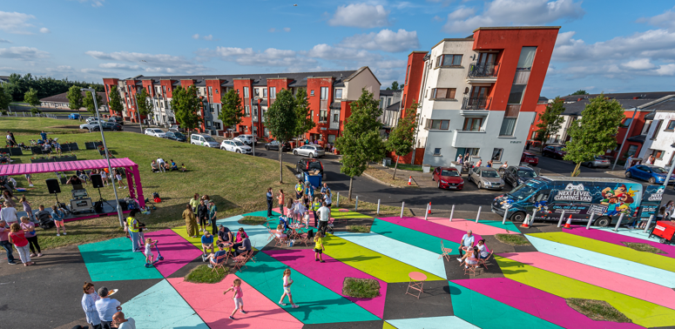
Legislation and Our Approach
Legislation / Definition
Housing (Miscellaneous Provisions) Act 2014
‘Any behaviour which causes or is likely to cause any significant or persistent danger, injury, damage, alarm, loss or fear to any person living, working or otherwise lawfully in or in the vicinity of a house provided by a housing authority’
Categorisation of ASB Complaints- A, B, C
Investigation & management of complaints
Inter-agency cooperation
Principles- Our Human Rights & Equality Duty

Slide 4
ASB Strategy Commitments
To ensure our residents feel safe and empowered to report ASB through increased community support and inter-agency cooperation
To deliver projects and initiatives across the county with the aim of designing out ASB hotspots in our estates
To assist victims of ASB to reduce the impact on their quality of life and to help perpetrators of ASB with the aim of preventing ASB from reoccurring
To produce a Tenant Participation Strategy to ensure we involve tenants in decisions about their homes and their neighbourhoods
To enhance and upskill our Estate Management Team to manage reports of ASB proactively and effectively.

Slide 5
ASB Complaints & Actions 2024
Complaints
Category A: 212
Category B: 330
Category C: 81
Most Frequent Incidents of ASB
Neighbour disputes
Condition of property
Noise complaints
Drug dealing
Vacant properties
Sub-letting/illegal occupants
Scramblers
Feuding
Actions & Responses
House calls / inspections | 415
Demand for Possession (Section 15 & 17) | 3
Abandonment notice served | 51
Surrenders Obtained (including Termination of Tenancy under Section 15) | 69
Warnings issued | 74
Interviews held (formal in office or by phone) | 514
Pre-Tenancy Meetings | 357

Slide 6
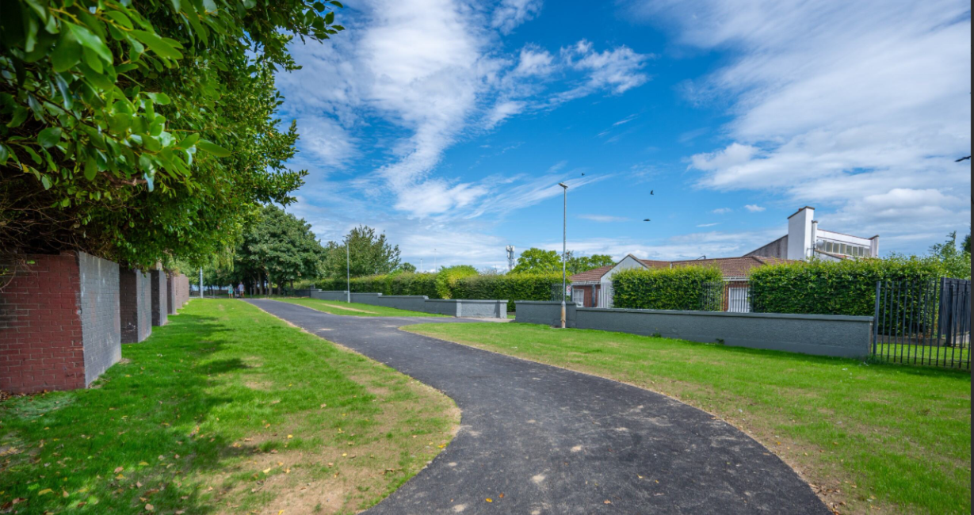
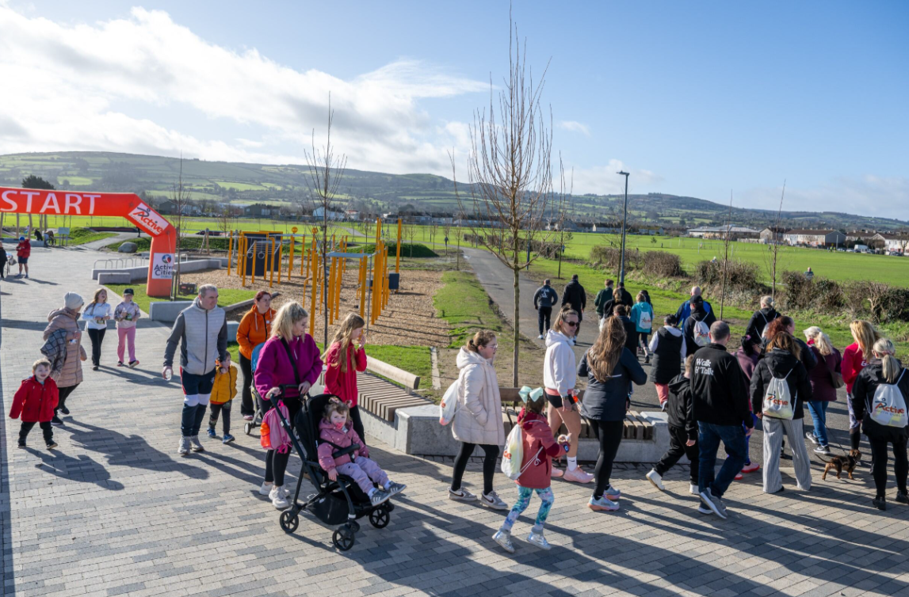
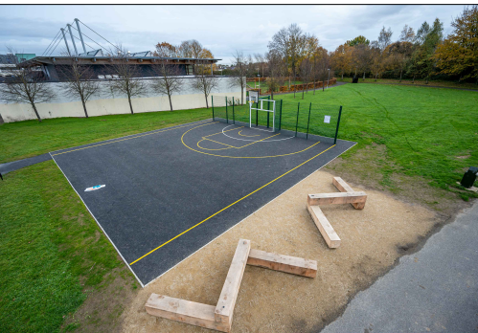
Proactive Estate Management Works & Initiatives
The Alcoves
Whitechurch
Walk & Talk
New MUGA
Mac Uilliam Estate
Balgaddy Better Blocks

Slide 7
Implementation, Monitoring & Improvement
Director of Housing, in conjunction with Housing Strategic Policy Committee, will be responsible for this strategy
Annual estate management action plan to support strategy implementation
Quarterly reporting to local area committees on key performance indicators
Feedback from tenants will be used to inform and improve our performance
Key Performance Indicators
Number of anti-social incidents reported
Number of complaints received
Number of house calls/inspections
Number of demands for possession
Number of abandonment notices served
Number of surrenders obtained
Number of evictions/exclusion orders
Number of interviews held
Number of pre-tenancy courses
Number of estate management initiatives

Slide 8
Thank you

