Slide 1
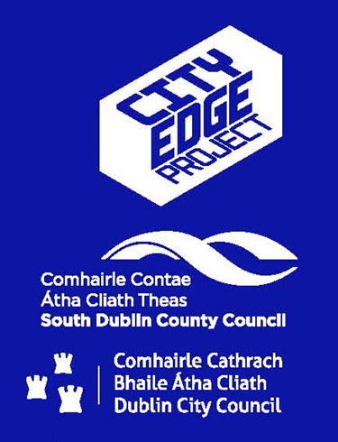
City Edge
LUPT SPC
29th May 2025

Slide 2
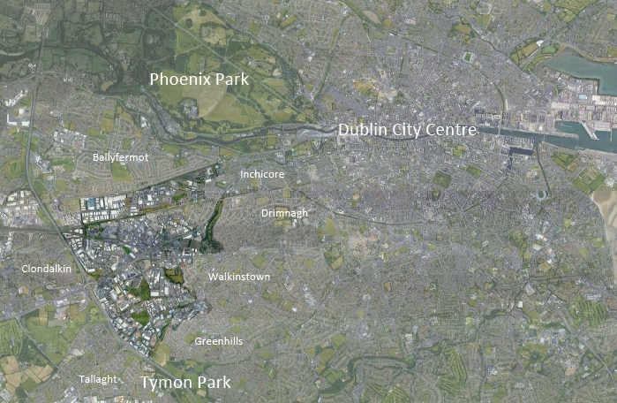
Railway
Canal
M50
Luas
City Edge
Red Cow
M50

Slide 3
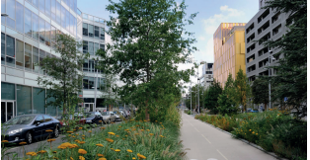
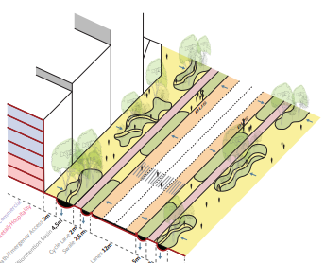
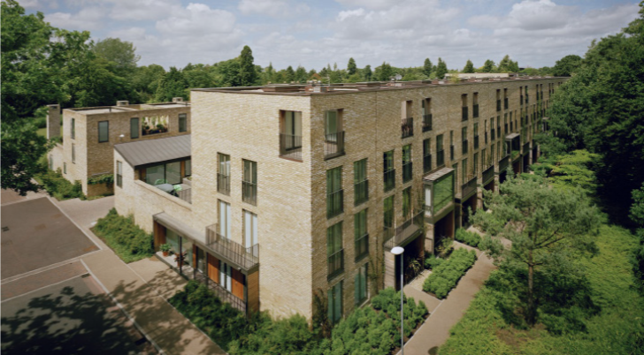
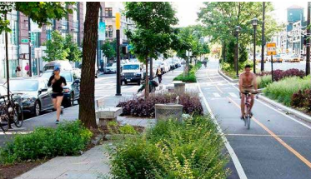
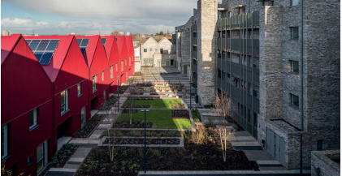
The City Edge Project
Joint initiative between SDCC and DCC to create a new urban quarter
Naas Road, Ballymount, and Park West areas
Aligns with NPF, RSES – compact growth, TOD, 15-minute city principles
700 Ha – largest regeneration area in Ireland
Up to 40,000 homes, 80,000 population and 75,000 jobs
Successful application in 2018 for €1 million URDF Funding to prepare non-statutory Strategic Framework – high level vision and delivery plan to 2070. Framework noted by Council May 2022.
Strategic Objectives:
Compact growth and 15-minute city principle
Active travel and public transport
Blue and green infrastructure
Housing choice
Diverse employment offer
Climate resilience.

Slide 4
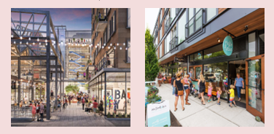
City Edge Update
‘Strategic Urban Regeneration Framework’ (SURF) is being finalised by SDCC and will contain urban design layouts, narrative, policies, objectives and phasing.
SURF will provide a statutory basis including more detailed guidance (than the Strategic Framework) to direct the planning of the area over the short to medium term (to approximately 2042).
Consultants are finalising Urban Design Report which sets out Priority Development Areas (PDAs) and indicative layouts for PDAs. Report will inform proposed SURF.
Several other studies are ongoing / completed which will inform proposed SURF including:
Transport modelling for various scenarios to the year 2042
A feasibility study into the undergrounding of overhead high voltage lines
A Seveso risk analysis study has been completed and consultation with the HSA is ongoing.
SURF will be proposed as a CDP Variation and Urban Development Zone designation will be sought, assuming relevant elements of the Planning and Development Act, 2024 are commenced in a timely manner.

Slide 5
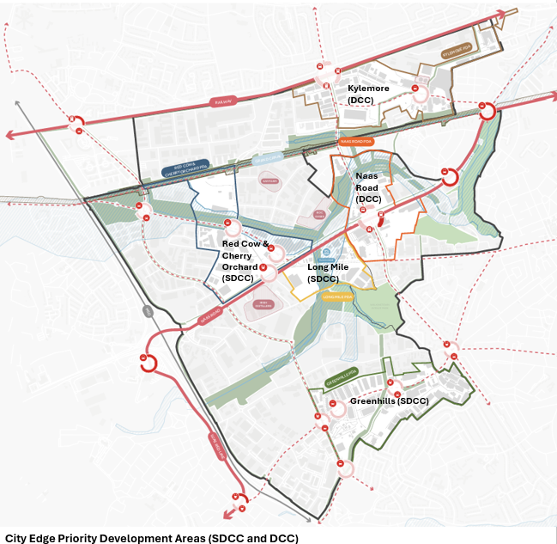
Priority Development Areas and Urban Design Layouts
Three Priority Development Areas (PDAs) have been identified within the SDCC area –
Red Cow & Cherry Orchard
Long Mile
Greenhills
Each PDA is likely to be developed within the short to medium term (between now and approx. 2042).
For each PDA urban design layouts and guidance have been prepared indicating:
Land use mix
Residential and employment capacity – unit numbers and floorspace
Indicative locations for school sites, community facilities and community parks
Blue and green infrastructure including major parks
Streets and greenways
Public transport links and hubs
Townscape strategy including building height and plot ratio guidance
SDCC PDA capacity estimated at 10,000 units and 362,000 sqm of employment.

Slide 6
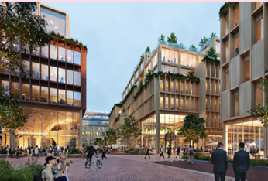
Urban Development Zone
An Urban Development Zone is a mechanism in new Planning and Development Act, 2024 which provides local authorities with the ability to identify strategic lands for which development would be of significant economic, social and environmental benefit to the State.
Under Section 602(b) of the P&D Act a Planning Authority may, having regard to certain matters, designate a candidate UDZ site in its development plan. This designation will be pursued for the City Edge lands.
City Edge is an ideal candidate for UDZ designation, given its objective to deliver transport-oriented development and compact growth at scale on brownfield land in a plan-led manner. UDZ designation is linked to development plan variation process.
The Act provides for UDZ pre-designation consultation (Section 604) which is separate to a development plan variation consultation and must take place ‘prior to proposing to make a variation of a development plan’.
The intention is to carry out pre-designation consultation following commencement of the relevant sections of Planning and Development Act, 2024, scheduled for Summer 2025.
Under Section 604, there are requirements for the planning authority (or if relevant, the Minister) including publication of notice; provision for written submissions or observations to be made; and a CE report on the submissions/observations for members to consider no later than 12 weeks after notice published.
A planning framework is required for designation as a candidate UDZ and the SURF will constitute the framework for this purpose.

Slide 7
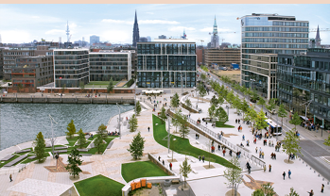
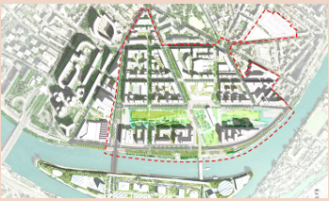
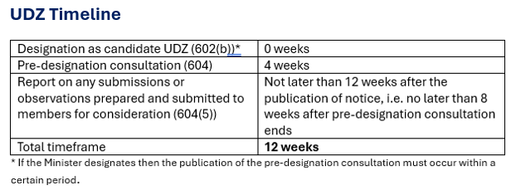
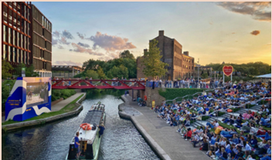
Next Steps
Finalise Strategic Urban Regeneration Framework (SURF).
Undertake Environmental Reports (SEA, AA, SFRA).
If relevant sections of the Act have commenced, carry out UDZ pre-designation public consultation.
If relevant sections have not commenced, consider whether to await commencement or proceed with proposed variation public consultation.
Members’ briefing will be held in advance of any public consultation.

