Slide 1
SDCC Road Safety Plan 2025 – 2030 (DRAFT)

Slide 2
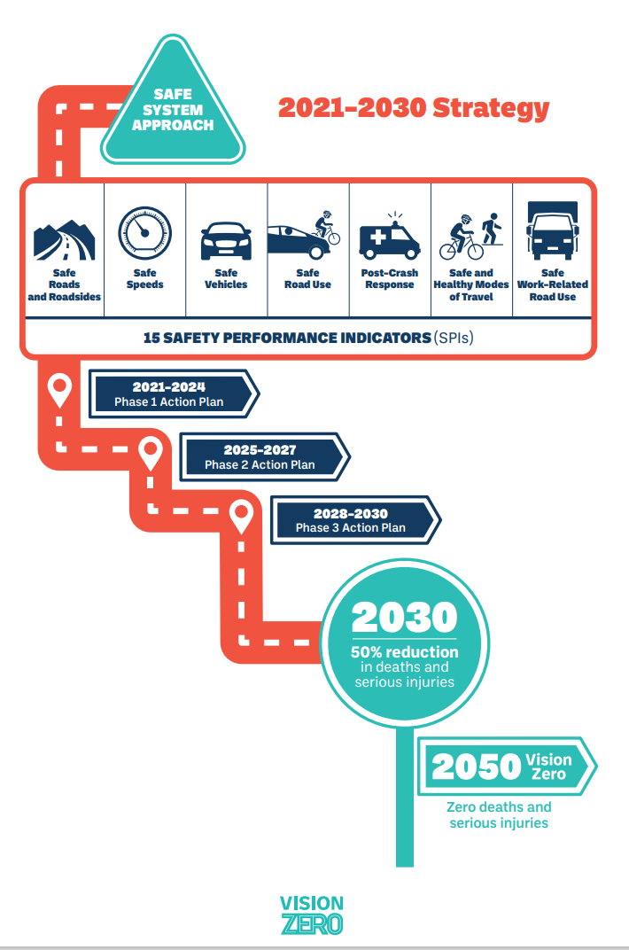
Towards Vision Zero
The Government Road Safety Strategy (GRSS) has adopted a Vision Zero Policy to be achieved by 2050
Vision Zero means that there are zero road deaths and fatalities. In line with the GRSS South Dublin County Council will also adopt a Vision Zero policy within this road safety plan 2025 - 2030.
Vision Zero was formally adopted in Ireland’s Programme for Government in 2020 and underpins the EU Road Safety Policy Framework (2021 – 2030)

Slide 3
Supported and delivered Cycle Right training to 6,320 pupils in 122 primary schools throughout the county Delivery of Pilot Adult Cycle Right initiative to Go-Ahead Ireland Employees 32 Schools within the county received their Green Flag for Travel or Global Citizenship Travel as part of the Green Schools Programme 30 km/h as the default speed limit in all residential estates that are in charge 20 X 30 km/h periodic speed limits outside schools, Cycle tracks is currently a 215 km Footpaths increased from 1264 km to 1500 km
Synopsis Evaluation of SDCC 2022-2024

Slide 4
Collisions by Road User Type
Presentation Title
Fatalities in South Dublin County Council, 2021-2024
Road User | 2021 | 2022 | 2023 | 2024 | Total
Driver | 1 | 0 | 1 | 0 | 2
Passenger | 2 | 0 | 0 | 0 | 2
Motorcyclist | 2 | 2 | 1 | 0 | 5
Cyclist | 0 | 0 | 1 | 1 | 2
Pedestrian | 0 | 2 | 2 | 0 | 4

Slide 5
Local Targets
The rates for local targets have been informed by the Road Safety Authority.
South Dublin County Council has set the following targets for Killed or Seriously Injured (KSI) as part of this plan.
2028: the target will be to reduce KSI by 10%, and
2030: the target will be to reduce KSI by 50%.

Slide 6
Safety Performance Indicators
Delivery of Cycle Right training to primary school children within the County
Increase our delivery of Education Programmes in Schools / Colleges / Corporates and Community groups
Increase our Education Awareness Campaigns along with hosting Multi-Agency campaigns with other stake holders
Promote School Streets and School Zones outside Primary Schools
Use of Speed Display Signs to monitor speed limit compliance

Slide 7
Safety Performance Indicators Continued..
Improved junction safety/redesign of junction
Speed limit review ongoing
HGV mobility policy review
School Crossings Reviews and Safety measures outside schools on-going
Continuing collaboration with SDCC Road Safety Working Together Group on a quarterly basis in oversight of the strategic aspects of the Council’s Road Safety Strategy and Plan.
Continuing liaison with ASG & RSA in the analysis of collision data

Slide 8
Actions 2025 – 2030
To Be Confirmed
These actions will also be linked to the annual Action Plan developed in
collaboration with the Road Safety Working Together
Group who will oversee the
delivery and evaluation of the plan.

Slide 9
Bring initial proposal to May 2025 SPC Bring proposal and 1st draft to June RSWTG Bring Final Draft to September RSWTG & SPC LAUNCH Thursday 9th October (as part of National Road Safety Week)
Draft Timelines 2025

