Slide 1
CLONBURRIS SDZ PROPOSED NON-MATERIAL AMENDMENTS 2025

Slide 2
Background and Current Status
Non-Material Amendment precedent within Adamstown SDZ– a practical and established approach to amending a Planning Scheme.
On 2nd May 2025, 16 proposed non-material amendments were circulated to various stakeholder departments for feedback and guidance
The Clonburris Planning Scheme approved by ABP in 2019, established a comprehensive framework to unlock the area’s development potential
Based on lessons learned, in response to the evolving nature of demands and planning directives, amendments have been proactively compiled
CLONBURRIS SDZ PROPOSED
NON-MATERIAL AMENDMENTS 2025

Slide 3
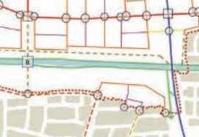
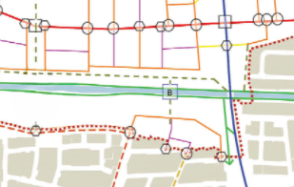
Rationale behind proposed amendments and associated impact
1. Implement the Compact Guidelines by removing Minimum Space Standards for Houses
To reflect Sustainable Residential Development and Compact Settlement Guidelines
Amend and relocate a proposed Pedestrian Bridge over Canal
To protect the pNHA, and biodiversity in the area, while continuing to support connectivity throughout the SDZ via strategic cycle corridor. Relocate pedestrian bridge to Lock 11
Relocate pedestrian bridge to Lock 11
CLONBURRIS SDZ PROPOSED
NON-MATERIAL AMENDMENTS 2025

Slide 4
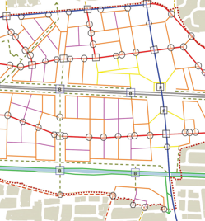
Rationale behind proposed amendments and associated impact
Amend the proposed vehicular bridge over railway to a pedestrian/cycle bridge, and modify streets from link street to local street
To promote sustainable and active travel, conforming with original SDZ principals
4. Deletion of North-South Avenue/Links Objective
Removal of this vehicular link is proposed in conjunction
with the deletion of the bridge crossing at this location
CLONBURRIS SDZ PROPOSED
NON-MATERIAL AMENDMENTS 2025

Slide 5
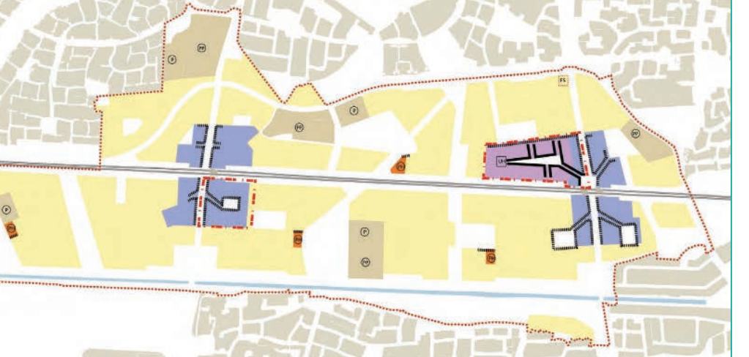
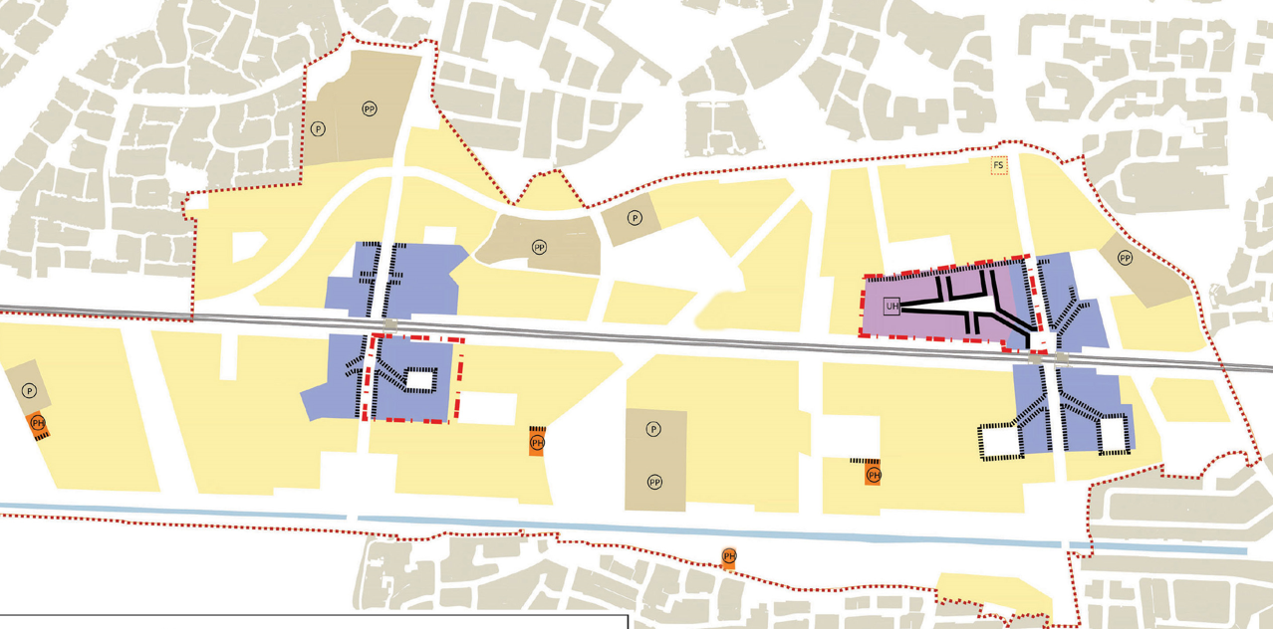
Rationale behind proposed amendments and associated impact
5. Remove the requirements for Park Hubs at Gallanstown & Cappagh and add new Park Hub at Canal Park
Proposed Park Hub at Gallanstown will be relocated to Canal Park South to support active recreation in the area. Na Clúainte Park will support a more passive recreation role, and serve to reengage focus toward biodiversity
Relocation of a Park Hub from Cappagh and Gallanstown to Canal Park South
CLONBURRIS SDZ PROPOSED
NON-MATERIAL AMENDMENTS 2025

Slide 6
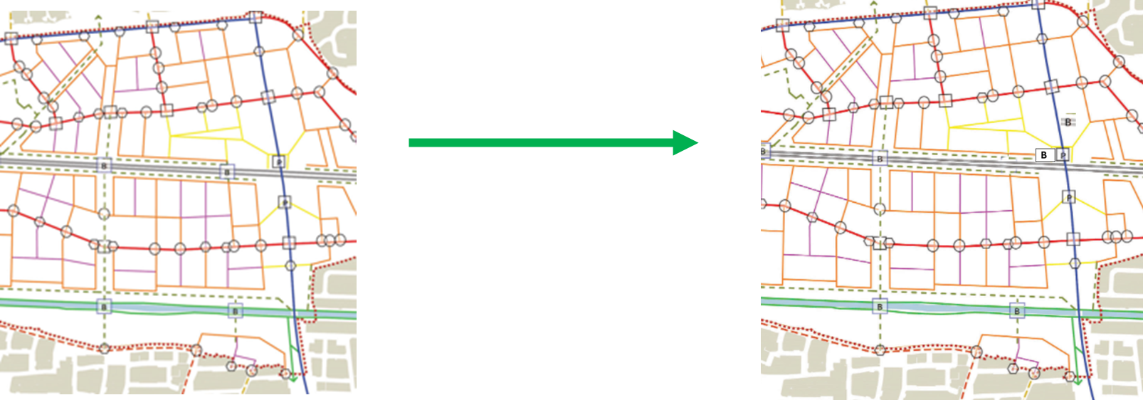
Rationale behind proposed amendments and associated impact
6. Pedestrian bridge – relocation to Urban centre in conjunction with railway
Increase footfall and provide broad multifunctionality
CLONBURRIS SDZ PROPOSED
NON-MATERIAL AMENDMENTS 2025

Slide 7
Rationale behind proposed amendments and associated impact
7. Clarification on the Green Bridge
To provide clarity on phasing
8. Provide limited flexibility of the urban design parameters to respond to site constraints
Relaxation of urban design parameters in response to immoveable infrastructure e.g. gas mains, substations, pNHA
9. Amend the EV charging requirements
Align EV requirements with County Development Plan
10. Clarify Catchment Areas
Minor amendment to catchment boundaries to exclude the Canal Extension area, which is already served by local centres to the south of the SDZ
11. Clarification in relation to the ‘Roll Over’ provision
Revise text in Planning Scheme regarding allowable ‘Roll-Over’ between phases
CLONBURRIS SDZ PROPOSED
NON-MATERIAL AMENDMENTS 2025

Slide 8
Rationale behind proposed amendments and associated impact
12. Provide clarity in relation to assessment of domestic extensions
Addition of text in Planning Scheme to address residential housing extensions
13. Amend the Retail Frontage parameters
Revise Planning Scheme to encourage varied and diverse retail uses in response to commercial and retail patterns of consumers
14. Potential unit movement from south to north
Proposed reallocation of unused residential units from southern to northern area
15. Allow rooftop telecommunications infrastructure, exempt from SDZ height limits, if sensitively designed, set back, and minimised in height to reduce visual impact
Clarification on provision of rooftop telecommunications infrastructure
16. Associated changes/references*
Comprehensive review of the Planning Scheme to address minor errors, text edits and internal cross-references
CLONBURRIS SDZ PROPOSED
NON-MATERIAL AMENDMENTS 2025

Slide 9
……….Next Steps
EIAR screening currently being finalised
Proposed Non-Material Amendment will be submitted to ABP
The Board will review and approve at their discretion
CLONBURRIS SDZ PROPOSED
NON-MATERIAL AMENDMENTS 2025

Slide 10
Follow up, Feedback and Questions

