Slide 1
County Heritage Plan Review
Update
Presented by
Rosaleen Dwyer, Heritage Officer
LUPT

Slide 2
Summary time-line
Pre-draft consultation process and evaluation of pre-draft submissions
2023-2024
Finalising draft document in preparation for Draft Plan consultation process
Q2/3
Bring final County Heritage Plan
2025-2030
to Council
Q4
Heritage Plan Update, LUPT SPC, May 2025

Slide 3
Introduction to the Plan
01
Heritage Plan Update, LUPT SPC, May 2025

Slide 4
Introduction to the new Heritage Plan, setting the context
objective is to set out a framework for the protection, management, promotion and celebration of the County’s heritage (natural, built, archaeological, and cultural)
highlight the expanding concept of heritage in South Dublin County with its many new communities
increased pressure on natural and built heritage resources arising from much needed development in the County
additional pressures from climate change
highlighting changes in national legislation, policies, obligations etc. since the first County Heritage Plan
new Heritage Plan guided by the objectives of the 2022 National Heritage Plan ‘Heritage 2030’, which sets out actions under three key themes of Leadership, Partnership, and Communities
Heritage Plan Update, LUPT SPC, May 2025

Slide 5
Policy context for the Heritage Plan
02
Heritage Plan Update, LUPT SPC, May 2025

Slide 6
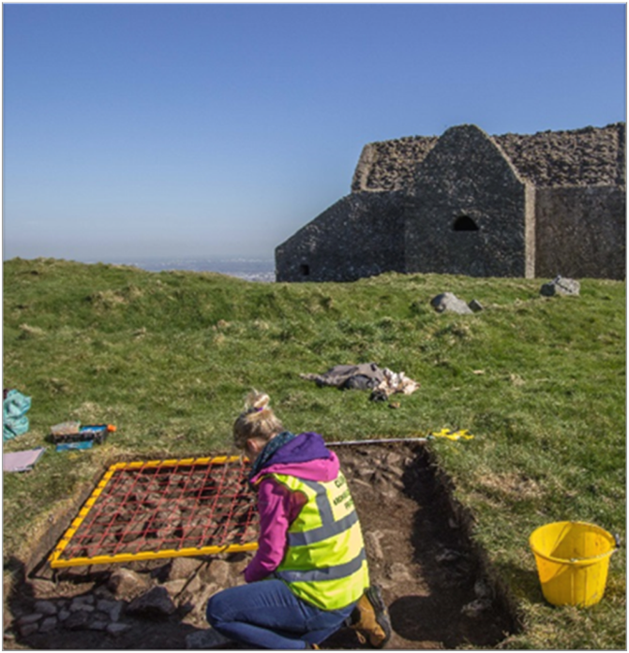
Policy context for the Heritage Plan
it sits within the Council’s framework of plans e.g. County Development Plan, Corporate Plan, Tourism Strategy, Culture and Creativity Strategy, Library Development Plan, County Biodiversity Plan, Climate Action Plan etc.
it sits within national objectives e.g. Heritage Ireland 2030, Heritage Council Strategic Plan, National Planning Framework etc.
it sits within international objectives e.g. UN Sustainability Development Goals, Conventions for the protection of archaeology, architecture, biodiversity, cultural heritage etc.
Heritage Plan Update, LUPT SPC, May 2025

Slide 7
Highlights from the previous Heritage Plan
03
Heritage Plan Update, LUPT SPC, May 2025

Slide 8
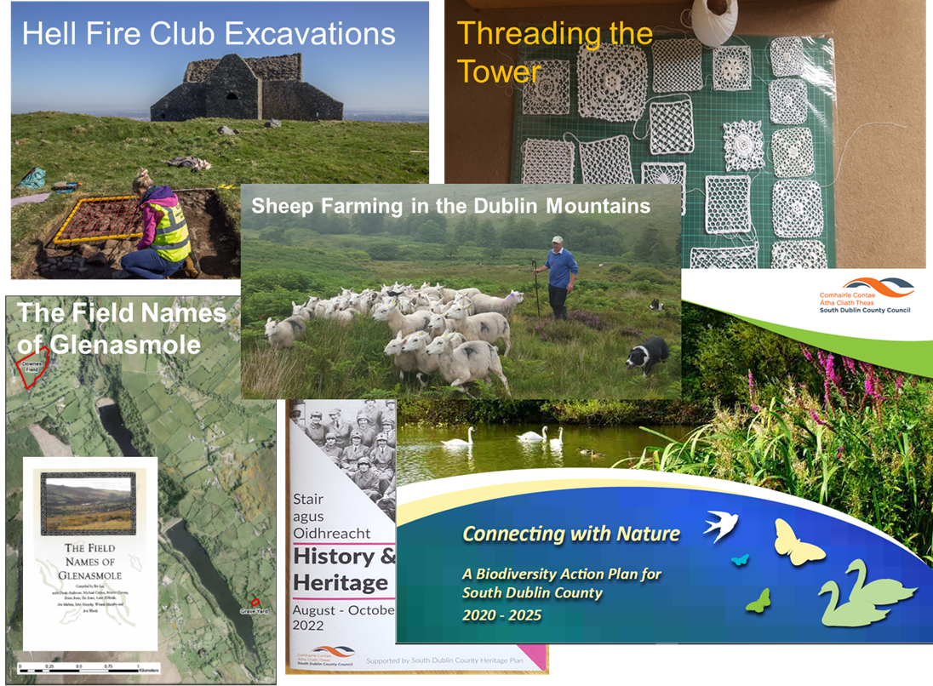
Highlights from the previous Heritage Plan
Highlights from the implementation of the existing County Heritage Plan that have expanded our knowledge of South Dublin County’s rich heritage
Heritage Plan Update, LUPT SPC, May 2025

Slide 9
SDCC’s Key Heritage values
04
Heritage Plan Update, LUPT SPC, May 2025

Slide 10
South Dublin County’s Key Heritage Values (= Action Themes)
Pride in our Place (Leadership)
  Understanding and protecting our heritage resource
  Identifying and finding the local stories that tell the County’s story
  Leadership in managing heritage governance, data, and resources
Partnership
  Working together with a wide range of individuals, groups, organisations, state bodies etc. to achieve joint objectives
  Supporting community engagement and access to heritage
  Building resilience and adapting to change, including climate change and biodiversity loss
Communicate and celebrate (Communities)
  Avail of every opportunity to tell the rich and dynamic story of South Dublin County and its people, from past, to present, to future
Heritage Plan Update, LUPT SPC, May 2025

Slide 11
ACTIONS
Strategic Objective 1 - Pride in our Place
Develop and implement a governance system to lead and oversee the implementation and monitoring of the County Heritage Plan, using best practice principles.
Lead by developing a structured programme to protect and monitor for Council-owned heritage assets, and prepare a plan to sustainably safeguard this rich resource into the future.
Support a more efficient sharing of heritage information across Council sections, and identify gaps in knowledge that could lead to better decision-making processes.
Avail of national grant funding opportunities that support built, archaeological, cultural and natural heritage projects.
Continue to identify survey needs and strengthen the evidence base to better understand the County's tangible and intangible heritage resource.
Assess and appropriately implement emerging methodologies for the presentation and the safeguarding of digital heritage records and archives.
Heritage Plan Update, LUPT SPC, May 2025

Slide 12
ACTIONS
Strategic Objective 2 – Working together in Partnership
Support and develop partnership projects that illustrate the contribution that built, natural, archaeological, and cultural heritage can make to sustainability, including the UN Sustainable Development Goals, and to addressing the impacts of climate change
Work with the County Library, Council's Tourism Office, and other stakeholders to raise awareness of the County's built, cultural and natural heritage, and improve accessibility by providing appropriate interpretation at buildings, areas, sites, etc
Work in partnership with the Irish Air Corps to raise the profile of the nationally important aviation heritage and history of the County and the role that this heritage legacy can continue to play in the cultural and economic development of South Dublin County.
Support local communities in their efforts to research and present stories of local heritage, historic events, and the lives of notable and every-day people.
Continue to progress the Dublin Mountains Archaeology Heritage Trail in partnership with stakeholders including DLRCC, DMP, and the Heritage Council.
Work with academic institutions, historians, and local communities to research and promote the County’s strong Norman history.
Develop and support citizen science projects to assist Council to monitor climate change impacts on the County’s heritage assets.
Heritage Plan Update, LUPT SPC, May 2025

Slide 13
ACTIONS
Strategic Objective 3 – Celebrate and Communicate
Promote and enhance understanding of the County's heritage through: the development of talks, exhibitions, and publications; increasing digital access through interactive maps, videos, virtual exhibitions and podcasts; and through the development of cultural tourism products.
Promote inclusivity in all heritage projects and events that celebrate the multi-cultural heritage of the County, both historic and newly emerging.
Research and celebrate the role that the County’s natural and geological assets have played in the natural, industrial, economic, and cultural development of the County.
Promote and celebrate bio-culture (the interconnectedness of natural and cultural heritage) and explore creative ways to present and share these intangible experiences in meaningful ways.
Encourage opportunities for intergenerational engagement in appropriate heritage projects and facilitate different ways of communicating heritage messages to a wider audience.
Research and promote the mythological stories of the area of South Dublin County and liaise with adjacent counties to explore this shared cultural heritage.
Heritage Plan Update, LUPT SPC, May 2025

Slide 14
Next Steps …
Pre-draft consultation process and evaluation of pre-draft submissions
2023-2024
Finalise draft document in preparation for Draft Plan consultation process
June/July
Assess submissions, revise draft document accordingly and bring final
County Heritage Plan
to Council
October/November
Heritage Plan Update, LUPT SPC, May 2025

Slide 15
Thank you

